Slide 1
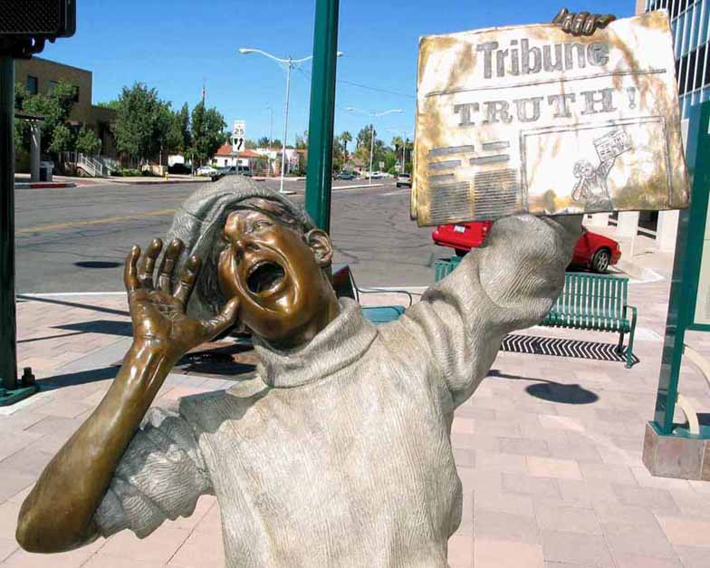
Know how to answer: conversational apologetics
Kedron Jones
Apologetics Research Society
October 18, 2014

Slide 2
Knowing How to Answer
“But in your hearts set apart Christ as Lord. Always be prepared to give an answer to everyone who asks you to give the reason for the hope that you have. But do this with gentleness and respect (1 Peter 3:15).”
“Be wise in the way you act toward outsiders; make the most of every opportunity. Let your conservation be always full of grace, seasoned with salt, so that you may know how to answer everyone (Colossians 4:5-6).”

Slide 3
An Effective Ambassador Has Three Essential Skills:
1
Knowledge
An accurate mind
He must have some basic knowledge. Minimally, he must know the character, mind, and purposes of his king.
“Therefore we are Christ’s ambassadors…” 1Corinthans 5:20

Slide 4
An Effective Ambassador Has Three Essential Skills:
2
Wisdom
An artful method
Knowledge must be deployed in a skillful way. There’s an element of wisdom, a tactical and artful diplomacy that makes his message persuasive.
“Therefore we are Christ’s ambassadors…” 1Corinthans 5:20

Slide 5
An Effective Ambassador Has Three Essential Skills:
3
Character
An attractive manner
Because an ambassador brings himself along in everything he does, his personal maturity and individual
“Therefore we are Christ’s ambassadors…” 1Corinthans 5:20

Slide 6
The Value of Using Conversational Apologetics
Present the truth clearly and cleverly.
Stop a aggressive challenger in their tracks and turn the tables.
Recognize someone’s bad thinking for the purpose of guiding them to the truth, yet remaining gracious and charitable.

Slide 7
The Columbo Tactic

Slide 8
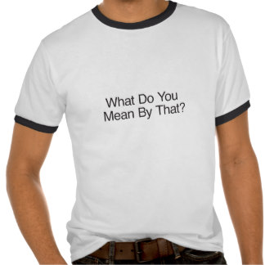
The First Kind of Question Helps You to Gain Information
Key Question: “What do you mean by that?”

Slide 9
“All religions are basically the same.”
“The Bible isn’t reliable.”
“I’m pro-choice.”
“The unborn is not human, but a potential human.”

Slide 10
The Second Question Tells You Why They Think the Way They Do.
Key Question: “How did you come to that conclusion?”

Slide 11
“The Bible has been translated and re-translated…”
How did you come to that conclusion?
“Jesus taught reincarnation after travelling to India.”
What reasons do you have for thinking that’s true?
“Joseph Smith is a prophet of God.”
- Why should I believe that about Joseph Smith?

Slide 12
Taking the Roof Off
Some beliefs have bad consequences

Slide 13
Father: “Why did you start smoking?”
Daughter: “Because all my friends were doing it.”
Father: “If all of your friends jumped off a cliff, would you do that too?”

Slide 14
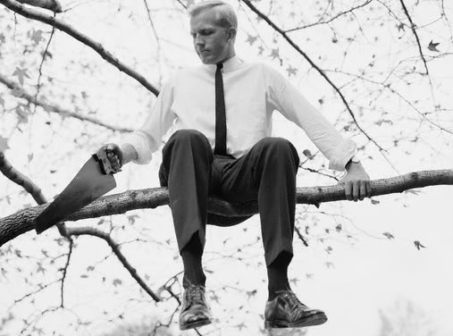
The Suicide Tactic
The Suicide Tactic makes capital of the tendency of some views to be self-refuting.

Slide 15
“There is no truth.”
“You shouldn’t judge others!”

Slide 16
Sticks & Stones Tactic
The goal of the Sticks and Stones tactic is to show that attacking a person or their character is NOT a legitimate argument.

Slide 17
Sticks & Stones Tactic
When someone attacks you or your character simply ask…
What do they mean by that? Ask for a definition.
One of three things will be true of their definition:
It won’t apply to you.
It applies to you, but it also applies to them in some way.
It doesn’t matter that it applies to you.

Slide 18
“You’re so intolerant.”
“You’re just homophobic.”
“You’re such a judgmental person.”
“Why are you so narrow-minded?”

Slide 19
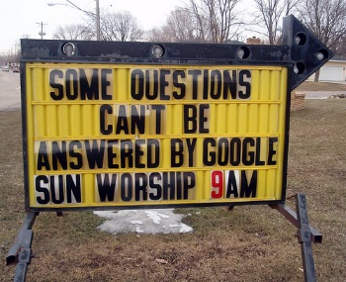
Concluding Remarks

