Slide 1
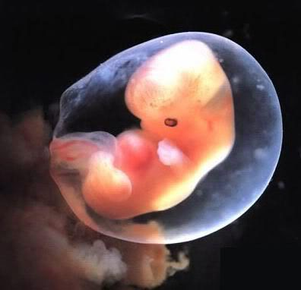
Defending life: Pro-Life apologetics 101 (Answering Pro-Choice Rhetoric & Arguments)

Slide 2
Answering Pro-Choice Rhetoric: Five Bad Ways to Argue for Abortion
1. Confuse objective claims with subjective claims.
2. Attack the person rather than refute the argument.
3. Assume what you are trying to prove.
4. Confuse human value with human function.
5. Disguise your true position by appealing to the hard cases.

Slide 3
#1 Confusing Objective Claims with
Subjective Claims

Slide 4
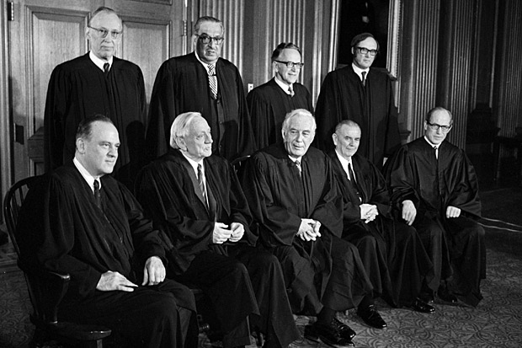
#2 Attacking the Person Rather Than Refuting The Argument

Slide 5
#3 Assume What You’re Trying to Prove

Slide 6
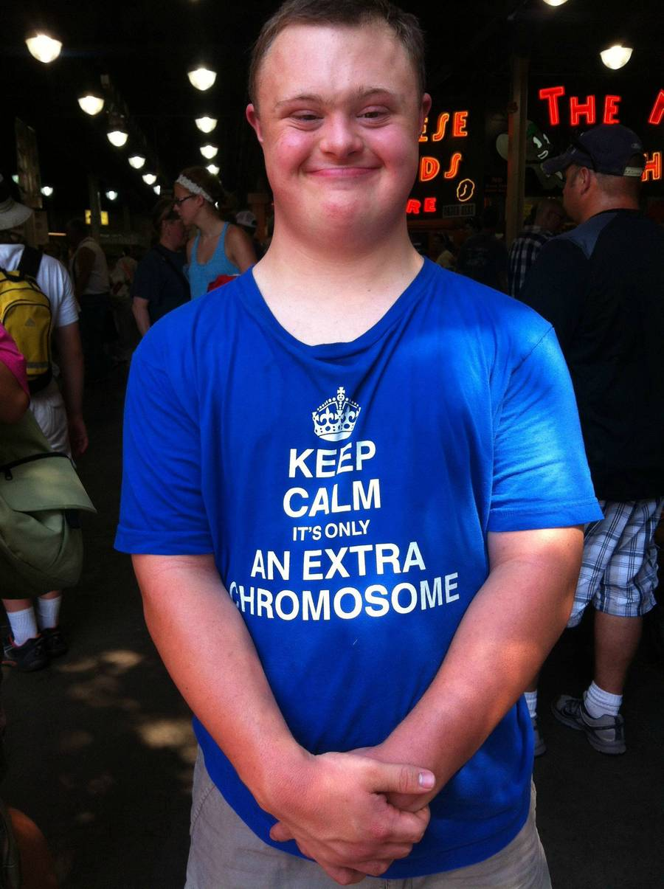
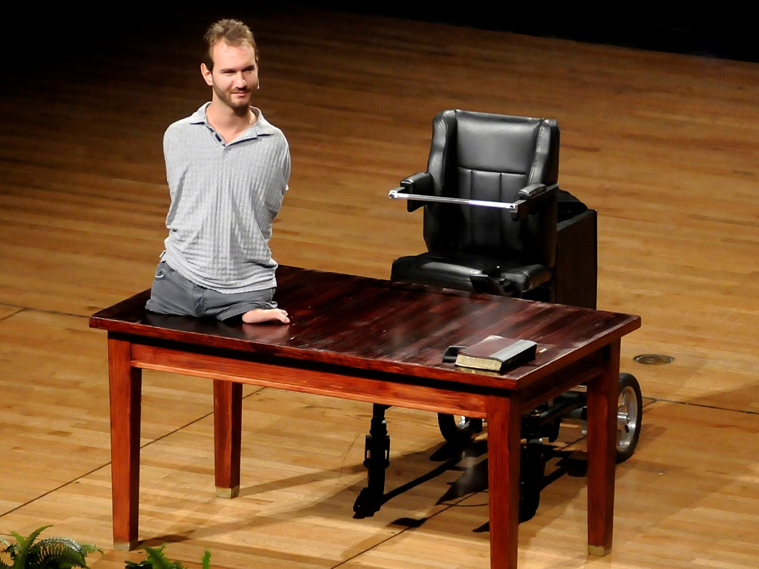
#4 Confuse Human Value With Human Function

Slide 7
#5 Disguise Your True Position by Appealing to the Hard Cases

Slide 8
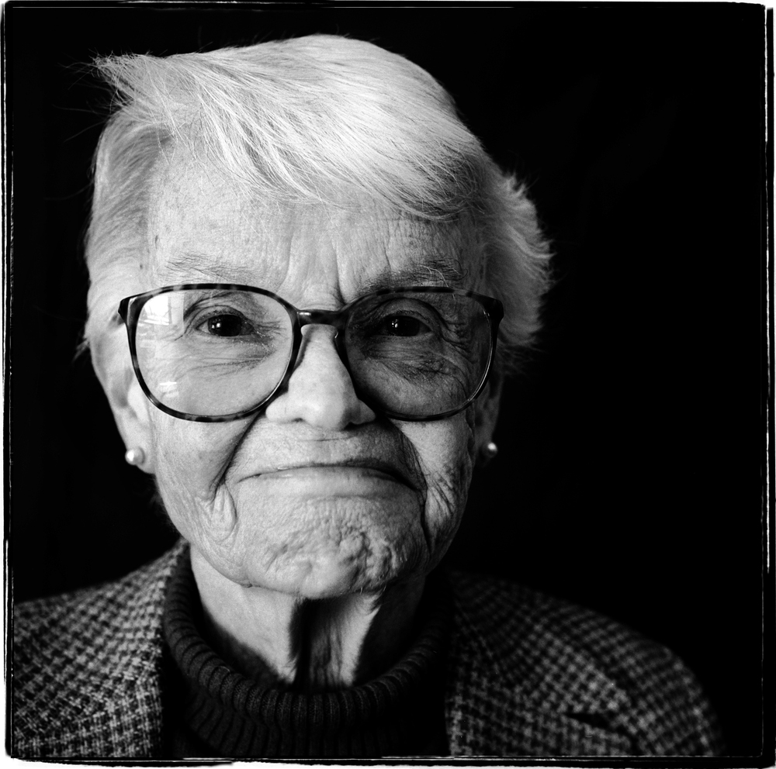
Judith Jarvis Thomson's
Violinist Argument

Slide 9
Judith Jarvis Thomson's Violinist Argument

Slide 10
Unstringing the Violinist
In order for the argument to work Thomson will have to show that these parallels work. If so then her case is unassailable, if not then her analogy fails and her argument crumbles.
First, we may not have the obligation to sustain strangers who are unnaturally plugged into us, but we do have a duty to sustain our own offspring.
Second, the child is not an intruder. He is precisely where he naturally belongs at the point in his development.
Third, Thomson tries to justify abortion as merely the withholding of support. But it is also something else, the killing of a child through dismemberment, poison, or crushing.
Fourth, barring cases of rape, a woman cannot claim that she bears no responsibility for the pregnancy in the same way she bears no responsibility for the violinist.

Slide 11
But What Happens if the Woman Was Rape?
Given Thomson concedes the humanity of the unborn, the fundamental question is whether we can kill innocent human beings to relieve our own suffering.
True, the child came into being through a violent act, but that has no bearing on how he should be treated.
Although carrying the child to term is burdensome and may involve serious social and psychological costs, that burden is nowhere near the harm the child would suffer being killed.

Slide 12
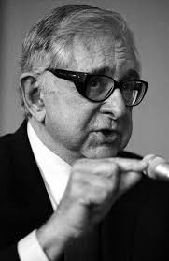
Unstringing the Violinist (Cont.)
Fifth, pregnancy unlike the violinist analogy, is not a prison bed. As Dr. Bernard Nathanson points out, “Few pregnant women are bedridden and many, both emotionally and physically, have never felt better. For these, it is a stimulating experience, even mothers who originally did not want to be pregnant.”

Slide 13
Summary of the Pro-Life Position
1. It is objectively wrong to kill an innocent human being.
2. Abortion kills an innocent human being.
3. Therefore, abortion is wrong.

Slide 14
“The measure of how much we care about this issue will not be found in the piety of our rhetoric, but in how much we are willing to sacrifice personally to stop the killing”
-Gregg Cunningham, Pro-Life Apologist

