Slide 1
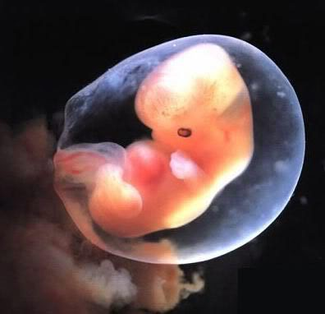
Defending life: Pro-Life apologetics 101 (A Critique of pro-choice theological arguments)

Slide 2
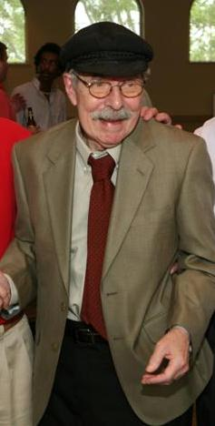
Is The Bible Silent on Abortion?
“One thing the Bible does not say is ‘Thou shalt not abort…”
Dr. Roy Bowen Ward,
Is the Fetus a Person?” Mission Journal (January 1986)

Slide 3
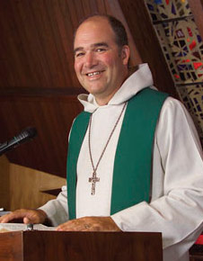
Is The Bible Silent on Abortion?
“Even as a minister I am careful what I presume Jesus would do if he were alive today, but one thing I know from the Bible is that Jesus was not against women having a choice in continuing a pregnancy. He never said a word about abortion (nor did anyone else in the Bible) even though abortion was available and in use in his time.”
-Rev. Mark Bigelow,
Letter to Bill O’ Reilly of Fox News, November 22, 2002

Slide 4
Is The Bible Silent on Abortion?
-Dr. Paul D. Simmons,
“Personhood, the Bible, and the Abortion Debate,” article published by the Religious Coalition for Reproductive Choice (1983)

Slide 5
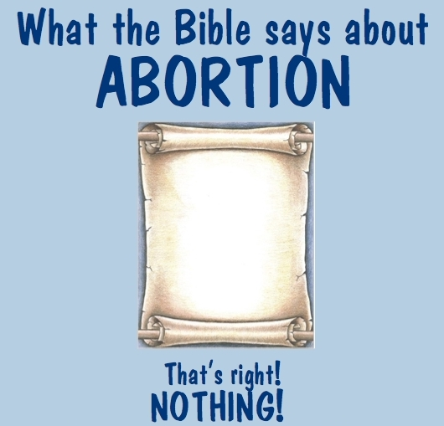
Summation of the Pro-Choice Biblical Argument for Abortion
Premise 1: The Bible does not mention the word “Abortion.”
Premise 2: The Bible nowhere teaches that the unborn are human.
Conclusion: Elective abortion is a matter of personal choice. Where the Bible speaks we speak, where it doesn’t speak, we stay silent and because the Bible is silent on abortion, therefore we should not be saying that elective abortion is wrong.

Slide 6
Does Silence Equal Permission?
The hidden (and undefended) premise in the argument advanced by Ward, Bigelow, and Simmons is that whatever the Bible doesn’t condemn it condones.
However, the Bible does not expressly condemn many things including racial discrimination against blacks, killing abortion doctors for fun, and lynching homosexuals, yet few people proclaim these acts morally justified. To the contrary, we know they are wrong by inference.
Scripture tells us it’s wrong to treat human beings unjustly, Lynching homosexuals treats human beings unjustly. Therefore, we know that Scripture condemns this activity even if the topic of lynching is never addressed.

Slide 7
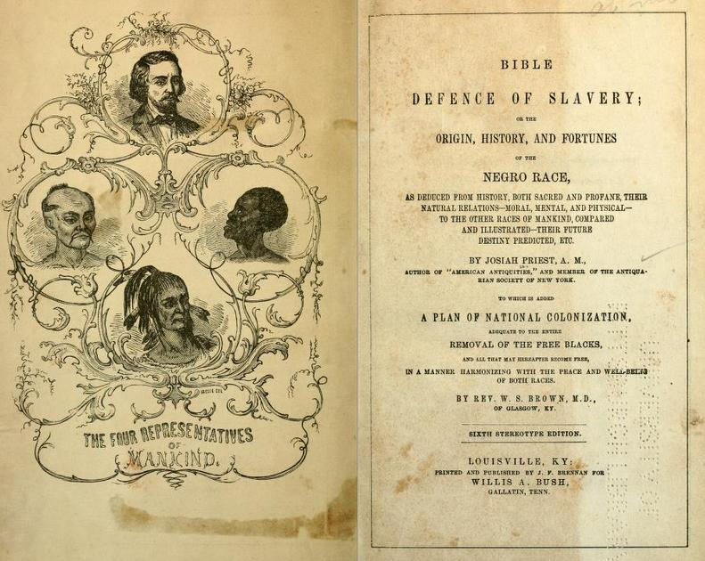
What’s the Real Issue?
Racists at one time argued from the alleged silence of the Scripture that blacks were not human. Some even denied that black people had souls.
While Scripture does not mention every specific race and nationality, it does teach that all humans are made in God’s image and were created to have fellowship with Him (Genesis 1:26; Galatians 3:28; Colossians 3:10-11; James 3:9).
Notes:
The inference is clear. If blacks are human beings, they are made in God’s image, too. No further proof from Scripture is necessary.

Slide 8
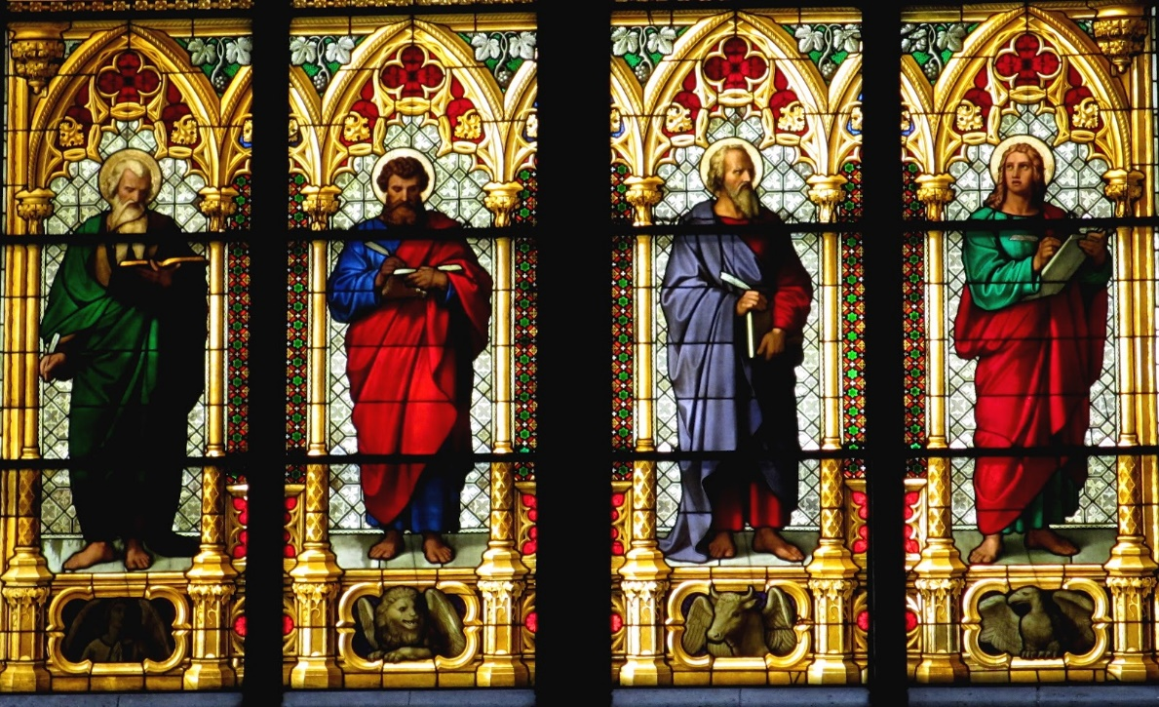
The Intent of the Biblical Writers
Prohibitions against abortion were largely unnecessary. Biblical writers, under the guidance from the Holy Spirit, selectively discussed subjects relevant to their intended audiences while leaving many other topics unstated.
If the Hebrews of the Old Testament and the Christians of the New Testament were not inclined to abort their unborn offspring, there’s little reason for Scripture to address the matter.

Slide 9
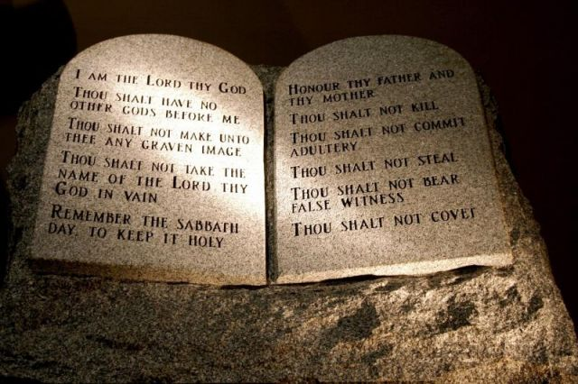
The Old Testament & Abortion
Humans have intrinsic value, hence, the shedding of innocent blood is strictly forbidden (Gen. 1:26, 9:6; Ex. 23:7; Prov. 6:6-7).
Children were seldom seen as unwanted or as a nuisance (unless they turn wicked), but as a gift from God (Psalms 127:3-5; Gen. 17:6, 33:5).
Immortality was expressed through one’s descendants (Gen. 15:5; Psalm 127:3).

Slide 10
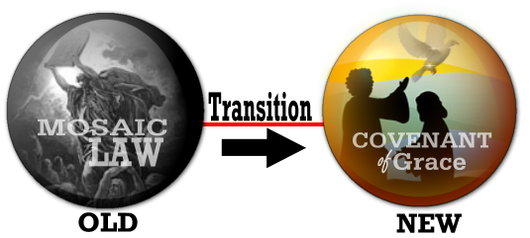
The New Testament & Abortion
A presupposition of the New Testament writers were that the unborn were fully human and valuable. The birth of Jesus and John the Baptist were examples of this (Matthew 1 and Luke 1).
Murder that is the intentional killing of innocent humans is regarded as a heinous sin (Matthew 19:18; Romans 13:9).
The unborn are called by God before birth (Gal. 1:15).

Slide 11
Why Exodus 21 & Other Passages Cannot Justify Abortion
“When people who are fighting injure a pregnant woman so that there is a miscarriage, and yet no further harm follows, the one responsible shall be fined what the woman’s husbands demands, paying as much as the judges determine. If any harm follows, then you shall give life for life, eye for eye, tooth for tooth, hand for hand, foot for foot, burn for burn, would for wound, stripe for stripe.” Exodus 21:22-25, New Revised Standard Version

Slide 12
Why Exodus 21Cannot Justify Abortion
Even if we grant the abortion advocacy position, it does not follow that the unborn are not fully human. The immediate preceding passage describes a situation in which a master unintentionally kills his slaves and escapes without penalty. Yet abortion advocates would not likely argue that the Old Testament authors considered slaves less human.
The passage does not remotely suggest that anyone has a right to deliberately kill an unborn child. At best, it shows that there is a lesser penalty for accidentally killing an unborn child.
When read in the original Hebrew, the passage seems to convey that both the mother and the child are covered by Lex Talionis (the law of retribution).

Slide 13
Why Exodus 21Cannot Justify Abortion
4. The word “miscarriage” is the Hebrew word “Yasa” which actually means “come out.” It is also used 1061 times in the Hebrew Bible. It is never translated “miscarriage” in any other case. Why should the Exodus passage be any different?
“If people are fighting and hit a pregnant woman and she gives birth prematurely but there is no serious injury, the offender must be fined whatever the woman’s husband demands and the court allows. But if there is serious injury, you are to take life for life, eye for eye, tooth for tooth, hand for hand, foot for foot, burn for burn, wound for wound, bruise for bruise.” Exodus 21:22-25, New International Version

Slide 14
Does Genesis 2:7 Justify Abortion?
“Then the Lord God formed man from the dust of the ground, and breathed into his nostrils the breath of life; and the man became a living being.”
Adam was a very special case. Adam was created from the dust of the Earth. He was not conceived like other humans.
The Unborn do in fact breathe while in the womb, but through the umbilical cord rather than the nostrils.
This argument proves too much. Some newborns do not breathe air through the nostrils until a couple of minutes after birth, which means that immediately upon delivery, the parents would be justified in committing infanticide.

Slide 15
Jews, Christians, & Abortion:
A Historical Look
The Sentences of Pseudo-Phocylides (written between 50 B.C. and A.D. 50): “A woman should not destroy the unborn babe in her belly, nor after its birth throw it before the dogs and vultures.”
The Sibyline Oracles includes among the wicked those who “produce abortions and unlawfully cast their offspring away.” Also condemned are sorcerers who dispense abortifacients.
First Enoch (first or second century B.C.) says that an evil angel taught humans how to “smash the embryo in the womb.”
Josephus (first-century Jewish historian) wrote: “The law orders all the offspring be brought up, and forbids women either to cause abortion or to make away with the fetus.”

Slide 16
Jews, Christians, & Abortion:
A Historical Look
The Didache (A.D. 70): “You shall not procure an abortion, nor destroy a newborn child.”
Tertullian (A.D. 197): “In our case, a murder being once for all forbidden, we may not destroy even the fetus in the womb, while as yet the human being derives blood from the other parts of the body for its sustenance. To hinder a birth is merely a speedier man-killing; nor does it matter whether you take away a life that is born, or destroy one that is coming to birth.”
Basil the Great (A.D. 374): “Let her that procures abortion undergo ten years’ penance, whether the embryo were perfectly formed or not”

