Slide 1
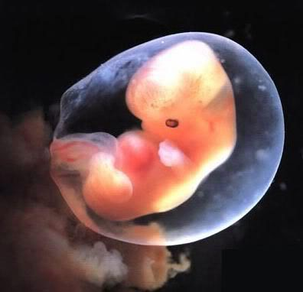
Defending life: Pro-Life apologetics 101 (philosophical Arguments for the value of the Unborn)

Slide 2
Distinction Without A Difference
“The unborn may be human, but it is not a person!”
What’s the difference???
Human Non-Persons
Human Persons
Can Kill
Cannot Kill

Slide 3
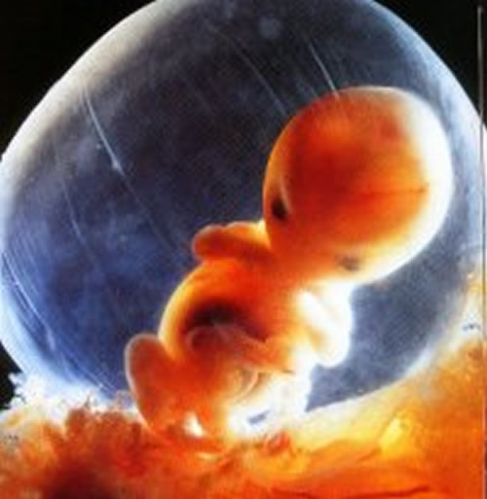
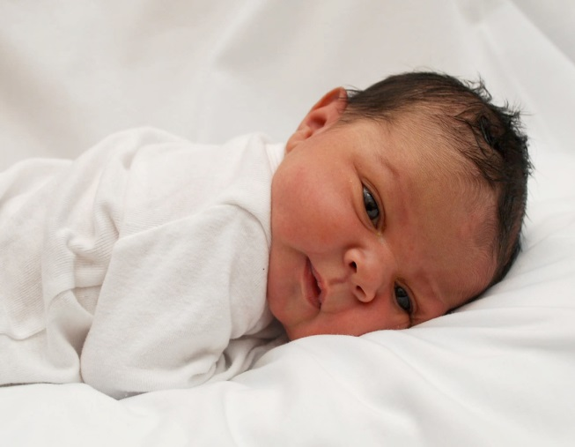
What Makes Humans Valuable ?
“Humans have intrinsic value, and are not valuable because of some function they can perform. If humans are valuable simply because of some function there will be difficulty justifying the value for all humans.”

Slide 4
The S.L.E.D. Test
The unborn differ from newborns in only four ways:
Size
Level of Development
Environment
Degree of Dependency

Slide 5
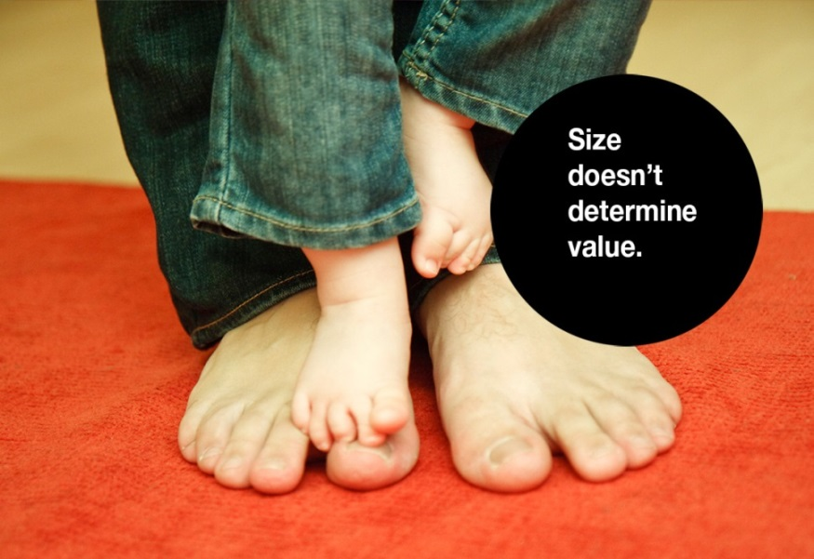
Size (or Physical Appearance)
Some will argue that the unborn are tiny. But does size really matter? Men are generally larger than women, does this make men more valuable than women?

Slide 7
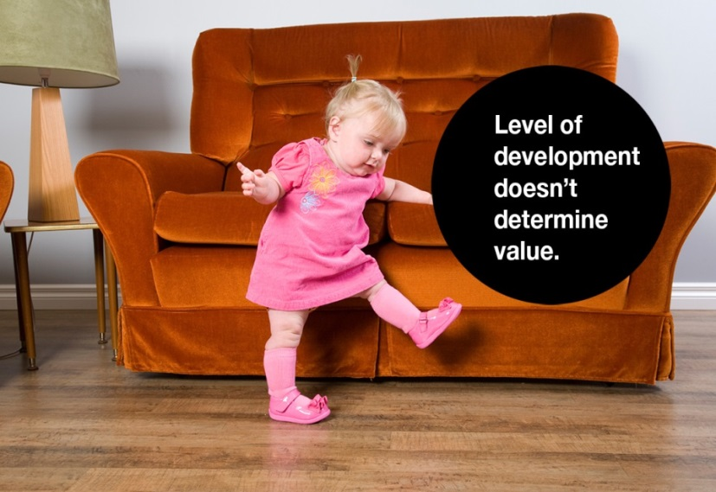
Level of Development
The unborn doesn’t have the same abilities as real persons. But two year olds are less developed then 21 year olds, can we kill them? Peter Singer argues that we can kill babies up to 21 days.

Slide 8
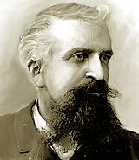
Level of Development
“In the most intelligent races...,there are a large number of women whose brains are closer in size to those of gorillas than to the most developed male brains. This inferiority is so obvious that no one can contest it for a moment; only its degree is worth discussion. All psychologists who have studied the intelligence of women, as well as poets and novelists, recognize today that they represent the most inferior forms of human evolution and that they are closer to children and savages than to an adult, civilized man. They excel in fickleness, inconstancy, absence of thought and logic, and incapacity to reason. Without a doubt there exist some distinguished women, very superior to the average man, but they are as exceptional as the birth of any monstrosity, as, for example, of a gorilla with two heads; consequently, we may neglect them entirely.” Gustave Lebon, French Psychologist (1879)

Slide 9
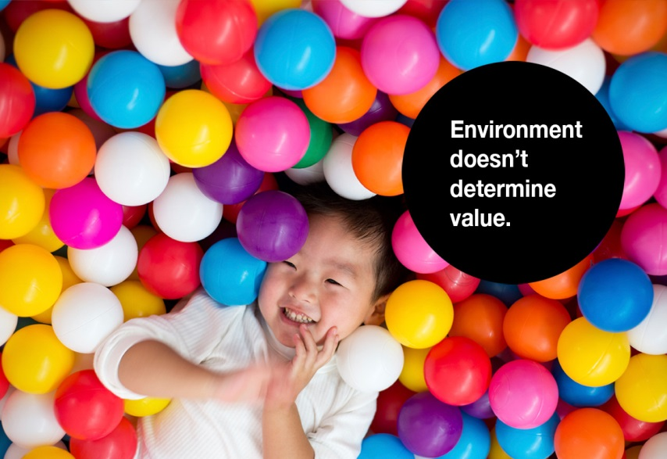
Environment
The unborn isn’t located in the right place as real persons. This is implicit in abortion laws.

Slide 10
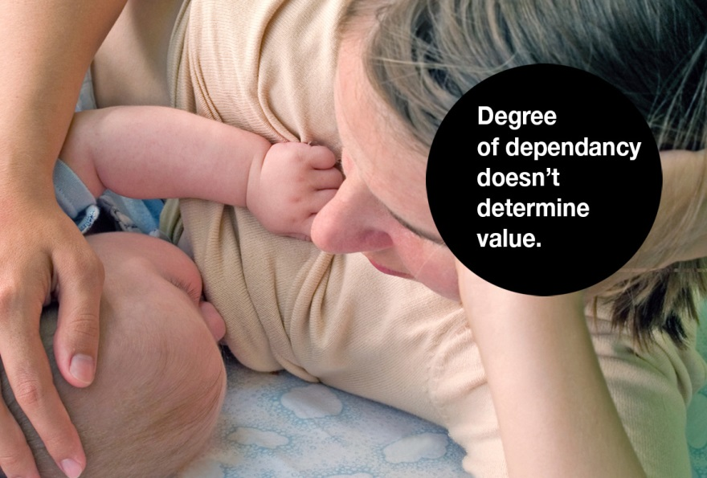
Degree of Dependency
The unborn is too dependent on others (i.e., he’s not viable). Can we kill conjoin twins since they are dependent on each other?

Slide 11
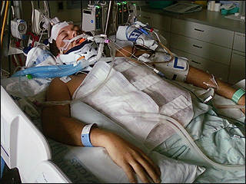
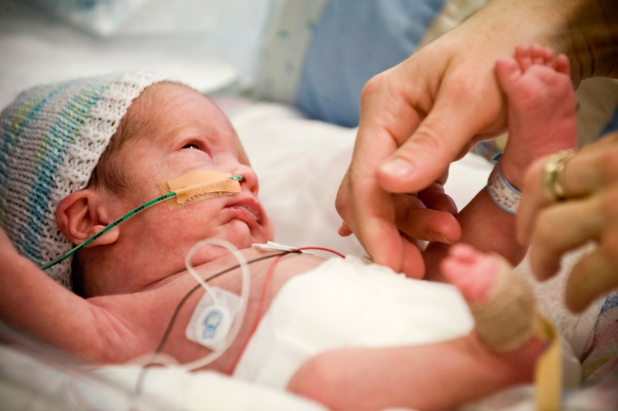
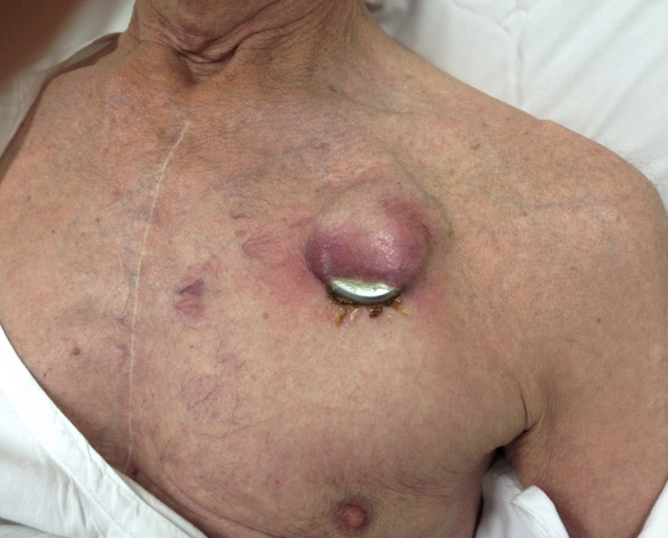
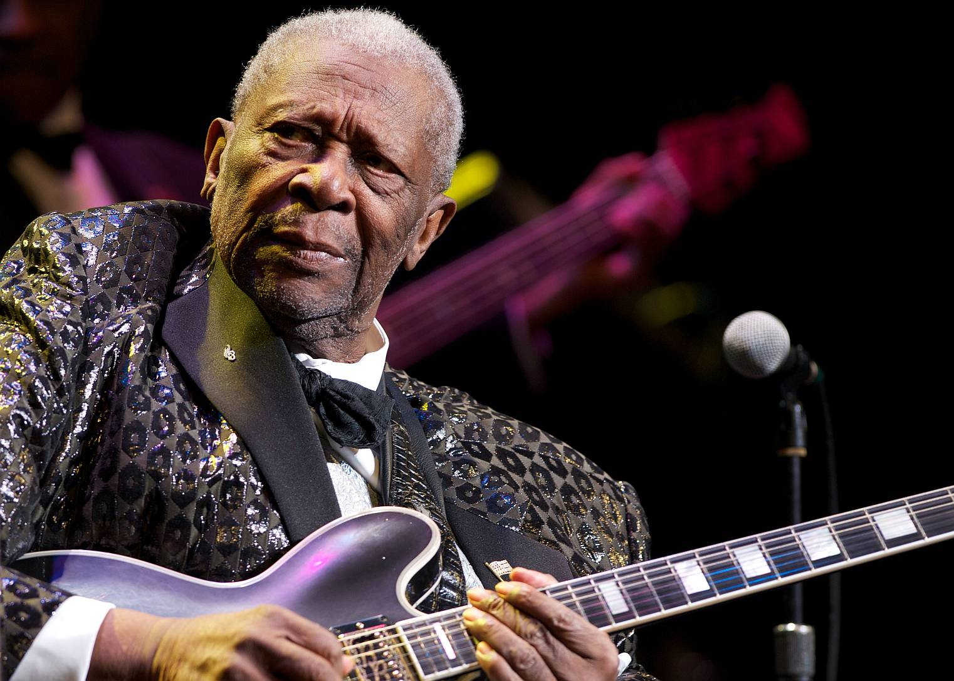
Degree of Dependency

Slide 12
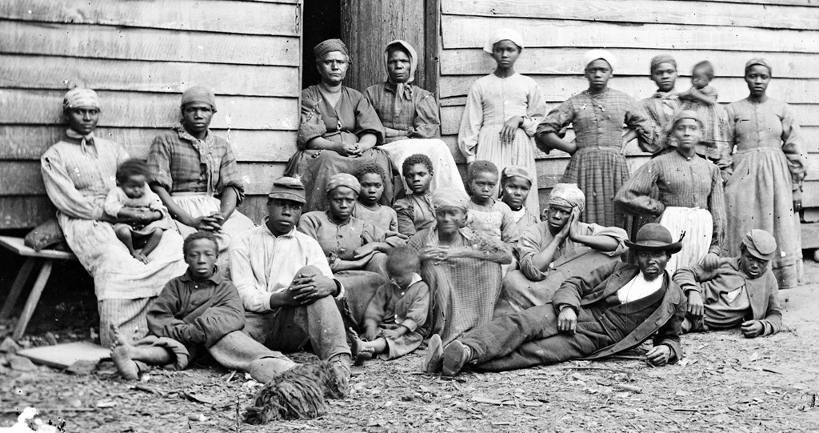
Discrimination Based On Arbitrary Qualities
“In the eyes of the law…the slave is not a person.”
Virginia Supreme Court decision, 1858

Slide 13
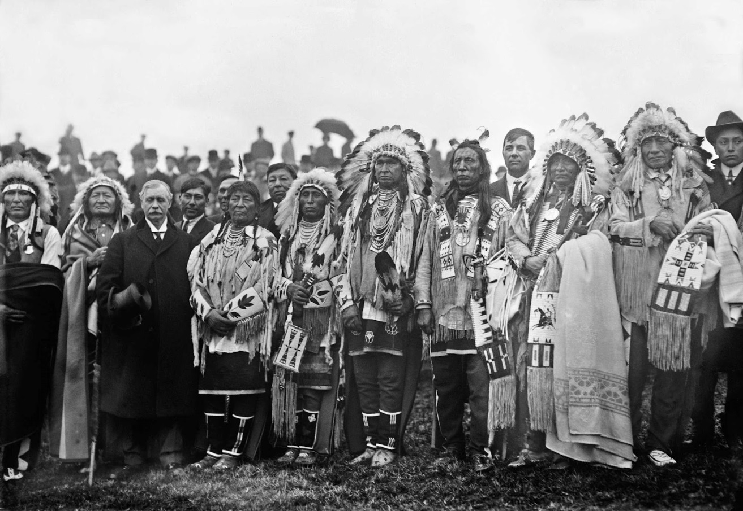
Discrimination Based On Arbitrary Qualities
“An Indian is not a person within the meaning of the Constitution…[Congress] may prevent an Indian from leaving his reservation, and while he is on a reservation it may deprive him of his liberty, his property, his life.”
-George Canfield
American Law Review, 1881

Slide 14
Discrimination Based On Arbitrary Qualities
“Women are persons in matters of pains and penalties, but are not persons in matters of rights and privileges.”
The British North America Act of 1867

Slide 15
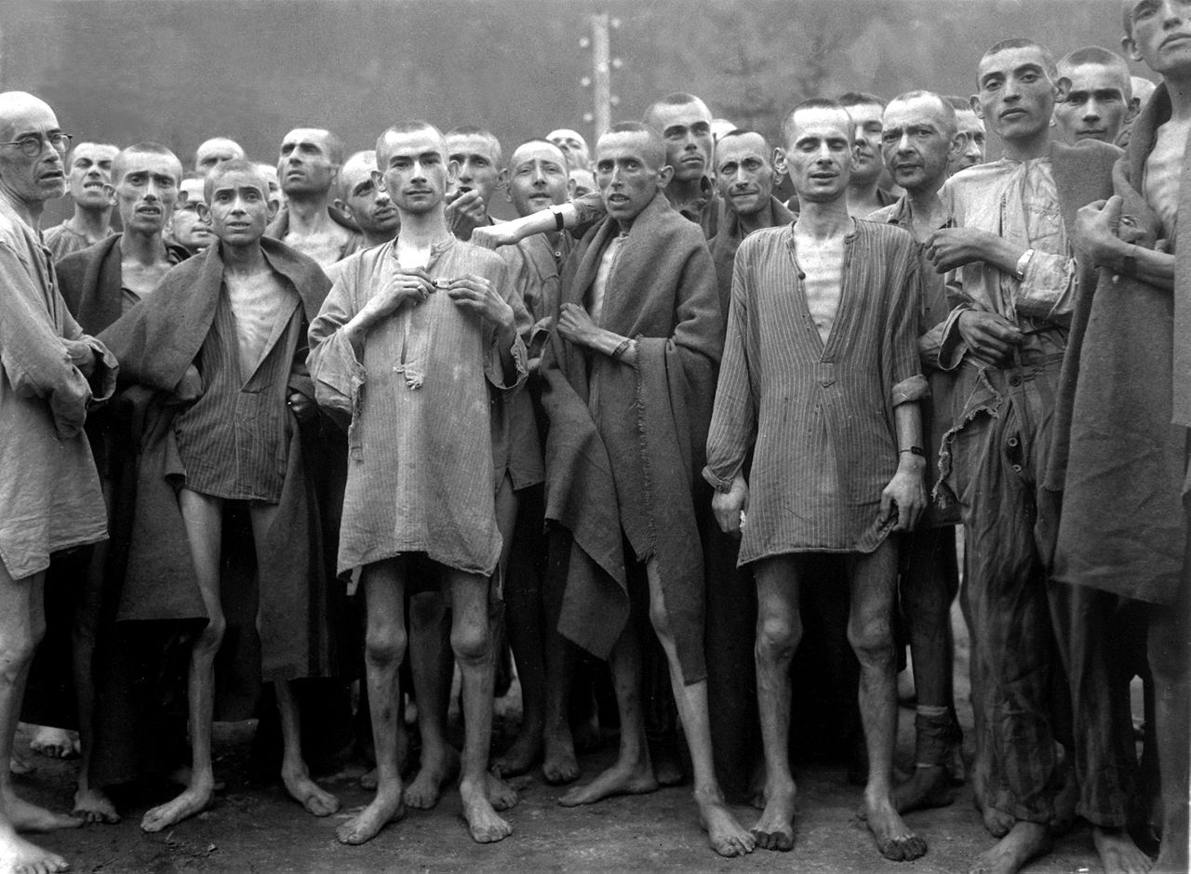
Discrimination Based On Arbitrary Qualities

Slide 16
Discrimination Based On Arbitrary Qualities
“Human babies are not born self-aware, or capable of grasping that they exist over time. They are not persons. [Therefore], the life of a newborn is of less value than the life of a pig, a dog, or a chimpanzee.”
-Peter Singer, Practical Ethics
(Cambridge: Cambridge University Press, 1979), 122-3

Slide 17
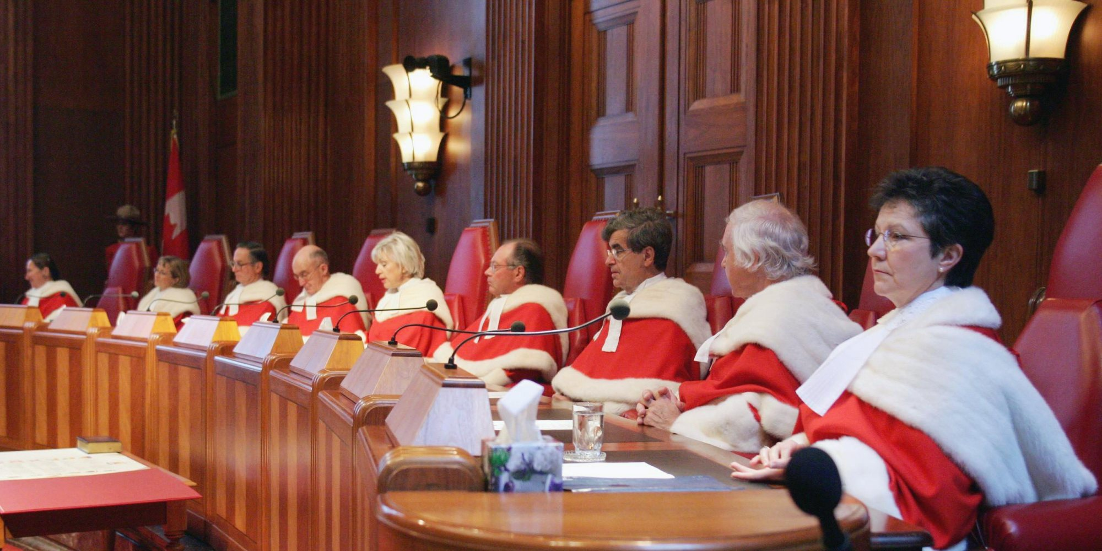
Discrimination Based On Arbitrary Qualities
“The law of Canada does not recognize the unborn child as a legal person possessing rights.”
-Canadian Supreme Court
Winnipeg Child and Family Services Case, 1997

Slide 18
Substance View of Personhood

Slide 19
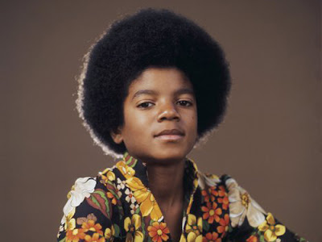
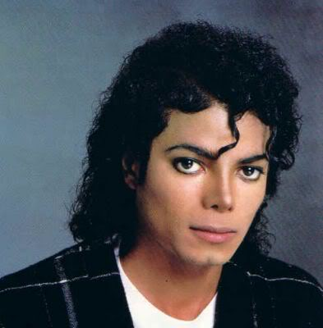
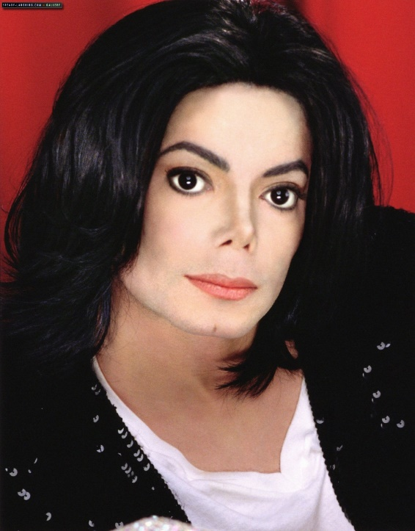
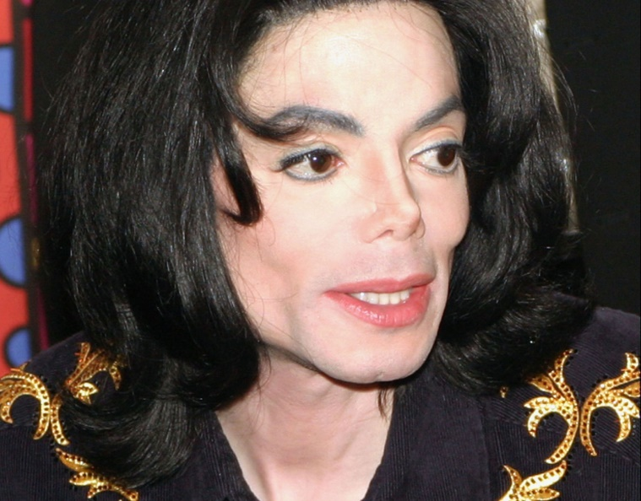
Substance vs Property
Notes:
Substance organisms maintain their identities through time. What moves a puppy to maturity or a fetus to an adult is not an external collection of parts but an internal, defining nature or essence. As a substance develops, it does not become more of its kind but matures according to its kind. It remains what it is from the moment it begins to exist. Consequently, a substance functions in light of what is it and maintains its identity even if its ultimate capacities are never realized due to disability or injury. A dog that never develops his capacity to bark is still a dog by nature.

Slide 20
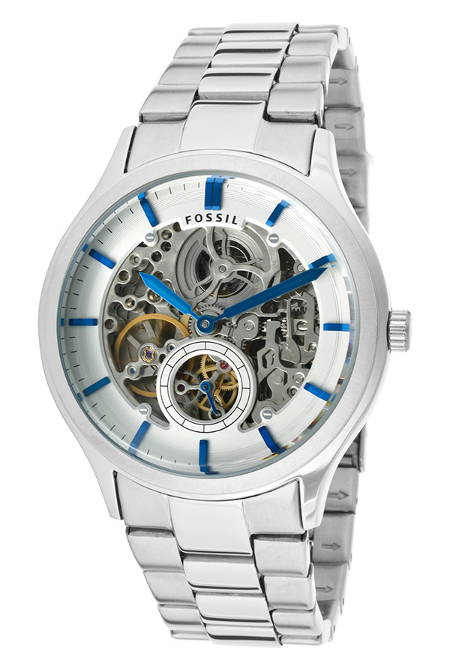
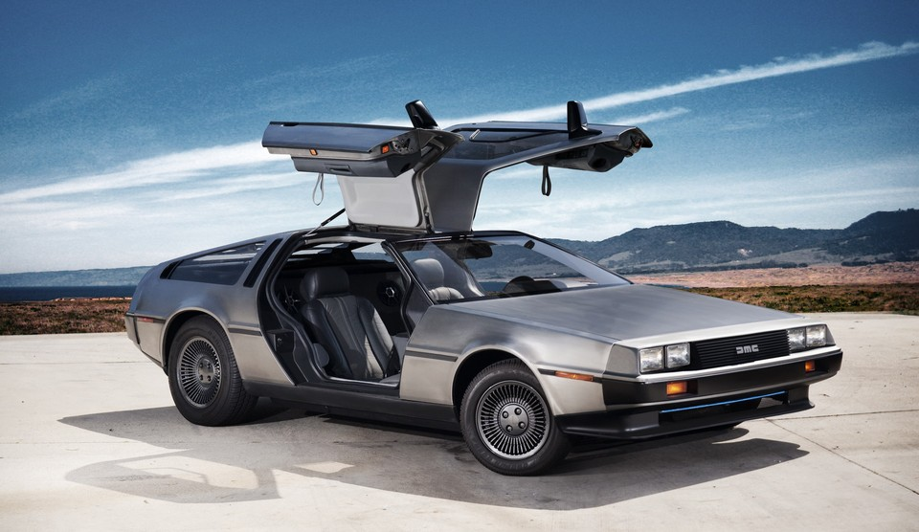
Substance vs Property
Notes:
Properties are things such as cars and machinery, do not necessarily maintain their identity through time. They are nothing more than the sum total of its parts. Change the motor or replace a tire, and you technically have a different vehicle from the one that rolled off the assembly line. There is no internal nature (or essence) that orders its development and grounds its identity through change.

Slide 21
The Pro-Life Position
Philosophically there is no morally significant difference between the embryo you once were and the adult you are today. Differences of size, level of development, environment and degree of dependency are not relevant in the way that abortion advocates need them to be.

Slide 22
The Pro-Life Position
The pro-life view is that no human being – regardless of size, level of development, race, gender, or place of residence – should be excluded from the community of human persons. Our view of humanity is inclusive, wide open to all – especially to those who are small, vulnerable, and defenseless.

