Slide 1
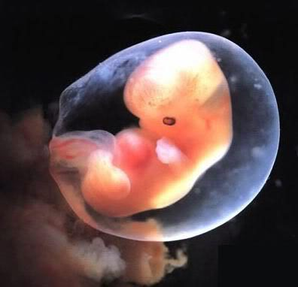
Defending life: Pro-Life apologetics 101 (Scientific Arguments for the Humanity of the Unborn)

Slide 2
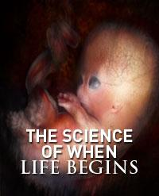
What Embryology Teaches
“From the earliest stages of development, the unborn are distinct, living, and whole human beings. Therefore, every “successful” abortion ends the life of a living human being.”
Notes:
In order to answer the question, “What is the unborn” we need to turn to the subject of Embryology. We do not go to other areas such as religion or politics to get this answer.

Slide 3
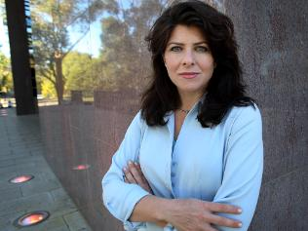
"The pro-choice movement often treats with contempt the pro-lifers' practice of holding up to our faces their disturbing graphics....[But] how can we charge that it is vile and repulsive for pro-lifers to brandish vile and repulsive images if the images are real? To insist that the truth is in poor taste is the very height of hypocrisy. Besides, if these images are often the facts of the matter, and if we then claim that it is offensive for pro-choice women to be confronted with them, then we are making the judgment that women are too inherently weak to face a truth about which they have to make a grave decision. This view is unworthy of feminism.” -Naomi Wolf, "Our Bodies, Our Souls," New Republic, 16 October 1996

Slide 4
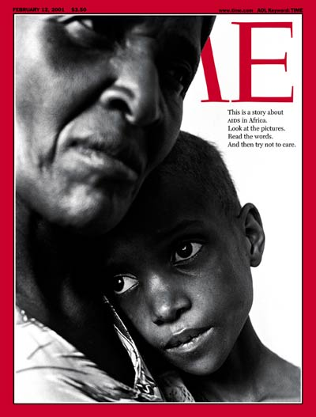
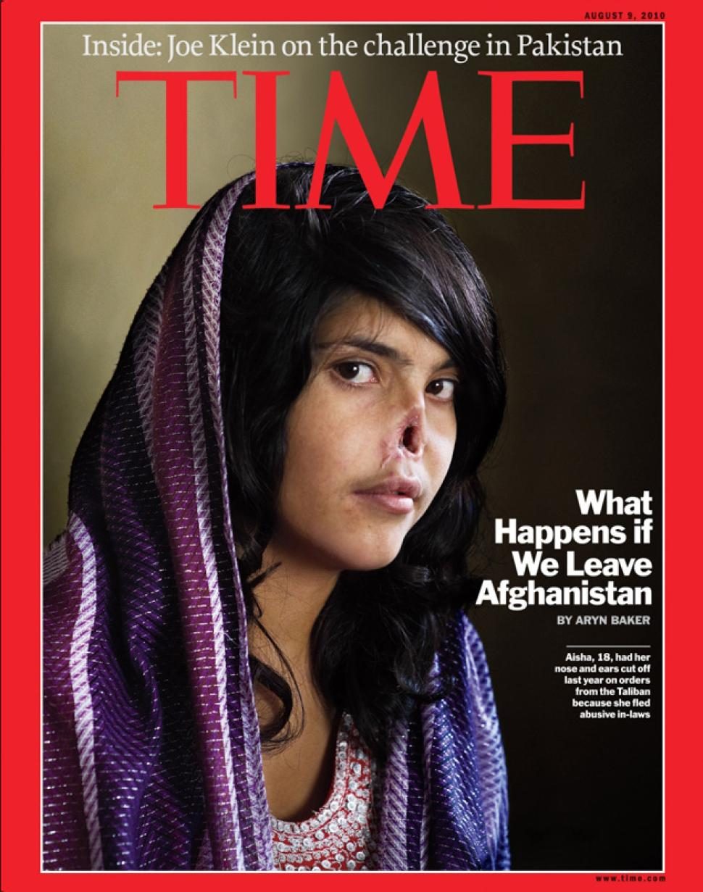

Slide 5
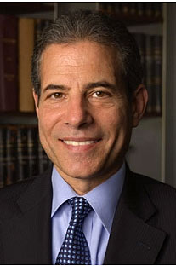
“[Bad] things do happen to people, and it is part of our job to confront and explain them. In the end, I felt that the image is a window into the reality of what is happening – and what can happen – in a war that affects and involves all of us. I would rather confront readers with the Taliban’s treatment of women than ignore it. I would rather people know that reality as they make up their minds about what the U.S. and its allies should do in Afghanistan.” Richard Stengel, Time Magazine Managing Editor.

Slide 6
Notes:
In order to answer the question, “What is the unborn” we need to turn to the subject of Embryology.

Slide 7
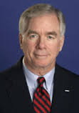
“A culture can trivialize injustice so long as it never has to look at it.” –Gregg Cunningham, Pro-Life Apologist

Slide 8
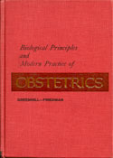
Individual Human Life Begins At Conception
"The term conception refers to the union of the male and female pronuclear elements of procreation from which a new living being develops." "The zygote thus formed represents the beginning of a new life."J.P. Greenhill and E.A. Friedman, Biological Principles and Modern Practice of Obstetrics. Philadelphia: W.B. Saunders, 1974. pp. 17, 23.

Slide 9
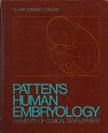
Individual Human Life Begins At Conception
"It is the penetration of the ovum by a spermatozoan and resultant mingling of the nuclear material each brings to the union that constitutes the culmination of the process of fertilization and marks the initiation of the life of a new individual." Clark Edward Corliss, Patten's Human Embryology: Elements of Clinical Development. New York: McGraw Hill, 1976. p. 30.

Slide 10
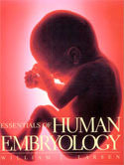
Individual Human Life Begins At Conception
“Human embryos begin development following the fusion of definitive male and female gametes during fertilization... This moment of zygote formation may be taken as the beginning or zero time point of embryonic development.” William J. Larson, Essentials of Human Embryology. New York: Churchill Livingstone, 1998.pp. 1, 14.

Slide 11
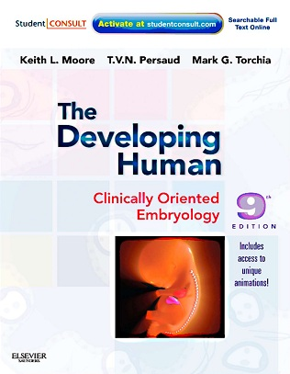
Individual Human Life Begins At Conception
"Human development begins at fertilization, the process during which a male gamete or sperm (spermatozoo development) unites with a female gamete or oocyte (ovum) to form a single cell called a zygote. This highly specialized, totipotent cell marked the beginning of each of us as a unique individual." "A zygote is the beginning of a new human being (i.e., an embryo)." (Keith L. Moore, The Developing Human: Clinically Oriented Embryology, 9th edition. Philadelphia, PA: Saunders, 2011. pp. 16, 2.)

Slide 12
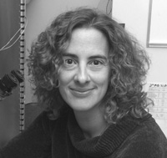
Individual Human Life Begins At Conception
"The scientific evidence supports the conclusion that a zygote is a human organism and that the life of a new human being commences at a scientifically well defined 'moment of conception.' This conclusion is objective, consistent with the factual evidence, and independent of any specific ethical, moral, political, or religious view of human life or of human embryos.“Condic, M. L., & Neuhaus, R. J. (2008). When Does Human Life Begin?. White Paper des Westchester Institute for Ethics & the Human Person, 1, 1.

Slide 13
Distinct (i.e., separate from their parents, not identical to their parents).
Unique genetic fingerprint (The unborn’s DNA is its own unique identity): An egg with 23 of the mother’s chromosomes unites with a sperm with 23 of the father’s chromosomes to create an individual living thing. The zygote is different from every other living cell because it has its own DNA fingerprint.
Different Circulatory system: The unborn has its own circulatory system and its blood never mixes or circulates with the material blood.
Different blood type: It is medically impossible for a single individual to have two completely different blood types.
Different gender: The unborn can be of a different gender (i.e., a male) thus having body parts such as a penis which is distinct from the mother.

Slide 14
Living (i.e., dead things don’t grow and the embryo is growing).
Embryology teaches that individual human life begins at conception. This refutes the idea that no one knows when life begins.
There is no doubt that the zygote is biologically alive. It fulfills the four criteria needed to establish biological life: 1) Metabolism, 2)Growth, 3) Reaction to Stimuli, and 4) Reproduction.
The only thing the unborn need to survive are adequate nutrition, a proper environment, and an absence of fatal threats. That’s all any of us need. There is no point in human development at which the developing entity goes from non-life to living.
There is no period of non-life biologically speaking.

Slide 15
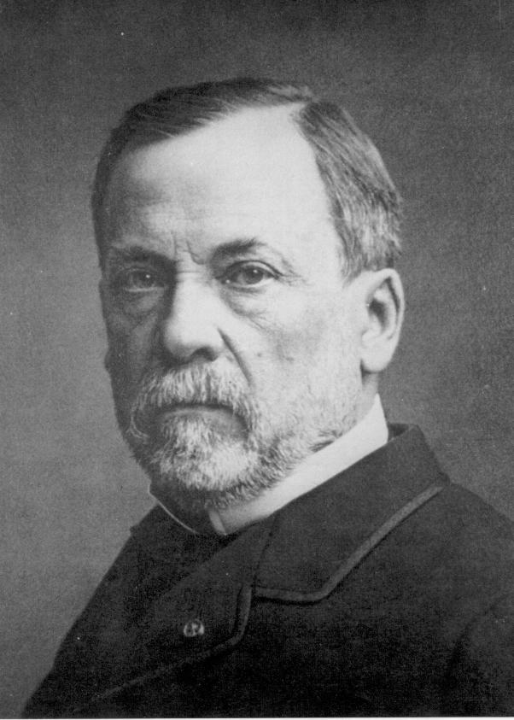
Whole Human Being
The Law of Biogenesis: Living things reproduce after their own kind (i.e., dogs produce dogs and humans produce humans). Because the unborn come from human parents, they too are a part of the human family and we ought not to harm them without justification. Elective abortion harms a member of the human family without justification, that’s why pro-lifers oppose it.
Louis Pasteur

Slide 16
Whole Human Being
Genetically they are human: The unborn may not seem to “look” human (at least in her earlier stages), but in fact she looks exactly like a human at that level of human development. Living things do not become something different as they grow and mature; rather, they develop the way that they do precisely because of the kind of being they already are.”
“Most importantly, the embryo is a complete or whole human organism rather than part of another living entity. All of its cells together in tandem toward the growth of a single entity, the embryo.” (The Case for Life, Pg. 37-38).

Slide 17
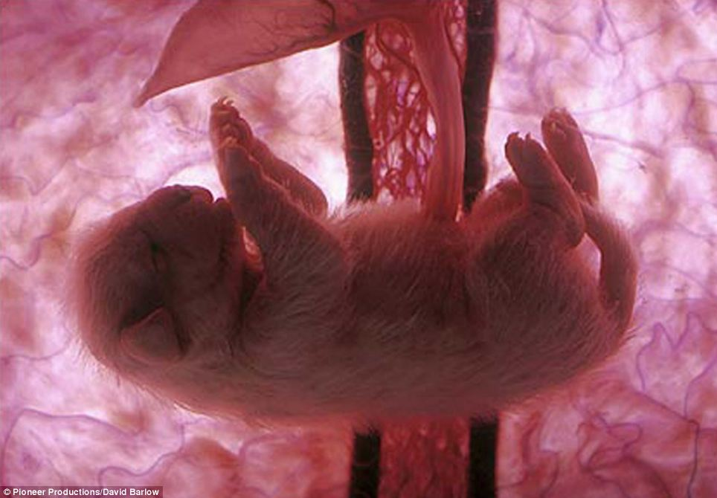
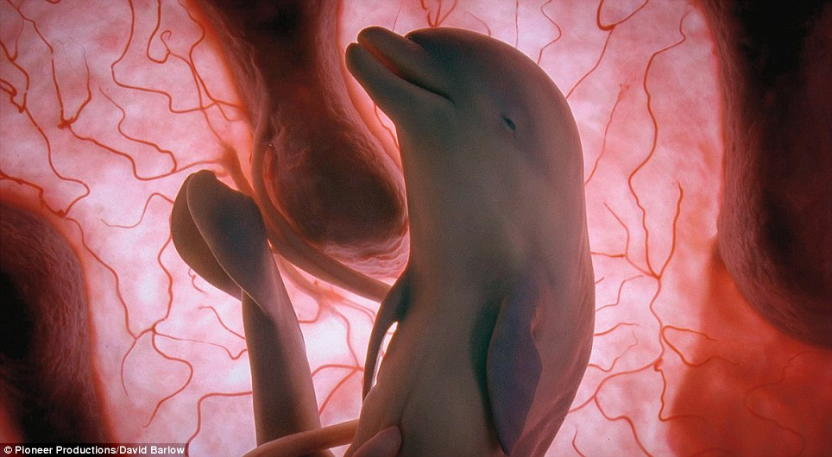
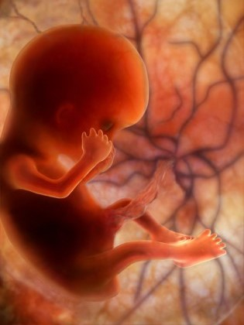
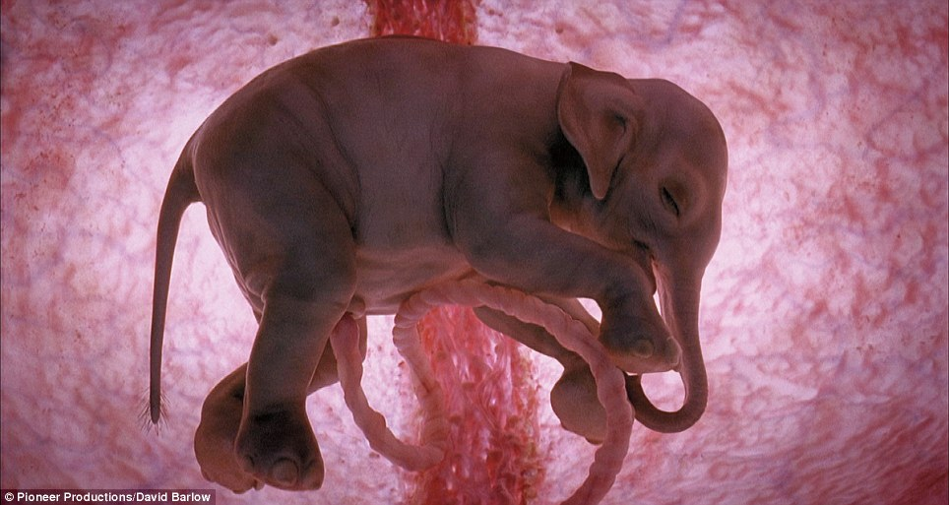
Which One Is The Human Fetus?

Slide 18
“Perhaps the most straightforward relation between you or me on the one hand and every human fetus from conception onward on the other is this: All are living members of the same species, homo sapiens. A human fetus, after all, is simply a human being at a very early stage in his or her development.”
-David Boonin
A Defense of Abortion (Cambridge University Press, New York, 2002). P 20

Slide 19
“It is possible to give ‘human being’ a precise meaning. We can use it as equivalent to ‘member of the species Homo sapiens’. Whether a being is a member of a given species is something that can be determined scientifically, by an examination of the nature of the chromosomes in the cells of living organisms. In this sense there is no doubt that from the first moments of its existence an embryo conceived from human sperm and eggs is a human being.”
-Peter Singer
Practical Ethics 2nd ed (Cambridge: Cambridge University Press, 1993, 2008), 85-86.

Slide 20
“There is simply no doubt that even the early embryo is a human being. All its genetic coding and all its features are indisputably human. As to being, there is no doubt that it exists, is alive, is self-directed and is not the same being as the mother – and is therefore a unified whole.”
-Benard N. Nathanson, M.D.
The Hand of God (Washington, DC: Regnery Publishing, 1996) 131.

Slide 22
One Point of Observation
“No one knows when life begins so I think that abortion should be legal anyway.”

Slide 23
So the unborn are…
Distinct
Living
Whole Human Being

Slide 24
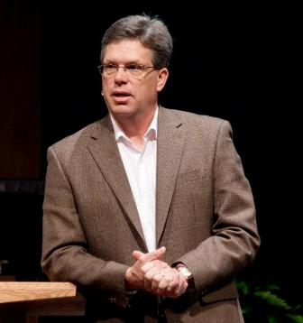
“Science can be a wonderful tool in the Pro-Life advocate’s arsenal. However, science can’t dictate morality, it can only inform morality. Science can tell us that something we are harming or killing is human; science can’t tell us that it’s wrong to kill that human. So while we can demonstrate scientifically that the unborn are living human organisms from fertilization, we must turn to philosophy to demonstrate whether we can or cannot kill that living human organism.”

