Slide 1
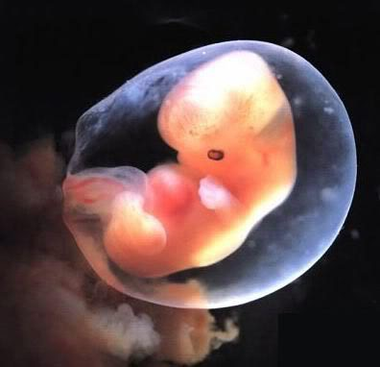
Defending life: Pro-Life apologetics 101

Slide 2
Course agenda
9am – 10:00am: Clarifying & Establishing a Foundation for the Abortion Debate.
10:00am – 11:00am: Scientific Arguments for the Humanity of the Unborn.
-15 Minute Break-
11:15am – 12:15pm: Philosophical Arguments for the Value of the Unborn.
-1 Hour Lunch-
1:30pm – 2:30pm: A Critique of Pro-Choice Theological Arguments.
2:30pm – 3:15pm: Answering Pro-Choice Rhetoric & Arguments.
-15 Minute Break-
3:30pm – 4:30pm: Q & A Panel Discussion.

Slide 3
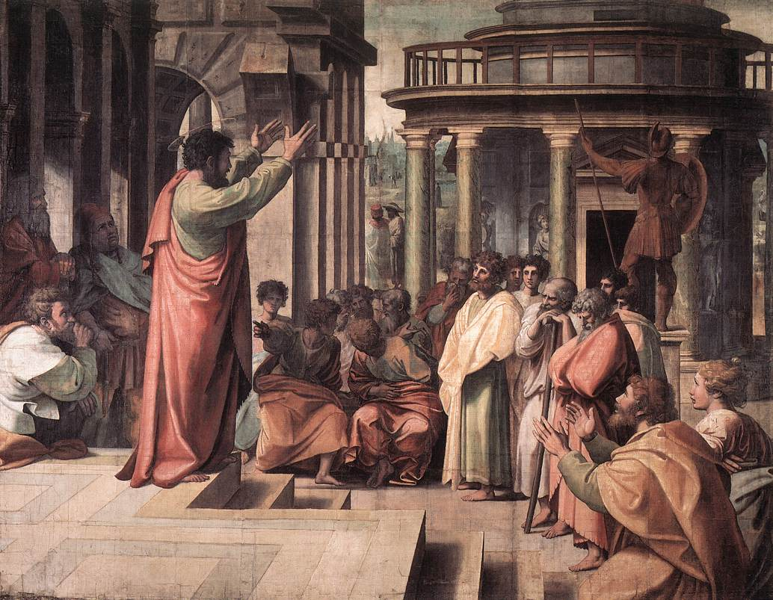
What Is Apologetics???

Slide 4
An Effective Ambassador Has 3 Essential Skills:
1
Knowledge
An accurate mind
He must have some basic knowledge. Minimally, he must know the character, mind, and purposes of his king.
“Therefore we are Christ’s ambassadors…” 1Corinthans 5:20

Slide 5
An Effective Ambassador Has 3 Essential Skills:
2
Wisdom
An artful method
Knowledge must be deployed in a skillful way. There’s an element of wisdom, a tactical and artful diplomacy that makes his message persuasive.
“Therefore we are Christ’s ambassadors…” 1Corinthans 5:20

Slide 6
An Effective Ambassador Has 3 Essential Skills:
3
Character
An attractive manner
Because an ambassador brings himself along in everything he does, his personal maturity and individual
“Therefore we are Christ’s ambassadors…” 1Corinthans 5:20

Slide 7
Just How Many Abortions in America?
Every Year: 1,200,000
Every Month: 100,000
One Every
Thirty Seconds!
Every Day: 3,287
Every Hour: 137

Slide 8
Just How Many Abortions in America?

Slide 9
Abortions in America
Roe v. Wade & Doe v. Bolton
For the stage prior to approximately the end of the first trimester, the abortion decision and it effectuation must be left to the medical judgment of the pregnant woman’s attending physician.
ABORTION FOR ANY REASON
2. For the stage subsequent to approximately the end of the first trimester, the State, in promoting its interest in the health of the mother, may, if it chooses, regulate the abortion procedure in ways that are reasonably related to maternal health.
RESTRICTIONS ONLY TO PROTECT LIFE OF MOTHER
3. For the stage subsequent to viability, the State in promoting its interest in the potentiality of human life may, if it chooses, regulate, and even proscribe, abortion except where it is necessary, in appropriate medical judgments, for the preservation of the life or health of the mother.
ONLY ABORTIONS TO SAVE THE LIFE OR HEALTH OF THE MOTHER

Slide 10
The Pro-Life Position
It is objectively wrong to kill an innocent human being.
2. Abortion kills an innocent human being.
3. Therefore, abortion is wrong.

Slide 11
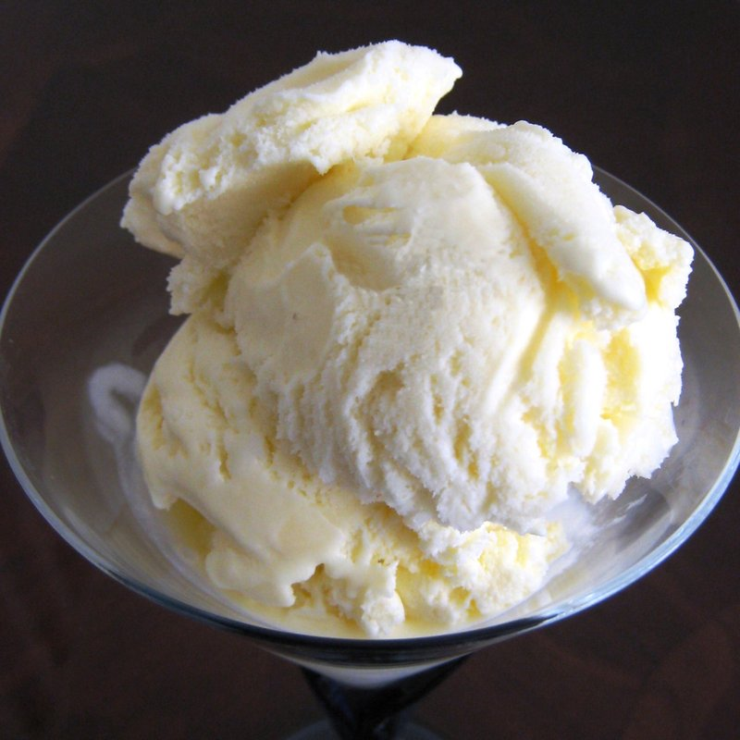
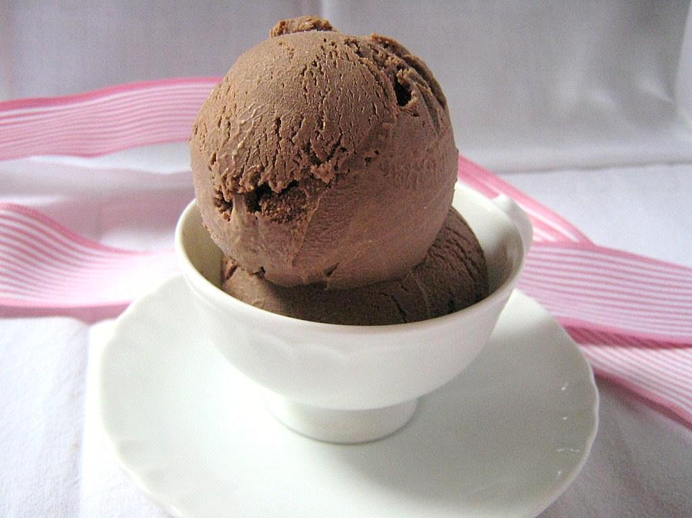
Two Kinds of Truth:
What is The Best Flavor of Ice Cream?
Vs.
Subjective Claims: Depend on the personal preference of the subject.

Slide 12
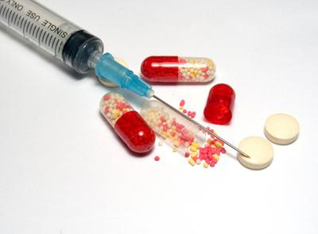
Two Kinds of Truth:
What is The Best Flavor of Ice Cream?
Objective Claims: Facts about the way the world really is.

Slide 13
Quiz: What Type of Claim Is It?
Subjective
“Ice Cream” Claims
Objective
“Insulin” Claims
“Coke tastes better than Pepsi”
Subjective

Slide 14
Quiz: What Type of Claim Is It?
Subjective
“Ice Cream” Claims
Objective
“Insulin” Claims
Objective
“Coke Zero has fewer calories than Coke”

Slide 15
Quiz: What Type of Claim Is It?
Subjective
“Ice Cream” Claims
Objective
“Insulin” Claims
“The Dodgers won the 1988 Baseball World Championship”
Objective
(Historical Claim)

Slide 16
Quiz: What Type of Claim Is It?
Subjective
“Ice Cream” Claims
Objective
“Insulin” Claims
“The Metro L.A. Church of Christ is the best church”
Subjective

Slide 17
Quiz: What Type of Claim Is It?
Subjective
“Ice Cream” Claims
Objective
“Insulin” Claims
“Kedron can bench press 200 lbs”
Objective

Slide 18
Quiz: What Type of Claim Is It?
Subjective
“Ice Cream” Claims
Objective
“Insulin” Claims
“The earth is the center of the solar system”
Objective
(Scientific Claim)

Slide 19
Quiz: What Type of Claim Is It?
Subjective
“Ice Cream” Claims
Objective
“Insulin” Claims
“Abortion is wrong”
Objective
(Moral Claim)

Slide 20
Pro-Choice Slogan #1

Slide 21
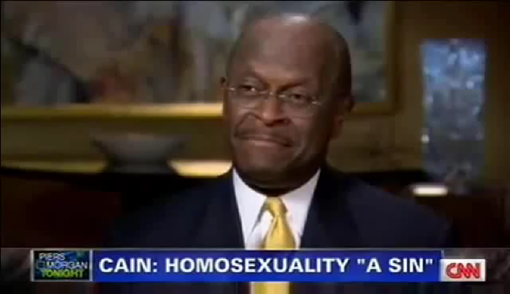
Pro-Choice Slogan #2
(The Modified Pro-Life Position)
“I’m personally opposed to green beans, but I believe everyone should have a right to choose to eat them.”
“I’m personally opposed gassing Jews, but I believe everyone should have a right to choose.”
“I’m personally opposed to rapping women, but I believe everyone should have a right to choose.”
“I’m personally opposed to abortion, but women should have the right to choose.”

Slide 22
Pro-Choice Slogan #2
(The Modified Pro-Life Position)
“Some people have the illusion that being personally opposed to abortion while believing others should be free to choose it is some kind of compromise between the pro-abortion and pro-life positions. It isn’t. Pro-choice people vote the same as pro-abortion people.

Slide 23
Pro-Choice Slogan #2
(The Modified Pro-Life Position)
Both oppose legal protection for the innocent unborn. Both are willing for children to die by abortion and must take responsibility for the killing of those babies even if they do not participate directly. To the baby who dies it makes no difference whether those who refused to protect her were pro-abortion or merely pro-choice.”

Slide 24
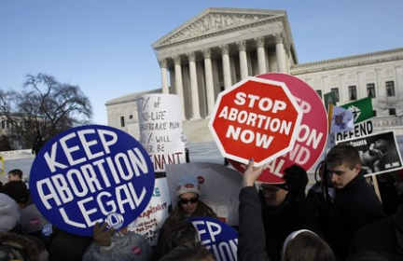
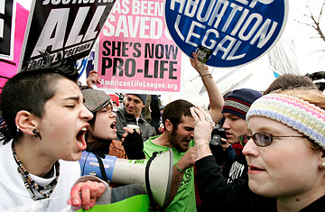
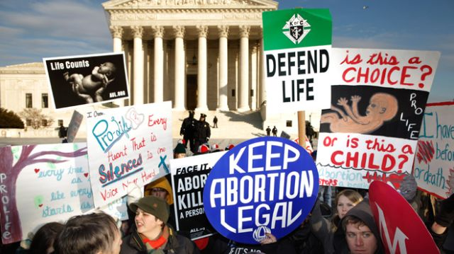
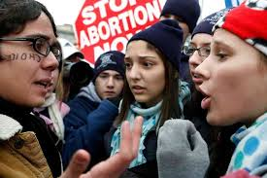
Is Abortion a Complex Issue?

Slide 25
Is Abortion a Complex Issue?
Rape
Poverty
Career
Circumstances
of
Abortion
Health problems for baby
No support
Unwantedness
Age

Slide 26
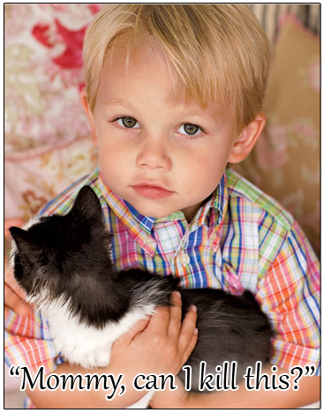
The Key Issue: What Is the Unborn?
This question trumps all other considerations

Slide 27
The Key Issue: What Is the Unborn?
People will say that women ought to have a right to privacy.
People will say, “Would you force a poor woman to bring another child into this world!”
People will say, “You mean to tell me that you would force women into the back alleys to have illegal abortions because you want to protect a bunch of embryos!”

Slide 28
The Key Issue: What Is the Unborn?
“If the unborn is not a human being, then no justification for abortion is necessary. However, if the unborn is a human being, then no justification for abortion is adequate.”
-Gregory Koukl, Pro-Life Apologist

Slide 29
The Key Issue: What Is the Unborn?
Not a Political Issue: Some people who share the biblical worldview argue that we should not be involved in the abortion debate because it is a political issue.
Not a Religious Issue: Some individuals will say that answering the question of when life begin is a religious question that cannot be answered so therefore people can have abortions.

Slide 30
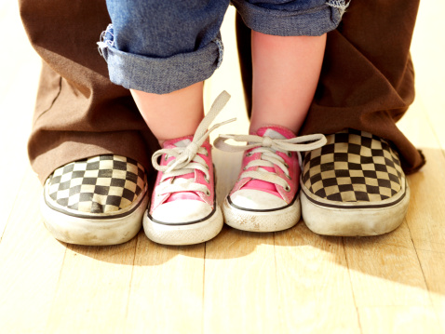
Trotting Out the Toddler
Identify the argument used to justify abortion.
Ask if this would justify killing toddlers
If it doesn’t, then they are assuming the unborn is
not a human.
Step 1
Step 2
Step 3

