Slide 1
Worship OT Gifts and Sacrifices and the Christian Life

Slide 2
John 5:39-40 You diligently study the Scriptures because you think that by them you possess eternal life. These are the Scriptures that testify about me, yet you refuse to come to me to have life.
Old Testament like a play….

Slide 3
Foreshadow: An object, event, person or situation which stands for something similar, but of greater significance in the future.
Prefigure: A specific thing which stands for another specific thing similar to it in the future.
Type and Antitype: A person or thing regarded as the symbol of someone or something which is yet to appear

Slide 4
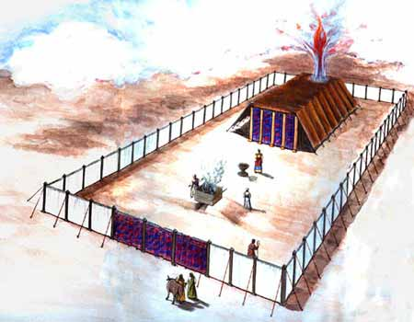
Model of The Jewish Tabernacle
Hebrews 8:1-6

Slide 5
Sacrificial Type and Antitype
Old Testament Sacrifice
New Testament fulfillment
Scriptures
Sweet Savor Sacrifices
The Burnt Offering
Jesus’ and our devotion to God
Ephesians 5:1,2 Romans 12:1,2
The Grain Offering
Giving back to God
Matthew 6:19-21
Romans 8,9
The Drink Offering
Pouring out our life for God
Luke 22:20 Philippians 2:16
The Fellowship Offering
Celebrating blessings from God
John 10:10
1 Thess 5:16
Blood Sacrifices
The Sin Offering
Jesus’ sacrifice for our sins
1 Peter 1:18,19
2 Cor 5:21
The Guilt Offering
Maintaining a relationship with one another
Matthew 5:23,24

Slide 6
Gifts/Offerings/Sweet Smelling Sacrifices
The Burnt Offering olah Leviticus 1
The Grain Offering minchah Leviticus 2
The Drink Offering nesek Leviticus 23
The Fellowship Offering shelem Lev 3

Slide 7
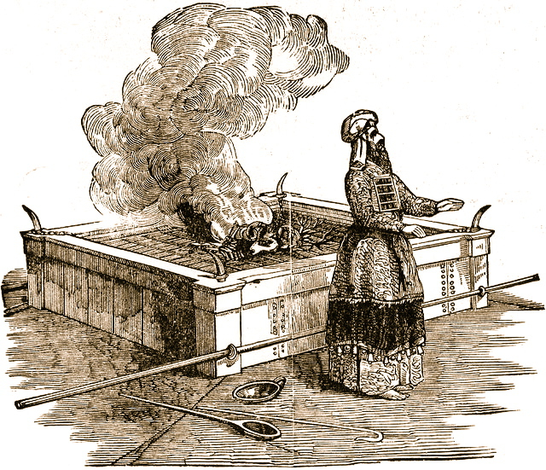
The Burnt Offering Leviticus 1
Lay hands on the animal.
Sacrifice the animal
Clean the body but not the head
Burn them on the altar
Meaning: Total commitment of one’s life to God.

Slide 8
The Burnt Offering
Jesus gave a burnt offering: Ephesians 5:1-2
God calls us to give a burnt offering. Romans 12:1-2 … in view of God’s mercy. Phil 1:20-22
Isaiah 6:8 Here am I, send me
What will you lay on the altar?

Slide 9
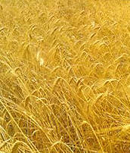
The Grain Offering
Give the FIRST FRUITS of what God has blessed you with.
NOT voluntary.
Grain = hard work
Oil = joy
Incense = prayer
Salt = eternal blessings, “treasures in heaven”
No yeast!!! 1 Cor 5:6-8 (or honey)

Slide 10
The Grain Offering
Application: Our contribution to God 2 Cor 8,9
For us, 10% is not mandatory, but giving sacrificially is.
Malachi 3:7-10
Matthew 5:20

Slide 11
The Drink Offering
Drink Poured out on the altar.
Application: Pouring out our life on the altar.
Usually given with the grain offering.
Application: We give our tithe, but God wants much more. He wants us to be “all in.”

Slide 12
The Drink Offering
Jesus gave a drink offering Luke 22:20
Paul gave a drink offering Phil 2:16-17 2 Tim 4:6,7
Haggai 1:3 What are you saving for?
1 Tim 6:6-10 Are you content?
The greatest joy comes from giving a drink offering.

Slide 13
The Fellowship Offering
Party Time!!!!! Celebrate the blessings of God.
Voluntary
Vow Offering Leviticus 11:16
Blessings hoped for Future
Thank Offering Leviticus 7:11-15
Blessings already received. Past
Free Will Offering Leviticus 22:23
Thankful for blessings in general Present

Slide 14
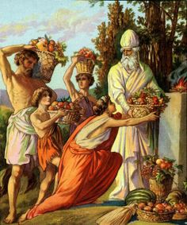
The Fellowship Offering
Application I Thess 5:16-18
Rejoice always (free will offering)
Pray continually (vow offering)
Give thanks in all circumstances (thank offering)
Placed on top of the burnt offering

Slide 15
Blood Sacrifices
The Sin Offering chatat Leviticus 4
For sins against God
The Guilt Offering asham Leviticus 5
For offenses against a fellow Jew
Hebrews 9:13-14
No sacrifice for willful sin! Lev 4:13-14 (Heb 10:26)

Slide 16
A Better Sacrifice Hebrews 9:23 It was necessary, then, for the copies of the heavenly things to be purified with these sacrifices, but the heavenly things with better sacrifices than these
The lesser sacrifice: Bulls, goats, red heifer | The greater sacrifice: Jesus
Outward (appearance) | Inward (reality)
Temporary, repeated many times | Eternal, done only once
Ceremonial | Real
Not voluntary | Voluntary

Slide 17
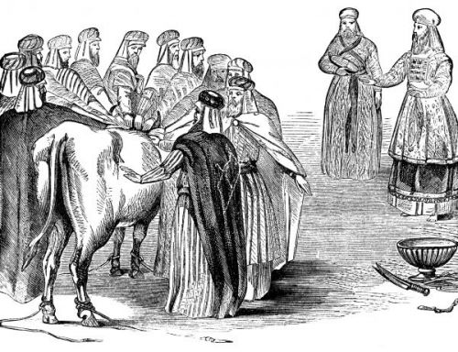
The Sin Offering Lev 4:1-5:13
Unblemished bull or goat (like Jesus)
Offender laid their hands on the animal (God put our sins on Jesus on the cross) Isaiah 53:6

Slide 18
The Sin Offering (cont.)
Offender killed the animal. (We killed Jesus) Matt 27:25
Blood sprinkled on the altar, as well as on the curtain.
Body burned outside the camp (like Jesus) Heb 13:11-13

Slide 19
The Guilt Offering Lev 5:14-6:7
Only for offenses of individuals, not groups.
Offender must make restitution first before bringing the sacrifice. (Matthew 5:23-24)
Is 53:10 Jesus offered himself as a guilt offering.
But….
God wants us to be confident Heb 10:19-22

