Slide 1
In Christ
Baptism in the New Testament

Slide 2
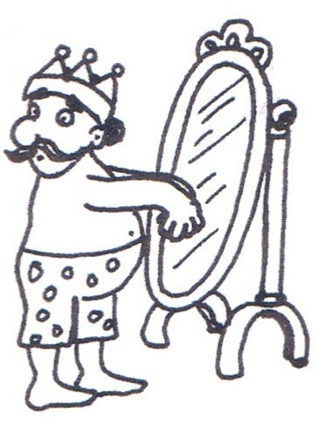
Matthew 22:1-14
Wearing the wrong clothes

Slide 3
A Question for Thought:
What is the most common phrase in the New Testament to describe a saved person?

Slide 4
A Question for Thought:
What is the most common phrase in the New Testament to describe a saved person?
In Christ
2 Cor 5:17, Eph 1:13, Eph 2:13, 1 Pet 5:14, many more.

Slide 5
Another Question:
How does one get into Christ?

Slide 6
Another Question:
How does one get into Christ?
Answer: Baptism!!!
Nothing else in the entire NT is connected with getting into Christ except baptism.
Pray into Christ?
Believe into Christ?
Repent into Christ?

Slide 7
In Christ
Romans 6:1-7
The man had not been buried with Christ.
The man had not been united with Christ in his resurrection.
The man had not been freed from sin.

Slide 8
A Trick Question:
Are we saved by baptism?

Slide 9
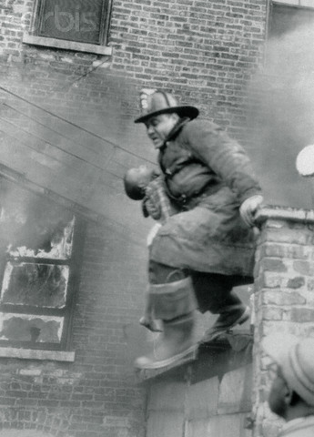
A Trick Question:
Are we saved by baptism?
Answer: yes and no
1 Peter 3:21-22
Illustration: A child in a burning building.

Slide 10
An Easy Question:
Is baptism how we are saved?

Slide 11
An Easy Question:
Is baptism how we are saved?
NO!!!!!
Romans 3:21-16 …through faith in his blood.
Rev 7:13-14 Clothes washed in the blood of the lamb

Slide 12
So What Is Baptism. Biblically?
It is when we are saved. It is when we get into Christ.
Illustration: Marriage
What if you weren’t married?
What if you weren’t baptized?

Slide 13
Acts 22:6-16
When were Paul’s clothes washed?
When he believed? v. 8
When he repented? v. 9
When he declared Jesus Lord? v.10
When he obeyed? v. 11
When he was baptized!

Slide 14
Who Is the Man at the Banquet?
He is anyone who thinks they are saved but are not.
He is 90+% of everyone we meet!!!!

Slide 15
What Should We Do?
What would you do if there were some people in a burning building?
We can’t be sentimental about this.

Slide 16
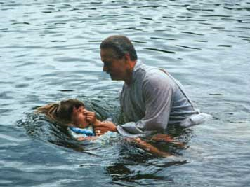
Why does it matter?
Essential vs important vs unimportant doctrines.
Any teaching relevant to salvation is, by definition an essential teachin.

Slide 17
A Brief History of Baptism
In the Book of Acts
Church Fathers
Catholicism
Reformation
The Sinner’s Prayer

Slide 18
Conversion Accounts in Acts
X = stated * = implied
Scripture | Faith | Repent | Baptized | Forgiven | H Spirit | Church
Acts 2:36-41 | * | X | X | X | X | *
Acts 8:9-13 | X |  | X |  |  | *
Acts 8:26-39 | * |  | X | * | *
Acts 9:1-19 | * | * | X |  | X | *
Acts 10:1-11:18 | * | X | X |  |  | *
Acts16:13-15 | * |  | X |  |  | *
Acts 16:25-34 | X |  | X | X |  | *
Acts 22:5-16 | X |  | X | X

Slide 19
A Ridiculously Brief History of Baptism
Epistle of Barnabas AD 110
We indeed descend into the water full of sins and defilement. However, we come up, bearing fruit in our heart…
Shepherd of Hermas AD 95
The seal, then, is the water. They descend into the water dead, and they arise alive.
Irenaeus of Lyon AD 185
This class of men have been instigated by Satan to denial of that baptism which is regeneration to God. Thus they have renounced the whole faith.
Tertullian of Carthage AD 205
Without baptism salvation is attainable by no one.

Slide 20
History of Baptism (cont.)
2nd Century: Catachumens Prescribed fasting, christening with oil, wait 6 months, etc.
Mid 4th century infant baptism practiced by some, but not generally accepted (Cyprian)
Late 4th century infant baptism encouraged (Augustine)
Augustine made baptism more than it was (a sacrament with power in and of itself, not requiring faith on the part of the believer)
After AD 1000 sprinkling became a common practice

Slide 21
History of Baptism (cont.)
1500’s Luther, Zwingli and Calvin reject the Catholic idea of sacrament. Faith alone salvation. (James 2:14f)
Result: Baptism not absolutely necessary?
1800’s Happy Predestination and the sinner’s prayer. Salvation became completely disconnected from baptism.

Slide 22
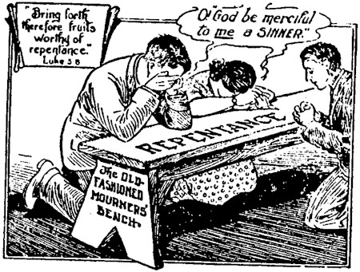
The Sinner’s Prayer
Mourner’s seat 1740
Charles Finney 1835-1875
Billy Sunday early 1900s
Billy Graham 1950s
Billy Bright 1950s The Sinner’s Prayer

Slide 23
The Sinner’s Prayer
Never mentioned anywhere before the 19th century in the US.
Even evangelicals will admit that this was not taught in the early church..
Evangelicals as slowly coming around on the Sinner’s prayer (Francis Chan, etc.)

Slide 24
Defense of the Sinner’s Prayer
Thief on the cross.
Revelation 3:
John 3:16

Slide 25
The Thief on the Cross
Today you will be with me in paradise.
Is Paradise heaven?
Did he receive the Holy Spirit?
Was he saved in the NT sense?

Slide 26
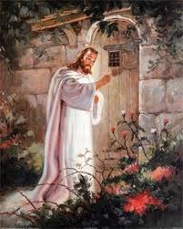
Revelation 3:20
Q: Who is Jesus speaking to?
Q: What is he talking about?
Q: Is this passage relevant to how one is saved?

Slide 27
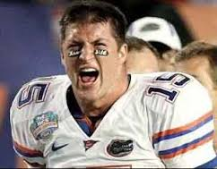
John 3:16
Whoever believes in me will inherit eternal life.
What is the definition of belief? Faith only?
Eph 2:8-10 …not by works
Amen!
Is baptism a work?

Slide 28
Is Baptism a work of man?
Is belief a work? John 6:29 Yes, sort of.
Is repentance a work? Yes
Is confession a work? Yes, sort of.
Is baptism a work? No

Slide 29
What kind of faith saves us?
Faith alone?
James 2:14-26 Apparently not.
James 2:26 Faith without deeds is dead.
Clearly, faith that is without deeds is not the kind of faith that will “save” us.

