Slide 1
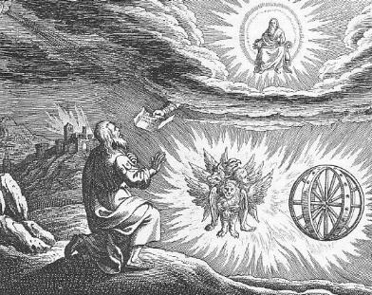
Prophets of the exile
Dr. John Oakes
APLA Jan, 2014

Slide 2
Prophets of the Exile
Jeremiah 627-585 BC
Lamentations
Ezekiel 593-570 BC
Daniel 605-535 BC

Slide 3
Ezekiel: Resources
The Book of Ezekiel Jim McGuiggan Montex Publishers
Ezekiel Iain M. Duguid The NIV Application Commentary

Slide 4
Historical Background
Josiah 640-609
Jehoahaz 608 (3 months, then replaced by Pharaoh)
Jehoiakim 608-597
Jehoiachin 597 (3 months, then into exile, when Ezekiel also was taken into exile)
Zedekiah 597-586
Gedaliah killed by Ishmael 585

Slide 5
Ezekiel’s Place in History

Slide 6
Themes in Ezekiel
1. The Sovereignty/glory of God
2. The utter sinfulness of humanity/Judah
3. The inescapability of God’s justice
a. Theodicy: Free will
4. The Messiah is coming/ The restoration of God’s Remnant.

Slide 7
Motifs in ezekiel
Captivity Motif
Exile Motif
Restoration Motif

Slide 8
Ezekiel Canonical?
Slight difference between the sacrifice legislated in Ezekiel and in Leviticus. Hananiah ben Hezekiah “burned 300 barrels of oil in his lamp in search for a reconciliation between the laws. He succeeded and Ezekiel was declared part of the canon.

Slide 9
More Background
Deuteronomy 28&29 Promised blessings and curses
It goes back to Genesis Ch 1-4 God sends us back into to the world to be disciplined by the world.
Books about victory and conquest (Joshua, Exodus, Nehemiah, 1,2 Samuel) vs Books about judgment, defeat and exile (Jeremiah, Ezekiel)
We, like Ezekiel, live as exiles and foreigners. We establish a “Judean enclave” – to be countercultural.

Slide 10
Ezekiel Outline
I. Ezek Ch 1-24 Jerusalem must fall. 592-586 BC
II. Ezek Ch 25-32 Judah’s enemies must fall as well.
III. Ezek Ch 33 Bridge from Ch 24 to Ch 34
IV. Ezek Ch 34-48 Jerusalem must be comforted. The Messiah will come and save a remnant. 585-570 BC

Slide 11
Detailed Outline I. Jerusalem Must Fall
Ch 1-3 Vision and Commission of Ezekiel
Ch 4 Ezekiel acts out the destruction of Jerusalem
Ch 5 A haircut and its meaning
Ch 6-7 Idolatry of Judah
Ch 8-11 The necessity of the destruction of Jerusalem and Judah
Ch 12 Signs and warning of judgment
Ch 13 False prophets
Ch 14 God, the righteous judge
Ch 15 The parable of the useless vine
Ch 16 Shameful history

Slide 12
Detailed Outline (cont.) Judah Must Be Destroyed
Ch 17 Parable of the two eagles
Ch 18 Individual righteousness
Ch 19 Parable of the lion and of the vine
Ch 20 A record of rebellion
Ch 21 Babylon, the sword of God
Ch 22 Corruption of God’s people
Ch 23 Ohola and Oholibah
Ch 24 The cauldron. Ezekiel refuses to mourn.

Slide 13
Detailed Outline (cont.)
II Ch 25-32 The End of the Road for Judah’s enemies
Ch 25 Ammon
Ch 26-28 Tyre
Ch 28 Sidon
Ch 29-32 Egypt
III Ch 33 Transition: The Watchman, Jerusalem has been destroyed

Slide 14
Detailed Outline (cont.) Jerusalem Must Be comforted
Ch 34 A better shepherd
Ch 35 Edom judged
Ch 36 The mountain of the Lord
Ch 37 Valley of dry bones
Ch 38-39 God and Magog—the enemies of God’s people—destroyed. God’s people saved.
Ch 40-48 The temple rebuilt Restoration of the remnant

Slide 15
Ezekiel 1
1:1 5th year of Jehoiachin’s exile 592 BC
Ezekiel “among the captives”
10,000 captives—the cream of the crop (2 Kings 24:14 Jer 24:1-10)
Ezek 1:4-28 Ezekiel sees the glory of God
On the throne, surrounded by the cherubim (Rev 4:6f).
The cherubim are the ones who guard God’s holiness

Slide 16
Ezekiel’s vision
1:4 cloud, flash of lightening (also fire in v. 13) = judgment From the North = Babylon
v. 5 four living creatures = cherubim Rev 4:6b-8 Identified as such in Ezek 10:1
v. 10 four faces man, lion, ox (Hebrew could be bull), eagle (Rev 4 lion, ox, eagle, man)
v. 12, 17 move God’s judgment coming like a chariot
v. 15-18 Wheels in wheels, with eyes all over = searching to protect God’s holiness (the version in Ezek 10:12, Rev 4:6 has eyes all over).
v. 22-28 The throne of God.
v. 28 rainbow = hope (hope recalls Lam 3:22-23)

Slide 17
Ezekiel 2 & 3 Ezekiel Commissioned
Ezek 2:1-7 Ezekiel’s mission
v. 4 say to them: this is what the Lord says.
2:1 “Son of man” (ben-adam) stresses his humanness
v. 4 Ezekiel needs to be obstinate and stubborn. Why? Because the people are obstinate and stubborn.

Slide 18
Why Do the Captives Continue to be stubborn?
Holding out hope. Jerusalem has not yet been destroyed.
False prophecies Jer 28:1-4 Jer 29:15-23
2 Chron 7: (v. 16 for example, but ignoring 7:13-14)
Psalm 89. (v. 3-4, 26-29 for example)
Itching ears 2 Tim 4:3-4
Trusting in the temple, rather than the God of the temple. (Jeremiah 7:4).
Being told “peace, peace.” (Jer 6:13-14, 8:11-12)

Slide 19
Ezekiel’s Commission (cont.)
Ezek 2:5 Whether they listen or fail to listen….
v. 5 They knew a prophet had been among them….
Ezek 2:8-3:3 Ezekiel eats the scroll. To be God’s prophet we must:
1. Have a personal encounter with God (1:4f)
2. Digest his Words (Jeremiah 15:16, Rev 10:9-11)
Ezek 3:4-9 They have heard it all before. They are very religious.
3:8 God’s solution: We need to be as hard and stubborn as they are.

Slide 20
Ezekiel: The Watchman of Israel
Ezekiel 3:16-21 Ezekiel a watchman
Hosea 9:8 A lookout
God to Ezekiel: Start prophesying
Q: Are you willing to be God’s watchman?
Eph 2:1-3 and Eph 2:4-10.
v. 20 Does God put stumbling blocks in front of people? Yes, he does. 2 Thess 2:11

Slide 21
Ezekiel 4 & 5 Dramatic symbolism
Ezek 4:1-3 Ezekiel acts out the siege of Jerusalem (588-586 BC)
a. Draws the city
b. Siege works: Babylon
c. Iron pan God is against Jerusalem and will not hear
their prayers
4:4-7 430 Days = 430 years = symbolically, length of captivity in Egypt
390 days for sin of Ephraim/Samaria/Northern Kingdom
40 days = 40 years of suffering for lack of faith (Heb 3:7- . . 4:2 (Numbers 14:26-35)
v. 4 “bear their sin” = bear the consequences
4:9-11 mixing and weighing grain = shortage of food during siege.
4:12 cook over human dung = unclean during exile.

Slide 22
Ezekiel 5 Ezekiel gets a haircut
A haircut: The point: From those to whom much has been given, much will be expected.
Cutting off hair and beard a big deal for Jews.
v. 2 fire, sword and exile
v. 3 The remnant motif (but even some of them will suffer v. 4)
v. 5 I have set you in the center of the nations. Great responsibility.
v. 12 Judgment on Judah! (as prophesied Deut 28:53-57)
v. 13 Comfort

Slide 23
Ezekiel 6 & 7 Judgment on Judah (and a ray of hope)
v. 2 Judgment on the Mountains, not just on Jerusalem.
v. 8 But a remnant will be saved. (because they “loathe themselves for the evil they have done)
v. 10 An ominous passage. “And you will know that I am the Lord” 72 times in Ezekiel.
Jeremiah 7 The end has come. Too late to repent (Heb 6:4-6)
This is “the day of the Lord” 26 times in OT (Is 2:12-22, Is 13:6-13, Is 34:4,8-10, Jer 46:10, Joel 1:15, 2:11-17, 2:28-31, 3:9-14*, etc.)
Ezek 7:4,9 We can reach the point that God shows no pity. Amos 5:24 Let justice roll on like a river.
v. 5 disaster! v. 7 doom!!!

Slide 24
Ezekiel 7 Cursed Money
Ezekiel 7:19-22 They will throw their silver into the streets. On the Day of Judgment, what the world holds to be valuable will be abominable.
Things you can buy Things you cannot buy
Medicine health
Books knowledge of God, wisdom
Position favor with God
Attention love

Slide 25
Ezekiel Ch 8-11 Necessity of destruction of Judah
Ezekiel 8:1 6th year 6th month now 31 years old.
Speaking to the elders. v. 3 by the hair of my head. Ezekiel reluctant to prophesy.
8:3 “idol of jealousy” A statue to Ashtoreth?
8:4 Note: God still occupies the temple. But…
8:6 Detestable things (Heb 10:26-31)
8:7-13 Hidden idols
8:14 Women
8:15 priests
8:18 even if they shout their prayers….

Slide 26
Ezekiel 9
9:1 Executioners from North (Babylon?).
9:2 Put a mark on the foreheads of those who grieve and lament. Rev 7:1-17 Mark = protect from eternal judgment. (note: not protected from temporal judgment Ezek 21:3-4)
For us, the mark is the Holy Spirit Eph 1:13-14.
9:6 Begin with my sanctuary. Judgment begins with the leaders.

Slide 27
Ezekiel and Theodicy
Ezekiel emphasized both judgment and grace.
Ezek 9:1-6 Righteous are sealed from spiritual destruction
Ezek 21:3-4 But righteous are not necessarily protected from the physical results of sin.
Exodus 34:6 is worked out in Ezekiel (Ezek 18:20, Jer 31:30)
But
Exodus 34:7 and Deut 5:9-10 are as well.
When God shows patience (which he does massively), it is tempting to doubt his willingness to judge, but when God finally comes in judgment, it can cause us to doubt his mercy.

Slide 28
Ezekiel 9 (cont.)
Ezek 9:5 Kill without pity or compassion. Whew!
9:6 Begin at my sanctuary (1 Pet 4:17)
9:9-10 They brought this on themselves
9:11 It (God’s wrath) is accomplished!

Slide 29
Ezekiel 10,11 Necessity of Judgment
Ezek 10:1 God on a sapphire (blue, royal) throne with his cherubim protecting his holiness.
Ezek 10:2-8 The one who showed mercy in Ezek 9 is now exacting judgment.
Ezek 10:9-17 Cherubim redescribed
Ezek 10:18 A momentous event. The Lord departs from the temple in Jerusalem. Judgment is around the corner. Jerusalem is doomed.

Slide 30
Ezekiel 11 Judgment on the Leaders of Judah
Remember, this is being said to the elders.
Their sin? Ezek 11:3 They say “peace, peace” when there is no peace.
Ezek 11:15 Peace, peace.
Ezek 11:7-11 The leaders will be killed outside Jerusalem. This is exactly what happened. 2 Kings 25:1-7
Ezek 11:18-19 A hopeful promise for those of the remnant. (parallel: Ezek 36:24-30)
11:23 The end of the road (so much for the P in TULIP)
God goes to Mt. of Olives. An interesting foreshadow.
11:24-25 Ezekiel has an unenviable job: tell the leaders.

Slide 31
Ezekiel 12 Acting out the destruction of Jerusalem
12:3 Son of man, pack your bags… A visual prophecy. Hopefully we, like Ezekiel, have packed our bags (Heb 11:13f)
12:5-10 A prophecy about Zedekiah. Dig through wall (v. 5) Cover your face (v. 6) At night (v. 7). Zedekiah (v. 10-14)
All fulfilled in detail. Jeremiah 52:4-11, 2 Kings 25:1-7 Ezekiel is a prophet!
12:16 But I will spare a remnant.
12:17-20 A second visual prophecy. Trembling.
12:21, 27 Every vision fails, It is the distant future. Don’t worry, be happy. (2 Peter 3:3-7).
12:28 God replies: No more delay!

Slide 32
Ezekiel 13 False Prophets Condemned
Ezek 13:10 False prophet’s message: Peace, peace. Flimsy walls against sin.
Ezek13:11 When I come, your whitewashed walls will be revealed for what they are!
Ezek13:15-16 Let us not be like them!
13:17f Prophetesses as well.
13:22 They dishearten the righteous and give heart to the unrighteous.

Slide 33
Ezekiel 14 Idols in the heart
Ezek 14:2 Elders have outward but not inward righteousness.
Ezek 14:3,4,7 Stumbling blocks before their faces. Looking at worldly things (entertainment, pornography, materialism)
14:9-11 God allows false prophets to test our hearts and as a lesson. (Deut 13:1-5)
14:13-14 I have decided. Even Noah, Daniel and Job could not change my mind! (parallel: Jer 15:1-2)
14:22-23 Ezekiel consoled. God is compassionate but not sentimental.

Slide 34
Ezekiel 15 The useless vine
What good is a vine if it bears no fruit?
Even less the trimmings of the vine. Their only use is as fuel for the fire.
Ezek 15:7 Even if the people have emerged from the fire (605, 597 BC), they will still be consumed by fire.

Slide 35
Ezekiel 16 Shameful history
Ezek 16:1 What to do about sin? Confront it!
16:2-5 You were the lowest of the low.
16:6-7 Yet I chose you.
16:8-14 I even entered an intimate relationship with you (Mosaic covenant).
16:15-34 But you trusted in self and made yourself a prostitute with Egypt, Philistia, Assyria and Babylon.
16:35-41 Therefore you will be destroyed.
16:43 The antidote: Remember the days of your youth.
16:60-62 Great news!!! I will remember the first covenant and will make a new covenant with you. (Hosea Ch 3, Jeremiah 31:31)

Slide 36
Ezekiel 17 Parable of two eagles
The two eagles are Babylon and Egypt. Message: Do not rely on the world for security. Do not make alliances with the world.
Ezek 17:2-4 Nebuchadnezzar takes a topmost shoot: Jehoiachin (597 BC) “Lebanon” = Israel (Jer 22:23) “Lebanon” = palace of Lebanese cedar.
17:5-6 A low-spreading vine: The Jews, although powerless, could flourish if they accept discipline and serve Nebuchadnezzar.
17:7-8 But Judah relied on the less powerful eagle: Egypt
17:9-10 This is a big mistake. 17:11-21 Parable interpreted.

Slide 37
Ezek 17 cont. God’s remnant
Ezek 17:22-24 But I (God) will plant a shoot—a remnant—on a high mountain. I will make it flourish.
A double prophecy of the kingdom: Restored Israel and the Church.
Amos 9:14, Isaiah 53:2 Isaiah 11:1-11 (esp. 10-11)

Slide 38
Ezekiel 18 Individual Righteousness
Ezek 18:2 A bogus proverb: Sour grapes.
The exiles: It is not our fault. Blame it on our fathers!
God: Wrong! Everyone is accountable for their own actions. So much for predestination/Original sin.
Ezek 18:4 All souls are mine. All can be saved (Rom 8:28-30)
Ezek 18:5-18 God’s justice. (does this contradict Exodus 20:4?)

Slide 39
Ezek 18 (cont) individual righteousness
Ezek 18:20 (for emphasis) God repeats himself.
Ezek 18:21-24 Our final state determines our eternal destiny (but be aware of Hebrews 6:4-6 and 2 Peter 2:20-22)
18:22 For the righteous: None of his offenses will be remembered
18:24 For the unrighteous: None of his good deeds will be remembered.
18:25-29 Godly vs human justice. (Matthew 20:1-16 exp. v. 14)
18:30 Here is the bottom line for us: Each will be judged according to his own ways.
18:32 The bottom line for God. He wants all to be saved. 1 Tim 2:4 The T and the P in TULIP are a lie.

Slide 40
Ezekiel 19 Parables of the lion and the vine
The message of both parables: Do not trust in the fact that you have kings from the line of David. Neither Zedekiah not Jehoiachin will be your saviour.
Ezek 19:1-9 The lioness is the royal line, descended from David.
19:3-4 The young lion is Jehoahaz. Neco took him to Egypt.
19:5-9 The second young lion is Jehoiachin. Nebuchadnezzar took him to Babylon.
Message: Do not trust in the lioness. God will judge the sinful nation.
Ezek 19:10-14 Same message. The mother vine is David’s line. Powerful branches/rods are strong kings of Judah. They will not save you.

Slide 41
Ezekiel 20 More shameful history
590 BC Elders come to Ezekiel for comfort. They will not get much of that (but there is a ray of hope)
20:2-29 You have always rebelled. Similar to Acts 7:9-53. The history you are so proud of is one long story of rebellion, sin and idolatry.
God wants to be glorified in and by the church, but if we are unfaithful and unrighteous, he will oppose us and take away our lampstand.
20:39-44 Even now, there is hope, but not for this generation (afterward, v. 39). Like the first generation in the wildernes under Moses. A dual prophecy of Zerubbabel and Jesus Christ.

Slide 42
Ezekiel 20:45-21:32 Babylon the sword of god
Ezek 20:45 God to Nebuchadnezzar: …set your face toward the south. Judah and Jerusalem.
Ezek 21:1 Just in case it is not clear, we are talking about Jerusalem.
21:3-4 Both the righteous and the unrighteous will be carried off. (Isaiah 57:1)
21:10 “The sword despises every such stick” Both the high and the low in Judah will be treated equally.
21:18-24 A signpost. The lot (of judgment) will fall on Jerusalem, not Rabbah/the Ammonites.

Slide 43
Ezekiel 21:26-27 God turns things upside down
Both the monarchy (the crown) and the priesthood (the turban) will suffer mortal blows.
When the Messiah comes—a new priest and a new king—the lowly will be exalted and the exalted will be brought low. Matthew 23:11
What the world thinks will save us will be our destruction. What the world despises will be our salvation.
21:28-32 Do not gloat, Ammon!

Slide 44
Ezekiel 22 Shameful Judah part III
Ezekiel 16 and 20 were primarily about the sins of their fathers. Ezekiel 22 is about their current shameful idolatry.
Ezek 22:3-5 Doom!
Ezek 22:6-12 A list of their sins. Note: many of these are social injustice.
22:15f The result: You will be scattered. Sin creates loneliness, aimlessness, purposelessness, separation, humiliation and desperation.
22:25-28 God calls out the leaders for their sin.

Slide 45
Ezekiel 23 Oholah and oholibah
Oholah (Heb: her tent) is Samaria/Ephraim/Northern Kingdom
Oholibah (Heb: my tent is in her) is Jerusalem/Judah
This chapter is R-rated. It is shocking on purpose.
Message: God will give us over to our lusts if we live by sight, not by faith (Romans 1:24-28)
Ezek 23:5-10 Oholah prostituted herself with Egypt and Assyria.
Ezek 23:11-27 Oholibah was worse than her sister!
v. 20 This is disgusting! Sin is disgusting. Their mistake: They were not satisfied with God. 1 Tim 6:8 Are you satisfied with what God has for you?

Slide 46
Oholah and Oholibah cont.
Ezek 23:22 The take-home lesson: I will give you over to what you give yourself to.
Ezek 23:25 God: I am jealous. Amazingly, God still loves Samaria and Judah. This is the story of Hosea. Romans 5:8 While we were still sinners, Christ died for us.
Ezek 23:28 I will give you over to the very thing you hate. This is what sin does. John 10:10 The thief comes to steal and kill and destroy. Jesus came that we can have life.
Summary: 23:49 Then you will know that I AM the Lord.

Slide 47
Ezekiel 24 The cauldron Ezekiel refuses to mourn
Jan 588 BC A date to mark down. The date Jerusalem was put under siege. Again, Ezekiel proves himself to be a prophet.
Ezek 24:6 A cauldron with encrusted layers of unrepented sin. Judah. 24:12 A heavy deposit.
Ezek 24:11,13 When God’s wrath is poured out, it will get hot enough to burn off the encrusted layers.
24:14 I will not have pity (as illustrated later in Ezek 24:15-24)
24:15-24 God to Ezekiel: Do not mourn when your wife dies. I will take away the delight of your eyes. How does God feel about judging Judah? Like Ezekiel feels about God taking away his wife.
The point: When we suffer discipline for our sins, we should accept it without complaint.

Slide 48
Part II The End of the road for god’s enemies Ch 25-32
Judgment may begin with God’s household (1 Pet 4:17-18), but those who oppose God’s people will get what is coming to them. Q: Do we rejoice when our enemies are judged? Rev 11:7-18, 16:5-6, Psalm 94:1-3. (but we should remember Romans 12:19)
Ezek 25 Ammon to be judged. She is the one who escaped judgment when Nebuchadnezzar came to the signpost.
Moab, Edom as well.

Slide 49
Old Testament Prophecies Fulfilled Between the Testaments
Ezekiel 26:3-14 Tyre.
v. 3 I will bring many nations against you
v. 4 I will scrape away her rubble and make her a bare rock. (Alexander did this)
v. 5 She will become a place to spread fishnets.
v. 6 Her settlements on the mainland will be ravaged by the sword.
v. 7 (specifically) Nebuchadnezzar will do this.
v. 12 They will… throw your stones, timber and rubble into the sea.
v. 14 It will never be rebuilt

Slide 50
Fulfillment of Ezekiel 26
Nebuchadnezzar takes mainland Tyre only after a siege of 13 years 586-573 BC
Alexander attacks Tyre in 332 BC, building a causeway to the island of Tyre using the rubble from Old Tyre.
Tyre attached again and again by Seleucids, Romans, Arabs, Crusaders, finally ceasing to exist as a city on the original site.

Slide 51
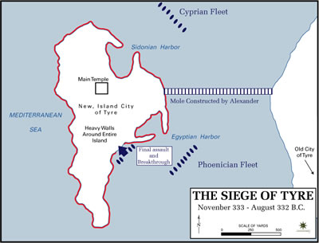

Slide 52
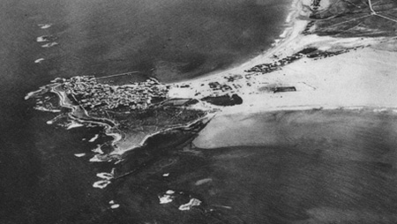
Site of Ancient Tyre Today

Slide 53
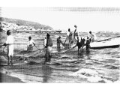
Tyre

Slide 54
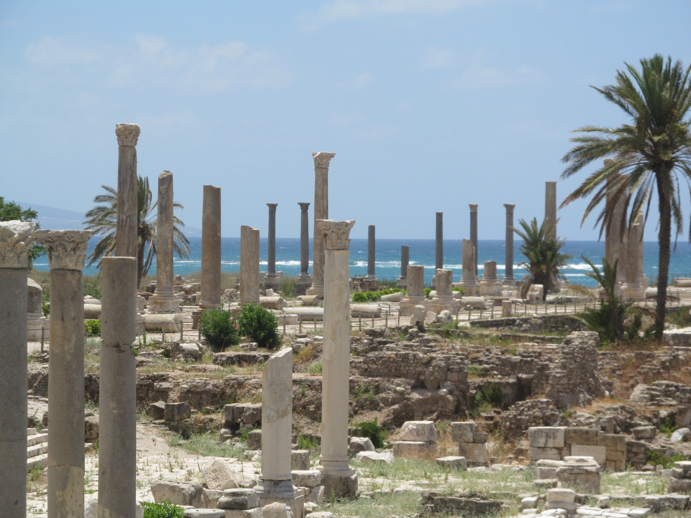

Slide 55
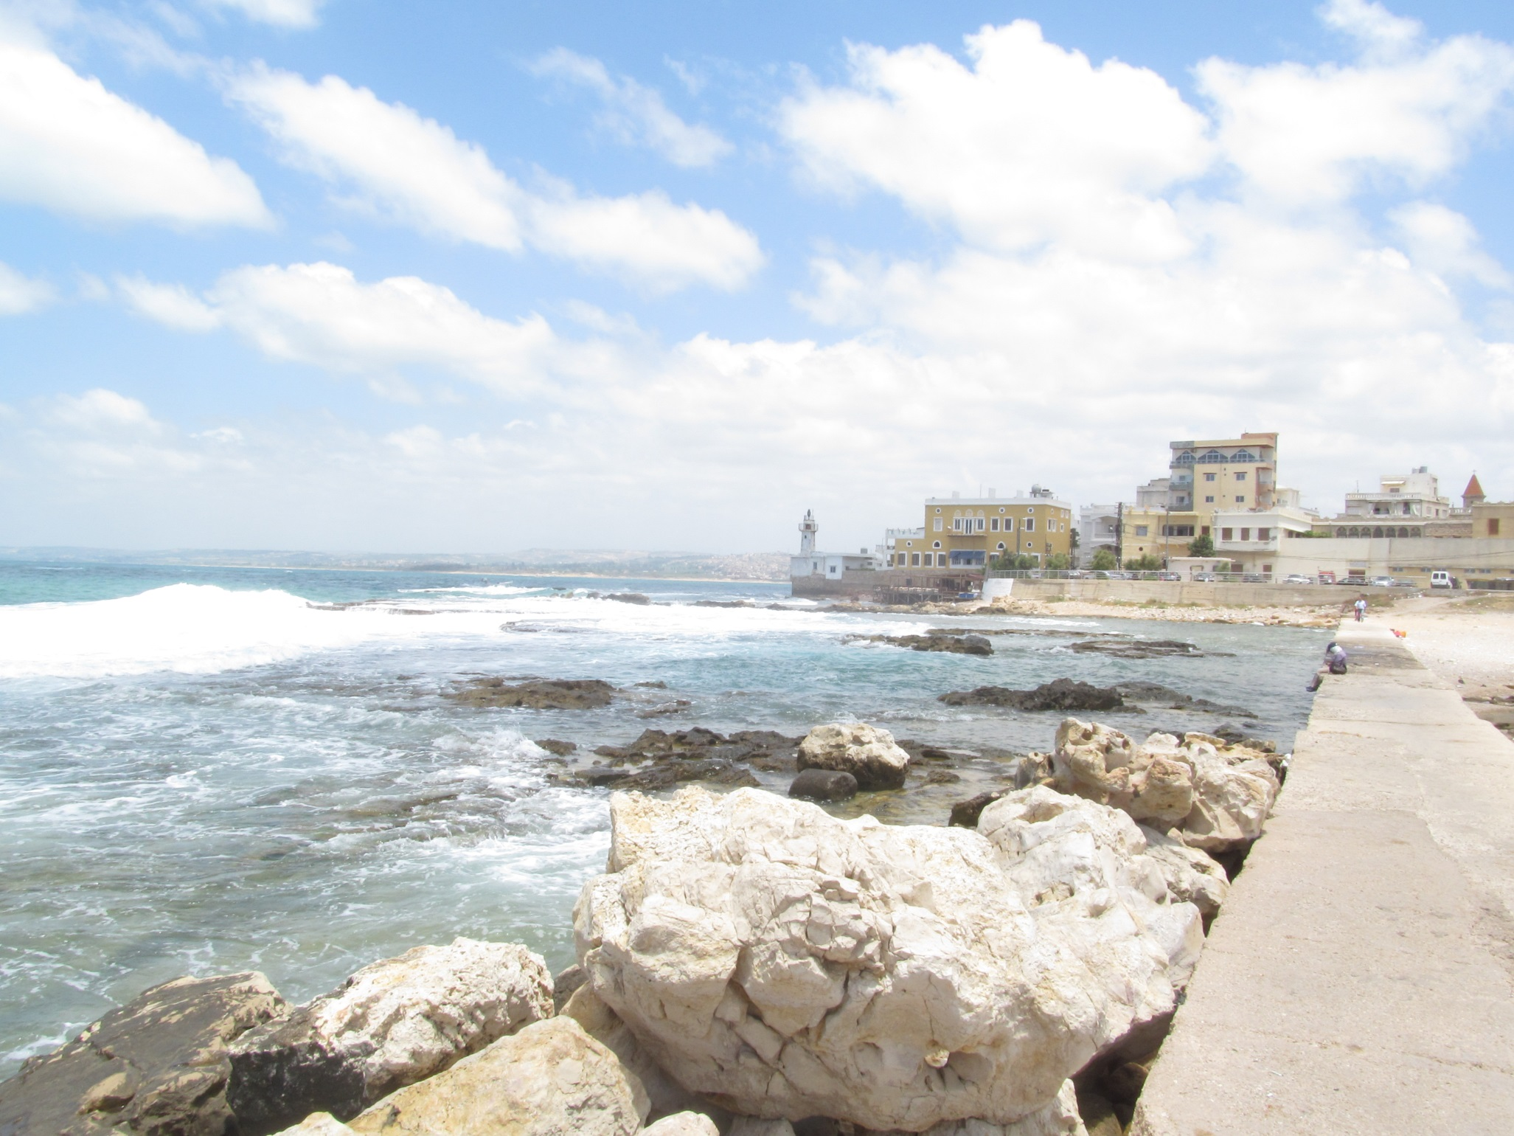

Slide 56
Secular historian Philip Myers in his history textbook:
“Alexander the Great reduced it [Tyre] to ruins. She recovered in a measure from this blow, but never regained the place she had previously held in the world. The larger part of the site of the once great city is no bare as the top of a rock—a place where the fishermen that still frequent the spot spread their nets to dry.”

Slide 57
Judgment on God’s enemies (cont.)
Ezekiel 28 Sidon
Ezekiel 29-32 Egypt
Ezekiel 35 Edom

Slide 58
Part III Ezekiel 33 Transition jerusalem has been destroyed
Ezekiel 33 is a transition from Ch 1-24 to Ch 34-48
God’s judgment has now been completed, so the message will turn from principally rebuke to principally encouragement. The Messiah is coming.
Ezek 33:1-6 The watchman of Israel. Ezekiel did his part.
Ezek 33:7-9 Ezekiel recommissioned.
Ezek 33:10 The people finally repented. Or did they…. “Our offenses and sins weigh us down and we are wasting away because of them.”
Sounds like they are whining! v. 12

Slide 59
Ezek 33 cont.
Ezek 33:11 Even when I judge you, I do it in the hopes that you will turn and live. Amazing that God justifies his judging to his people.
Ezek 33:12 God responds to their whining that it is too hard. “The wickedness of the wicked will not cause him to fall when he turns from it.”
33:13 But if you trust in your past righteousness.
33:17 More whining. “The way of the Lord is not just.” You are too hard. Rom 10:5 (Moses) and Rom 11:2f (Elijah) Rom 11:22f Consider God’s kindness and his sternness.

Slide 60
Ezekiel 33 Jerusalem has fallen
33:21 A key transitional moment in Ezekiel. A messenger arrives (as prophesied in Ezek 24:26). Jerusalem has fallen!!! Ezekiel is vindicated as a prophet.
33:22 Ezekiel begins to prophesy again (Ezek 24:27)
33:23-29 Ishmael (Jer 40, 41, 2 Kings 25:25-26) is saying peace, peace. v. Abraham was only one man. If he could do it….
33:30-33 Ezekiel now a popular prophet. Ezekiel not impressed
v. 31 They express devotion.
v. 32 Looking for entertainment. (one who sings a love song)
v. 33 A faithful watchman looks for true repentance.

Slide 61
IV ezekiel 34-48 Comfort for God’s people. The Messiah is coming!
The tone noticeably shifts in this part toward offering comfort, now that God’s wrath against his people has been completed.
There is much double prophecy in this section. Much of what God says through Ezekiel can be applied to the restored remnant which will return under Zerubbabel and Nehemiah, but it applies even more so to the messianic kingdom and the Church.

Slide 62
Ezekiel 34 The Messiah: A better shepherd
The job of a shepherd:
Ezek 34:2 To care for the flock, not for yourself.
Ezek 34:4 To care for the weak
Ezek 34:4 To bring back the strays.
Ezek 34:4 To bring in the lost.
God’s charge: You treated my sheep harshly. The result is the sheep are scattered.
Ezek 34:7-10 I will hold you accountable. I will remove you from leading my flock
34:11-22 I will shepherd the flock myself
v. 18-20 Even in the absence of good shepherds, the sheep have some responsibilities.

Slide 63
Ezek 34 The Good shepherd is coming
Ezek 34:23f God’s shepherd is coming. “My servant David.”
John 10:1-18 I am the good shepherd.
34:26 Showers of blessings
34:27 Much fruit, Security, Freedom (John 8:31f)
34:29 Spiritual food, the bread of life.

Slide 64
Ezekiel 36 The mountain of the lord
“The mountains of Israel” are God’s people personified.
Ezek 36:1-7 I will judge the nations who opposed you.
Ezek 36:8-15 My wrath is filled up and complete. Now I will bless you more even than before. (v.10,11)
Ezek 36:22 It is not for your sake that I do this. It is for my holy name. Deut 7:7-9.

Slide 65
Ezek 36 a new covenant
Ezek 36:24f A remnant devoted to God. A New Covenant.
v. 24 all nations
v. 25 cleansed by water
v. 26 a new heart and a new spirit
v. 27 receive the Holy Spirit
v. 29-30 blessings
v. 31 repentance
No wonder Jesus challenged Nicodemus he should have known
v. 32 not because you are awesome
v. 33 much fruit
v. 35 imagery from the Garden of Eden. The Kingdom of God

Slide 66
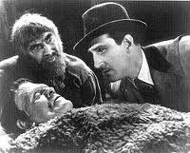
Ezekiel 37 the valley of dry bones
The promise of resurrection (on many levels and in many ways)
He’s Alive!

Slide 67
Ezek 37 The valley of dry bones
Ezek 37:2 The bones are “very dry” No hope!!! God specializes in this kind of situation.
Ezek 37:3 Son of man, can these bones live?
Q: Can your neighbor live? Can your marriage live? Can you spiritual life be revived?
37:4 The solution to spiritual death: “Dry bones, hear the word of the Lord.” Sometimes we need to preach to dry bones!
37:5 Revived by receiving the Holy Spirit. Zech 4:6 Rom 8:9-11
37:7-10 A bizarre vision!
37:11-14 Primary application is to Israel. God will bring them back to life in Canaan. (but it is a double prophecy)

Slide 68
Ezekiel 37 cont.
Ezek 37:15f Parable of two sticks: Judah and Ephraim
[aside: The two sticks are NOT the Bible and the Book of Mormon]
37:22f Messianic prophecy
I will make them one nation in the land
One king
I will save them
I will cleanse them
They will be my people (Hosea 1:10-11 Hosea 2:23 Hos 11:1)
My servant David will be king over them v. 24
A new covenant. v. 26
I will dwell (tabernacle) with them v. 26-27 John 1:14
This is about the Church but it is also about heaven—the Kingdom

Slide 69
Ezekiel 38-39 gog and magog
This is an idealized vision of enemies attacking God’s people and God defending them. The Jews need assurance that after God restores them to the Land, it will not happen all over again.
Jim McGuiggan: “Gog is a grand illustration of any and all who oppose God’s people.”
There is much parallel here with Revelation, especially Rev 20:7-10, in which an idealized powerful enemy of God attacks defenseless believers but the enemy is destroyed without “firing a shot.”
This applies to the restored remnant, but it is also messianic.

Slide 70
Ezekiel 38-39 gog and magog
38:1-4 I am against you Gog, prince of Magog
Meshech and Tubal tribes in Asia Minor. Herodotus
Gog and Magog have allies from Persia (east), Cush (south), Put (west) and Gomer and Togarmah (north) God’s people are surrounded!
v. 8 You will invade the Promised Land “gathered from many nations to the mountains of Israel”
v. 11 unwalled cities. God’s people living in security. No problem. God will destroy them without a shot.
v. 16 God is in control.

Slide 71
Gog and magog (cont.)
v. 19-23 Apocalyptic language against God’s enemies
39:1-4 Judgment on Gog and Magog: the enemies of God’s people.
v. 9-20 more apocalyptic language.
v. 25-29 This is what it is about. This vision is to encourage God’s people that he will protect them.

Slide 72
Apocalyptic literature
A wider scope than prophecy
Visual. A divine comic book
Need to know the historical setting to understand
Heavily symbolic
Other literature: Assume literal unless context says figurative
Apocalyptic: Assume figurative unless context says literal
Dramatic, vivid, forceful
Get the big picture—do not get caught up in the details

Slide 73
Ezekiel 40-48 The Temple rebuilt restoration of the remnant
The purpose of this section is to illustrate the Kingdom of God/God with his people. Do not get caught up in the details. It gives very precise instructions for building the restored temple.
Is it about restoration of the kingdom and temple in 516 BC? Yes
Is it about the church and the heavenly tabernacle? Yes
Is it about the ultimate embodiment of the tabernacle/Kingdom of God/Heaven? Yes.
Hebrews 8:3-6 “See to it that you make everything according to the pattern shown you on the mountain.” (or in Ezekiel 40-48).
Ultimately, it is about God’s holiness—his perfection.

Slide 74
Ezekiel 40-48
Ezek 40:1 The twenty-fifth year of the exile (572 BC)
Ezek 43:1 The glory of the Lord returns to the temple (after leaving it Ezekiel 8:6). He enters through the East Gate (as he had exited it through the East Gate).
43:10 Why all the details? “that they may be ashamed of their sins.”
44:2 The East gate is to stay shut (because only the holy can enter through the East gate.
46:1-3 Except on Sabbaths and New Moons.

Slide 75
Ezekiel 40-48 (cont.)
44:15f Only the Zadokites (also 43:19) can minister in the temple.
v. 23 teach difference between the holy and common.
v. 28 I am to be their only inheritance. They will have no possessions in the land.
Ezekiel 47 The river from the temple. (Revelation 22:1-5) God taking care of his people. Imagery from the Garden of Eden.
It comes from the temple—from God.
It cleanses (Zech 13:1)
It is living water (Zech 14:8, John 7:37-39)

Slide 76
Summary of Ezek 40-48 (and perhaps of the entire book of ezekiel)
Ezekiel 48:35 And the name of the city from that time on will be:
THE LORD IS THERE
We are back in the Garden if Eden—in the fully realized Kingdom of God, where God intended us to be all along.

Slide 77
Daniel, Prophet to the Nations
Is the Bible the inspired word of God?
Las Vegas Sept 9,10 2012

Slide 79
Theme of Daniel:
God Rules the Nations: Do Not Fear!
Message of Daniel:
Stay Righteous in an Unrighteous World
God is in Control!

Slide 80
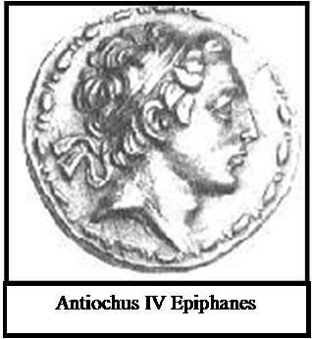
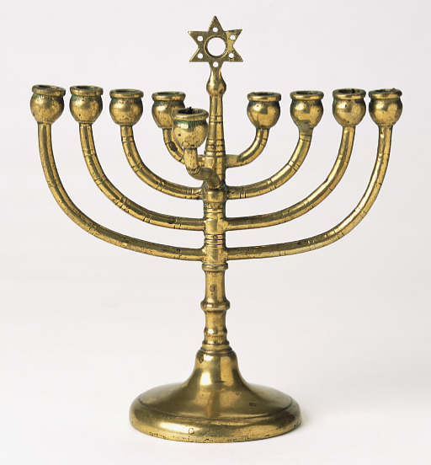
Principle Audience of Daniel
Jews suffering incredible persecution under Antiochus Epiphanes

Slide 81
Daniel is Unique Because…
Daniel ↔ O T like Revelation↔ N T
Apocalyptic
End Times (eschatology)
Written to a persecuted people
Daniel is the fighting ground for Bible skeptics
Daniel and angels
Set in a pagan nation
A prophet to the nations
A history book… of the future!

Slide 82
Sir Isaac Newton
The folly of Interpreters has been, to foretell times and things, by this Prophecy, as if God designed to make them Prophets. By this rashness they have not only exposed themselves, but brought the Prophecy also into contempt. The design of God was much otherwise. He gave this and the Prophecies of the Old Testaments, not to gratify men's curiosities by enabling them to foreknow things, but that after they were fulfilled they might be interpreted by the event; and his own Providence, not the Interpreters, be then manifested thereby to the world. For the event of things predicted many ages before, will then be a convincing argument that the world is governed by providence.[7]

Slide 83
Was Daniel Written about 150 BC?
Pro:
Greek words in the text?
A modern form of Aramaic?
The real reason…
Con:
Septuagint translation
Dead Sea Scrolls
Credulity of Rabbis
Prophecies fulfilled after 150 BC

Slide 84
Historical Background
722 BC Northern Kingdom Destroyed by Assyria
605 BC Nubuchadnezzar (Bablyon) enters Judah, taking tribute and hostages (DSM&A)
586 BC Zedekiah rebels, Nebuchadnezar destroys Jerusalem and the temple
538 BC Cyrus takes Babylon, Persians/Medes take control of Babylon and Judea.
536 BC Captives return to Judea and Jerusalem.
334-332 BC Alexander destroys and conquers Persian Empire
185-163 BC Antiochus Epiphanes, Seleucid Emperor, rules over Jerusalem. Great persecutions. 1 Maccabees
167 BC Temple desecrated
164 BC Temple rededicated by Macabeean leaders.

Slide 85
Historical Background (cont.)
Battle of Actium 31 BC Ptolemaic Greek power destroyed Dan 11:36f
6 BC Birth of Jesus
AD 30 Crucifixion and resurrection of Jesus
AD 70 Destruction of Jerusalem by Titus
AD 81-96 Domitian, emperor of Rome
AD 395 Final division of Rome into East and West
AD 476 Last emperor of Western Rome
AD 1453 Byzantium (Eastern Rome) taken by Ottomans
AD 2014 Jesus comes back to rule in Jerusalem

Slide 86
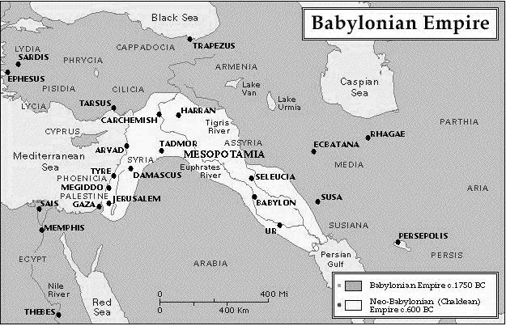
Babylonian Empire c. 1750 BC and c. 600 BC

Slide 87
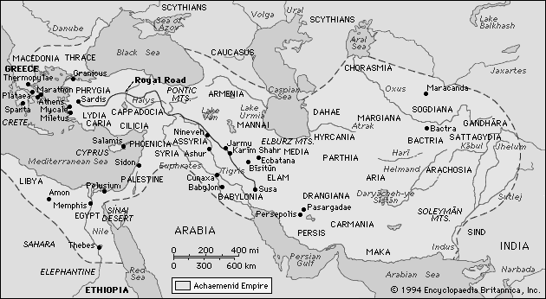
Achaemenid Persian/Median Empire at its Height c. 450 BC

Slide 88
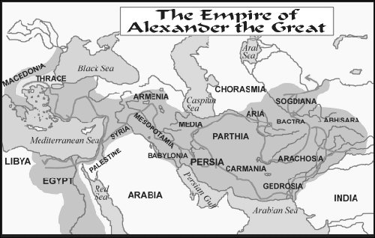
Alexander the Great Empire Nations c. 330 BC

Slide 89
Very Brief Outline of Daniel
Practical examples in the lives of Daniel, Shadrach, Meshach and Abednego: how to remain righteous in an unrighteous world. Ch 1, 3-6
Prophecies of the future: God Rules the Nations Ch 2, 7-12

Slide 90
Daniel Chapter One
Righteous behavior on the job.
Pressure from the world to compromise and conform.
Isaiah 39:6,7 (note: they are eunuchs)
Belshazzar = Bel protects
God is in control
1:2 The Lord delivered Jehoiachim…
1:9 God caused the official to show favor to Daniel
1:17 God gave them knowledge and understanding
1:8 Daniel resolved not to defile himself.
What about you?

Slide 91
Daniel Chapter Three
Righteousness in a religious context: Standing up for God and for the truth
The fires of persecution.
“I will bow my head, but not my heart.”
What would you have done?
App’n: Persecution of Diocletian

Slide 92
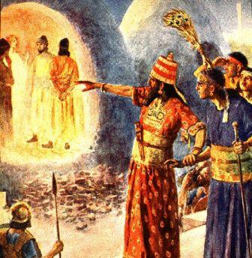

Slide 93
Daniel Chapter Four
Those who walk in pride, he will humble.
Pride in our accomplishments: “Look at this great Babylon that I have built… by my mighty power and for the glory of my majesty.”
(1 Corinthians 4:7, Deuteronomy 8:6-18, 2 Cor 12:7-10)
Two ways to be humbled:
God’s blessings
God’s discipline

Slide 94
The city stands on a broad plain, and is an exact square 120 furlongs (13.5 miles) in length each way, so that the entire circuit is four hundred and eighty furlings. It is surrounded, in the first place, by a groad and deep moat, full of water, behind which rises a wall fifty royal cubits in width (87 feet) and twoo hundred in height (350 feeet). On the top, along the edges of the wall, they constructe buildings on a single chamber facing one another, leaving between them room for a four hourse chariot to turn… The city is divided into two portions by the river which runs through the midst if it.
Herodotus, c. 450 BC

Slide 95
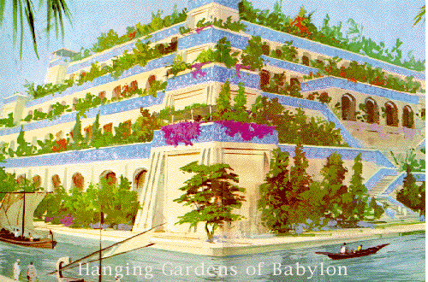
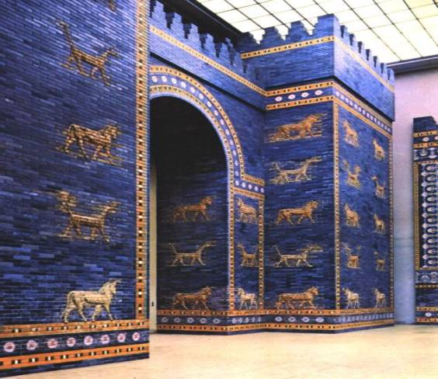
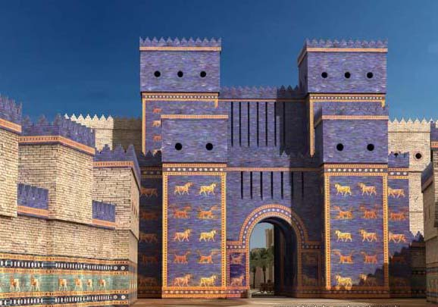

Slide 96
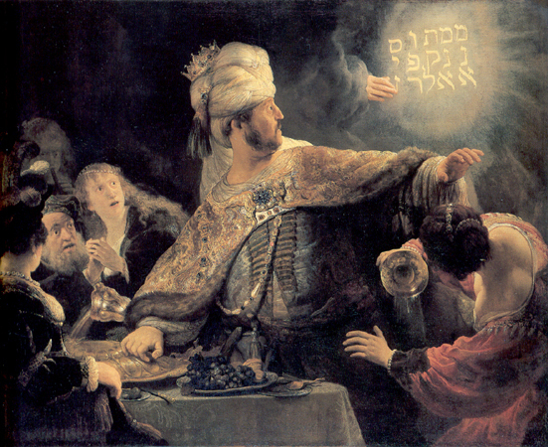
Daniel Chapter Five
Party animal meets man of God.
The writing is on the wall, literally!!!
Oct 12, 538 BC
Side note: v. 8 “I will make you third highest ruler in the kingdom.” Q: Why third?
Message: If you stand up against unrighteousness, God will cover your back and he will take revenge on the unrighteous.

Slide 97
Ziggurat in Ur: Nabonidus and Belshazzar

Slide 98
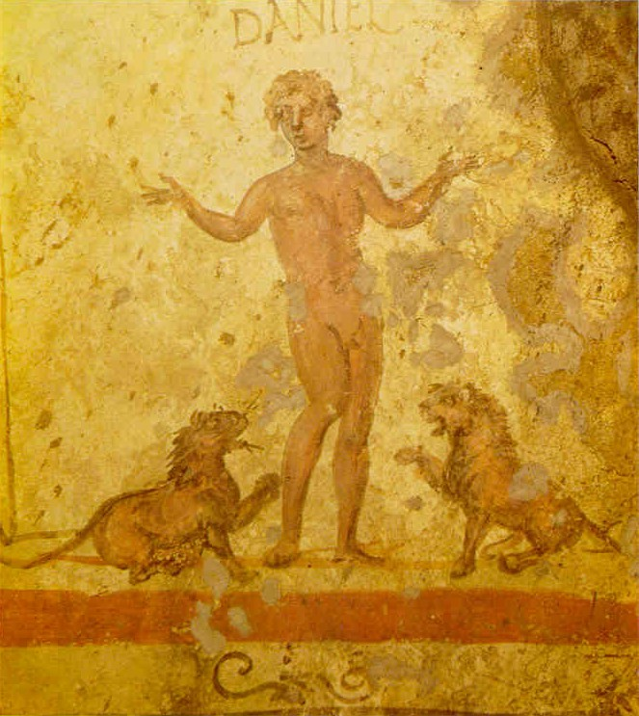
Daniel Chapter Six
Thrown to the lions for being righteous.
Righteousness on the job.
v. 4-5 “We will never find any basis for charges against this man Daniel unless it has something to do with the law of his God.”
Would they say that about you?
Why did he pray with his windows open?

Slide 99
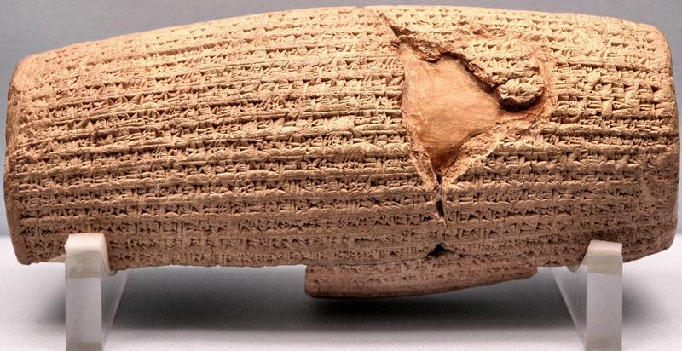
Cyrus Cylinder British Museum 535 BC
Ezra 1:2-4

Slide 100
Daniel Chapter Two:
Nebuchadnezzar’s Vision of a Great Statue
Part of the Statue | Nation
Head of Gold | Babylon
Chest of Silver | Persia/Media (539 BC)
Belly of Bronze | Greece (331 BC)
Legs of Iron | Rome (31 BC)

Slide 101
Babylon
Persia/Media
Greece
Rome: A divided kingdom

Slide 102
Babylonian Empire c. 1750 BC and c. 600 BC

Slide 103
Achaemenid Persian/Median Empire at its Height c. 450 BC

Slide 104
Alexander the Great Empire Nations c. 330 BC

Slide 105
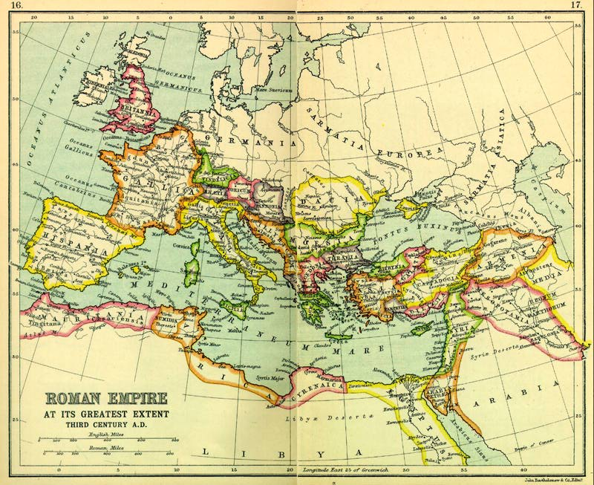
Rome At Its Height
Divided:
Diocletian AD 284
Theodosian AD 395
West:
Fell AD 476
East Byzantium):
Fell 1453

Slide 106
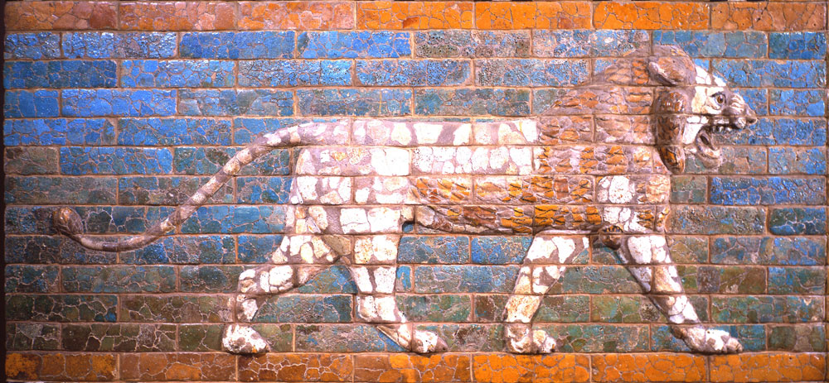
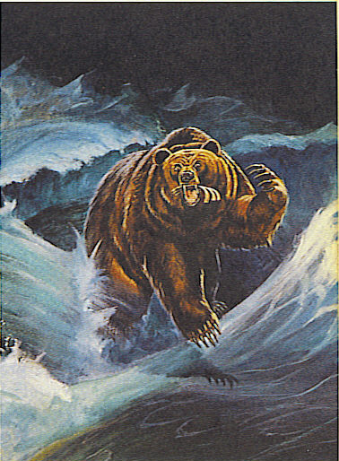
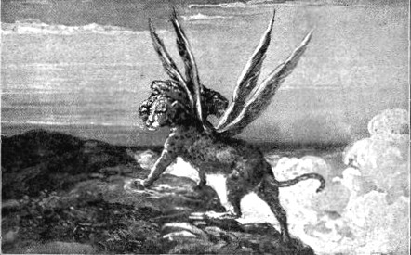
Daniel Chapter 7 Four Beasts

Slide 107
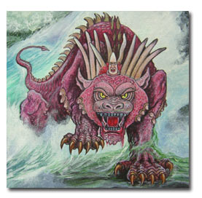
Daniel 7: Ten Horns and a Little Horn

Slide 108
The First Eleven Emperors of Rome
Emperor
Dates of Rule
Significance to Biblical Events
Augustus
27 BC-14 AD
Birth of Christ
Tiberius
14 AD-37 AD
Crucifixion of Christ
Gaius (Caligula)
37 AD-41 AD
Claudius
41 AD-54 AD
Jews Exiled from Rome
Nero
54 AD-68 AD
First persecutions, Execution of Paul and Peter
Galba
68 AD-69 AD
One of the three overcome by Vespasian
Otho
69 AD-70 AD
One of the three…
Vitellius
69 AD-70 AD
One of the three…
Vespasian
69 AD-79 AD
Attack on Jerusalem
Titus
79 AD-81 AD
The general who destroyed Jerusalem
Domitian
81 AD-96 AD
First Systematic Persecutor of the Church

Slide 109
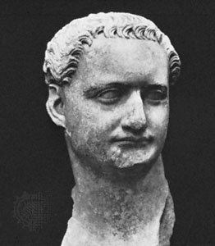
Domitian (c. 81-96 AD)

Slide 110
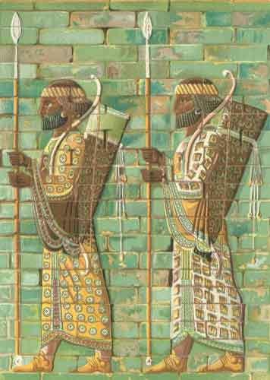
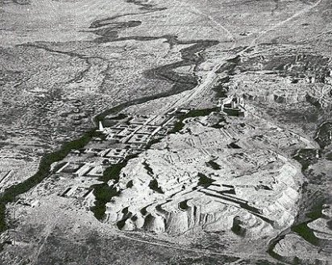
Daniel Chapter Eight: A Ram and a Goat
Ancient Susa and the Ulai Canal

Slide 111
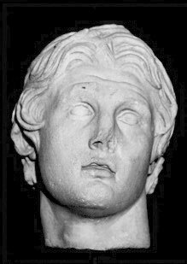
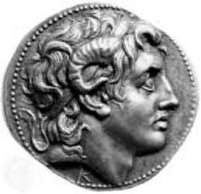
Alexander the Great
Died “at the height of his power” at the age of 35

Slide 112
The Four Horns of Daniel Seven
Horn (King) | Territory Ruled
Antigonus | The East. From Syria to India.
Cassander | The West. Macedonia and Greece.
Lysimachus | The North. Thrace and Asia Minor.
Ptolemy | The South. Egypt and Palestine.

Slide 113
Daniel 8: The Abomination of Desolation

Slide 114
Daniel Chaper Nine: The Messiah Comes to Jerusalem
Seventy sevens = 490 years
The decree to restore and rebuild Jerusalem
Ezra 7:13-16 458 BC
458 - 490 = AD 32
No…… (no zero BC) = AD 33
Actually, during the last week: AD 26-33

Slide 115
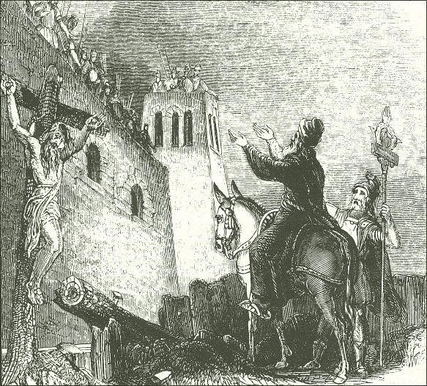
The Destruction of Jerusalem AD 70 Josephus: The Jewish Wars

Slide 116
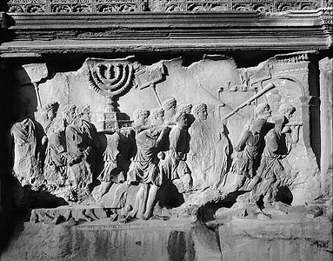
Romans Taking Spoils of Jerusalem from the Arch of Titus, Rome, c. 81 AD

Slide 117
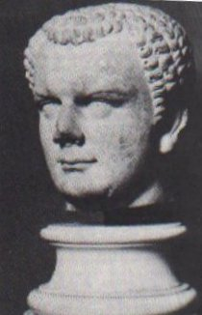
Roman General and Emperor Titus who destroyed Jerusalem in AD 70

Slide 118
The Kings of the South and the Kings of the North in Daniel Eleven
Kings of the South
Kings of the North
Daniel 11 Verse
Ptolemy I 323-283 BC
Seleucus I Nicator 321-282 BC
Daniel 11:5
Ptolemy II Philadelphus 283-247 BC
Antiochus I Soter 280-261 BC
Daniel 11:6
Antiochus II Theos 261-246 BC
Daniel 11:6
Ptolemy III Eugertes 247-221 BC
Seleucus II Callinicus 246-226 BC
Daniel 11:7,8
Seleucus III Soter 226-223 BC
Daniel 11:8
Ptolemy IV Philopator 221-203 BC
Antiochus III “The Great” 223-187 BC
Daniel 11:9-19
Ptolemy V Epiphanes 203-181 BC
Seleucus IV Philopator 187-175 BC
Daniel 11:20
Ptolemy VI Philometor 180-146 BC
Antiochus IV Epiphanes 175-164 BC
Daniel 11:21-35
Antiochus V Eupator 164-162 BC
(v. 6) After some early, indecisive struggles, the Ptolemaic kingdom and the Seleucid kingdom will agree to share power peacefully. In order to seal the deal, Ptolemy II

Slide 119
The Theme of Daniel Eleven
Those who are wise will instruct many, though for a time they will fall by the sword or be burned or captured or plundered. When they fall, they will receive a little help, and many who are not sincere will join them. Some of the wise will stumble, so that they may be refined, purified and made spotless until the time of the end, for it will come at the appointed time. 11:33-35

Slide 120
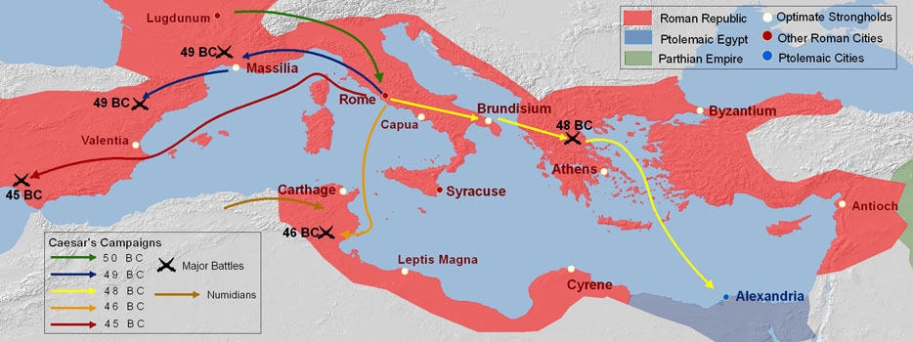
Daniel 11:36-45 The End of the Greek Kingdoms: The Battle of Actium.

Slide 121
Daniel Chapter Twelve: The Time of the End
Those who are wise will shine like the brightness of the heavens, and those who lead many to righteousness, like the stars for ever and ever.
Daniel 12:3-4
How do I know that I will raise from the dead?

Slide 122
Daniel: What about….
(fill in the blank with your favorite “issue”)
God: Let me mind my business. I rule the nations. Take care of your local ministry and trust in me.

Slide 123
Memory Verses
Jeremiah 20:9
Jeremiah 2:5
Daniel 4:37b
Jer 17:9-10
Jer 17:7-8
Jeremiah 42:19b
Jeremiah 5:30-31

Slide 124
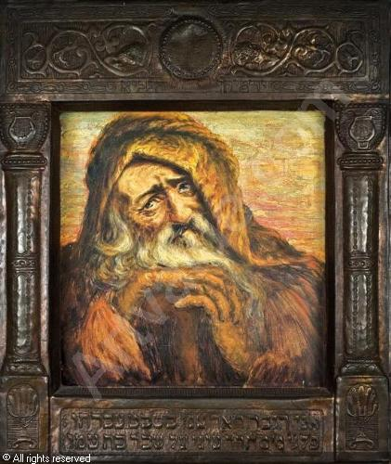
Jeremiah: The Burden of the Lord

Slide 125
Jeremiah’s Nicknames
The Weeping Prophet
The Burden (Oracle) of the Lord (Jeremiah 23:33)

Slide 126
Historical background to Jeremiah
a. Ministry began 13th year of Josiah (627 BC) One year after his reform. Started out great.
b. Shallum/Jehoahaz 609 3 months. Deposed by Pharaoh.
c. Jehoiakim 609-597 Unfaithful, worshipped Baal, etc. surrendered to Babylon, rebelled went to Egypt.
d. Jeconiah/Jehoiachin 597 Also unfaithful. Blinded and taken into exile.
e. Zedekiah 597-586 Also unfaithful. Turned to Egypt again. Jerusalem destroyed, Zedekiah killed, temple burned.
d. Captivity and humility. Rebelled again. Ishmael murdered Gedaliah. The people panic. Jeremiah taken to Egypt.
e. Stoned to death in Egypt Bummer!

Slide 127
Themes in Jeremiah
False Religion
God’s Judgment
The Remnant

Slide 128
Remnant
Jer 6:9 God gleans the remnant
Jer 29:1-11 God has plans for the remnant (written within days of captivity)
Jer 31:7, Jer 33:14-18 God saves the remnant
Jer 39:9 God directs the remnant
Jer 40:11 God abundantly blesses the remnant
Jer 42:1-3, 15, 19 God releases the remnant
Jer 43:4-7, 44:14
Jer 50:20 God forgives the remnant

Slide 129
Symbolism
Jer 1:11-16 The Almond Tree
Jer 13:1-11 The Linen Belt
Jer 13:12-14 The Wineskins
Jer 18:1-10 The Potter’s House
Jer 19:10-13 The Jar
Jer 24:1-10 The Fig baskets
Jer 27:1-8 The Yoke
Jer 32:1-41 The Field
Jer 43: 8-13 The Stones

Slide 130
Jeremiah: A prophet for today
Arguably, Jeremiah, of all the prophets, has a message which resonates with the mindset and issues of the modern and post-modern age.
Francis Schaeffer (Death in the City) called Jeremiah the quintessential prophet for the postmodern age, with its moral relativism and its “open-mindedness.”
“Jeremiah provides us with an extended study of an era like our own, where men have turned away from God, and society has become post-Christian.”
Schaeffer

Slide 131
Jeremiah’s relationship with God
An interesting aspect of Jeremiah’s relationship with his God was his openness about questioning the will of God, yet his trust and willingness to submit to his will.
Jeremiah 4:10 “You have deceived this people and Jerusalem by saying, ‘You will have peace,’ when the sword is at our throats.”
Jeremiah 12:1 “You are always righteous, O Lord, when I bring a case before you, Yet I would speak with you about your justice: Why does the way of the wicked prosper? Why do the faithless live at ease?”

Slide 132
Jeremiah: a prophet of social justice
Jer 5:26-29 …they have become rich and powerful and have grown fat and sleek. Their evil deeds have no limit; they do not plead the case of the fatherless to win it, they do not defend the rights of the poor. Should I not punish them for this?
Jeremiah 22:15-16 Does it make you a king to have more and more cedar? Did not your father have food and drink? He did what was right and just, so all went well with him. He defended the cause of the poor and needy, and so all went well. Is that not what it means to know me? Declares the Lord.
Jer 22:2-3 To the king: Do what is just and right. Rescue from the hond if his oppressor the one who has been robbed. Do not wrong or violence to the alien, the fatherless or the widow, and do not shed innocent blood in this place.

Slide 133
Outline of jeremiah
I. Jeremiah’s mission Ch 1
II. God’s charge against his people Ch 2 You have left God!
III. Jeremiah’s message Ch 3-5 Return and repent!
IV. Jeremiah’s critique Ch 6 The leaders say peace, peace…
V. Judgment is coming on Judah Ch 7-22
VI. Good News! Ch 23-33 God will gather a remnant.
VII. History surrounding the destruction of Jerusalem Ch 34-45
VIII. Judgment on Judah’s enemies Ch 46-51.
IX. Epilogue Ch 52 The Fall of Jerusalem

Slide 134
Archaeological support of events recorded by jeremiah and baruch
1. The fall (but not destruction) of Jerusalem in 597 BC
2. The destruction of Lachish.
3. The raising up of Jehoiachin by Evil-Merodach 560 BC

Slide 135
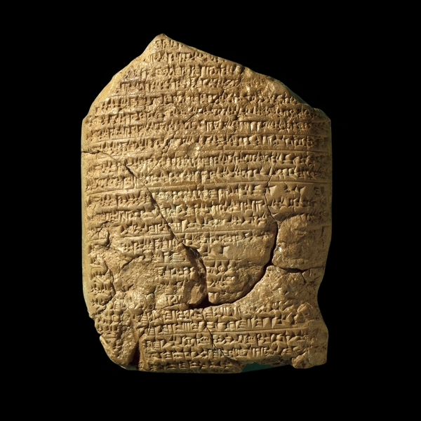
The Babylonian Chronicles British Museum, London, 597 BC 2 Kings 24:10-17
[In] the seventh year, the month of Kislev, the king of Babylonia mustered his forces and marched to Syria. He camped against the city of Judah (Jerusalem) and on the second day of the month of Adar he took the city and captured the king. He appointed a king of his own choice there, took its heavy tribute and brought them to Babylon.

Slide 136
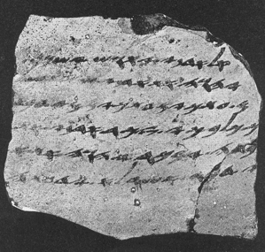
One of the Lachish Letters, 588 BC
Jeremiah 34:6,7

Slide 137
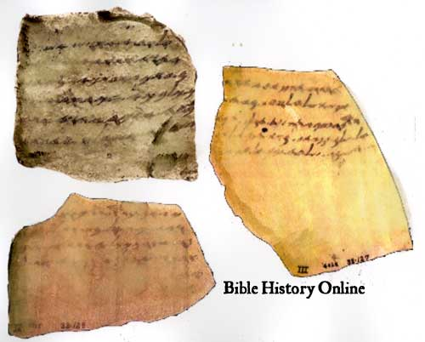

Slide 138
The lachish letters
The Lachish Letters 588 BC 6 letters on clay shards
Send an army of relief or the city will fall to Nebuchadnezzar
The light at the top of Azekah just went out, and we are next Jeremiah 34:6,7
Within two days, the author of this letter was killed. Two years later, Jerusalem fell.

Slide 139
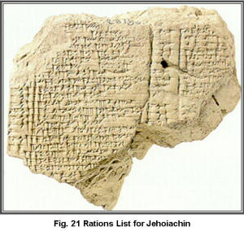
Yaukin (Jehoiachin), king of the land of Judah
Jeremiah 52:31-34

Slide 140
I. Jeremiah’s Mission Ch 1
Jer 1:4 I have set you apart before you were born as a prophet to the nations.
Jer 1:7-8 His mission: Say whatever I command you.
His mission: to preach judgment is coming.
A seething cauldron (1:13)
Disaster from the North (Babylon) 1:14
But he also a positive mission to build and to plant (1:9)
like the branch of an almond tree (the first to bud in the early spring) Jer 1:11

Slide 141
Jeremiah’s commission
Jer 1:6 Jeremiah insecure. Are you sure you want me to be your prophet?
No wonder. He was terribly persecuted by his own people!
Jeremiah 20:1-18. Esp v. 9
Q: Are you prepared to be a “laughing stock?” Are you prepared to “sit alone?” (Jer 15:17) to be thrown into a miry pit (Jer 38:6}?
Remember that God will put words in our mouth (Luke 12:11-12) You will be my spokesman Jer 15:19 I will be with you and will rescue you (Jer 1:8, Jer15:20)

Slide 142
II. God’s charge against his people: They have betrayed his love Ch 2
Jer. 2:4-5 You became worthless to God.
Q: Is God exaggerating? (Titus 1:15)
v. 5 Q: Is God enough for you? Or do you need more? Are you willing to accept what God gives you?
You (v. 6) and the priests (v. 8) do not ask “Where is the Lord?” They stopped seeking the Lord.
2:11-13 Q: How do we become worthless? Answer: By seeking the blessings of the world rather than the blessings God offers.
v. 11 Has a nation ever changed its gods? Even the pagans are more loyal than you!

Slide 143
II. God’s Charge against his people (cont.)
v. 13 Q: Have you “dug your own cisterns”—looked for satisfying water elsewhere than in the living water from God? (Jer 18:14-15a)
2:20-22 You are like a runaway bride—loved deeply by her lover, yet you went for prostitution. (also 2:32)
v. 23 You are like a wild donkey in heat… ouch!
v. 27 We say to an inanimate piece of wood, “You are our father.” Who, me???? (Rom 1:25)
Titus 1:15-16

Slide 144
III. Jeremiah’s Message: Repent and Return Ch 3-5
3:14-18 Return and I will choose you. I will bring you back from the northern land and I will make a new covenant.
3:22 Return from backsliding. Rev 2:1-7
4:1-4 What “unplowed ground” do you need to break up?
4:8 Do you need to put on sackcloth and ashes? (ie not take care of even your most basic needs as you attend to repentance) (2 Cor 7:11-12)

Slide 145
Disaster from the north
The result: Disaster from the North (Babylon) 4:5,6 a lion = Babylon
Jer 4:23-26 The natural result of sin: an empty life in ruins.
The postmodern attitude: Jer 5:12-13
Jeremiah: a prophet of social justice. Jer 5:26-29
A passage relevant for the postmodern, post-Christian world: Jer 5:30-31 A horrible and shocking thing has happened in the land: The prophets prophesy lies, the priests rule by their own authority, and my people love it that way. But what will you do in the end?
This is our struggle!!!

Slide 146
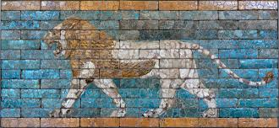
Disaster from the North: Babylon Jeremiah 4:5,6
The Ishtar Gate, Babylon, Pergamum Museum

Slide 147
IV. Jeremiah’s critique: The Leaders say “peace, peace” Ch 6
Jer 6:13-15 The leaders dress the wounds of my people lightly. They say “peace, peace.” Leaders: Is that you?
v. 15 no longer ashamed…. Are you able to be ashamed as you once were? Some of us are no longer willing to confront sin.
If you are friends of the world, God says it is no longer peace, peace for you. 2 Tim 4:1-5
God’s solution: 6:16-20 Stand at the crossroads and look… Seek the good way and walk in it. We already know what to do….
6:20 It is not simply about being more religious. Jeremiah 23:16-24, 33-40

Slide 148
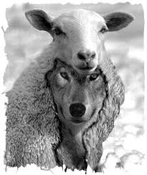
Peace, peace! They dress the wounds of my people lightly

Slide 149
The temple of the Lord, the temple of the lord
Jer 7:1-8 Do not trust in deceptive words.
The sanctuary will not save you if you are not already sanctified.
Q: Equivalent for us?
Trusting in the church rather than in Jesus, who is the head of the church.
Notice: Jesus quoted Jer 7:11 in Matthew 21:13 Might we view the church as the source of our livelihood or a business opportunity?

Slide 150
v. Judgment is coming on judah Ch 7-22
Jer 15:1-2 Even if Moses and Samuel were to stand before me, my heart would not go out to this people. Death, sword, starvation, captivity. (Ezek 14:13-14)
17:5 Do not trust in man
17:7 Blessed is the man who trusts in the Lord
17:9 The heart is deceitful above all things
17:10 I, the Lord, search the heart.
God’s plan for his people Jer 18:1-12 (sounds like Ezek 18) Q: What is God saying about us?

Slide 151
Keeping the Sabbath as a measuring line of our heart
17:19-27 If you keep the Sabbath, you will have kings on their throne in Jerusalem forever, but if you do not, I will kindle an unquenchable fire.
Q: Is God exaggerating? As how we view and use our money is an accurate reflection of how we view God, so how we accept and use an opportunity from God to rest, reflect and enjoy a relationship (putting aside the worries, pleasures and attractions of the world) with him is an accurate reflection of our wider spiritual health. Thus, this is not a gross exaggeration. Amos 8:5 expresses this well. “When will the New Moon be over that we may sell grain, and the Sabbath be ended that we may market meat.” (also Isaiah 58:13-14)

Slide 152
Jeremiah 18&19 God is the Potter, we are the clay
Jer. 18 At the potter’s house. God’s plan for his people Jer 18:1-12 The pot was marred, so he formed it into something different.
Jer 18:12 The people’s response: It is no use. We will not change.
Jer 19:1-10 God’s response. Jeremiah shatters the pot. Jer 19:10 These people are past remaking. Judgment and doom!

Slide 153
Jeremiah 20 Jeremiah and Pashhur
Jeremiah (about the insult and reproach of Pashhur):
“But if I say, ‘I will not mention him or speak any more in his name,’ his word is in my heart like a fire, a fire shut up in my bones. I am weary of holding it in; indeed I cannot.” (Jer 20:9)

Slide 154
vi. Good news! God will gather a remnant Ch 23-33
Jeremiah 23:1-8 God will gather a remnant and place shepherds over them.
v. 5 a righteous branch. the Hebrew for branch is nazer Jesus is called the branch in that he is the “branch” of David/Jesse (Isaiah 11:1,11) , but also in that he is a Nazarene. (Matthew 2:23)
v. 6 a king. The Lord our Righteousness.
Jer 25:8-14 70 years

Slide 155
Jer 29:10-14 I know the plans I have for you
Jeremiah 29:10-14 I will rescue you from captivity. I will bring you back to the Promised Land.
Do you believe God has great plans for you if you will plow up the unplowed ground, seek the ancient paths, and seek him with all your heart?
Will you wait seventy years for God to bless you?
Jeremiah 30:1-11
v. 10 Has God saved you from a distant place?

Slide 156
Jeremiah 31:27-37 A new covenant
v. 32 It will not be like the covenant I made with their forefathers. How is that?
v. 28 A covenant only of blessing.
v. 29-30 About individuals in a relationship with God. No more group blessings and curses (such as Deut 29,30)
v. 34 It won’t be you are born then you get to know me. You will be born knowing me.
v. 34b I will forgive their wickedness. (Q: Wasn’t that also true with Israel? Heb 9:6-10, 10:15-18)
v. 35-37 Great assurance!

Slide 157
A sign of hope: Jeremiah buys a field
Jer 32:1-15 Jeremiah buys a field. This represents confidence that God will do what he says.
Note v. 4 Zedekiah will see it all with his own eyes (but then will have his eyes taken out)
Destruction (v. 26-29) and renewal (36-44)
Jeremiah 33:12-22 Still more encouragement. Why does God make such a strong promise?

Slide 158
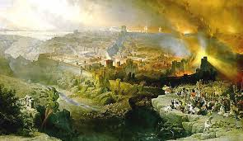
vii. History surrounding the destruction of jerusalem ch 34-45
The tragic events of 588-586 BC serve as vindication of God’ justice and of Jeremiah as a true prophet of God.

Slide 159
Jeremiah 35 The Recabites
Jer 35:1-16 The Recabites.
Q: What is God’s point to his people?
Q: What is God’s message to us?

Slide 160
Jeremiah 36 Jehoiakim Burns the scroll
Jer 36:1-3 What was on the scroll?
36:4 What if they had repented?
36:15-26 How might we be like Jehoiakim?
Q: Did God’s word work? (Isaiah 55:11) Is it true that God’s word always works (either to judge or to save).
36:27-32 We cannot destroy God’s word, but if we reject his word we will be destroyed.

Slide 161
More events surrounding the destruction of Jerusalem
Jer 37 Zedekiah replaces Jehoiachin. V. 1-3
37:9 Do not trust in Egypt. God’s plans are set.
37:13 Jeremiah inspects his property, is accused of treason with Babylonians, beaten and jailed.
Jer 38:1-3 Jeremiah prophesies—speaks treason. Zedekiah not very happy. v. 4-6 lowered into a cistern. Jeremiah is getting to a pretty low place.
38:17-18 God is upset when we do not accept the discipline he puts into our lives. 38:19 Zedekiah’s excuse.
Jer 39 Jerusalem falls

Slide 162
Don’t go down to egypt!
Jer 40:1-6 Nebuchadnezzar frees Jeremiah, leaves Gedaliah in charge. Israel to serve Babylon (v. 9) 70 years.
Jer 41 Gedaliah assassinated, Jews flee to Egypt.
Jer 42:10-12 Serve Nebuchadnezzar I will save and deliver you. Will you trust God?
Jer 42:19-22 If you go to Egypt, you will die by the sword.
42:19 A clarion call to all who would follow God. DO NOT GO TO EGYPT!

Slide 163
viii. Judgment on judah’s enemies ch 46-51
Judgment may begin with the household of God, but God’s enemies should not take this as a sign that they will escape a similar judgment.
1 Pet 4:17

Slide 164
ix. Epilogue the fall of jerusalem ch 52
This passage clearly is an epilogue, given Jeremiah 51:64 “The words of Jeremiah end here.”
It may have been added by Baruch or by another editor.
The events of Jer 52:31-34 have been confirmed by archaeological discovery, as mentioned previously.

