Slide 1
The Old Testament Reliability, Inspiration and Inerrancy
Apologetics Research Society
9/14/2013

Slide 2
Outline
I. Inspiration and Inerrancy
II. Text of the Hebrew Bible
III. Old Testament Canon
IV. Inspiration and other Religions
V. Supposed Contradictions in the OT
VI. Historical Reliability of OT
VII. Messianic Prophecies
VIII. Daniel

Slide 3
I. Inspiration and Inerrancy The Biblical Meaning of Inspiration
2 Tim 3:16
2 Peter 1:20-21
1 Thess 2:13
I believe that the entire scripture is inspired by God because:
The Bible says so
The evidence supports this conclusion
By faith in God

Slide 4
What, Exactly, Is Inspired by God?
The Original Autographs For sure!
(But we do not have those)
The Copyists? No
Why would God trust his inspired word to fallible copyists?
The Translators? No
Why would God trust his inspired word to fallible translators?

Slide 5
Inspired Translations?
Q: God is sovereign: Wouldn’t he see to the inspiration of the translators?
Q: Does this mean we do not have direct access to the inspired Word of God?
The question of exaggerated and unreasonable faith.
Does God change lights from red to green for us?
Does God move the had of the copyist or the mind of the translator?
Does God reveal his one chosen mate to us?

Slide 6
Inerrancy
Is the Bible inerrant? If so, in what sense?
Inerrant: The Bible contains no errors whatsoever. This is the standard fundamentalist view.

Slide 7
Is the Bible Inerrant? Are There Mistakes in the Autographs (Original Manuscripts)?
Does the sun move across the sky?
Are the gospels or Bible in general exact transcriptions?
Is Genesis 1 literal?
Did Jesus clear the temple twice?
Are there chronological errors in the NT?
What would it mean if there was a “mistake” in the Bible?
What is your definition of “error?”
Was Moses literally in the desert exactly 40 years
Be cautious about imposing a modernist/Western concept of inerrancy.

Slide 8
Bible “Errors”
Matthew 2:23 Where is the prophecy that Jesus will be called a Nazarene? Answer: Isaiah 11:1-2, Zechariah 6:9-15
Two different and contradictory Genealogies in Matthew and Luke. Answer: Matthew is genealogy of Joseph and Luke is genealogy of Mary (Joseph the son in law of Heli)
Matthew 1:23 “The virgin will be with child” is a misquote of the Bible.
Matthew 2:15 Mistakenly makes Hosea 11:1 a prophecy (no, it is a fulfilled foreshadow, not a fulfilled historical prophecy)

Slide 9
Bible “Errors”? (cont.)
Is David mistaken? Psalm 51:4 Against you only have I sinned. Psalm 51:5 Original sin?
Psalm 103:12 How far is it from the East to the West?
Do Bible writers misquote the OT? Is it an “error” if they quote from an unispired translation (the Septuagint)? Are they paraphrasing? Is that a mistake?
Bottom line, Inspiration is very solid, but inerrancy is tricky, depending on how you define it.

Slide 10
Conclusion (with regard to Biblical inspiration)
Although it is true that we do not have a perfect Greek or Hebrew text, and although we do not have inspired, inerrant translations, with the help of modern scholarship of the languages, knowledge of OT and NT cultures, careful textual criticism and so forth, we have at least as good access to understanding the original inspired Word of God as Christians living in the first or second century.

Slide 11
Is The Bible Inerrant?
The Simple Answer: Yes, definitely.
The Nuanced Answer: What do you mean by inerrant?
Are Jesus’ speeches transcripts?
What about speeches by Abraham or Noah?
How would a Near Eastern Jew 700 BC understand inerrancy?
Does the chronology have to be strictly correct for the text to be inerrant?
The question is not what can God do, but what did he do.

Slide 12
Chicago Statement on Inerrancy
Article X.
WE AFFIRM that inspiration, strictly speaking, applies only to the autographic text of Scripture, which in the providence of God can be ascertained from available manuscripts with great accuracy. We further affirm that copies and translations of Scripture are the Word of God to the extent that they faithfully represent the original.
WE DENY that any essential element of the Christian faith is affected by the absence of the autographs. We further deny that this absence renders the assertion of Biblical inerrancy invalid or irrelevant.
Article XI.
WE AFFIRM that Scripture, having been given by divine inspiration, is infallible, so that, far from misleading us, it is true and reliable in all the matters it addresses.
WE DENY that it is possible for the Bible to be at the same time infallible and errant in its assertions. Infallibility and inerrancy may be distinguished, but not separated.

Slide 13
Chicago Statement on Inerrancy
Article XII.
WE AFFIRM that Scripture in its entirety is inerrant, being free from all falsehood, fraud, or deceit.
WE DENY that Biblical infallibility and inerrancy are limited to spiritual, religious, or redemptive themes, exclusive of assertions in the fields of history and science. We further deny that scientific hypotheses about earth history may properly be used to overturn the teaching of Scripture on creation and the flood.
Article XIII.
WE AFFIRM the propriety of using inerrancy as a theological term with reference to the complete truthfulness of Scripture.
WE DENY that it is proper to evaluate Scripture according to standards of truth and error that are alien to its usage or purpose. We further deny that inerrancy is negated by Biblical phenomena such as a lack of modern technical precision, irregularities of grammar or spelling, observational descriptions of nature, the reporting of falsehoods, the use of hyperbole and round numbers, the topical arrangement of material, variant selections of material in parallel accounts, or the use of free citations.
Article XIV.
WE AFFIRM the unity and internal consistency of Scripture.
WE DENY that alleged errors and discrepancies that have not yet been resolved vitiate the truth claims of the Bible.

Slide 14
Inerrancy: A Conclusion
The Bible is theologically and doctrinally inerrant.
Theological inerrancy holds up to careful scrutiny.
Evidence for doctrinal inerrancy is also very strong.
The Scripture is verbally inspired
Paul agrees with this! Galatians 3:16
Careful analysis of the scripture supports this conclusion

Slide 15
How Do I Answer Questions About Biblical Reliability?
Don’t overreach. Don’t oversell the evidence.
Don’t paint yourself into a corner.
Don’t undersell either.
Leave some ammunition.
Be confident: You are right! (at least in the big picture)

Slide 16
II. The Hebrew Text of the Old Testament
A section of the Psalms from the Dead Sea Scrolls

Slide 17
Reliability of the Old Testament Hebrew and Aramaic Text
The Masoretic Text
The Dead Sea Scrolls
The Septuagint and Other Early Translations

Slide 18
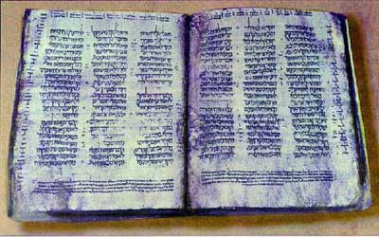
The Hebrew Text of the Old Testament
The Cairo Codex: The former and latter prophets AD 895
The Aleppo Codex: Oldest Hebrew manuscript of the entire Old Testament AD 920
The Leningrad Codex: Manuscript of the whole Old Testament AD 1008
The Masoretes and the Masoretic Text. These guys were fanatics!
The Cairo Codex

Slide 19
Early Translations of the Old Testament
Samaritan Pentateuch 400 BC 6000 errors?
Septuagint 200 BC
Syriac Version AD 100
Quotes from the Mishnah/Talmud

Slide 20
The Masoretes AD 500-1000 Tiberias
Before starting to copy the scrolls or codices, the scribe required by the Masoretes to go through an elaborate ceremony. In order to preserve the integrity of the text, the Masorete scribes counted all the letters in the Old Testament. They kept track of such arcane details as the middle verse of the Pentateuch (Leviticus 8:7). They also found the middle verse of the entire Hebrew Bible (Jeremiah 6:7). They were aware of the middle word of the whole Old Testament, as well as the middle word of each book. They also kept record of the middle letter and verse of each book. Taking it to the extreme, they also counted the number of times each Hebrew letter appeared in each book and counted the number of verses which contained all the letters of the Hebrew alphabet. All this was intended to produce exact copies of the Scriptures. All this without word processors.

Slide 21
The Talmudists (AD 100-400) were radical too!!!
A synagogue roll must be written on the skins of clean animals, prepared for the particular use of the synagogue by a Jew. These must be fastened together with strings taken from clean animals. Every skin must contain a certain number of columns, equal throughout the entire codex. The length of each column must not extend over less than forty-eight, or more than sixty lines; and the breadth must consist of thirty letters. The whole copy must be first lined; and if three words be written in it without a line, it is worthless. The ink should be black, neither red, green, nor any other color and be prepared according to a definite recipe. An authentic copy must be the exemplar, from which the transcriber ought not in the least deviate. No word or letter, not even a yod (a vowel mark), must be written from memory, the scribe not having looked at the codex before him…. Between every consonant the space of a hair or thread must intervene; between every word, the breadth of a narrow consonant; between every new section, the breadth of nine consonants; between every book, three lines. The fifth book of Moses must terminate exactly with a line, but the rest need not do so. Besides this, the copyist must sit in full Jewish dress, wash his whole body, not begin to write the name of God with a pen newly dipped in ink, and should a king address him while writing that name he must take no notice of him…. The rolls in which these regulations are not observed are condemned to be buried in the ground or burned; or they are banished to the schools, to be used as reading books.

Slide 22
But… There is still that annoying 1400 years or so!

Slide 23
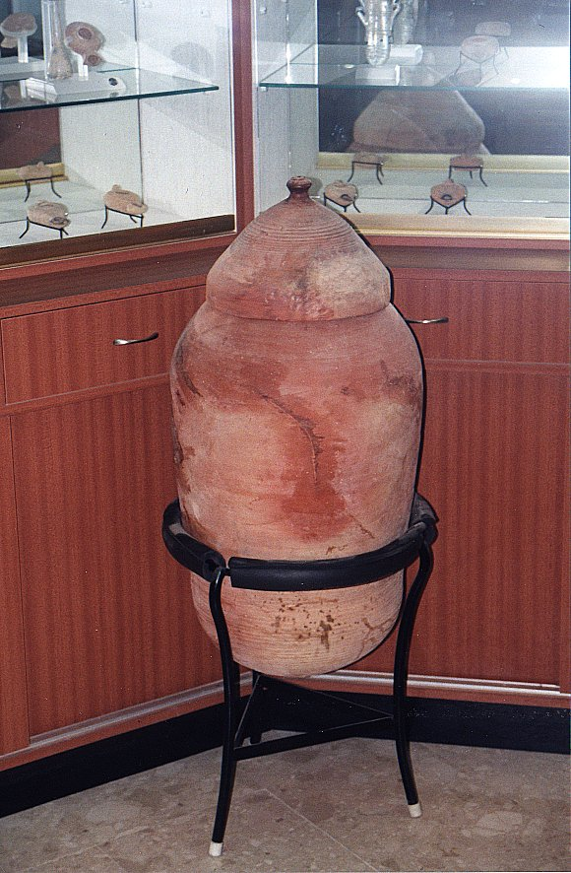
All this changed in 1947 with an Arab child in the hills east of Jerusalem….

Slide 24
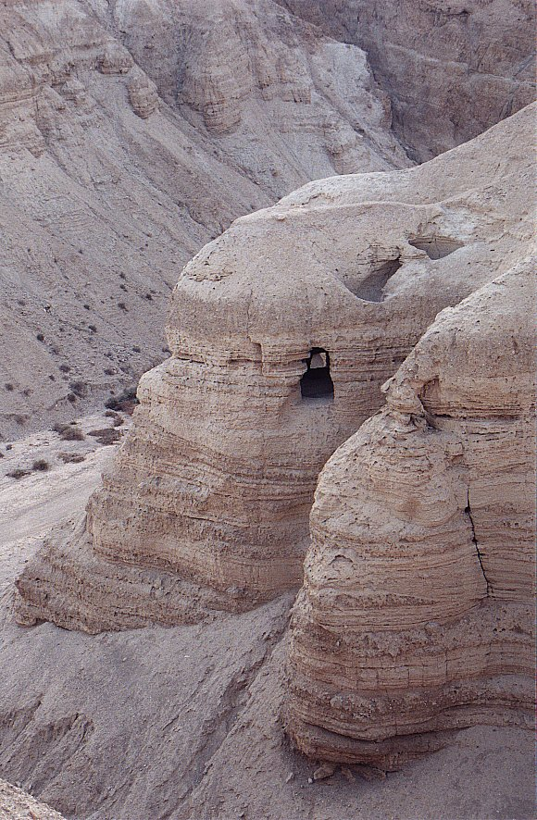
Qumran
Cave #4

Slide 25
The Effect of the Dead Sea Scrolls
Last Old Testament Book Written Autograph | Dead Sea Scrolls Written | Oldest Old Testament Manuscript Before Dead Sea Scrolls

Slide 26
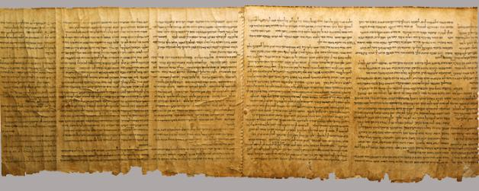
Important Dead Sea Scrolls
Isaiah 58:6-65:4
Isaiah A 13 changes t0 1952 RSV
Isaiah B
Samuel
1 & 2 Samuel 250 BC
Psalms
Exodus paleo-Hebrew 200 BC

Slide 27
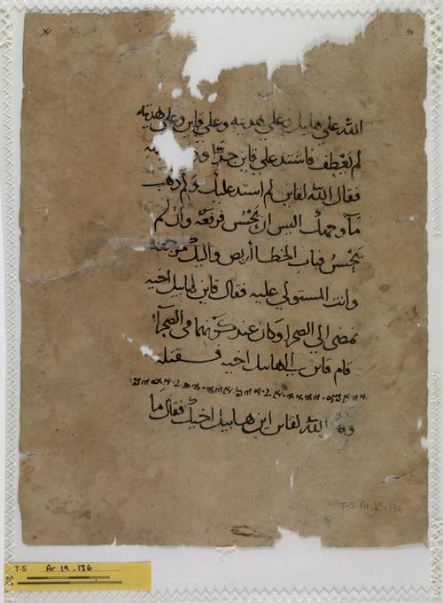
Other Hebrew Bible Translations
Samaritan Pentateuch 400 BC
6000 errors?
Septuagint 250 BC
Aramaic Targums about 0 BC
Old Syriac AD 100
Old Latin AD 100
Vulgate Jerome AD 386
Arab Translation of Samaritan Pentateuch

Slide 28
Copying Errors/Editing of the Text?
Slips of the pen
Lines repeated, switched, etc.
Scribes’ attempts to “improve” or “smooth” the text.
Interpolations.

Slide 29
Textual Errors in the Hebrew Bible
Names and numbers
Amerixan vs American 510 vs 51 or 5100 or 500 soldiers
The Hebrew letters kaleth (ד) and resh (ר) are very difficult to distinguish. Similarly, the letters he (ה) and heth (ח) could easily be mistaken for one another.

Slide 30
III. Old Testament Canon
Targums, Talmud, Mishna
Talmud: Ezra
Josephus Not 10,000 but 22 books
New Testament!!! (all but either books quoted)
Council of Jamnia AD 90-100 Confirmed that Ecclesiastes and Song of Solomon should remain included in the accepted canon. Did NOT create an OT canon.

Slide 31
Old Testament Apocrypha
Included in the Septuagint?
Included by Jerome in Vulgate under protest.
Never quoted by Jesus. Mentioned in Jude, alluded to in Hebrews.
Used extensively by the Church Fathers, esp. after AD 200. 1 Esdras included in Coptic Bibles.
Finally rejected definitively by Jewish Rabbis.

Slide 32
Old Testament Apocrypha
Composed in the 3rd and 2nd century BC
Attached to (included in?) Septuagint
Never quoted in NT (Jude 14 and exception?)
By 3rd Century these books were quoted extensively and treated as scripture by church fathers
Included in Jerome’s Vulgate
Rejected by Jews by 3rd century. NOT in Jewish Bible
Included in KJV, Luther’s Bible
Excluded by Protestant Bibles in 17th century

Slide 33
Old Testament Apocrypha
Tobit
Judith
Additions to Esther
First Maccabees
Second Maccabees
Wisdom
Sirach (Ecclesiasticus)
Baruch
Additions to Daniel:
The Prayer of Azariah and The Song of the Three Children
Susanna
Bel and the Dragon

Slide 34
Tobit, Judith, Additions to Esther, Susanna, Bel and the Dragon
Jewish Fables/Parables
Tobit: Using the smoke from the liver and heart of a fish to drive off a demon.
Judith: Nebuchadnezzar called a king of the Assyrians.
Additions to Esther: A Greek interpolation. A “Targum” A Jewish commentary. Never in Hebrew.
Susanna: Daniel as a young boy. “And from that day onward, Daniel was greatly esteemed by the people.”
Bel and the Dragon: Daniel convinces Cyrus that Bel and “the Dragon” are mere idols

Slide 35
1st and 2nd Maccabees
1st Maccabees of very high quality. Rejected because it is favorable of the Romans?
2nd Maccabees of much lower quality.
Some very inspiring stories. (2 Maccabees 7)
Many historical errors.
2 Maccabees 6:17 “Without further ado, we must go on with our story.”
“I will bring my own story to an end here too. If it is well written, and to the point, that is what I wanted; if it is poorly done and mediocre, that is the best I could do” (2 Maccabees 15:37-38)

Slide 36
Wisdom and Sirach (Ecclesiasticus)
Very similar in form and substance to Proverbs.
Wisdom is a Pseudepigrapha (falsely ascribed book) Solomon? Written about 100 BC
Some very good advice.
Envy and anger shorten one’s life, Worry brings on premature age. One who is cheerful and gay while at table benefits from his food (Sirach 30:24,45)
If there are many with you at table, be not the first one to reach out your hand. Sirach 31:18)

Slide 37
Wisdom and Sirach Include False Doctrine and Unbiblical Advice
Tell nothing to a friend or foe; If you have a fault, reveal it not (Sirach 19:7)
For kindness to a father will not be forgotten, it will serve as a sin offering–it will take lasting root. In time of tribulation it will be recalled to your advantage, like warmth upon frost it will melt away your sins (Sirach 3:14-15).
Water quenches a flaming fire and alms atone for sins. (Sirach 3:29)
Worst of all wounds is that of the heart, worst of all evils is that of a woman.... There is scarce any evil like that in a woman; may she fall to the lot of the sinner (Sirach 25:12,18).

Slide 38
Summary of the Evidence for the Old Testament
Our Hebrew Bible is very similar to the original writings. No significant biblical doctrine is in doubt
The Old Testament books were chosen by consensus of Jewish teachers somewhere between 400 and 200 BC.
The entire Bible we have in our hands is essentially what God had written by the inspired writers.

Slide 39
VII. Inspiration of Scriptures of Other Religions
Islam
Bahai
Mormonism (Don’t go there!)
Hinduism, Buddhism, etc.

Slide 40
Muslim Apologetics
Numerology.
Scientific accuracy.
Perfectly reliable text.
Beauty of the Arabic text.
The main thing: Undermine the Bible at any cost!

Slide 41
Quranic view of biblical inspiration
Follow the Injil 5:47
( euvaggelion ) (below)
Follow the O.T. 6:92, 37:117, 40:53
“Qur’an unchanged” MS Discoveries...
“The people of the Injil shall rule in accordance with Allah’s revelations therein. Anyone who does not rule in accordance with Allah’s revelations -- these are the wicked!”
Inconsistency: Use OT and NT to refute Christians. Why, if the scriptures are “corrupt”?

Slide 42
Historical errors in the Qur’an
Ishmael = Isaac 37:102
2 trees in Eden = 1 tree 20:120
Noah’s 4th son drowns 11:43
Zechariah silent 3 days (not 9 months) 3:41
Pharaoh’s magicians repent 20:70
Judges 7 / 1 Sam 17 conflated 2:249
Jesus’ childhood miracles 3:49, 5:110, 19:30

Slide 43
Scientific Errors in the Qur’an
23:14—Creation from the clot of blood
“Then we made the sperm into a clot of congealed blood; then from that clot we made a lump; and we made out of that lump bones and clothed the bones with flesh.”
18:86—Traveling west…
“… till, when he reached the setting-place of the sun, he found it setting in a muddy spring.”

Slide 44
Scientific errors in Qur’an (II)
21:33—Sun and stars orbit the earth
41:12 7--“heavens”, stars, comets in “lowest heaven
34:9, 52:44—Piece of sky falls and kills someone
36:4, 23:14--Man deposits child into the mother

Slide 45
Purported Prophecies (I)
Deut 18:15-18
¹⁵The Lord your God will raise up for you a prophet like me from among your own brothers. You must listen to him. ¹⁶For this is what you asked of the Lord your God at Horeb on the day of the assembly when you said, "Let us not hear the voice of the Lord our God nor see this great fire anymore, or we will die.“ ¹⁷The Lord said to me: "What they say is good. ¹⁸ I will raise up for them a prophet like you from among their brothers; I will put my words in his mouth, and he will tell them everything I command him.

Slide 46
Purported Prophecies (III)
Isa 21:7 ”when he sees…riders on donkeys or riders on camels, let him be fully alert”
Muslim claim: riders on donkeys = Jesus, riders on camels = Mohammed. Context: fall of Babylon!
Jn 14:16—parakletos → periclytos (praised one)—without any MS supp. Moreover, 14:26 shows the helper is the Spirit. Jn 16—The helper to abide forever. (M is dead.) 14:26—Helper to be sent in Jesus’ name; but no Muslim would allow this! Besides, Acts 1:5—helper to come in not many days – not in the 7th century!

Slide 47
Purported Prophecies (III)
Isa 21:7 ”when he sees…riders on donkeys or riders on camels, let him be fully alert”
Muslim claim: riders on donkeys = Jesus, riders on camels = Mohammed. Context: fall of Babylon!
Jn 14:16—parakletos → periclytos (praised one)—without any MS supp. Moreover, 14:26 shows the helper is the Spirit. Jn 16—The helper to abide forever. (M is dead.) 14:26—Helper to be sent in Jesus’ name; but no Muslim would allow this! Besides, Acts 1:5—helper to come in not many days – not in the 7th century!

Slide 48
Theory of Abrogation
Sura 6:34 “no one can alter Allah’s promises”
Sura 6:115 “No one can change His words”
Sura 10:64 “There is no changing the promises of Allah”
vs.
Sura 2:106 None of Our revelations do We abrogate or cause to be forgotten, but We substitute something better or similar: Knowest thou not that Allah hath power over all things?
Whatever Mohammad said later “abrogates” his previous sayings.

Slide 49
Abrogation (cont.)
Sura 53:19 In “a moment of weakness” Muhammad said: “Have you thought of Al-lat, al Uzza and AManat? These are exalted intermediaries whose intercession is to be hoped for.” Later abrogated, of course.
Examples: More than four wives for Muhammad 33:50 and 33:52
Praying toward Jerusalem abrogated by praying toward Mecca.
Sura 9 “Ultimatum” 9:5 “Verse of the sword” abrogates milder statements about unbelievers.

Slide 50
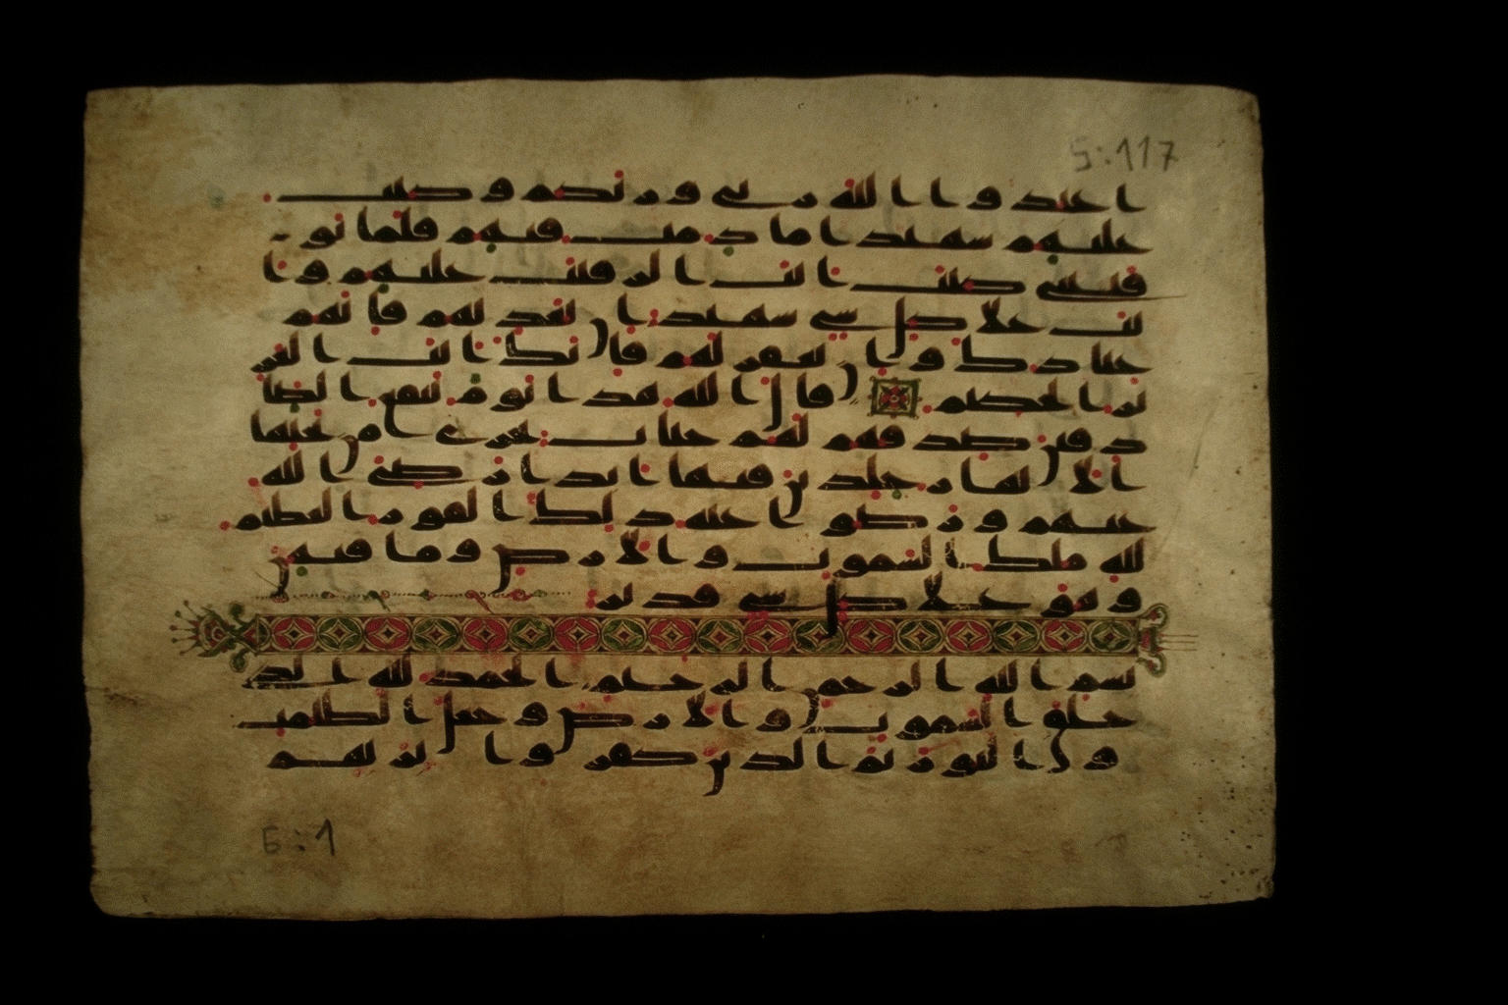
Muslim Claims of Inerrancy
Claim that the text is without error
Uthman
Sana’a Manuscripts
Generally refuse to allow translation because, unlike Christians, they require that we read a perfect Qur’an
Sana’a Manuscript

Slide 51
Part V Supposed Contradictions in the Bible
Claim: The Bible is full of obvious errors of fact and of doctrine, which is proved by all the contradictions it has with itself.
Possible Reactions:
Ignore the questions (a bad idea)
Think carefully and “Be prepared to give an answer” (1 Peter 3:15)

Slide 52
Bible “Contradictions”
Claims that the doctrine which is taught in two different passages is contradictory.
Identical events described by two different authors have details of fact that appear to contradict.
Numbers of objects, people or years in two different passages do not agree.

Slide 53
Bible “Contradictions”
Claim: The Bible is full of contradictions.
Genesis 7:17 vs Genesis 8:3 Forty days or 150 days?
Genesis 37:36 vs Genesis 39:1 Was Joseph sold to the Midianites or to the Ishmaelites?
Proverbs 26:4 vs Proverbs 26:5 Do we answer a fool?
Mathew 27:5 vs Acts 1:18 How did Judas die?
John 19:17 vs Mark 15:21-23 Who carried the cross?
More serious Exodus 20:4-5 vs Ezek 18:19-20
All-time most difficult: Matt 10:10, Luke 9:3 vs Mk 6:8 Were they to carry a staff?

Slide 54
Bible Contradictions (cont.)
“David took seven hundred (2 Samuel 8:4) or seven thousand (1Chronicles 18:4) horsemen from Hadadezer. Which is correct?”
“Exodus 20:8, ‘Remember the Sabbath day by keeping it holy’ contradicts Isaiah 1:13 ‘Your… Sabbaths and convocations—I cannot bear…’”

Slide 55
Bible Contradictions? Au-Contraire
The Bible has dozens of authors, yet a miraculously consistent message and theme.
Mesopotamians, Egyptians, Bedouins and Greeks
Priests, farmers, soldiers, kings, fishermen, prophets and prime ministers
Historians, poets, seers, teachers
The Bible is the greatest book in the world on…
Relationships
Philosophy
Family
Business/Finances

Slide 56
More Thoughts on Biblical Inspiration
Unity of theme, doctrine and theology
The Bible works
Changed Lives. John 7:17
The Bible is the best book in the world on…
Psychology
Teaching Look at Jesus’ parables
Literature (Psalms)
Wisdom (Proverbs)
Philosophy
Character, Ethics
Child Raising
Finances
Government Q: Other????

Slide 57
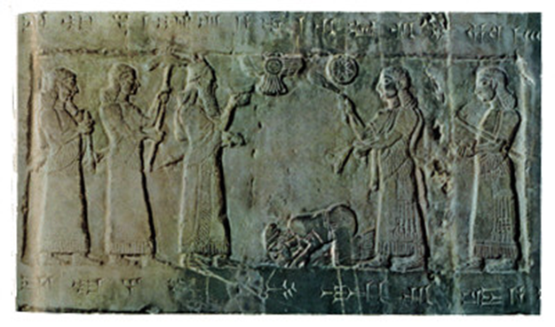
VI. OT History and Archaeology

Slide 58
DOMINANT POWERS DURING THE HISTORY OF ISRAEL
Dominant Power
Dates
Hittites and Egyptians
2000-900 BC
Assyria
900-606 BC
Babylon
605-539 BC
Persia
538-331 BC
Alexander and the Greek Dynasties
330-63 BC
Rome
After 63 BC

Slide 59
Ziggurat in Ur

Slide 60
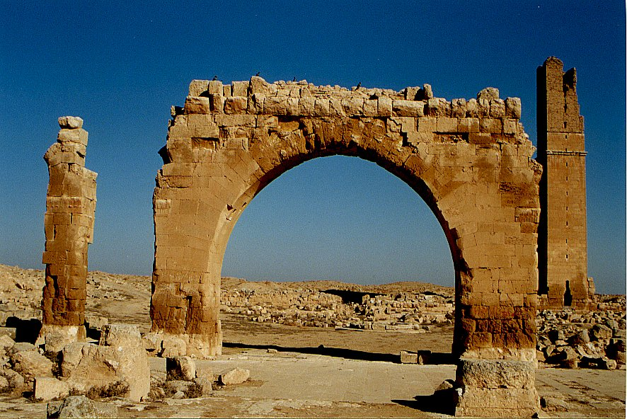
Haran Ruins In Mesopotamian Plane Near Sanli Urfa, Turkey

Slide 61
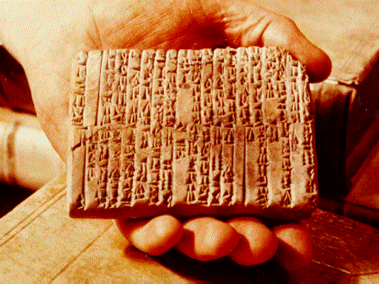
One of the Ebla Tablets about 2100 BC
Nahor, Terug, Abram, Sarai

Slide 62
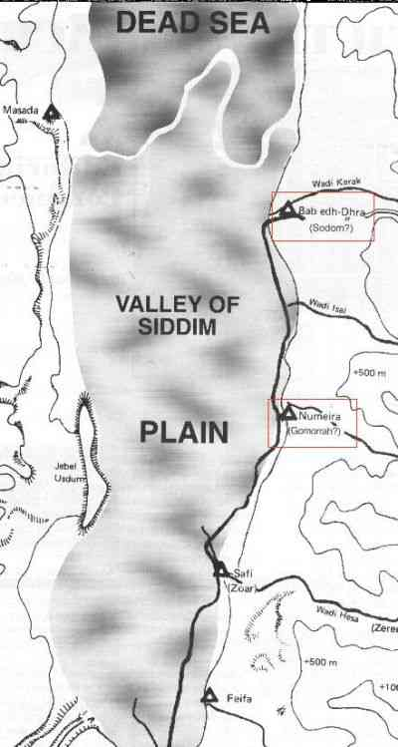
The Five City League, including Sodom and Gomorrah
Genesis 14:2

Slide 63
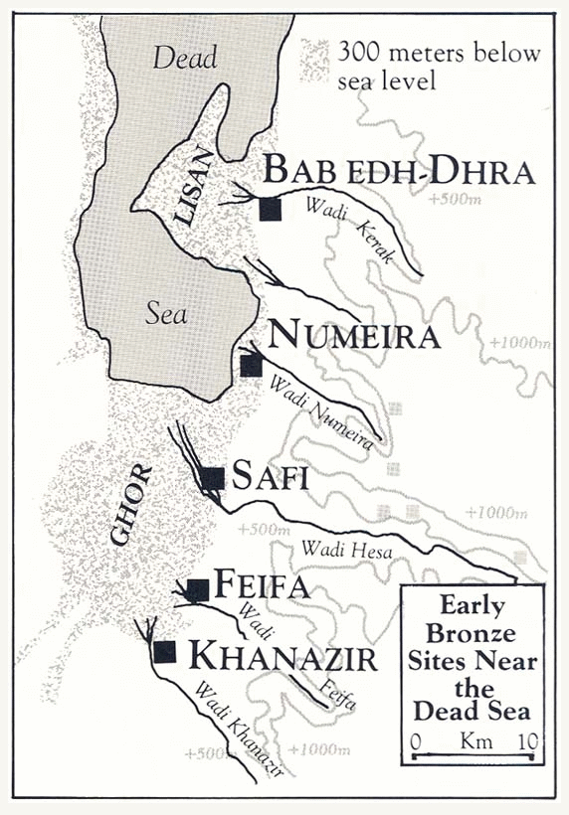

Slide 64
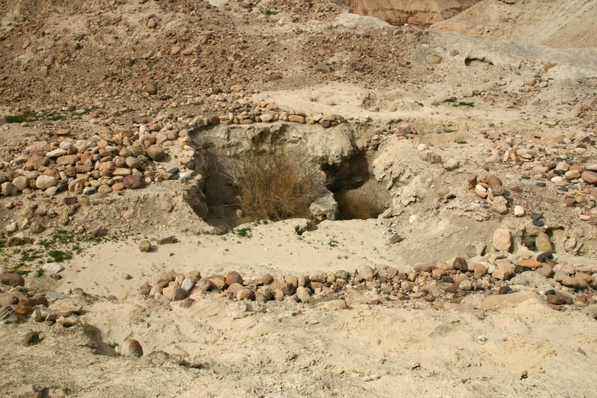
Ruins at Bab ed-Dhra (Sodom)

Slide 65
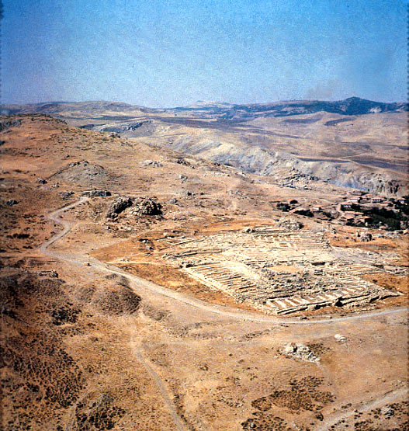
Ruins of Hattusha, capital of the Hittites

Slide 66
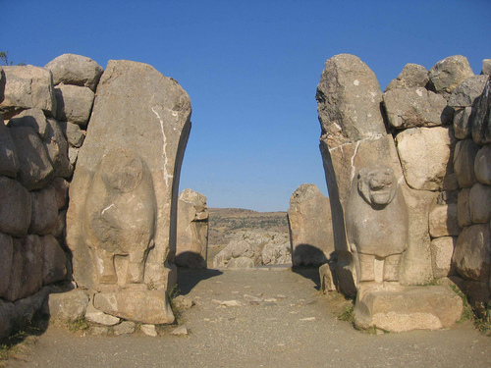
The Lion Gate in Hattusha

Slide 67
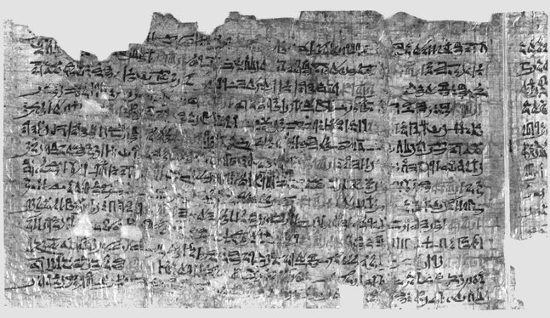
Papyrus Ipuwer
• 2:2—The river is blood = The river was turned to blood—Exod 7:20 • 2:6— Blood is everywhere = Blood is throughout all the land of Egypt— Exod 7:21 • 4:14—Trees are destroyed = And the hail… broke every tree in the field— Exod 9:25 • 9:11—The land is not light = And Moses stretched forth his hand… and there was a thick darkness— Exod 10:22 • 2:13—He who places his brother in the ground is everywhere = For there was not a house where there was not someone dead— Exod 12:30

Slide 68
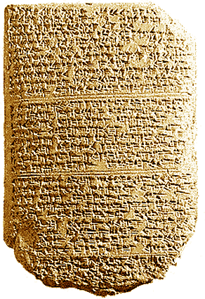
‘The Habiru plunder all lands of the king. If archers
are here this year, then the lands of the king, the
lord, will remain; but if the archers are not here,
then the lands of the king, my lord, are lost.’
One of the Tel El Amarna Letters c. 1400 BC

Slide 69
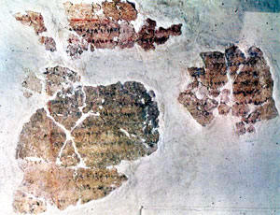
Deir Alla Inscription: Balaam the Seer
8th Century Jabbok River (Ammon)

Slide 70
Archaeological Facts about Jericho
1. The city was strongly fortified in the Late Bronze I period, the time of the Conquest according to the biblical chronology (Joshua 2:5,7,15).
2. The city was massively destroyed by fire (Joshua 6:24).
3. The fortification walls collapsed at the time the city was destroyed, possibly by earthquake activity (Joshua 6:20).
4. The destruction occurred at harvest time, in the spring, as indicated by the large quantities of grain stored in the city (Joshua 2:6, 3:15, 5:10).
5. The siege of Jericho was short, as the grain stored in the city was not consumed (Joshua 6:15,20).
6. Contrary to what was customary, the grain was not plundered, in accordance to the command given to Joshua (Joshua 6:17,18).

Slide 71
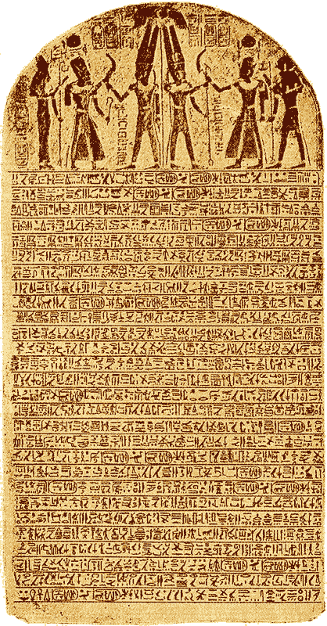
The Stele of Merneptah Egypt, 1230 BC
Mentions the Israelites in Canaan

Slide 72
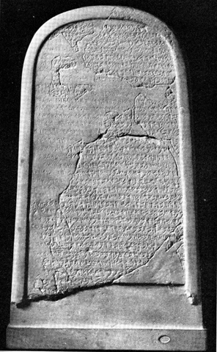
The Moabite Stone or Mesha Stele 870 BC
the Louvre
Ahab “of the house of Omri”
1 Kings 16:28

Slide 73
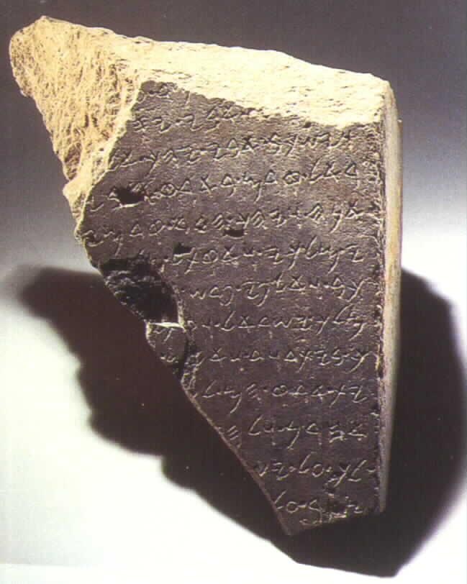
The Tel Dan Inscription
820 BC
2 Kings 8:28-29
‘I killed Jehoram, son of Ahab, king of Israel and I killed Ahaziah, son of Jehoram, king of the house of David”

Slide 74
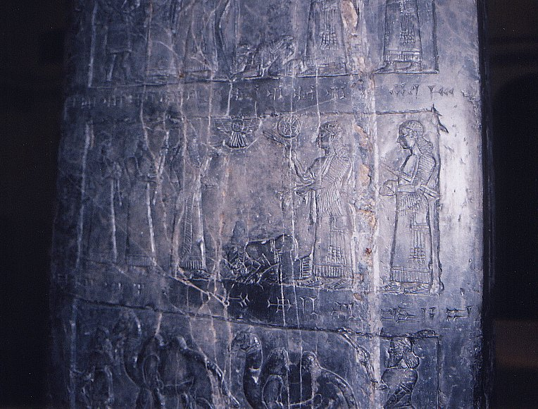
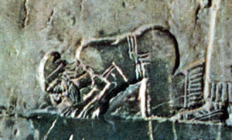
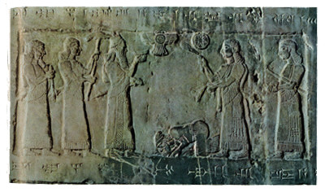
Black Obelisk of Shalmanezer III 840 BC
British Museum 2 Kings 17:3-6

Slide 75
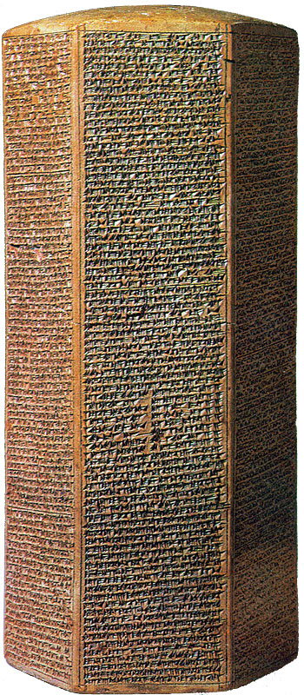
The Sennacherib Cylinder or Taylor Prism British Museum, London (2 Kings 18) 691 BC
As to Hezekiah the
Jew… I made him…
“like a bird in a
cage”

Slide 76
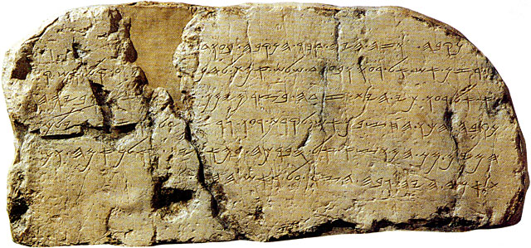
The Siloam Inscription.
2 Kings 20:20-21
"Now the rest of the acts of Hezekiah--all his might, and how he made a pool and a tunnel and brought water into the city--are they not written in the book of the chronicles of the kings of Judah? So Hezekiah rested with his fathers."

Slide 77
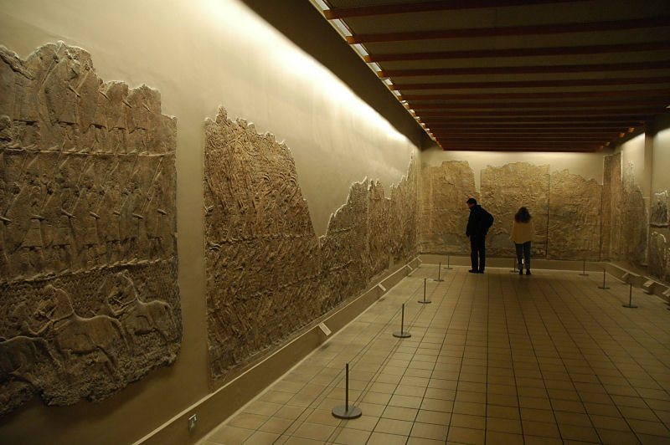
Lachish Room, British Museum

Slide 78
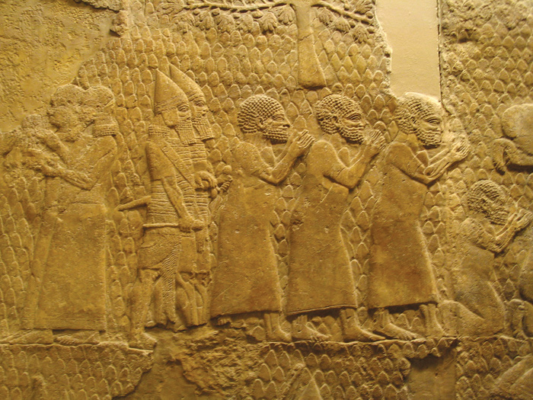
Israeli Captives Being Led from Lachish

Slide 79
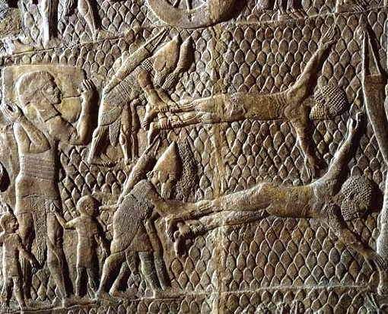
Jewish captives skinned alive in front of Lachish Walls

Slide 80
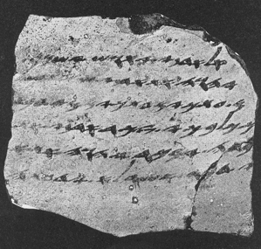
One of the Lachish Letters, 588 BC
Jeremiah 34:6,7

Slide 81
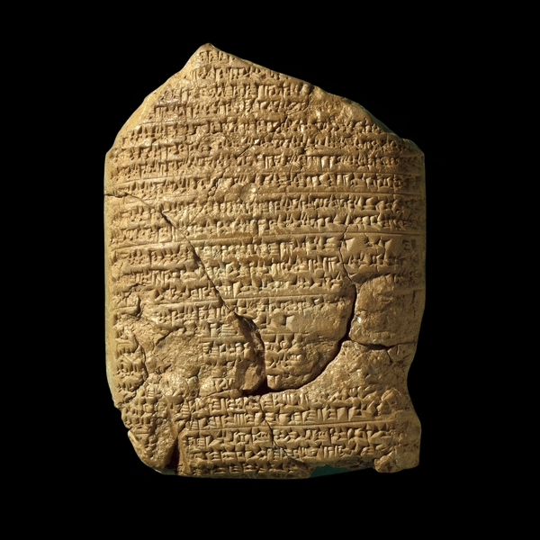
The Babylonian Chronicles British Museum, London, 597 BC 2 Kings 24:10-17
[In] the seventh year, the month of Kislev, the king of Babylonia mustered his forces and marched to Syria. He camped against the city of Judah (Jerusalem) and on the second day of the month of Adar he took the city and captured the king. He appointed a king of his own choice there, took its heavy tribute and brought them to Babylon.

Slide 82
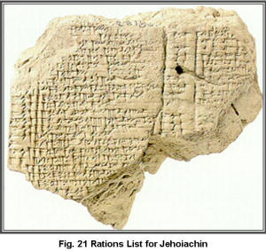
Yaukin (Jehoiachin), king of the land of Judah

Slide 83
Ziggurat in Ur: Nabonidus and Belshazzar

Slide 84
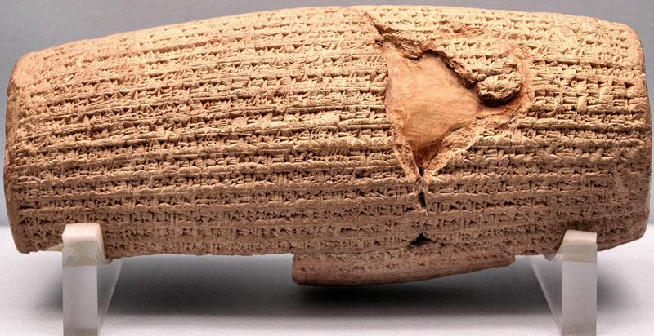
Cyrus Cylinder British Museum 535 BC
Ezra 1:2-4

Slide 85
VII. Messianic Prophecies
Luke 24:44 He said to them, “This is what I told you while I was still with you; Everything must be fulfilled that is written about me in the Law of Moses, the Prophets and the Psalms.

Slide 86
Good Questions:
Where these prophecies in fact written hundreds of years before Jesus lived?
Were they in fact written about the Jewish Messiah?
Might Jesus have arranged to fulfill the prophecies in order to support his claim to be the Mesiah?
Do we know from extra-biblical sources that Jesus did in fact do this?

Slide 87
Isaiah 53:1-13:
He was despised and rejected by men, a man of sorrows, familiar with suffering. (v. 3)
But he was pierced for our transgressions, he was crushed for our iniquities; the punishment that brought us peace was upon him, and by his wounds we are healed. (v. 5) (John 19:31-37)
He was oppressed and afflicted, yet he did not open his mouth; he was led like a lamb to the slaughter and as a sheep before her shearers is silent, so he did not open his mouth. (v. 7)

Slide 89
Micah 5:2
But you, Bethlehem Ephrathrah, though you are small among the clans of Judah, out of you will come for me one who will be ruler over Israel, whose origins are from old, from ancient times.
Isaiah 9:1,6
In the past he humbled the land of Zebulun and the land of Naphtali, but in the future he will honor Galilee of the Gentiles, by the way of the sea, along the Jordan…. For to us a child is born… And he will be called Wonderful Counselor, Mighty God, Everlasting Father, Prince of Peace.

Slide 90
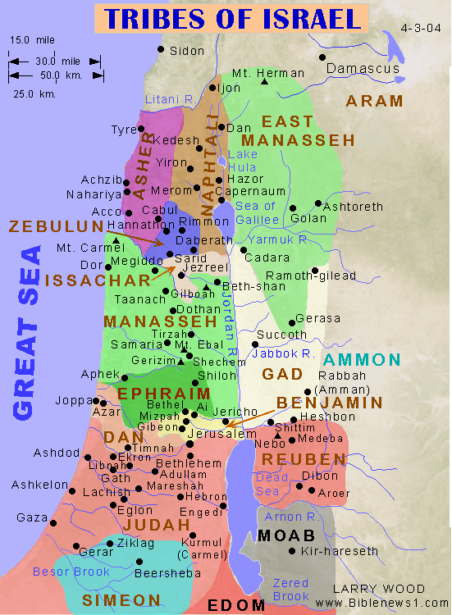

Slide 91
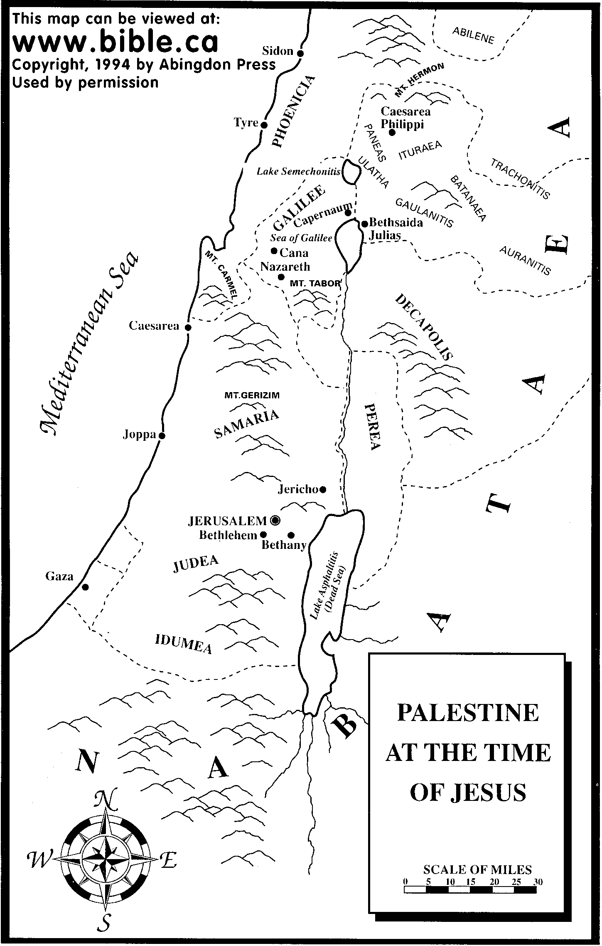

Slide 92
Psalm 22:16-18
Dogs have surrounded me;
a band of evil men have encircled me,
they have pierced my hands and my feet.
I can count all my bones; (John 19:3-37)
people stare and gloat over me.
They divide my garments among them
and cast lots for my clothing. (John 19:23,24)

Slide 95
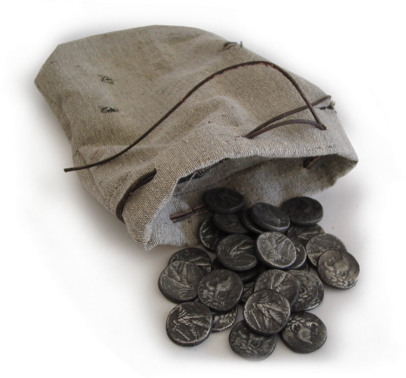
Zechariah 11:12,13
I told them, “If you think it best, give me my pay; but if not, keep it.” so they paid me thirty pieces of silver. (Matthew 26:14-16)
And the Lord said to me, “Throw it to the potter”—the handsome price at which they priced me! So I took the thirty pieces of silver and threw them into the house of the Lord, to the potter. (Matthew 27:3-8)

Slide 96
Daniel 9:24-26
Seventy ‘sevens’ are decreed for your people and your holy city to finish transgression, to put an end to sin, to atone for wickedness, to bring in everlasting righteousness, to seal up vision and prophecy and to anoint the most holy.
Know and understand this: From the issuing of the decree to restore and rebuild Jerusalem, until the Anointed One, the ruler comes, there will be seven ‘sevens’ and sixty two ‘sevens’
Decree of Artaxerxes (Ezra 7:12-26) 458 BC
458 BC - 490 years = -32 (no zero BC)

Slide 97
According to the Old Testament, the Messiah must:
Be born in Bethlehem
Be raised in Galilee near Nazareth
Be despised and rejected by men
Be meek and silent before his accusers
Be “pierced”
Be crucified
Have his garments divided and gambled over
Be betrayed for 30 pieces of silver
Come to Jerusalem to make atonement for sin in about AD 33
And many more….
Was all this an accident, or did God plan all along for the death of Christ for forgiveness of sins?

Slide 98
But There is More… A Lot More!
Historical Foreshadows
Prefigures of the Messiah

Slide 99
Foreshadows of the Messiah
You diligently study the Scriptures becauseyou think that by them you possess eternal life. These are the Scriptures that testify about me, yet you refuse to come to me to have life. John 5:39,40
Numbers 21:4-9 (John 3:14, Romans 6:23, 2 Corinthians 5:21)
Genesis 22:1-10 Abraham and Isaac

Slide 100
Prefigures of the Messiah
Jonah (Matthew 12:39-40, Jonah 1:12)
Adam
Melchizedek
Joseph
Moses
David
Elijah
Joshua
Deborah
Esther
Etc….

Slide 101
Parallels Between Moses and Jesus
Moses
Jesus
Pharaoh tried to kill him
Herod tried to kill him
Called by God to leave Egypt
Carried out of Egypt
Forty years in the wilderness to prepare for his ministry
Forty days in the wilderness to prepare for his ministry
Left his position with the king of Egypt to dwell with the Jews
Left the right hand of the Father to life with the Jews
Led Israel out of slavery in Egypt
Leads Spiritual Israel out of sin
Aaron prepared the way
John the Baptist prepared the way
Baptized Israel in the Red Sea in order to free them
Commands baptism in water for freedom from sin
Gave manna in the wilderness
(sort of)
Gives spiritual bread to all who hunger
Gave water to the people in the desert
Gives spiritual water: the Holy Spirit
Spoke to God on Mt. Sinai
Spoke to God on Mt. Hermon

Slide 102
VIII. Daniel Chapter Two:
Nebuchadnezzar’s Vision of a Great Statue
Part of the Statue | Nation
Head of Gold | Babylon
Chest of Silver | Persia/Media (539 BC)
Belly of Bronze | Greece (331 BC)
Legs of Iron | Rome (31 BC)

Slide 103
Babylon
Persia/Media
Greece
Rome: A divided kingdom

Slide 104
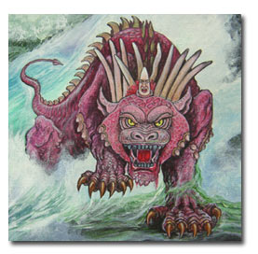
Daniel 7: Ten Horns and a Little Horn

Slide 105
The First Eleven Emperors of Rome
Emperor
Dates of Rule
Significance to Biblical Events
Augustus
27 BC-14 AD
Birth of Christ
Tiberius
14 AD-37 AD
Crucifixion of Christ
Gaius (Caligula)
37 AD-41 AD
Claudius
41 AD-54 AD
Jews Exiled from Rome
Nero
54 AD-68 AD
First persecutions, Execution of Paul and Peter
Galba
68 AD-69 AD
One of the three overcome by Vespasian
Otho
69 AD-70 AD
One of the three…
Vitellius
69 AD-70 AD
One of the three…
Vespasian
69 AD-79 AD
Attack on Jerusalem
Titus
79 AD-81 AD
The general who destroyed Jerusalem
Domitian
81 AD-96 AD
First Systematic Persecutor of the Church

Slide 106
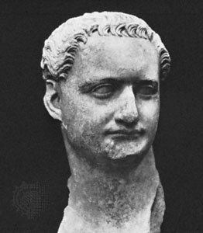
Domitian (c. 81-96 AD)

Slide 107
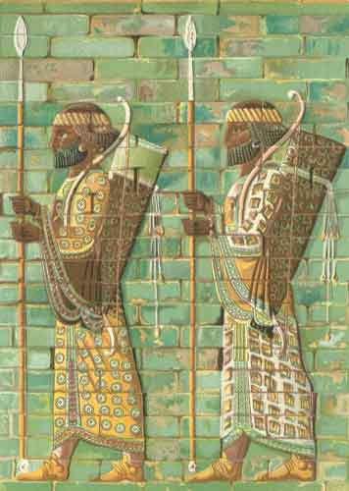
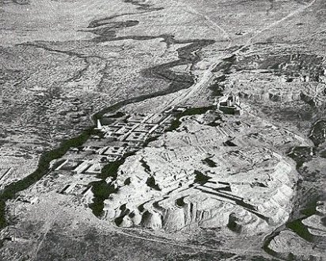
Daniel Chapter Eight: A Ram and a Goat
Ancient Susa and the Ulai Canal

Slide 108
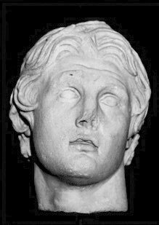
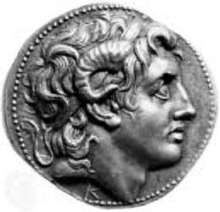
Alexander the Great

Slide 109
The Four Horns of Daniel Eight
Horn (King)
Territory Ruled
Antigonus
The East. From Syria to India.
Cassander
The West. Macedonia and Greece.
Lysimachus
The North. Thrace and Asia Minor.
Ptolemy
The South. Egypt and Palestine.

Slide 110
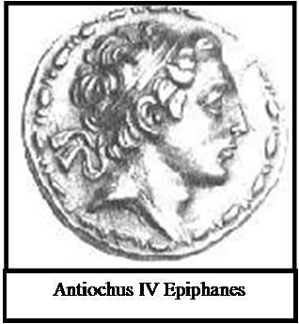
Daniel 8: The Abomination of Desolation

Slide 111
Daniel Chaper Nine: The Messiah Comes to Jerusalem
Seventy sevens = 490 years
The decree to restore and rebuild Jerusalem
Ezra 7:13-16 458 BC
458 - 490 = AD 32
No…… (no zero BC) = AD 33

Slide 112
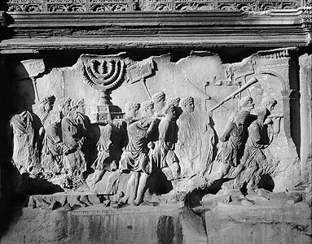
Romans Taking Spoils of Jerusalem from the Arch of Titus, Rome, c. 81 AD

Slide 113
The Kings of the South and the Kings of the North in Daniel Eleven
Kings of the South
Kings of the North
Daniel 11 Verse
Ptolemy I 323-283 BC
Seleucus I Nicator 321-282 BC
Daniel 11:5
Ptolemy II Philadelphus 283-247 BC
Antiochus I Soter 280-261 BC
Daniel 11:6
Antiochus II Theos 261-246 BC
Daniel 11:6
Ptolemy III Eugertes 247-221 BC
Seleucus II Callinicus 246-226 BC
Daniel 11:7,8
Seleucus III Soter 226-223 BC
Daniel 11:8
Ptolemy IV Philopator 221-203 BC
Antiochus III “The Great” 223-187 BC
Daniel 11:9-19
Ptolemy V Epiphanes 203-181 BC
Seleucus IV Philopator 187-175 BC
Daniel 11:20
Ptolemy VI Philometor 180-146 BC
Antiochus IV Epiphanes 175-164 BC
Daniel 11:21-35
Antiochus V Eupator 164-162 BC
(v. 6) After some early, indecisive struggles, the Ptolemaic kingdom and the Seleucid kingdom will agree to share power peacefully. In order to seal the deal, Ptolemy II

Slide 114
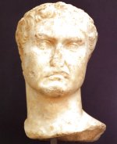
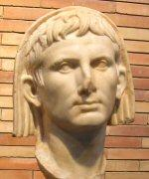
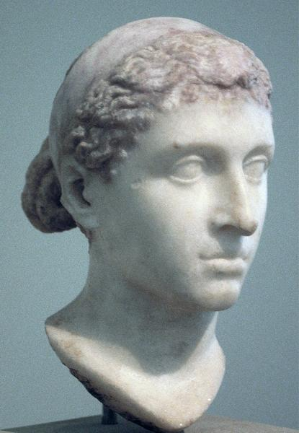
Daniel 11:36-45 The Final End of the Greek Kingdoms
Marc Antony (Museum of Fine Art, Budapest)
Bust of Octavian/Augustus as high priest. Museo Nacional de Arte Romano,
http://www.livius.org/
Cleopatra (Altes Museum, Berlin)

Slide 115
The Theme of Daniel Eleven
Those who are wise will instruct many, though for a time they will fall by the sword or be burned or captured or plundered. When they fall, they will receive a little help, and many who are not sincere will join them. Some of the wise will stumble, so that they may be refined, purified and made spotless until the time of the end, for it will come at the appointed time. 11:33-35

Slide 116
More Evidence for Inspiration
Scientific Accuracy (especially Genesis 1)
Laws with medical implications

