Slide 1
Deuteronomy 8
Entering the Promised Land

Slide 2
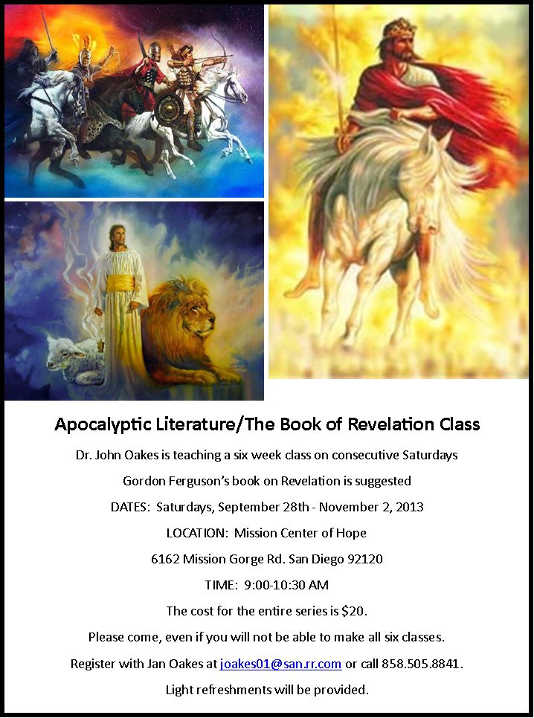
Revelation Class
Starting 9/28
Mission Center
Of Hope
Sign-up Today 5

Slide 3
In the wilderness: The life of a disciple
OLD TESTAMENT TYPE
NEW TESTAMENT ANTITYPE
SLAVERY IN EGYPT
LOST, SLAVE TO SIN
WANDERING IN THE WILDERNESS
LIVING THE LIFE OF A DISCIPLE
ENTERING THE PROMISED LAND
ENTERING HEAVEN

Slide 4
Deuteronomy 8:1
God’s purpose for us:

Slide 5
Deuteronomy 8:1
God’s purpose for us:
To prosper in this life
To make it to heaven
Remember Hebrews 3:16-19 Their bodies were scattered across the desert.

Slide 6
Deuteronomy 8:2
How will God bless us and get us into heaven?

Slide 7
Deuteronomy 8:2
How will God bless us and get us into heaven?
By humbling us and by testing us.
Why?
So that we will keep his commandments. Deut 8:2b

Slide 8
Deuteronomy 8:3
How will God humble us?

Slide 9
Deuteronomy 8:3
How will God humble us?
By causing us to be hungry.
How has God caused you to hunger?

Slide 10
Deuteronomy 8:3
He caused you to hunger, then he fed you with manna.
God meets our needs, but not the way we would have chosen.
Ex: Numbers 21:4-9
Numbers 11:4-6

Slide 11
Deuteronomy 8:4
Your clothes did not wear out and your feet did not swell during these forty years.
We need to recognize and appreciate God’s “little miracles” every day.

Slide 12
Deuteronomy 8:5
What is God’s plan for blessing you?

Slide 13
Deuteronomy 8:5
What is God’s plan for blessing you?
…the Lord your God disciplines you…

Slide 14
Deuteronomy 8:6-9
Why does God discipline us?

Slide 15
Deuteronomy 8:6-9
Why does God discipline us?
So that he can bless us.
Two ways God humbles us:
1. By giving us a lot of blessings.
2. By taking those blessings away from us.

Slide 16
Deuteronomy 8:11-14 A Solemn Warning
When God blesses you, you better praise God!
Don’t become comfortable….
Q: Are we Americans tempted to become comfortable?
v. 14 Then your heart will become proud.

Slide 17
Deuteronomy 8:15-18
He humbled you…
He blessed you…
He humbled you…
He blessed you…
So do not be a prideful dog!
1 Corinthians 4:17

Slide 18
Conclusion: Deuteronomy 8:19
Do not EVER forget the Lord your God

