Slide 1
Jeremiah
THE Burden of the Lord

Slide 2
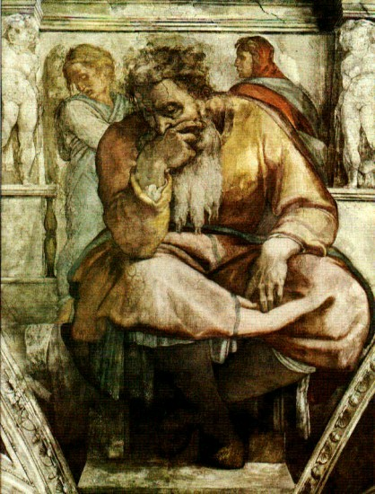
jeremiah
The Weeping Prophet
The Burden of the Lord
(Jeremiah 23:33)

Slide 3
It All went downhill…
Jeremiah 1:1-3
13th Year of Josiah 615 BC A Great king.
Jehoikim 609-597 BC Blinded by Nebuchadnezzar
Zedekiah 597-586 Turned to Egypt
Jerusalem and the Temple Destroyed 586
Captivity
Jeremiah stoned to death in Egypt
Jer 1:4-9 Jeremiah is not fired up about his mission

Slide 4
Jeremiah’s Mission
Jer 1:4-19
Say whatever I command you Jer1:7-8
Preach judgment is coming “from the North” Jer 1:14

Slide 5
God’s Charge Against his people
Jer 2:4-5 Is God exaggerating?
Jer 2:11-13 How do we become worthless?
Titus 1:15-16

Slide 6
Jeremiah’s Message: Repent and REturn
3:14 Return and I will choose you.
3:22 Return from backsliding.
4:3 Turn over unplowed ground.
4:8 Put on sackcloth and ashes.

Slide 7
Jeremiah’s Critique
Jer 6:13-15
Dress the wounds of the people lightly
Say “peace, peace” when there is no peace
No longer ashamed
Jer 6:16-20 The solution?
Stand at the crossroads
Walk in the ancient paths

Slide 8
Jeremiah Announces good news
Jer 23:1-8
Jer 29:1-14
Jer 30:1-11
v. 28 A covenant of blessing
v. 29-30 A personal relationship
v. 34 Forget their wickedness
v. 36-37 Never again will I remove the blessing
Jer 31:27-37
Jer 33:12-22

