Slide 1
The Moral Question of Abortion
Presented By Kedron Jones

Slide 2
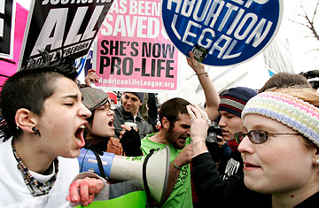
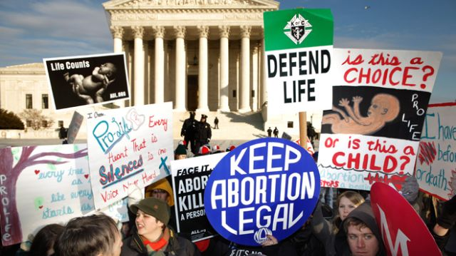
Is Abortion A Complex Issue?

Slide 3
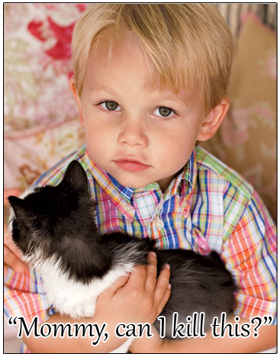
The Key Issue: What Is the Unborn?
This question trumps all other considerations

Slide 4
The Key Issue: What Is the Unborn?
People will say that women ought to have a right to privacy.
People will say, “Would you force a poor woman to bring another child into this world!”
People will say, “You mean to tell me that you would force women into the back alleys to have illegal abortions because you want to protect a bunch of embryos!”

Slide 5
The Key Issue: What Is the Unborn?
“If the unborn is not a human being, then no justification for abortion is necessary. However, if the unborn is a human being, then no justification for abortion is adequate.”
-Gregory Koukl, Pro-Life Apologist

Slide 6
One Point of Observation
“I don’t know if the unborn are human and I think that abortion should be legal anyway.”

Slide 7
One Point of Observation (Cont.)

Slide 8
One Point of Observation (Cont.)
“I’m pro-life and am against abortion but I am glad it’s legal because I would never force my belief on others.”

Slide 9
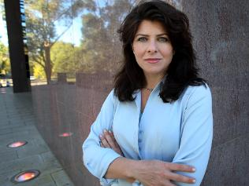
"The pro-choice movement often treats with contempt the pro-lifers' practice of holding up to our faces their disturbing graphics....[But] how can we charge that it is vile and repulsive for pro-lifers to brandish vile and repulsive images if the images are real? To insist that the truth is in poor taste is the very height of hypocrisy. Besides, if these images are often the facts of the matter, and if we then claim that it is offensive for pro-choice women to be confronted with them, then we are making the judgment that women are too inherently weak to face a truth about which they have to make a grave decision. This view is unworthy of feminism.” -Naomi Wolf, "Our Bodies, Our Souls," New Republic, 16 October 1996

Slide 10
“A culture can trivialize injustice so long as it never has to look at it.” –Gregg Cunningham, Pro-Life Apologist

Slide 11
The Pro-Life Position
“From the earliest stages of development, the unborn are distinct, living, and whole human beings. Therefore, every “successful” abortion ends the life of a living human being.”

Slide 12
The Pro-Life Position
It is prima facie immoral to kill an innocent human being.
2. Abortion kills an innocent human being.
3. Therefore, abortion is immoral.

Slide 13
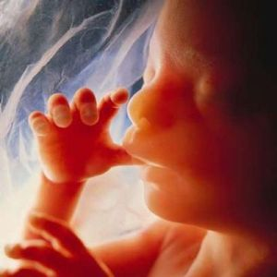
What Is The Unborn (The Scientific Case)?
“Scientifically we know that from the earliest stage of development that the unborn are distinct, living and whole human beings.”

Slide 14
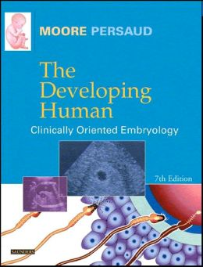
What Is The Unborn (The Scientific Case)?
"Human development begins at fertilization, the process during which a male gamete or sperm (spermatozoo development) unites with a female gamete or oocyte (ovum) to form a single cell called a zygote. This highly specialized, totipotent cell marked the beginning of each of us as a unique individual." "A zygote is the beginning of a new human being (i.e., an embryo)." (Keith L. Moore, The Developing Human: Clinically Oriented Embryology, 7th edition. Philadelphia, PA: Saunders, 2003. pp. 16, 2.)

Slide 15
Distinct (i.e., separate from their parents, not identical to their parents).
Unique genetic fingerprint (The unborn’s DNA is its own unique identity): An egg with 23 of the mother’s chromosomes unites with a sperm with 23 of the father’s chromosomes to create an individual living thing. The zygote is different from every other living cell because it has its own DNA fingerprint.
Different blood type: It is medically impossible for a single individual to have two completely different blood types.
Different gender: If a woman is pregnant with a boy then it means that she also has a penis, two more eyes, legs, arms and etc. Even if the woman had a female, it means the pregnant woman has an extra vagina.

Slide 16
Living (i.e., dead things don’t grow and the embryo is growing).
Embryology teaches that individual human life begins at conception. This refutes the idea that no one knows when life begins.
There is no doubt that the zygote is biologically alive. It fulfills the four criteria needed to establish biological life: 1) Metabolism, 2)Growth, 3) Reaction to Stimuli, and 4) Reproduction.
The only thing the unborn need to survive are adequate nutrition, a proper environment, and an absence of fatal threats. That’s all any of us need. There is no point in human development at which the developing entity goes from non-life to living.

Slide 17
Whole Human Being
The Law of Biogenesis: Living things reproduce after their own kind (i.e., dogs produce dogs and humans produce humans). Because the unborn come from human parents, they too are a part of the human family and we ought not to harm them without justification. Elective abortion harms a member of the human family without justification, that’s why pro-lifers oppose it.
Genetically they are human: The unborn may not seem to “look” human (at least in her earlier stages), but in fact she looks exactly like a human at that level of human development. Living things do not become something different as they grow and mature; rather, they develop the way that they do precisely because of the kind of being they already are.”
“Most importantly, the embryo is a complete or whole human organism rather than part of another living entity. All of its cells together in tandem toward the growth of a single entity, the embryo.” (The Case for Life, Pg. 37-38).

Slide 18
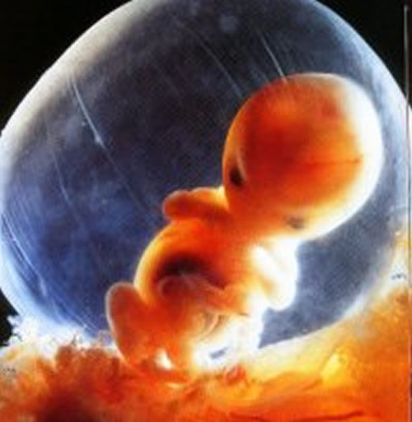
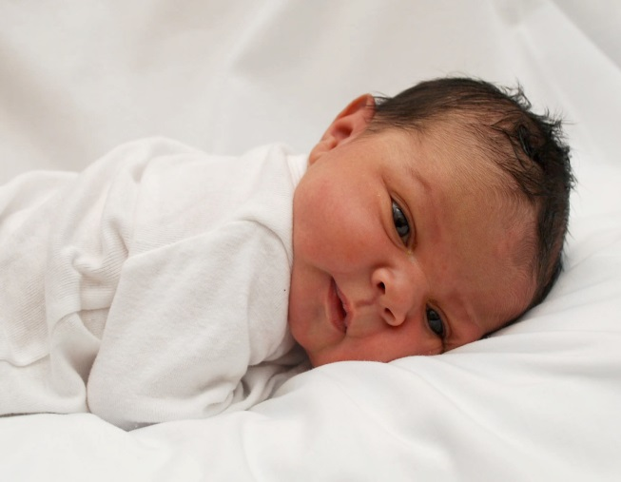
What Makes Humans Valuable (The Philosophical Case)?
“Humans have intrinsic value, and are not valuable because of some function they can perform. If humans are valuable simply because of some function there will be difficulty justifying the value for all humans.”

Slide 19
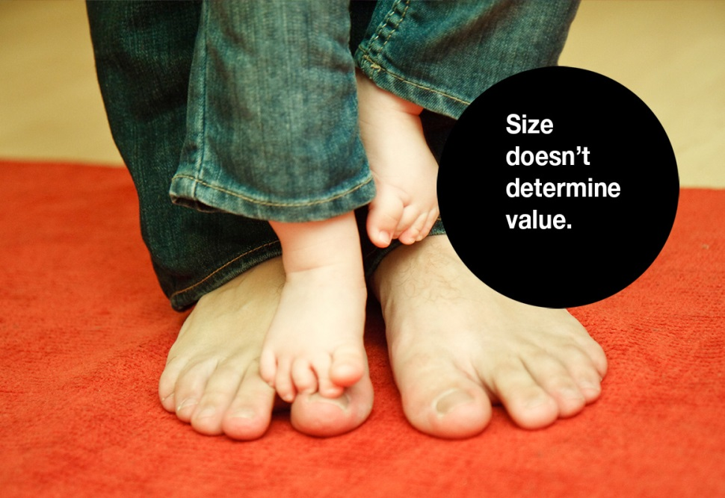
Size

Slide 20
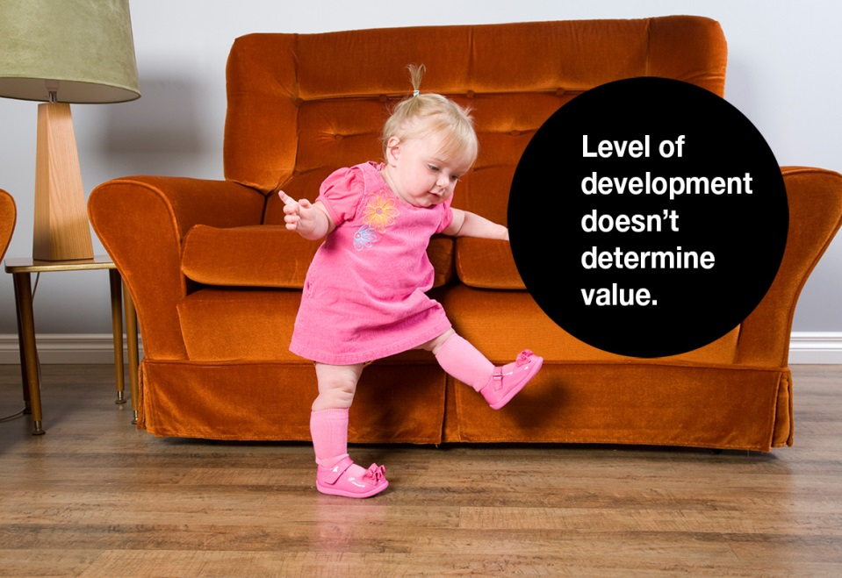
Level of Development

Slide 21
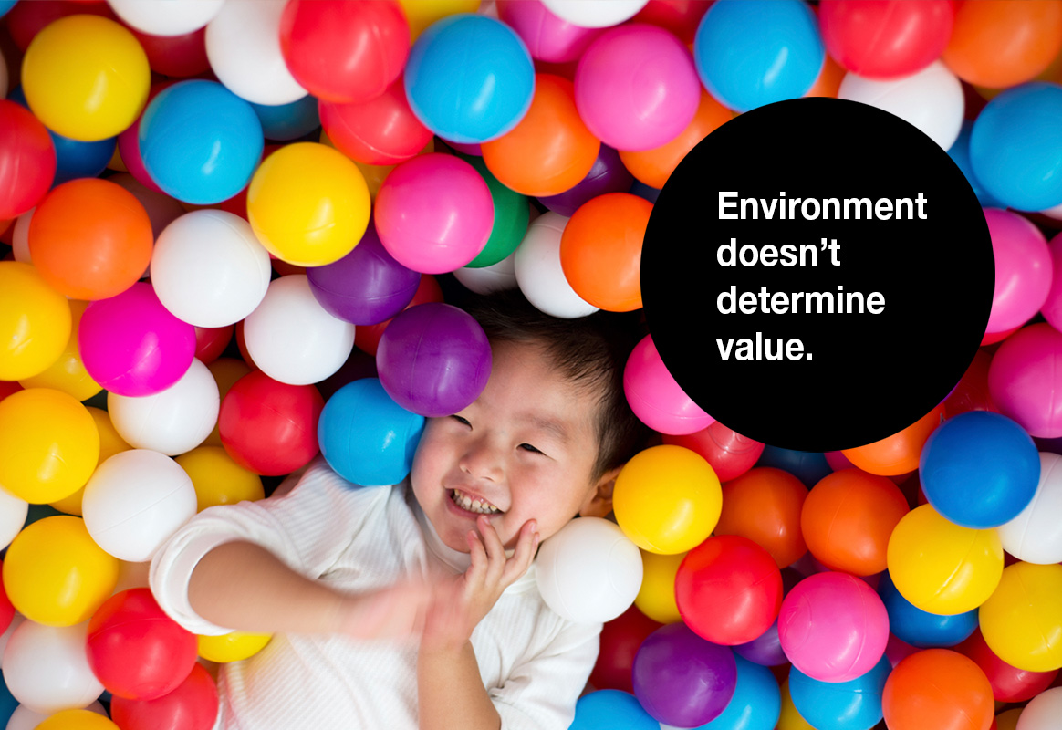
Environment

Slide 22
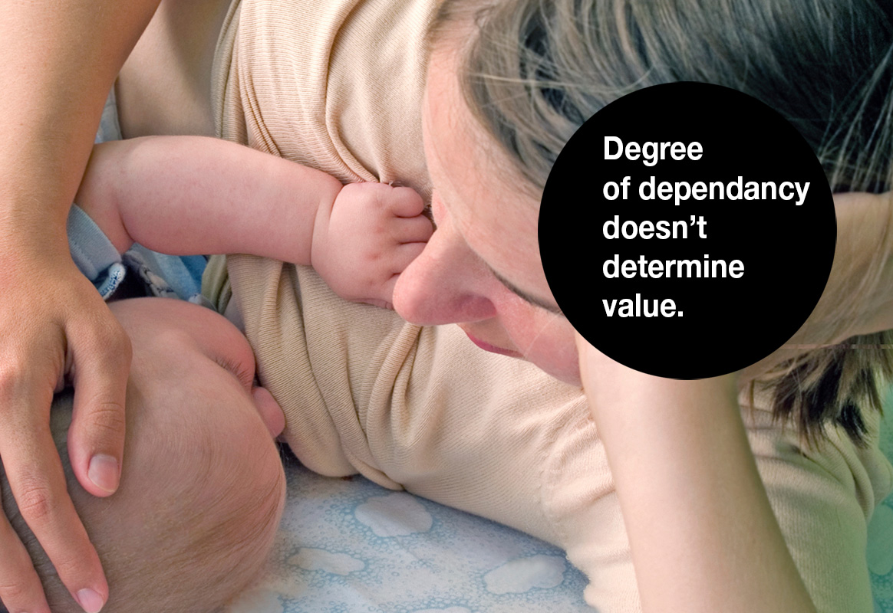
Degree of Dependency

Slide 23
S.L.E.D. Test
Size (or Physical Appearance): Some will argue that the unborn are tiny. But does size really matter? Men are generally larger than women, does this make men more valuable than women?
Level of Development: The unborn doesn’t have the same abilities as real persons. Two year olds are less developed then 21 year olds, can we kill them? Peter Singer argues that we can kill babies up to 21 days.
Environment: The unborn isn’t located in the right place as real persons. This is implicit in abortion laws.
Degree of Dependency: The unborn is too dependent on others (i.e., he’s not viable). Can we kill conjoin twins since they are dependent on each other?

Slide 24
Five Bad Ways to Argue About Abortion
1. Confuse objective claims with subjective claims.
2. Attack the person rather than refute the argument.
3. Assume what you are trying to prove.
4. Confuse human value with human function.
5. Disguise your true position by appealing to the hard cases.

Slide 25
“The measure of how much we care about this issue will not be found in the piety of our rhetoric, but in how much we are willing to sacrifice personally to stop the killing”
-Gregg Cunningham, Pro-Life Apologist

