Slide 1
In Christ
Baptism in the New Testament

Slide 3
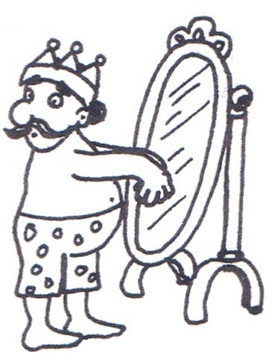
Matthew 22:1-14
Wearing the wrong clothes

Slide 4
A Question for Thought:
What is the most common phrase in the New Testament to describe a saved person?

Slide 5
A Question for Thought:
What is the most common phrase in the New Testament to describe a saved person?
In Christ
2 Cor 5:17, Eph 1:13, Eph 2:13, 1 Pet 5:14, many more.

Slide 6
Another Question:
How does one get into Christ?

Slide 7
Another Question:
How does one get into Christ?
Answer: Baptism!!!
Nothing else in the entire NT is connected with getting into Christ except baptism.
Pray into Christ?
Believe into Christ?
Repent into Christ?

Slide 8
In Christ
Romans 6:1-7
The man had not been buried with Christ.
The man had not been united with Christ in his resurrection.
The man had not been freed from sin.

Slide 9
A Trick Question:
Are we saved by baptism?

Slide 10
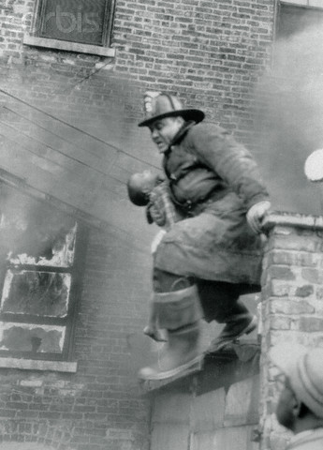
A Trick Question:
Are we saved by baptism?
Answer: yes and no
1 Peter 3:21-22
Illustration: A child in a burning building.

Slide 11
An Easy Question:
Is baptism how we are saved?

Slide 12
An Easy Question:
Is baptism how we are saved?
NO!!!!!
Romans 3:21-16 …through faith in his blood.
Rev 7:13-14 Clothes washed in the blood of the lamb

Slide 13
So What Is Baptism. Biblically?
It is when we are saved. It is when we get into Christ.
Illustration: Marriage
What if you weren’t married?
What if you weren’t baptized?

Slide 14
Acts 22:6-16
When were Paul’s clothes washed?
When he believed? v. 8
When he repented? v. 9
When he declared Jesus Lord? v.10
When he obeyed? v. 11
When he was baptized!

Slide 15
Who Is the Man at the Banquet?
He is anyone who thinks they are saved but are not.
He is 90+% of everyone we meet!!!!

Slide 16
What Should We Do?
What would you do if there were some people in a burning building?
We can’t be sentimental about this.

Slide 17
A Ridiculously Brief History of Baptism
Epistle of Barnabas AD 110
We indeed descend into the water full of sins and defilement. However, we come up, bearing fruit in our heart…
Shepherd of Hermas AD 95
The seal, then, is the water. They descend into the water dead, and they arise alive.
Irenaeus of Lyon AD 185
This class of men have been instigated by Satan to denial of that baptism which is regeneration to God. Thus they have renounced the whole faith.
Tertullian of Carthage AD 205
Without baptism salvation is attainable by no one.

Slide 18
History of Baptism (cont.)
2nd Century: Catachumens
Mid 4th century infant baptism practiced by some, but not generally accepted (Cyprian)
Late 4th century infant baptism encouraged (Augustine)
Augustine made baptism more than it was (a sacrament with power in and of itself, not requiring faith on the part of the believer)
After AD 1000 sprinkling became a common practice

Slide 19
History of Baptism (cont.)
1500’s Luther, Zwingli and Calvin reject the Catholic idea of sacrament. Faith alone salvation.
Result: Baptism not absolutely necessary?
1800’s Happy Predestination and the sinner’s prayer. Salvation became completely disconnected from baptism.

Slide 20
The Sinner’s Prayer
Never mentioned anywhere before the 19th century in the US.
Even evangelicals will admit that this was not taught in the early church..
Evangelicals as slowly coming around on the Sinner’s prayer (Francis Chan, etc.)

