Slide 1
Who Said Jesus was a Myth!?
By, Brian Colón

Slide 2
2 Peter 1:16
?
“For we did not follow cleverly devised myths when we made known to you the power and coming of our Lord Jesus Christ, but we were eyewitnesses of his majesty.”
Notes:
This ENTIRE presentation centers on whether or not Peter was lying here.
We can’t say that he thought Jesus was real but wasn’t
Peter’s “eyewitness” testimony is attested by Luke, John, and Paul

Slide 3
Overview
Historians don’t talk about mythical people as if they actually existed.
Mythical stories are not said to have occurred in the context of historical events.
The stories of Jesus contain actual people.
Osiris and Mithras look nothing like Jesus!

Slide 4
Historians don’t talk about mythical people as if they actually existed.

Slide 5
Historians
Flavius Josephus
Publius Cornelius Tacitus

Slide 6
Flavius Josephus
Now there was about this time Jesus, a wise man, if it be lawful to call him a man; for he was a doer of wonderful works, a teacher of such men as receive the truth with pleasure. He drew over to him both many of the Jews and many of the Gentiles. He was Christ. And when Pilate, at the suggestion of the principal men amongst us, had condemned him to the cross, those that loved him at the first did not forsake him; for he appeared to them alive again the third day; as the divine prophets had foretold these and ten thousand other wonderful things concerning him. And the tribe of Christians, so named from him, are not extinct at this day. (Antiquities of the Jews, Book 18, Chapter 3, Verse 3)
Now there was about this time Jesus, a wise man, if it be lawful to call him a man; for he was a doer of wonderful works, a teacher of such men as receive the truth with pleasure. He drew over to him both many of the Jews and many of the Gentiles. He was Christ. And when Pilate, at the suggestion of the principal men amongst us, had condemned him to the cross, those that loved him at the first did not forsake him; for [they reported that] he appeared to them alive again the third day; as the divine prophets had foretold these and ten thousand other wonderful things concerning him. And the tribe of Christians, so named from him, are not extinct at this day. (Antiquities of the Jews, Book 18, Chapter 3, Verse 3)
Notes:
Josephus was…
a Jewish Historian
Born in AD 37
What is the difference between a Christian and a Jew?
A Jew doesn’t believe that Jesus is the Messiah
Messiah -> Mashiach -> Christos -> Christ
“Now there was ABOUT THIS TIME Jesus, a wise man…”
Josephus was talking about Pontius Pilate before this
The “Christian sounding” parts are easy to bracket.

Slide 7
Arabic Version
At this time there was a wise man who was called Jesus. And his conduct was good, and he was known to be virtuous. And many people from among the Jews and the other nations became his disciples. Pilate condemned him to be crucified and to die. And those who had become his disciples did not abandon his discipleship. They reported that he had appeared to them after his crucifixion and that he was alive; accordingly, he was perhaps the Messiah concerning whom the prophets have recounted wonders. (Arabic summary, presumably of Antiquities 18.63. From Agapios’ Kitab al-’Unwan (“Book of the Title,” 10th c.). See also James H. Charlesworth, Jesus Within Judaism, (http://ccat.sas.upenn.edu/~humm/Topics/JewishJesus/josephus.html).
Notes:
Found in 1971

Slide 8
Flavius Josephus
…Albinus was but upon the road; so he assembled the Sanhedrim of judges, and brought before them the brother of Jesus, who was called Christ, whose name was James, and some others… (Antiquities of the Jews, Book 18, Chapter 3, Verse 3)

Slide 9
From Josephus
Jesus was alive while Pilate was the procurator of Judea.
Jesus had a brother named James
Jesus was a wise teacher.
Many Jews and Gentiles followed him.
Pilate condemned him to the cross.
His followers reported that they had seen him alive after his death.
The Christian movement was still in existance when Josephus wrote.

Slide 10
Cornelius Tacitus
...Nero fastened the guilt and inflicted the most exquisite punishments on a class hated for their disgraceful acts, called Christians by the populace. Christ, from whom the name had its origin, suffered the extreme penalty (i.e., Crucifixion) during the reign of Tiberius at the hands of one of our procurators, Pontius Pilatus, and a most mischievous superstition, thus checked for the moment, again broke out not only in Judea, the first source of the evil, but even in Rome, where all things hideous and shameful from every part of the world find their center and become popular.
Notes:
Tacitus:
Born in AD 56 (around the same time Paul was writing 1 Corinthians).
Here is writing about the fire that broke out in Rome, late in the summer of AD 64.
Nobody knew for sure who started that fire, but it was rumored that Emperor Nero himself did it.
According to Tacitus, Nero framed the Christians

Slide 11
Cornelius Tacitus
Accordingly, an arrest was first made of all who pleaded guilty; then, upon their information, an immense multitude was convicted, not so much of the crime of firing the city, as of hatred against mankind. (Tacitus, Annals 15.44)
Notes:
Tacitus:
Born in AD 56 (around the same time Paul was writing 1 Corinthians).
Here is writing about the fire that broke out in Rome, late in the summer of AD 64.
Nobody knew for sure who started that fire, but it was rumored that Emperor Nero himself did it.
According to Tacitus, Nero framed the Christians

Slide 12
From Tacitus
There was a group known as "Christians"
They were named after someone named "Christ"
He was executed under Pontius Pilate during the reign of Tiberius Caesar
The Romans considered the Christians superstitious
The Christians were hated and were alleged to perform "abominations"
The movement originated in Judea
The movement spread to Rome
By AD 64 there was a vast multitude of them in Rome.

Slide 13
Paul
For what I received I passed on to you as of first importance: that Christ died for our sins according to the Scriptures, that he was buried, that he was raised on the third day according to the Scriptures, and that he appeared to Cephas, and then to the Twelve. After that, he appeared to more than five hundred of the brothers and sisters at the same time, most of whom are still living, though some have fallen asleep. Then he appeared to James, then to all the apostles, and last of all he appeared to me also, as to one abnormally born. (1 Corinthians 15:3-8)
Notes:
1 Corinthians was written in AD 55
The oral tradition is much earlier.
Robert Price thinks that this section of the scripture is an interpolation

Slide 14
Mythical stories are not said to have occurred in the context of historical events.

Slide 15
Historical Context
In the fifteenth year of the reign of Tiberius Caesar—when Pontius Pilate was governor of Judea, Herod tetrarch of Galilee, his brother Philip tetrarch of Iturea and Traconitis, and Lysanias tetrarch of Abilene— during the high-priesthood of Annas and Caiaphas, the word of God came to John son of Zechariah in the wilderness. (Luke 3:1)
In what year was Mithras born?
Notes:
Tiberius was a co-emperor with Augustus from 12 AD to 14 AD before Tiberius became the sole emperor. This means that “the word of God came to John” during the 13th year of Tiberius’ sole reign. Luke includes the 2 years where he was reigning along side Augustus.
12+15=27
This means that Jesus was baptized by John and started his ministry in 27 AD.
This book was written around 55 AD which means that there was not enough time for legends to creep into Luke’s Gospel.

Slide 16
Historical Context
Jeff Says,
You guys are dead wrong in the argument that there are no secular confirmations of Jesus Christ. Not to mention the thousands of people who actually saw Jesus and the numerous apostles that wrote about Him.
You need to do much more research on this fact, before posting such claims.
Administrator says,
Jeff – Neither you (nor anyone – including us) should ever believe one book that said ‘thousands of people saw this or that,’ especially when circular reasoning abounds within a religious context. You should study what most Biblical scholars agree with – that the apostles were anonymous and lived 2-4 generations after the mythical Jesus. And remember this is YOUR side telling me this. Why believe anything if it was written to confirm earlier writings? Example: Saints coming our of their graves – wow what a story that would make worldwide, not to mention local, news!” But there is no non-biblical record of this nor the many miracles of your said prophet. Sorry – you lose.
How can someone be born 2-4 generations after the death of someone who never existed?
Notes:
Jeff Says,
You guys are dead wrong in the argument that there are no secular confirmations of Jesus Christ. Not to mention the thousands of people who actually saw Jesus and the numerous apostles that wrote about Him.
You need to do much more research on this fact, before posting such claims.
Administrator says,
Jeff – Neither you (nor anyone – including us) should ever believe one book that said ‘thousands of people saw this or that,’ especially when circular reasoning abounds within a religious context. You should study what most Biblical scholars agree with – that the apostles were anonymous and lived 2-4 generations after the mythical Jesus. And remember this is YOUR side telling me this. Why believe anything if it was written to confirm earlier writings? Example: Saints coming our of their graves – wow what a story that would make worldwide, not to mention local, news!” But there is no non-biblical record of this nor the many miracles of your said prophet. Sorry – you lose.

Slide 17
The stories of Jesus contain people that actually existed.

Slide 18
Real People
John the Baptist
Pontius Pilate
Gamaliel

Slide 19
John the Baptist
Jesus’ relative
Baptized Jesus

Slide 20
John the Baptist
“Now some of the Jews thought that the destruction of Herod’s army came from God, and that very justly, as a punishment of what he did against John, that was called the Baptist: for Herod slew him, who was a good man, and commanded the Jews to exercise virtue, both as to righteousness towards one another, and piety towards God, and so to come to baptism. (Josephus, Antiquities of the Jews, XVIII, 5:2)

Slide 21
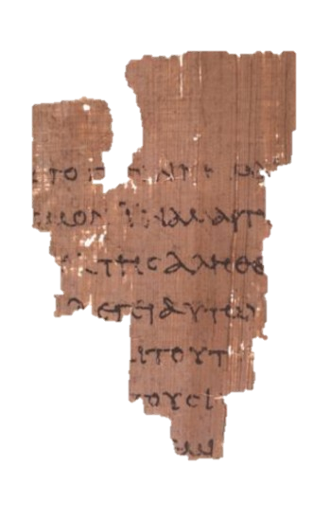
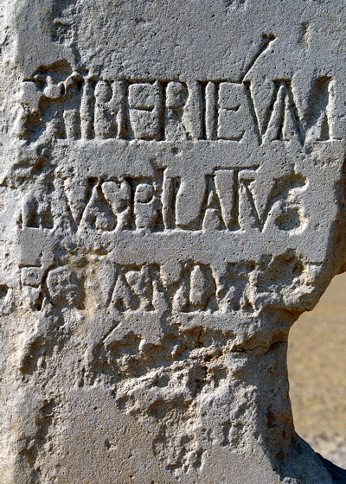
Pontius Pilate
Spoke to Jesus
(Matthew 27:11-26, Mark 15:1-15, Luke 23:1-25, John 18:28-40)
Notes:
“Pontius Pilate, prefect of Judea, has restored the Tiberieum of the Seaman (or possibly, of the Caesareans)”
This stone was discovered in June 1961 by an archaeology team led by Dr. Antonio Frova while excavating an ancient theater which is thought to be built by the decree of Herod the Great in 30 B.C.

Slide 22
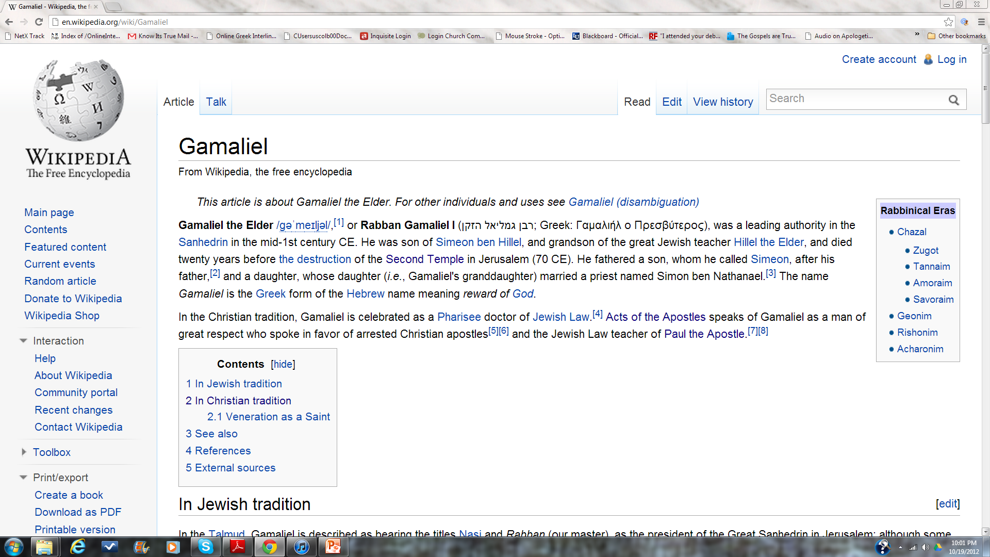
Gamaliel
Pharisee and teacher of the law (Acts 5:34)
The teacher of the Apostle Paul (Acts 22:3)
Notes:
Google his name

Slide 23
Osiris and Mithras look nothing like Jesus!

Slide 24
Mithras
Born of a virgin
Born on Dec 25th
12 disciples
Performed Miracles
Dead for 3 days
Resurrected

Slide 25
Mithras was born from a solid rock as an adult.
BUSTED
Mithras was born of a virgin?

Slide 26
BUSTED
Mithras was born on December 25th?
Many ancient gods were celebrated on December 25th.
Jesus was not one of them!

Slide 27
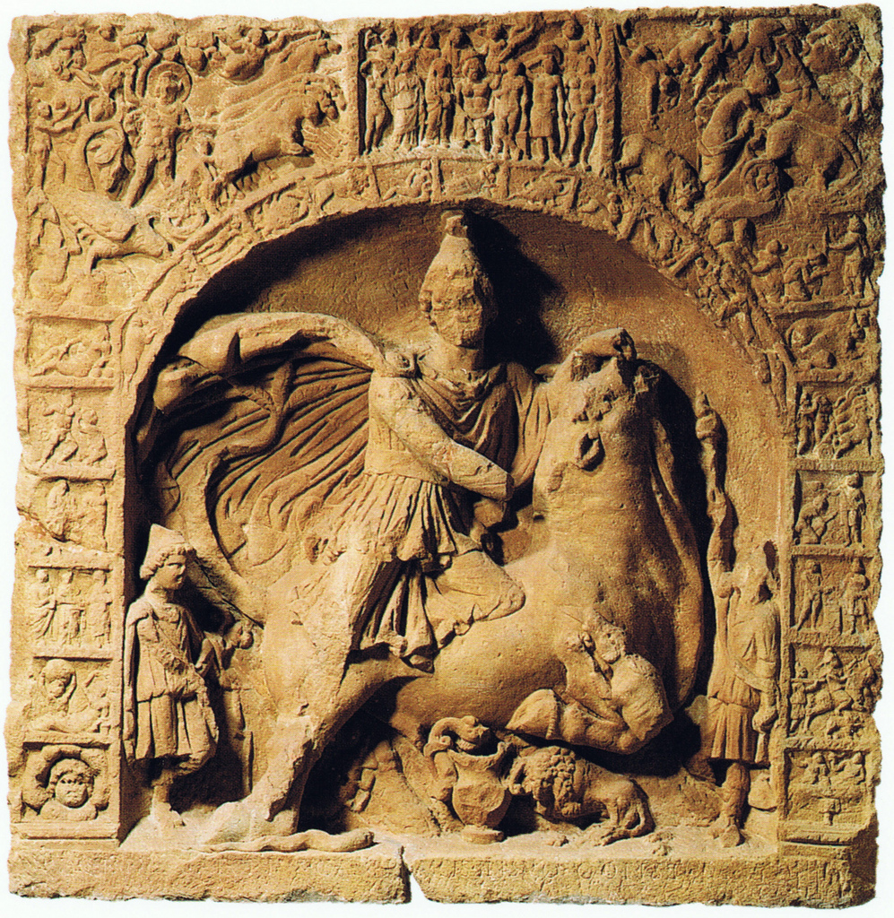
BUSTED
Mithras had 12 disciples?
Let’s look at the evidence supporting this claim…

Slide 28
BUSTED
Mithras never died.
Mithras was crucified?

Slide 29
BUSTED
Mithras rose from the dead?
Mithras never died.

Slide 30
Osiris

Slide 31
Osiris' brother, Set fooled Osiris into getting into a box, which Set then shut, sealed with lead, and threw into the Nile. Osiris' wife, Isis, searched for his remains until she finally found him. She managed to open the box, but Osiris was already dead.
She used a magic spell she learned from her father and brought him back to life so he could impregnate her. Afterwards he died again and she hid his body in the desert. Months later, she gave birth to Horus. While she raised Horus, Set was hunting one night and came across the body of Osiris.
In a fit of rage, Set tore the body into fourteen pieces and scattered them throughout the land. Isis gathered up 13 of the 14 pieces (the missing piece was his penis, which was eaten by a cat fish) and bandaged them together for a proper burial. Osiris then went on to become the zombified lord of the underworld.
Notes:
Does that sound at all like Jesus?

Slide 32
Sostrata, of Pherae, had a false pregnancy. In fear and trembling she came in a litter and slept here. But she had no clear dream and started for home again. Then, near Curni she dreamt that a man, comely in appearance, fell in with her and her companions; when he learned about their bad luck he bade them set down the litter on which they were carrying Sostrata; then he cut open her belly, removed an enormous quantity of worms-- two full basins; then he stitched up her belly and made the woman well; then Asclepius revealed his presence and bade her send thank-offerings for the cure to Epidaurus.
(Mary R. Lefkowtiz and Maureen B. Fant (eds.), Women's Life in Greece and Rome (Baltimore: John Hopkins University Press, 1982), p. 122.
Jesus appearing to Cleopas and his
companion on the road to Emmaus
Notes:
Robert Price thinks this is the same story with the names changed.

Slide 33
The young man in question... would on no account allow the immortality of the soul, and said, “I myself, gentlemen, have done nothing now for nine months but pray to Apollonius that he would reveal to me the truth about the soul; but he is so utterly dead that he will not appear to me in response to my entreaties, nor give me any reason to consider him immortal.” Such were the young man's words on that occasion, but on the fifth day following, after discussing the same subject, he fell asleep where he was talking with them, and... on a sudden, like one possessed, he leaped up, still in a half sleep, streaming with perspiration, and cried out, “I believe thee.” And when those who were present asked him what was the matter; “Do you not see,” said he, “Apollonius the sage, how that he is present with us and is listening to our discussion, and is reciting wondrous verses about the soul?” “But where is he?” they asked, “For we cannot see him anywhere, although we would rather do so than possess all the blessings of mankind.” And the youth replied: “It would seem that he is come to converse with myself alone concerning the tenets which I would not believe."
(Life of Apollonius of Tyana 8:31)14. Conybeare trans., Loeb ed, Vol. II. pp. 403, 404.
Thomas seeing Jesus after his death.

Slide 34
2 Peter 1:16
“For we did not follow cleverly devised myths when we made known to you the power and coming of our Lord Jesus Christ, but we were eyewitnesses of his majesty.”
Notes:
This ENTIRE presentation centers on whether or not Peter was lying here.
We can’t say that he thought Jesus was real but wasn’t
Peter’s “eyewitness” testimony is attested by Luke, John, and Paul

Slide 35
knowitstrue.com/myth

