Slide 1
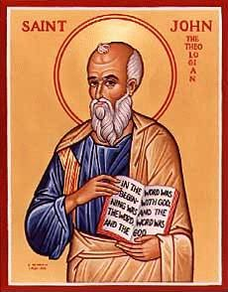
The Gospel of John
Robert Carrillo
and
John Oakes

Slide 2
Outline of John
I. Prologue 1:1-1:18
II. Book of Signs 1:19-12:50
III. Book of Glory Passion Story 13:1-20:31
IV. Epilogue 21:1-21:25
Theme: The Son of who reveals God’s glory.
Theme verses 1:14, 1:18, 3:16 20:30-31

Slide 6
Uniqueness of John

Slide 7
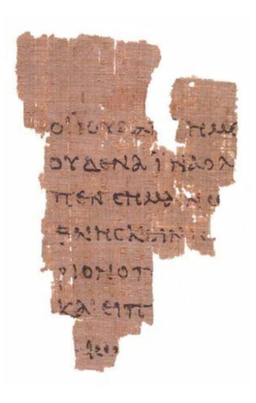
Uniqueness
Major items not in John
• Major events of Jesus life –
Birth
Baptism
Temptation
Transfiguration
Agony in Garden
Virgin Birth
• Exorcisms
• (Casting out Demons)
Usually healing and exorcism are one
• Secrecy theme not in John
Often telling people to not say who he is No
claim to messiahship - I AM Statements
John is full of claims by Jesus about who he is.
• Parables are absent in JOHN
John 18:31
Saturday, October 13, 12

Slide 8
John the solo Gospel
Also, Unique to John.
• No Intro – Prologue Logos teaching
• Baptisms by JESUS and his disciples
• Pivotal events
Raising Lazarus (Trigger for Pharisees)
In the Synoptic Gospels it was clearing the
Temple that was a trigger.
Farewell Discourse on the Holy Spirit as
counselor
• Geographical setting
Synoptics –Jesus ministry is in Galilee
Goes to Jerusalem once near end
In John he frequencies Jerusalem a lot –
Judean focus not Galillean
• Time settings
How long he ministered? Based on Passovers
In synoptic there was only ONE = One year
John there are three mentioned and possible
4th.
Saturday, October 13, 12

Slide 9
Characteristics
Use of Terms ...
Four time - “Monogenes” - The intimate
relationship to the father as the “Son”: 3:35,
5:22,27,30,36 6:38, 8:25,28,40, 10:15,30, 12:49-50,
14:28, 15:10,15, 17:2,17:11,22
aposynagōgos (“put out of the synagogue”), appears
in the gospel (9:22; 12:42; and 16:2).
The term, “the Jews,” is used in a pejorative way
in such passages as 9:18; 10:31; 18:12, 36–38; and
19:12. Possibly a reaction to the counsel of Jamniaa
KINGDOM OF GOD (2xs)
Saturday, October 13, 12

Slide 10
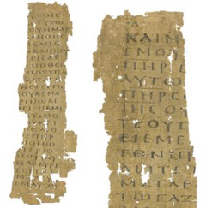
John’s Gospel
Sometimes same events positioned differently
Late in synoptics, early in John (Temple)
John probably puts it up front to make a
point
In Jewish writing thematic was very
important
Last supper
In Synoptics it’s a Passover meal
In John its before Passover also his death
Saturday, October 13, 12

Slide 11
John 1:1
ἐν ἀρχῇ
In the Beginning
Saturday, October 13, 12

Slide 12
Genesis 1
ἐν ἀρχῇ
In the Beginning
Saturday, October 13, 12

Slide 13
John’s Gospel
CHIASM: A -B - C- D- C- B -A
V:1-5 Identity and Mission of the WORD
V: 6-8 The Testimony of John the Baptist to
the Word
V: 9-10 The Incarnation of the Word
V:10-13Response to the Word
V:14 The Incarnation of the Word
V:15 The Testimony of John the Baptist to the Word
V:16-18 The Identity and Mission of the Word
Saturday, October 13, 12

Slide 14
II Book of Signs 1:19-12:50
Seven I AM statements
I AM the bread of life 6:35
I AM the light of the world 8:12,9:5
I AM the door (and the gate) 10:7
I AM the good shepherd 10:1,14
I AM the resurrection and the life 11:25
I AM the Way the Truth and the Life 14:6
I AM the true vine 15:1
All are metaphors

Slide 15
Seven Signs
[knew thoughs of Nathanael 1:43-50]
water to wine 2:1-11
healing of official’s son 4:43-54
healing at pool of Bethesda 5:1-5
feeding of 5000 6:1-14
walking on water 6:16-21
man born blind 9:1-12
resurrection of Lazarus 11:1-44
[miraculous catch of fish John 21:1-13]

Slide 16
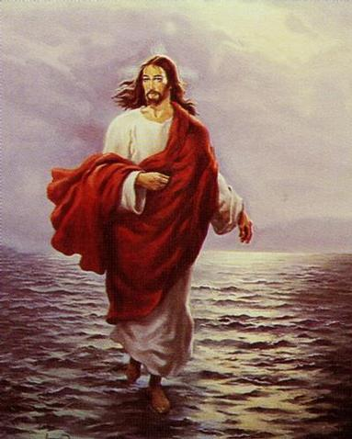
Purpose of the Signs of Jesus
Cause people to have faith in God
Cause people to give glory to God

Slide 17
Signs in John: A Pattern
Miracle/Sign
Response or challenge of people
Follow-up teaching
Response (some have faith and some reject Jesus)

Slide 18
Signs, Claims and I Am Statements
I. Knowing Nathanael’s mind and heart, which causes belief (1:49)
“Rabbi, you are the Son of God; you are the King of Israel.
Q: Implications?

Slide 19
II. Water to Wine: The “first sign” of Jesus
John 2:1-11. v. 11 “He thus revealed his glory, and his disciples put their faith in him”
metaphor/symbol: the marriage feast in heaven. Isaiah 25:6
empty jars = Jewish ritual
wine = New Covenant
Result: 2:11 God’s glory is revealed and people (the disciples in this case) put their faith in Jesus.

Slide 20
III. Jesus Clears the Temple Another “sign”
Jesus clears the temple John 2:12-17
“The Jews” demand a sign to prove his authority to act this way.
John 2:18-19
Note: The Jews assumed that authority as an inspired teacher must be supported by “signs.”
Jesus: No sign will be given you if you demand one.

Slide 21
IV. The Miracles Jesus Did Not Do
A. Jesus did not work miracles as a response to a challenge or to defend his claims about himself. John 2:18-22.
B. He did not do miracles to convince the hard-hearted or to force people’s mind. Matthew 13:55-58
John 13:27 Satan did not hesitate in this area at all. (notice v. 28 Jesus did not resist this)
Implication?

Slide 22
The Miracles Jesus Did Not Do
C. Jesus did not work miracles to take care of his own physical needs John 4:6 tired. John 19:28 Jesus thirsty. Mark 11:12, Luke 4:3-4 hungry
Implications?
D. Jesus did not use his power to judge or destroy his enemies. Luke 9:52-56. Jn 12:47
Implications?

Slide 23
The Miracles Jesus Did Not Do
E. (and this one contains them all) He did not use his power to end the crucifixion.
Mark 15:29-30.
Matthew 26:52-53. Jesus: I could call on my Father and he would put at my disposal more than twelve legions of angels.
Implications?

Slide 24
Jesus Clears the Temple
John 2:18-19. What is the sign of Jesus?—the sign proving my right to be greater than the temple? I will be raised from the dead on the third day.

Slide 25
IV. Sign #2 The Official’s Son
Jesus heals official’s Son 4:43-54 (parallels Matt 8:5-13, Luke 7:1-10)
Healing for Gentiles too.
Healing from a distance.
Result: faith 4:53 Your son will live “he and all his household believed.”
Gentile man believes without seeing. (unlike Thomas, but like us John 20:29)

Slide 26
V. Sign #3 Healing at Bethesda
John 5:1-9 Jesus: “Get up your mat and walk”
“My father is always at work to this very day and I, too, am working” (v17)
5:18 Result: The Jews tried even harder to kill him. Why? He claims to be equal to God.

Slide 27
Theme: Jesus Replacing/Greater than the Jewish Festivals
1. Jesus greater than the Sabbath Jn 5:1-18
2. Jesus greater than Passover Jn 6:1-70
3. Jesus greater than Booths/Tabernacles Jn 7:1-9:41
4. Jesus greater than Festival of Lights (Chanukkah)
Jn 10

Slide 28
Testimonies of Jesus John 5:31-40
Jesus: There are three things which testify about me:
a. John the Baptist
b. The miracles
c. Prophecy/Scripture
John 5:45-47 I am Greater than Moses.

Slide 29
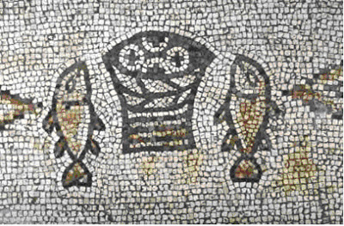
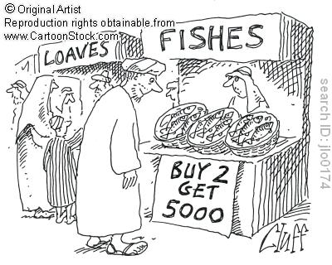
VI. Sign #4 Feeding the 5000
Theme: Jesus will replace Moses and will replace the Passover.
Type: Marriage feast with God
Jesus gives bread (like the manna)
People’s response: 6:14 “Surely this is the prophet” (Deuteronomy 18:17-19)

Slide 30
VII. Sign #5 Walking on Water
Jn 6:16-24 (Matt14:22-33, Mark 6:47-51)
John’s emphasis: A parallel to Moses parting the water. An Exodus/Passover scene.
“It is I” (I AM that I AM ego eimi) Do not be afraid. Suddenly they are on the other side (recalling the crossing of the Red Sea)

Slide 31
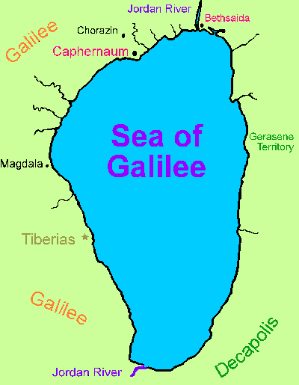

Slide 32
VIII. John 6:25-70 I AM The Bread of Life subtext: I am greater than Moses
v. 25-27 Seek spiritual not physical food
“Work” for spiritual food.
v. 28-29 What is the work of God? Believe in the one he sent. Irony
v. 30 Jews demand a sign again (recall clearing the temple)
Jesus: I gave you bread. I am greater than Moses. Isn’t that testimony enough?
In fact: I AM the bread of life. physically v. 35 and eternally v. 47-51.

Slide 33
A Practical Question
6:35b What is “bread” for you? What do you hunger for?
6:35c What is “water” for you? What do you thirst for?
The people: Please give us this bread!

Slide 34
John 6:53-59 Eat the flesh and the blood
Not a prefigure of the Lord’s Supper.
The Lord’s Supper is a remembrance of this fact.
v. 60-70 The people respond. Offended.
Jesus: What about you?
Peter: To whom else shall we go?

Slide 35
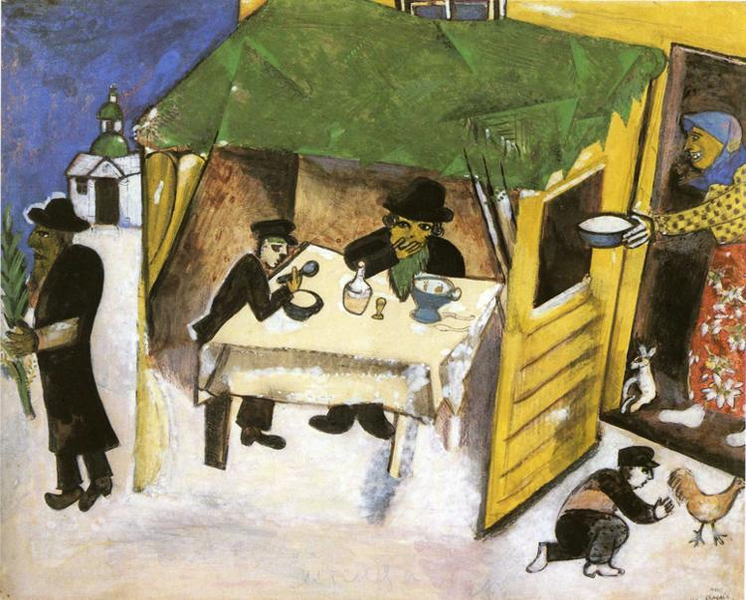
IX. John 7:1-9:41 Tabernacles Discourses
Tabernacles (Sukkot)
Harvest Festival
Remembrance of Wandering in the Wilderness = living by faith in a relationshiip with God
John 1:14

Slide 36
Tabernacles/Booths/Sukkot
A Celebration of Wandering in the Wilderness: Living in Close Fellowship with God (John 1:14 Jesus tabernacled with us)
Water Motif: Water Pouring Ceremony
Light Motif: The Illumination of the Temple

Slide 37
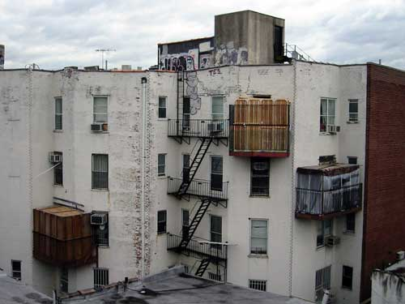
Sukkot in a City

Slide 38
John 7-8 Many Claims
7:16-My teaching is from God. If anyone chooses to do God’s will….
Response: You are demon-possessed.
7:37-38 I am the source of living water.
Response: He is the Prophet. He is the Christ. Tried to seize him
8:12 I AM the light of the world.
Response: Many put their faith in him.
8:46 Sinless
Response: A Samaritan and Demon-possessed.
8:51 If anyone keeps my word, he will never see death. (I am greater than Abraham)
Response: You are demon-possessed
8:58 Before Abraham was born, I AM. (claims to be God)
Response: Picked up stones to stone him.

Slide 39
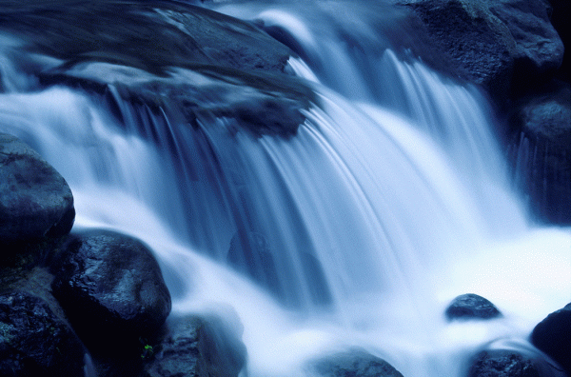
John 7:37 Living Water
If anyone is thirsty, let him come and drink. Whoever believes in me, as the Scripture has said, streams of living water will flow from within him
Isaiah 12:3
Zech 14:8,16
Joel 3:18

Slide 40
The Water-Pouring Ceremony
Every Day of the Feast
Procession from the Temple to the Pool of Siloam
Priest fills a golden pitcher with water from Siloam (“living” water, by the way)
Recite Isaiah 12:3
Back through the Water Gate to the Temple
Pour the water out over the altar of sacrifice
A symbol of the Holy Spirit and of salvation.
Isaiah 12:3, Zechariah 14:8,16, Joel 3:18, Ezek 45:25 41:1-11
Jesus: The Messianic Age has come.

Slide 41
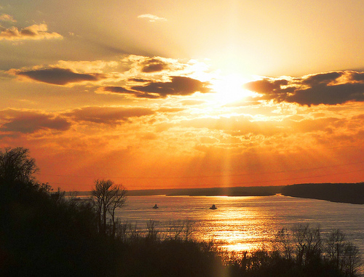
John 8:12 I Am The Light of the World
John 8:12 I AM the light of the world.
John 9:5 While I am in the world, I AM the light of the world.
John 12:46 I have come into the world as a light, so that no one who believes in me should stay in darkness.

Slide 42
The Illumination of the Temple
Every night during Tabernacles.
Entire Temple lit up with lamps.
Celebration in the Court of Women.
A symbol of the shekinah—God’s glory which was in and above the Tabernacle.
Jesus: I am the shekinah of God.
John 12:36 Through Jesus we can become sons of light, and no longer walk in darkness.
Jesus: I am the fulfillment of Tabernacles.

Slide 43
John 8:48-58 The Greatest Claim of Jesus
8:51 If anyone keeps my word, he will never see death.
Now we know you are demon-possessed!
Before Abraham was born: I AM.
They picked up stones to stone him.

Slide 44
X Sign # 6 Jesus proves he is the light of the world
9:5 I AM the light of the world.
This miracle involves both water and light.
Note: Wash in the Pool of Siloam.
The man grows in his faith.
v. 11 “the man Jesus”
v. 17 “the Prophet”
v. 31 from God
v. 38 Lord, I believe!
The parents and the Pharisees become more blind than they were at the beginning.

Slide 45
XI. John 10 More claims and testimonies
The Context: The Feast of Dedication (Hannukuh) John 10:22
John 10:7 I AM the gate. (John 14:6)
John 10:11,14 I AM the good shepherd.
The Shepherd Discourse Ezekiel 34:2-10
1st Macabbees: false shepherds
1 Samuel 17:34
Response: Division. You are demon-possessed!
Could a demon give sight to the blind?
John 10:25,32,38 My miracles testify to the things I say

Slide 46
Jesus: I AM God
John 10:30 I and the father are one.
Response: John 10:31 They picked up stones to stone him.
You, a mere man, claim to be God.

Slide 47
XII. Sign #7 The Raising of Lazarus
For John: The greatest of Jesus’ signs.
John 11:4 This sickness will not end in death (irony)
Purpose: To give glory to God (and to his son)
John 11:23-26 I AM the resurrection and the life! He who believes in me will live, even though he died.
John to the reader: Do you believe this?

Slide 48
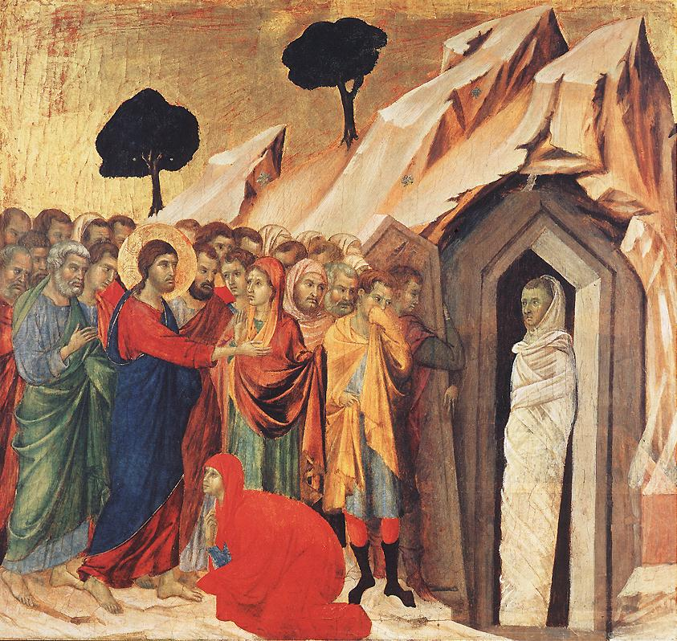
Jesus proves he is the resurrection and the life.
“Lazarus: Come out!”
John 11:45-51 Believe or murder Jesus. A stark choice.
What about you?

Slide 49
John Chapter 12
Theme: The Glorification of the King
A transition… Jesus enters Jerusalem
A transition… Jesus’ public ministry ends
A transition… The Book of Signs ends and the Book of the Passion begins

Slide 50
The Glorification of the Messiah/King
John 12:1-8 Anointing of a king for burial.
John 12:12-16 Triumphal entry of the King.
John 12:28 God: I will glorify your name.
John 12:32 Jesus will be lifted up (glorified)
(talk about irony!)

Slide 51
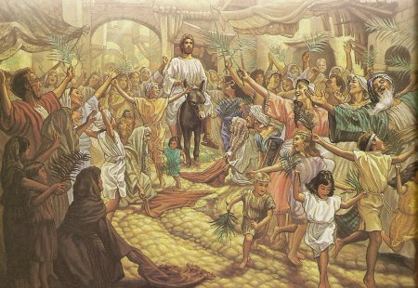
John 12:12 The Passion Story Begins…
I Maccabees 13:21
Hosannah! Ps 118:25-26
Jesus hailed as King and Messiah.
King of Peace (donkey)
Zechariah 9:9

Slide 52
Jesus: The Hour Has Come! Jn 12:23
The hour for a triumphant king? No!!
Unless a kernel of wheat falls to the ground an dies.
Q: Message for us?
John 12:32 (John 3:14, John 8:28) I will draw all men to myself. How??? By dying!
John 12:36 Jesus’ public ministry ends
John 12:37-50 Final summary Do not reject me.

Slide 53
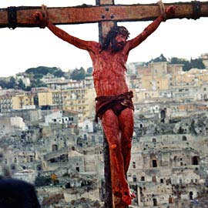
John 13:1-20:29 The Book of the Passion
Jesus’ public ministry is done.
Ch 13-17 Very personal view of Jesus with his apostles.
John Ch 2-12 Jesus’ message to the world. John Ch 13-17 Jesus’ message to the

Slide 54
A Little Chronological Problem
When did the Last Supper happen according to John?
John 18:28 The day before the Passover? (Synoptics are definite that the Last Supper was a Passover Seder)
Solution:
1. John is just plain wrong.
2. John 18:28 is a reference to any day in Passover/Feast of Unleavened Bread.
3. The Jews disagreed over the day of Passover (Nisan 14 vs Nisan 15)

Slide 55
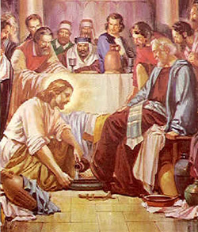
John 13 Jesus’ Love for the Apostles
John 13:1 Jesus loved them “to the end.”
John 13:3-11 Jesus shows them his love.
John 13:12-17 Go and do likewise.
John 13:18-30 Jesus will be betrayed.
John 13:31-38 Love one another as I have loved you.

Slide 56
John Ch. 14
1. Jesus is trying to reassure them that he is with them and that, even when he is gone, He will still be with them in the form of the Holy Spirit. You guys will be OK.
2. He is both setting an example and giving them a command to love.

Slide 57
Jesus: Trust in me
Wedding metaphor
Jewish betrothal: Groom promises to “build a room” for the bride.
Claim to be deity
Trust in God, Trust also in me.
If you have seen me, you have seen the father.
Greater works than these.
Bringing salvation and offering the Holy Spirit

Slide 58
Jesus Comforts the Disciples
Ask anything in my name.
I will send the comforter (Holy Spirit) You will not be alone.
My peace I leave you.

Slide 59
John 15 The Vine and the Branches
The vine: A common metaphor
Psalm 80:8-18, Isaiah 5:1-7, Jeremiah 2:21 Ezekiel 15:1-8 Ezekiel 19:10 and Hoseah 10:1.

Slide 60
I am the Vine. My Father is the gardener
Q: In what sense is Jesus a vine?
Q: In what sense is the Father a gardener?
Q: In what sense are we branches?
John 15:2a, 15:6 Matthew 7:15-20 Can we be cut off the vine? If so, why?

Slide 61
John 15 Abide in Me
The key point in John 15 is abiding in Christ.
Abiding = Bearing fruit. Q: What fruit?
Answer: The things we ask for. 15:7-8
John 15:9-17 The key to abiding is love (and obedience)

Slide 62
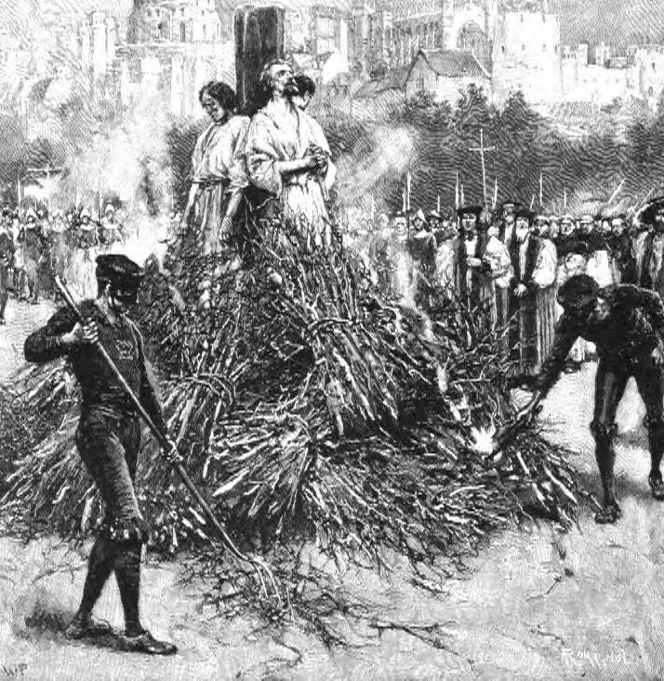
John 15:18-16:4 The reason we need so much comfort: Persecution
Jesus “assures” them with six if… then.. Statements
v. 18, 19, 20 (2x), 22, 24

Slide 63
John 16 Jesus Comforts His Disciples
John 16:6 It is good that I am going away.
I will send the Comforter.
Aside: Does the Holy Spirit “proceed from the Father and the Son” (filoque)? John 15:7
He will convict the world
He will guide you into the truth

Slide 64
Comfort for the Disciples
16:20 Your grief will turn to joy.
16:25 I will speak to you plainly.
16:33 Take heart: I have overcome the world.

Slide 65
John 17 Jesus Prays for the Disciples
Themes:
Jesus’ amazing love and concern for the disciples John 17:11-19
Glory 9 times in John 17 John 17:4-5
Knowing God John 17:3, 25-26
Unity and Relationship John 17:23

Slide 66
John 18-19 The Passion Narrative
Things to notice:
Jesus is totally in control. He is not a victim.
V. 4 “Jesus, knowing all that was going to happen to him”
Jesus fulfilling prophecies (unlike the rest of John) 18:9,32 19:24 19:36,37
Jesus confronts Annas(contrast with Peter), Jesus questions Pilate!
Deity: I Am He v. 5,8

Slide 67
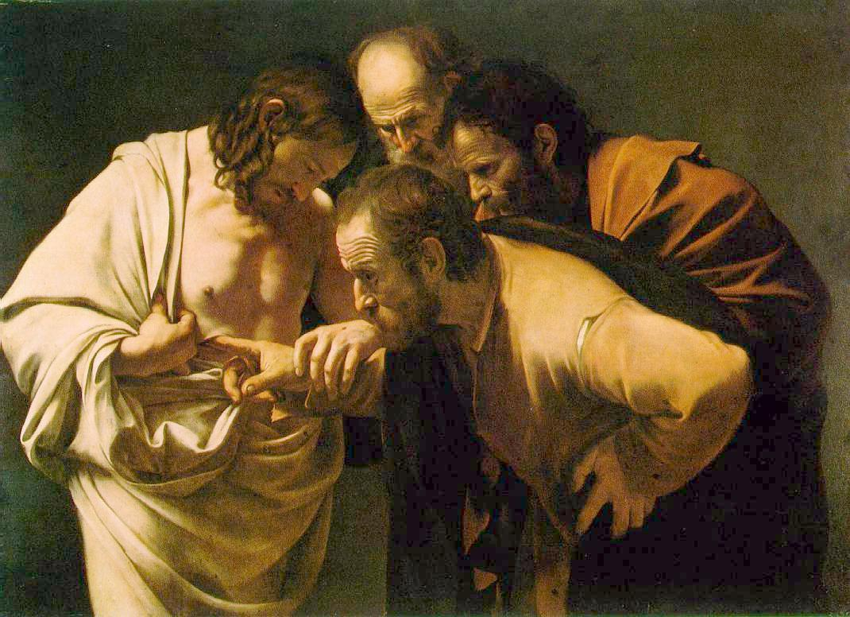
John 20 Resurrection Appearances
Mary Magdalene
Peter and “the other disciple (John)
Mary Magdalene again
The disciples (- Thomas)
The disciples, including Thomas

Slide 68
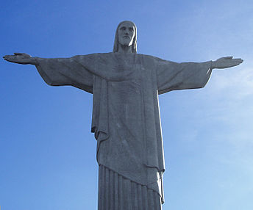
Jesus’ Signs and Claims: Summary
John 20:29-31 Will you believe, even though you have not seen? If you do, you will have life in his name.
What is your response to Jesus?
For God so loved the world that he gave his one and only Son that whoever believes in him will not perish but will have eternal life. John 3:16

Slide 69
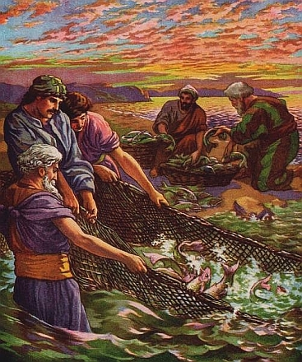
John 21 Epilogue
The eighth sign
Purpose:
To explain restoration of Peter
To correct the false idea that John would live until Jesus comes back.

Slide 70
John 21:24
John: I was there. I saw the whole thing. Jesus did a lot more than this!
“These are written that you may believe that Jesus is the Christ, the Son of God, and that by believing you may have life in his name.”

