Slide 1
Amos, Isaiah, Jeremiah, Ezekiel
An Overview
By Pedro Figueroa

Slide 2
Focus of Amos
Amos 1:1-2 Time of Uzziah king of Judah and Jeroboam son of Jehoash King of Israel (792-750 B.C.)
Amos 6:1-7 Their Luxurious Indulgence: the people of God more interested in comfort than righteousness.
V.7 Exile predicted→ Precursor to Isaiah’s ministry
Amos 5:24 God’s Call to Righteousness: Israel’s were selling their brothers into slavery and not meeting the needs of the poor. Instead they were covering for this lack of righteousness with religious acts. (see v. 21 -23) Amos 2: 6-7

Slide 3
Outline of Isaiah
God Judges the Nations (Ch. 1-35)
God Comforts his People (Ch. 36-48)
God’s Prince of Peace (Ch. 49-57)
God’s Program for Salvation (Ch. 58-66)

Slide 4
Themes In Isaiah
Judgement is Real
God Against Falsehood
God Rules the Nations
Glory is With the Lord

Slide 5
Isaiah Historical Context
Notes:
Tiglath-pileser III 2Kings 15:19-20 - known as Pulu in Babylon or Pul in Israel.
Sargon II 2 Chronicles 28:1-27 - covers various events from reign of Tiglath-pileser to Sargon II
Sennacherib 2 Chronicles:29-33, Is 36:1-7, 37:21,35-37 - constant threat to Judah under king Hezekiah

Slide 6
More Historical Context
Tiglath-pileser III 2Kings 15:19-20 - known as Pulu in Babylon or Pul in Israel.
Sargon II 2 Chronicles 28:1-27 - covers various events from reign of Tiglath-pileser to Sargon II
Sennacherib 2 Chronicles:29-33, Is 36:1-7, 37:21,35-37 - constant threat to Judah under king Hezekiah

Slide 7
Tiglath- Pileser (Pul) standing with driver. (British Museum)

Slide 8
Sennacherib Prism

Slide 9
Judgement is Real
Is 1: 2 – 9 Rebellious people
Is 5: 11-13, 22-23 Lack of understanding
Is 28: 7-9 Worldly leadership
Is 29: 1- 4, 13, 15-16 God must respond

Slide 10
God Against Falsehoods
Is 44:9-20 False Idols
Is 40: 18 – 20 False Gods
Is 32: 5- 6 False Teachings
Is 46: 4 – 7 False Reliance

Slide 11
God Rules The Nations
Is 45: 1 – 6 God raises up Cyrus
Is 42: 1- 4 God raises up His servant
Is 23: 8-9 God plans for nations
Is 14: 24 – 27 God has a plan for the world

Slide 12
Glory is With the Lord
Is 43: 1- 13 Glory of God’s Children
Is 2: 1-5 Glory of God’s Kingdom
Is 16: 1- 3 Glory of God’s Power
Is 65: 17 – 20 Glory of God’s Salvation

Slide 13
Isaiah’s Life Story
Isaiah means Yahweh saves
Isaiah ministered for about 60 years (742 – 680 B.C.)
Isaiah may have been tied to royal family of Mannaseh
Names of Isaiah’s children
Is 7:3 Shear Jashub = a remnant will return
Is 8:1-3 Maher-Shalal-Hash-az = quick to the plunder swift to the spoil
Went around naked/inner garment only for 3 years (Is 20:1-4)

Slide 14
Outline of Jeremiah
The Call of Jeremiah (Ch. 1)
God’s Charges and Judgement (Chs. 2-25)
Events in the Life of Jeremiah (Chs. 26-45)
Foreign Nations Judged (Chs. 46-51)
The Fall of Jerusalem (Ch. 52)

Slide 16
Themes in Jeremiah
False Religion
God’s Judgement
The Remnant

Slide 17
Jeremiah History
2Chron 34:1-2 Josiah (8 years old)became King 640 B.C. (2Kings22:1-2)
2Chron 34:3-7 Josiah began to seek God 632B.C. Josiah 16 years old.
Jer 1:1-10 During Josiah’s 13th year. Jeremiah began ministry in 627 B.C.
How did Jeremiah begin ministry? With appointment by God. This is contrasted to other “prophets, teachers and leaders” in Jeremiah.

Slide 18
False Religion
Jer 2:8-12 Leaders gone astray.
Jer 2:20-25 Israel gone astray.
Jer 5:1-3 Jerusalem in rebellion.
Jer 19:1-5 Israelites burning children as sacrifices.
What had happened to God’s people?
• 2 Chron 34:14-33 Lost Law
Jer 26:1-24 A few remembered God’s Word and others did not.
Jer 27:1-3, 12-15, Jer 28:1-5, 15-17
Jeremiah 36:1-2, 5-6, 8-10, 13-19, 20-24

Slide 19
God’s Judgements
Jer 6: 1-6 Against Jerusalem
Jer 28: 1-9, 17 Against false prophets
Jer 39: 1-7 Against ungodly leaders Against the ungodly nations
Egypt 46:1-4, 13-15  Damascus 49:23-26
Philistine 47:1-4  Edom 49:7-10
❖ Moab 48:1-3  Babylon 50:1-5,18-21

Slide 20
Remnant
Jer 6:9 God gleans the remnant
Jer 29:1-11 God has plans for the remnant (written within days of captivity)
Jer 31:7, Jer 33:14-18 God saves the remnant
Jer 39:9 God directs the remnant
Jer 40:11 God abundantly blesses the remnant
Jer 42:1-3, 15, 19 God releases the remnant
Jer 43:4-7, 44:14
Jer 50:20 God forgives the remnant

Slide 21
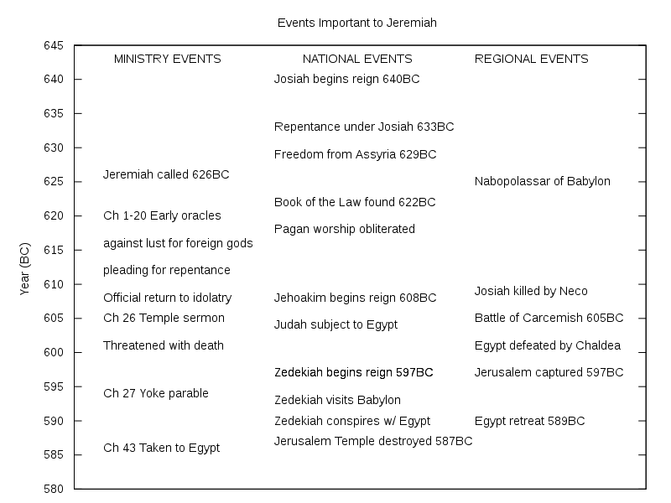
History

Slide 22
Key Life Events: Jeremiah
Jer 16:1-4 Forbidden to marry or have children
Jer 37: 1-5, 11-21 Imprisoned
Jer 40: 1-6 Freed

Slide 23
Symbolism
Jer 1:11-16 The Almond Tree
Jer 13:1-11 The Linen Belt
Jer 13:12-14 The Wineskins
Jer 18:1-10 The Potter’s House
Jer 19:10-13 The Jar
Jer 24:1-10 The Figs baskets
Jer 27:1-8 The Yoke
Jer 32:1-41 The Field
Jer 43: 8-13 The Stones

Slide 24
Jer 34:1-7, Tablet of Lachish 588 B.C.

Slide 25
Archaeology
Lachish Letters.
The Lachish Letters 588 BC 6 letters on clay shards
Send an army of relief or the city will fall to Nebuchadnezzar
The light at the top of Azekah just went out, and we are next Jeremiah 34:6,7
Within two days, the author of this letter was killed. Two years later, Jerusalem fell.

Slide 26
Ezekiel Outline
Judah Denounced
Ch 1-24 (593-588 B.C.) Before fall of Jerusalem
II. Oracles Against Foreign Nations
Ch 25-32 (587-571 B.C.)
Future Restoration
Ch 33-48 (585-573 B.C.) After fall of Jerusalem

Slide 27
Ezekiel’s Place in History

Slide 28
Judah Denounced
Lord’s Watchman Ez 3:16-21
Jerusalem Replica Ez 4:1-5
Sharp Sword Ez 5:1-4, 9-12
Temple Glory Departs Ez 10:15-19
Judgement Ez 14:12-14
Unfaithful bride Ez 16:1-15

Slide 29
Oracles Against Foreign Nations
Ammon Ez 25:1-4 Rejoiced over Israel’s suffering
Edom Ez 25: 12-13 Took revenge on Judah
Tyre Ez 28:1-3 Took place of God
Philistia Ez 25:15 Sought to destroy Israel
Egypt Ez 29:17-20 Egypt boasted (v.9)

Slide 30
Future Restoration
New Life Ez 37:1-10
New Heart Ez 36:24-28,36
New Temple Ez 40-43

