Slide 1
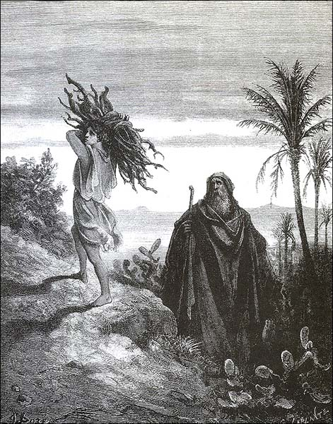
Introduction to the Old Testament
John Oakes
Robert Carrillo
Mark Wilkinson
Pedro Figueroa
Spring, 2012

Slide 2
Recommended Reading
“He Lives Forever” Thomas Olbricht College Press
“A Quick Overview of the Bible” Douglas Jacoby Harvest House
“From Shadow to Reality” John Oakes IPI Books

Slide 3
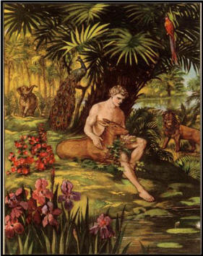
Biblical Themes
Bible: God wants a relationship with us.
Old Testament: The Messiah is coming, bringing salvation.
New Testament: The Messiah is here, and he has brought salvation.
  John 5:39 These scriptures testify about me.

Slide 4
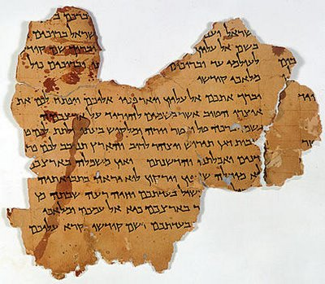
The Jewish Bible tanakh (Luke 24:44)
The Law torah, pentateuch
  Genesis - Deuteronomy
The Prophets neviim
  Joshua, Judges… Ezekiel,
  …“the twelve”
The Writings ketuvim
  Job, Psalms, Proverbs,
  Ecclesiastes,… 2 Chronicles
  (Matt 23:35)

Slide 5
Our Outline
Introduction
Genesis Creation, Choosing of Abraham
Exodus-Deuteronomy God gives the Law
Joshua-2 Samuel God gives them a land
1 Kings, Micah, Isaiah, etc. God sends prophets
2 Kings Jeremiah, Ezekiel, etc. God judges his people
Daniel, Ezra, Nehemiah, Zechariah, etc. Captivity and return from exile.
Job, Psalms, Proverbs Wisdom Literature.

Slide 6
Old Testament Themes
I The Messiah is coming.
II God chooses a person and a people through whom to send the Messiah.
III God wants to bless his people (physically). The grace of God.
IV The call to repentance.
V God’s amazing patience with his people
VI Judgment for those who will not repent. This is a major and unmistakable theme!
VII. Salvation and forgiveness
VIII God works through history

Slide 7
Historical Outline
The Fall
God chooses a man of faith
God creates a people of his own
God gives his people a covenant
God gives his people a place and a temple
God sends his prophets.
God sends his Son

Slide 8
Historical Periods
Patriarchal Period
Captivity in Egypt
Escape from Egypt and Conquest of Canaan
Judges
United Kingdom
Divided Kingdom
Captivity in Babylon
Restoration to Judea

Slide 9
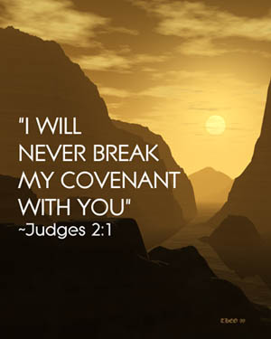
Covenants
Noah Genesis 9
Abraham Genesis 17
Moses Exodus 24
David 2 Sam 7
The New Covenant Jeremiah 31:31

Slide 10
Major Historical Events:
God Saves and God Judges His People
Creation
The Flood judgment
The choice of Abraham salvation
Escape from Egypt salvation
Kingship of David salvation
Destruction of the Northern Kingdom judgment
Destruction of the Southern Kingdom judgment
Restorations under Zerubabbel and Ezra salvation

Slide 11
Key People in the Old Testament
What do we learn from them?
Adam Giving in to temptation
Noah Faithful preacher
Abraham Man of faith
Joseph Man of perseverance
Moses Humility
Joshua Courage, Leadership
Samuel God’s spokesman
David Heart for God
Solomon Wisdom
Elijah God’s prophet
…all are prefigures of the Messiah

Slide 12
Timeline
Old Testament Event | Date | OT Book
Adam and Eve, Cain and Abel | ? | Genesis
The Flood | ? | Genesis
Abraham | 1950 BC | Genesis Job?
Isaac | 1850 BC | Genesis
Jacob | 1800 BC | Genesis
Israel in Egypt | 1800-1450 BC | None
Moses in Egypt, Exodus and Wandering | 1450-1400 BC | Exodus-Deuteronomy
Israel enters and conquers Promised Land | 1400 BC | Joshua
Period of the Judges | 1400-1050 BC | Judges, Ruth
David, king of Israel | 1050-1000 BC | I,II Samuel, I Chronicles, Psalms
Solomon, King | 1000-950 BC | I Kings, 2 Chronicles, Proverbs, Ecclesiastes, SoS
Rehoboam, Jeroboam, Divided Kingdom | 950-722 BC | I,II Kings, 2 Chronicles , Hosea, Amos, Jonah,
Northern Kingdom (Samaria) destroyed by Assyria | 722 BC | Isaiah, Micah, I Kings, II Chron
Jerusalem defeated by Nebuchadnezzar | 605 BC | Jeremiah, II Kings, II Chron
Jerusalem, temple Destroyed by Neb. | 586 BC | Jeremiah, II Kings, II Chron
Babylonian captivity | 605-538 BC | Ezekiel, Daniel
Restoration under Cyrus, Persia | 536 BC | Ezra, Daniel
Restoration under Darius, temple rebuilt | 520 BC, 516 BC | Haggai, Zechariah, Ezra
Jerusalem rebuilt. Artaxerxes, Nehemiah | 458-440 BC | Ezra, Nehemiah, Malachi
Greek Period | 330-164 BC | Daniel, I Maccabees
Maccabeen Period, Hasmonean Dynasty | 164-63 BC | I Maccabees

Slide 13
Language, Author, Canon
Hebrew and Aramaic (Parts of Ezra, Daniel 2:2-7:28)
Many authors (but one message and theme!)
  Heb 1:1
Who chose the books and when?
  Talmud c. 450 BC “Men of the Great Assembly”
  Scholars: Jewish teachers by about 250 BC
  Council of Jamnia AD 90? No!

Slide 14
Homework
Read 1 Maccabees?
Read from He Loves Forever or From Shadow to Reality
Memorize Romans 15:4 and/or 1 Cor 10:11
Quiz next week

Slide 15
Quiz #1
List three of the themes of the OT (ex cr for more)
List these books in chronological order: Isaiah, Nehemiah, Ruth, Song of Songs, Deuteronomy, 2 Samuel, Zechariah.
What are the three divisions of the Hebrew Bible?

Slide 16
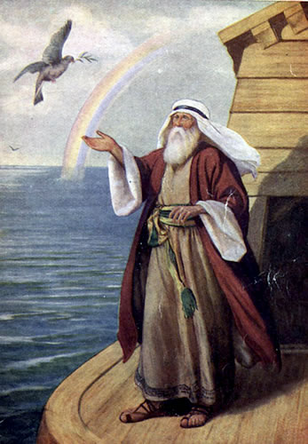
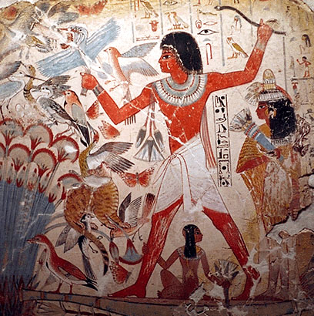
Genesis
Creation, Fall and Judgment
God chooses a man through whom to send the Messiah

Slide 17
An Outline of the Bible:
Genesis 1: Who is God?
Genesis 2: Who is man?
Genesis 3 & 4 The problem of sin.
Genesis 5-Revelation 22 The solution.

Slide 18
Another Outline of the Bible
I. Genesis 1 God created the universe and the earth. It was very good.
II. Genesis 2 God created man so that we could have an intimate relationship with him.
III. Genesis 3 and 4 We messed up very badly—destroying that relationship.
IV. Genesis 5-Rev 20 God is repairing the damage done by sin.
V. Rev 21-22 God has fixed the problem and we are back in a relationship with him.

Slide 19
Themes in Genesis
God: a loving Creator.
The Fall: Sin and separation from God.
Judgment
The Solution: God chooses a man of faith through whom to send the Messiah.

Slide 20
Outline of Genesis
Ch 1 Creation God, the creator
Ch 2,3 Adam and Eve The fall of man, God’s plan begun.
Ch 4 Cain and Abel Temptation, sin, judgment and death.
Ch. 5 Genealogy God’s plan to send the Messiah
Ch 6-9 The Flood Judgment against sin and salvation by faith
Ch 10 More Genealogy God’s plan to send the Messiah
Ch 11 The tower of Babel God opposes the proud
Ch 12-23 Abraham; The Father of Faith God chooses a person through whom to send the Messiah.

Slide 21
Outline of Genesis (cont.)
Ch 24-26 Isaac The Son of Promise
Ch 27-35 Jacob The Father of the Nation
Ch 37-47 Joseph Favorite son and savior of Israel
Genesis 49 The Twelve Tribes Prophecies about God’s People.
Genesis 50 The Death of Jacob

Slide 22
Genesis Chapter 1: Creation
Genesis Ch 1-4 is primarily theology.
Genesis 1:1
  In the beginning…
  In the beginning, God…
  In the beginning, God created… (Heb 11:3 Rom 1:21-25)
  In the beginning God created the heavens and the earth

Slide 23
Competing World Views
Naturalism/Atheism
Postmodernism: No World View
Deism
Pantheism
Animism/Polytheism
Dualism
Biblical Theism

Slide 24
The Christian World View
According to Genesis 1-4:
1. The physical world is: a. real b. created out of nothing (ex nihilo) and c. essentially good.
2. There exists an unseen spiritual reality which is not limited to or defined by the physical reality. Human beings have a spiritual aspect to their nature.
3. The creator of both the physical and spiritual realm is the God who reveals himself in the Bible.
4. Human beings have both a physical and a spiritual nature, The spiritual nature is more essential as it is eternal.
5. God is not easily defined but he can be characterized by certain qualities. God is a person. God is love, God is just, God is holy, God is omniscient, omnipotent and omnipresent.

Slide 25
The Christian World View (cont.)
6. Although all God’s creation, including the physical world is good, evil does exist. Such evil is the result of freedom of will given to created beings and their subsequent decision to use that freedom to rebel--to “sin”
7. Because of God’s justice and his holiness, those who choose to rebel against him will ultimately be judged and separated from God for eternity.
8. The solution to evil, to sin and its eternal consequences is provided by God through the atoning substitutionary sacrifice of Jesus Christ.
All of this is found in Genesis 1-4

Slide 26
Genesis Chapter 1: Creation
Genesis 1:2-10 God creates order and distinctions out of disorder and formlessness
  Light vs dark
  Sky, water, land
  Living vs non-living 1:11
  Male vs female 1:27
  Good vs evil Gen Ch 3
Genesis 1:11-25 God creates life

Slide 27
Genesis 1:26-30 God creates mankind in his image, to rule the earth.
  Q: In what sense are we created in God’s image?
  Q: What are the implications that God put us in charge of the earth?
  God blessed them 1:28 This was his plan.
Genesis 1:31 Summary: It was all very good.
  Q: Do you agree with God’s analysis here?

Slide 28
Genesis Chapter One: Creation
Young Earth Theory
  Earth is young and science supports this conclusion.
  Earth is young because God created it “with an appearance of age.”
Day/Age Theory
Gap Theory
Framework Theory
It’s all just a myth
Each view has its problems

Slide 29
Is Genesis 1:1 a Myth?
Yes! It is a true myth.
  A myth is a simplified story, given to explain the gods (or God) to common people.

Slide 30
Creation Myths
Babylonian Creation Myth
  Primeval swamp. Marduk kills Tiamat. Blood + mud = humans
Egyptian Creation Myth
  Primeval ocean “Nun” from which arrises a Primeval hill.
Greek Creation Myth
  Prometheus and Epimetheus form clay molds. Earth supported by Atlas.
Iroquois Creation Myth
  Enigorio and Enigohahetgea: Good and evil brothers battle
Genesis One is an obvious exception to this pattern

Slide 31
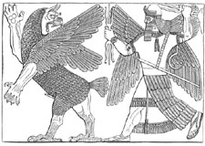
Babylonian Creation Myth: Marduk kills Tiamat

Slide 32
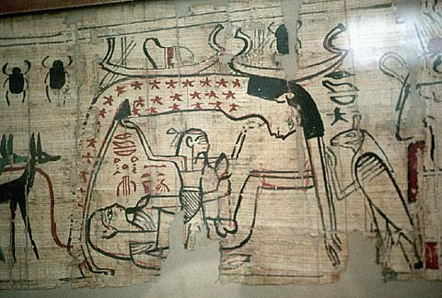
Egyptian Creation Myth

Slide 33
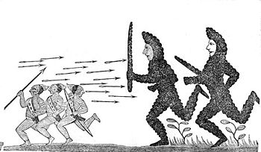
Iroquois Creation Myth:
Enigorio and Enigohahetgea Battling the Ronnongwetowanca (Stone Giants)

Slide 34
A Quick Summary of Genesis One:
a. God pre-existed the universe
b. God created the universe: “Let there be light”
c. God created the earth
d. God created life
e. Last of all, God created mankind

Slide 35
A More Detailed Summary of Genesis One
From the Viewpoint of an Observer on the Earth:
a. The earth created and is spinning: night and day. Day 1
b. Water covers earth, Very thick atmosphere forms. Day 2
c. The earth cools, land appears out of the water. Day 3
d. Life appears on the earth. Day 3
e. (Photosynthetic life dramatically changes the chemistry of the atmosphere from reducing to oxidizing.)
f. Finally, the heavenly objects appeared in the sky Day 4
g. More advanced life forms; first in the water, later on the land Day 5
h. Even more advanced life forms. Last of all human beings Day 6

Slide 36
Is the Metaphorical Day a Reasonable Interpretation?
Pre-Science Theologians Who Said Yes.
Philo 1st century
Origen early 3rd century
Augustine early 5th century
Thomas Aquinas 13th century

Slide 37
Translations of yom in the Old Testament (NIV)
1181 times as “day” (but with several different connotations of the word, some not being literal)
  Isaiah 4:2 In that day the Branch of the Lord will be beautiful…
67 times as “time”
30 times as “today”
18 times as “forever”
10 times as “continuously”
6 times as “age”
4 times as “life”
2 times as “perpetually”

Slide 38
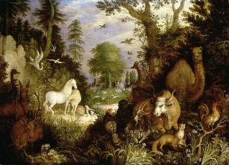
Genesis 2 Who is man?
Created in God’s image 1:27
Given authority over the earth 1:26 2:19-20
Created to know God and to be known by him.
  Created for relationships Genesis 2:18. 23-25
  God walked in the garden 3:8
Given everything, including “free will.” Genesis 2:9, 15-17
Adam and Eve are us!

Slide 39
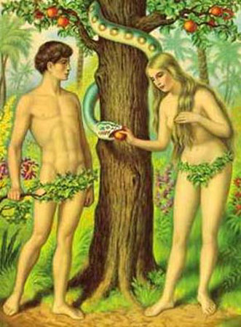
Genesis 3 & 4 The Problem: Sin
Genesis 3:6 The fruit was desirable.
Their sin? Pride. Wanted to be “like” God.
The result: lost innocence death and separation from God.
Adam and Eve are us in this sense as well.
Genesis 3:15 God will provide a solution: Jesus.

Slide 40
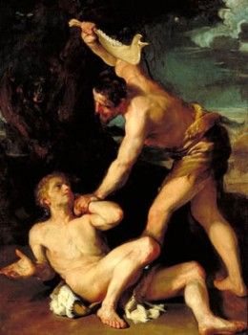
Genesis 3 & 4 The Problem: Sin
Genesis 4:1-16 Cain and Abel. Things did not improve with their children
4:6 For us, “sin is crouching at your door; it desires to have you, but you must master it.”

Slide 41
Genesis 6-8 Things get even worse
(But God has a plan to save us from our sin)
Gen 6:6 “The Lord was grieved that he had made man on the earth, and his heart was filled with pain.”
The world was judged (2 Peter 3:5-9), but Noah and his family were saved.
We are Noah and his family!!! (1 Peter 3:20-22)

Slide 42
Explanations of the Flood
Worldwide flood.
Local flood
Just an unfounded myth

Slide 43
Ancient Cultures With Flood Stories
Hindus
Burma (Myanmar)
New Guinea
Aborigines of Australia
New Zealand
Iroqoi
Incas
Aztecs
Greeks
Babylonians
Sumerians
Celts
Hottentots (Southern Africa)

Slide 44
Common Elements
1. The flood a judgment.
2. Massive or world wide in effect.
3. Some humans saved from this flood and repopulate the earth.

Slide 45
The Bible and the Flood
New Testament writers clearly believe this was a historical event. Matthew 24:38-39
It happened as judgment for sin 2 Peter 3:6-7
It is a prefigure of final judgment
It is a miracle, not a “natural” event—like the fire which will destroy the world
Belief in the flood based chiefly on faith in the Bible, certainly not on science.

Slide 46
Genesis 12-50
God’s Plan: Salvation by faith.
Genesis 12-23 God chooses a man of faith through whom to bring the Messiah.
Genesis 24-50 God prepares a people through whom to send the Messiah.

Slide 47
Genesis 12-23 Abraham
Abraham the chief (human) figure in Genesis
Abraham is a “type” and we are the “antitype”.
  Romans 4:11-12, 16-17 Faith is why Abraham was made the father of us all and the father of many nations.
Abraham: Salvation is by faith.

Slide 48
Genesis 12, 15, 17
A covenant with Abraham
Genesis 12:2 I will make you into a great nation.
Genesis 12:3 All nations will be blessed through you.
Gen 13:15 I will give you this land.
Genesis 15:4-5 I will give you a son, and your offspring will be like the stars in the sky.
Genesis 17:6 Kings will come from you.

Slide 49
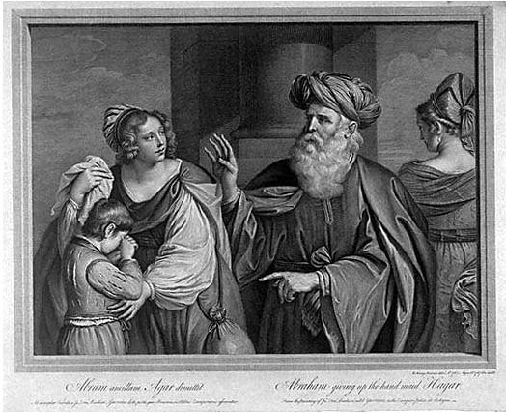
Hagar, Sarah, Ishmael and Isaac
Hagar, Ishmael represent slavery and they represent physical Israel.
  Ishmael… born “the usual way”
Sarah and Isaac represent freedom, promise. They represent spiritual Israel—us?
  Isaac the child of promise
Galatians 4:21-31

Slide 50
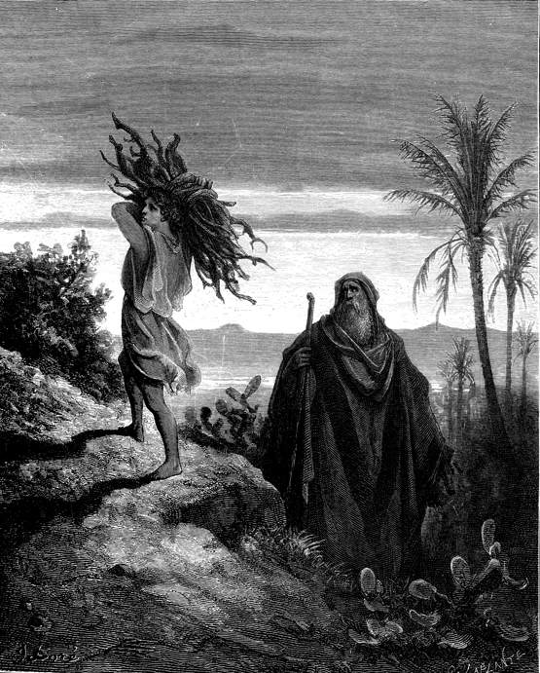
Abraham and Isaac
Genesis 22:2-14
Take your son… your only son Isaac…
1 Cor 15:3-4 3rd day.
Heb 11:19 Figuratively, Abraham received is son on the 3rd day.

Slide 51
Genesis 14:
Melchizedek: An interesting guy!
Without genealogy, without descendents. (Hebrews 7:3)
“Without beginning of days or end of life” (Hebrews 7:3)
A priest forever. (Hebrews 7:3, Psalm 110:4)
The King of Salem (Jerusalem) (Genesis 14:18)
A priest, but not of the family of Levi. (Heb 7:6)
He blessed Abraham. (Genesis 14:19)
Abraham offered him a tithe/sacrifice (Genesis 14:20).
A priest “forever” (Heb 7:3, Psalm 110:4)

Slide 52
Melchizedek: Prefigure of Christ
Melchizedek means King of Righteousness.
King of Salem means King (prince?) of Peace.
The King of physical Jerusalem.
Without beginning or end of days.
Without descendants.
High Priest because of his character, not by descent.
Greater than Abraham (Heb 7:4, John 8:53-58).
Gave Abraham bread and wine (last supper, Lord’s Supper)
Not a Levite (not even a Jew!)
A priest for everyone; not just for the Jews.
A priest and a king.

Slide 53
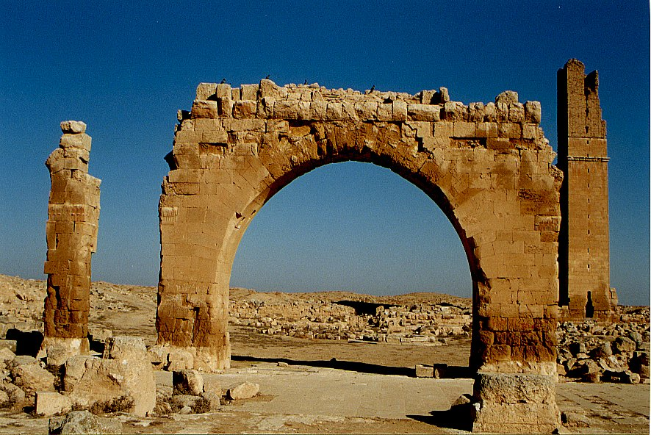
An Aside:
Archaeology and Genesis
Haran Ruins In Mesopotamian Plane Near Sanli Urfa, Turkey

Slide 54
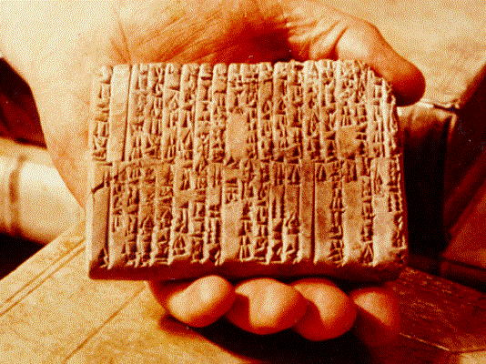
One of the Ebla Tablets about 2100 BC
Nahor, Terug, Abram, Sarai

Slide 55
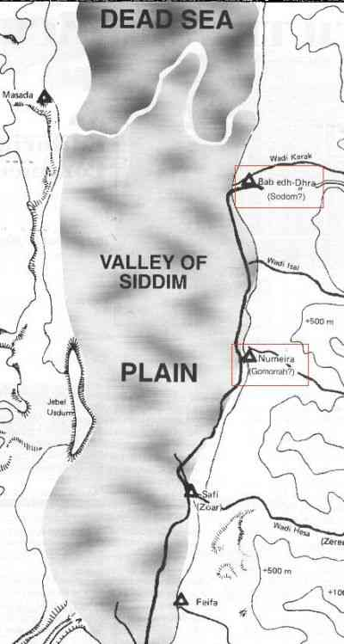
The Five City League, including Sodom and Gomorrah
Genesis 14:2

Slide 56
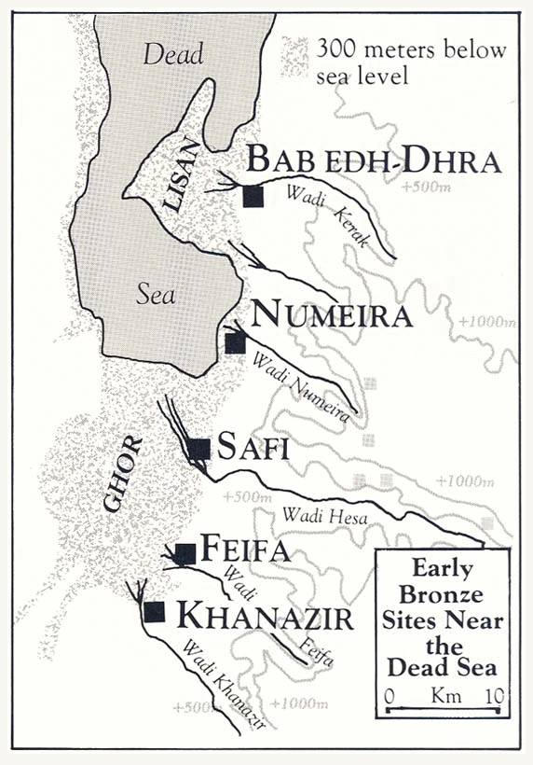

Slide 57
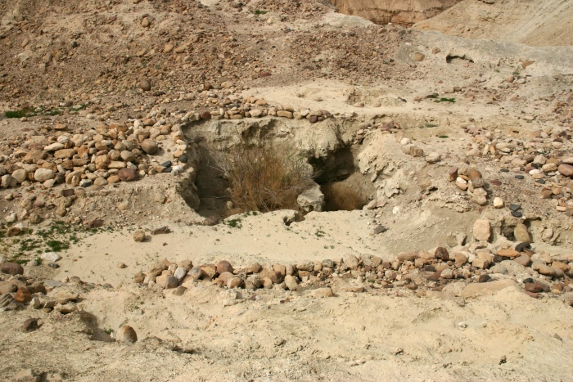
Ruins at Bab ed-Dhra (Sodom)

Slide 58
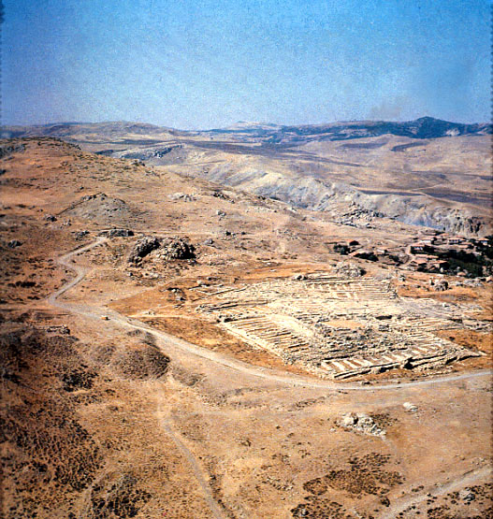
Ruins of Hattusha, capital of the Hittites

Slide 59
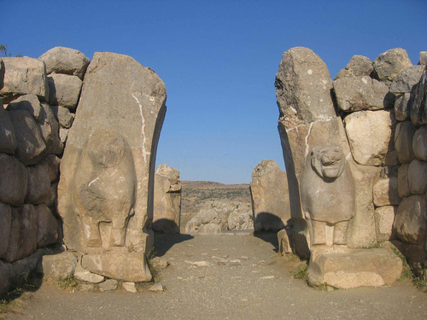
The Lion Gate in Hattusha

Slide 60
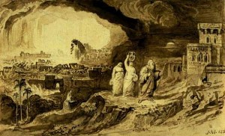
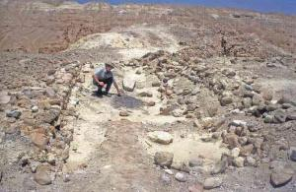
Genesis 19: Sodom and Gomorrah
Judgment!
Salvation
2 Pet 2:6 Lot, “a righteous man.”
Lot’s wife Luke 17:32

Slide 61
Genesis 25: Jacob and Esau
Esau: Israel and the Old Covenant.
  The natural first-born.
Jacob: Spiritual Israel and the New Covenant.
  The chosen “first-born.” Romans 9:10-13
  Q: Did God hate Esau?

Slide 62
Genesis 37, 39-45
Joseph: A prefigure of the Messiah.
Prince … Slave in Egypt…. Prince
Favorite son.
A dream: King of the Jews.
Brothers decided to kill him.
Instead, they betrayed him for 20 pieces of silver.
Became a slave in Egypt. (Hosea 11:1)
Raised up to Pharaoh’s right hand.
Saved Israel.

Slide 63
Genesis 49 Final Prophecies
God is sending the Messiah
Genesis 49:10-11
  Scepter
  Staff
  “until the coming of the one whom all nations will obey”
  Foal, colt
  Wine, “blood of grapes”
Genesis 50 Jacob dies. End of the Patriarchal Period

Slide 64
Class #3
The Law: Exodus, Leviticus, Numbers, Deuteronomy
Outline of the four books:
God saves his people from slavery
God gives his people a Law and a Covenant
God protects his people in the Wilderness.
  He also disciplines them for their hard hearts.
God brings his people to the Promised Land

Slide 65
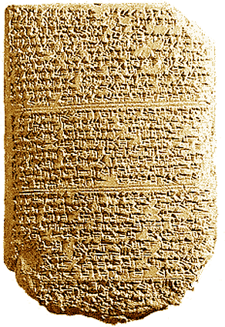
‘The Habiru plunder all lands of the king. If archers
are here this year, then the lands of the king, the
lord, will remain; but if the archers are not here,
then the lands of the king, my lord, are lost.’
One of the Tel El Amarna Letters c. 1400 BC

Slide 66
Exodus: Leaving a Life of Sin
Theme: God saves his people from bondage.
Application: God will go to any length for us to be saved from bondage to sin.
Ch 1 Israel in slavery.
Ch 2 God prepares Moses.
Ch 3-6 God sends Moses.
Ch 7-11 The ten plagues.
Ch 12 The Passover.
Ch 12-14 The Exodus, crossing the Red Sea
Ch 15-17 Wandering and grumbling.
Ch 18 Moses and Jethro
Ch 19-31 At Mt. Sinai. Moses receives the Law.
Ch 32 Aaron and the golden calf. The first tablets destroyed.
Ch 33-40 More laws.

Slide 67
Historical Foreshadows
Exodus - Deuteronomy
In Egypt = bondage to sin, being a non-Christian
Escape from Egypt = salvation, leaving our life of sin.
Wandering in the Wilderness = life of a disciple, learning to rely on God
Entering the Promised Land = entering heaven—a secure relationship with God.

Slide 68
Historical type/antitype in the Exodus
OLD TESTAMENT TYPE
NEW TESTAMENT ANTITYPE
SLAVERY IN EGYPT
LOST, SLAVE TO SIN
WANDERING IN THE WILDERNESS
SAVED, BUT LIVING THE LIFE OF A DISCIPLE
ENTERING THE PROMISED LAND
ENTERING HEAVEN

Slide 69
Slavery in Egypt = Slavery to Sin
Exodus 2:23-25 Suffering in slavery
Exodus 3:7-10 God sends a savior
Exodus 5:1-5 Let my people go.

Slide 70
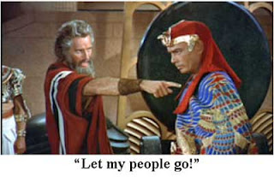
Jesus to Pharaoh: Let my people go!

Slide 71
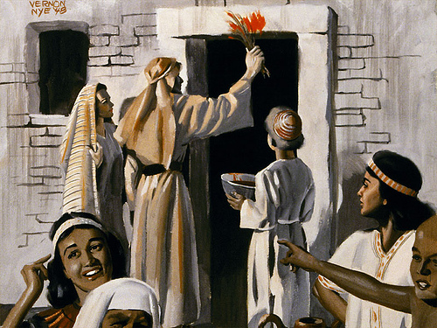
Plague #10: The Passover
A death sentence
An unblemished Passover lamb
  John 1:29, 1 Cor 5:7, Rev 13:8
Blood sprinkled on the wooden beam above their doors
Saved from death and saved from slavery

Slide 72
Passover (Pesach) and the Lord’s Supper
Passover meal (seder) a remembrance of salvation Exodus 12:14
Do not break the bones of the lamb. Ex 12:46
Unleavened bread (the influence of sin 1 Cor 5:7-8
Bitter herbs to remember the bitterness of slavery (to sin)
3rd cup (the one they took after the supper): the cup of redemption.

Slide 73
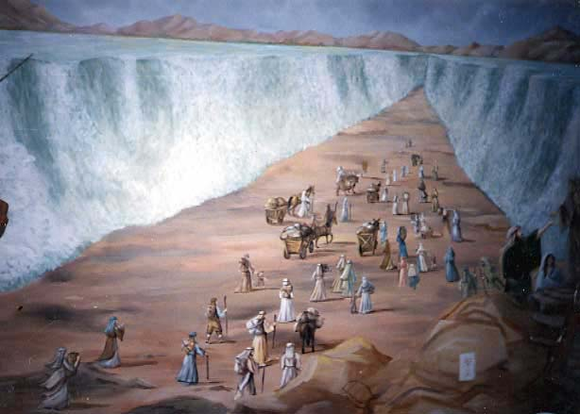
Crossing the Red Sea: Baptized into Moses (1 Cor 10:1-4)

Slide 74
Parallels Between Moses and Jesus
Moses
Jesus
Pharaoh tried to kill him
Herod tried to kill him
Called by God to leave Egypt
Carried out of Egypt
Forty years in the wilderness to prepare for his ministry
Forty days in the wilderness to prepare for his ministry
Left his position with the king of Egypt to dwell with the Jews
Left the right hand of the Father to life with the Jews
Led Israel out of slavery in Egypt
Leads Spiritual Israel out of sin
Aaron prepared the way
John the Baptist prepared the way
Baptized Israel in the Red Sea in order to free them
Commands baptism in water for freedom from sin
Gave manna in the wilderness
(sort of)
Gives spiritual bread to all who hunger
Gave water to the people in the desert
Gives spiritual water: the Holy Spirit
Spoke to God on Mt. Sinai
Spoke to God on Mt. Hermon

Slide 75
Wandering and Grumbling:
The Life of a Disciple
Many left Egypt, but few entered the Promised Land
  Hebrews 3:14-4:2 1Cor 10 Do not be like them!
Why? They looked back to Egypt Exodus 16:2,3 Numbers 11:4-15 Numbers 21:4-9
The life of a disciple: Deut 8:2-5
We need to eat the manna and drink the water!

Slide 76
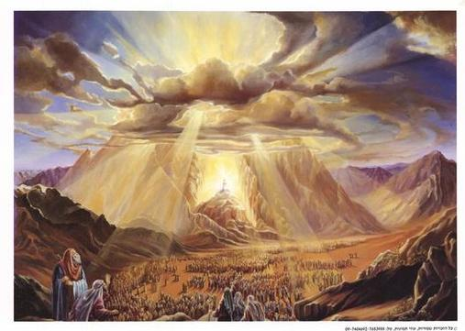
Exodus 19-31: Moses Receives the Law at Sinai
Exodus 19:12-19 A consuming fire, smoke, clouds, earthquakes…
The greatest moment in the history of Israel.
Exodus 24: The covenant is sealed.
Ex 24:3 “We will do everything that the Lord has commanded.”

Slide 77
Numbers:
The Stubbornness of Israel and God’s Patience
Ch 1-4 The nation of Israel. A census.
Ch 5-9 Dedication of the Tabernacle.
Ch 10-12 Wandering again. Quail, grumbling and rebellion.
Ch 13,14 Exploring Canaan. Bad and good reports. All will die in the desert.
Ch 15 More laws.
Ch 16,17 Korah’s rebellion.
Ch 18,19 More laws.
Ch 20 Moses strikes the rock: will not enter Promised Land. Aaron dies.
Ch 21 Rebellion, the bronze snake, defeat of the Amorites.
Ch 22-25 Balaam. Israel falls into idolatry.
Ch 26-30 Various laws. Joshua to succeed Moses.
Ch 31-37 Victory east of the Jordan. Division of the land.

Slide 78
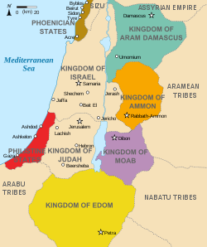
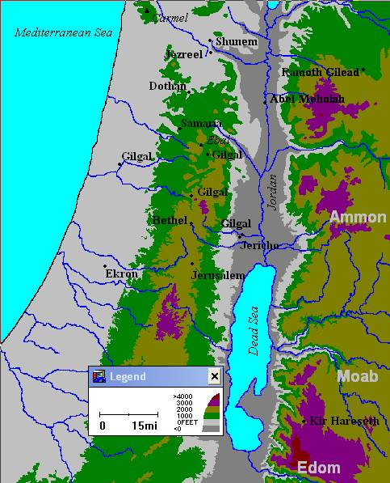
Edom, Moab, Ammon, Midian

Slide 79
Leviticus:
The Seriousness of Sin and the Need for Sacrifice
Ch 1-7 The five sacrifices.
  Ch 1 The Burnt Offering.
  Ch 2 The Grain Offering.
  Ch 3 The Fellowship Offering.
  Ch 4,5 The Sin Offering.
  Ch 5,6 The Guilt Offering.
Ch 8-10 The Priesthood.
Ch 11-22 Various laws.
Ch 23-25 The Sabbath and the Feasts
Ch 26 Punishment and Reward.
Ch 27 More laws.

Slide 80
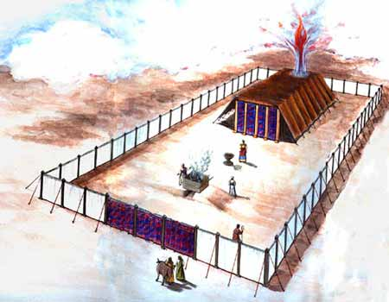
Model of The Jewish Tabernacle
Hebrews 8:1-6

Slide 81
Type/Antitype Relationships in the Tabernacle
ITEM IN TABERNACLE OR TEMPLE
ANTITYPE IN THE NEW COVENANT
SCRIPTURE REFERENCE
The tabernacle itself
God dwelling with his people
John 14:1-3, John 1:14J. Rev 1:13
The bronze altar of sacrifice
The sacrifice of Jesus for sins
Hebrews 9:14
The basin/laver
Baptism
Titus 3:5
The show bread
The bread of life, Jesus Christ
John 6:48-51
The lampstand
The Holy Spirit
Zechariah 4:1-6
The altar of incense
The prayers of the saints
Revelation 5:8
The blue, purple and scarlet yarn
The heavens, the kingship of God, the blood of Jesus
The curtain
Separation from God
Matthew 27:51
The ark of the covenant
The presence of God
Psalm 132:7,8
The Mercy Seat
The grace of God
The Cherubim
The angels in heaven
Ezekiel 10:15-22

Slide 82
Sacrificial Type and Antitype
Old Testament Sacrifice
New Testament fulfillment
Scriptures
Sweet Savor Sacrifices
The Burnt Offering
Jesus’ and our devotion to God
Ephesians 5:1,2 Romans 12:1,2
The Grain Offering
Giving to God from our blessings
Matthew 6:19-21
Romans 8,9
The Drink Offering
Pouring out our life for God
Luke 22:20 Philippians 2:16
The Fellowship Offering
Celebrating our blessings from God
John 10:10
1 Thess 5:16
Blood Sacrifices
The Sin Offering
Jesus’ sacrifice for our sins
1 Peter 1:18,19
2 Cor 5:21
The Guilt Offering
Relationship with one another
Matthew 5:23,24

Slide 83
Gifts/Offerings/Sweet Smelling Sacrifices
The Burnt Offering olah Leviticus 1
The Grain Offering minchah Leviticus 2
The Drink Offering nesek Leviticus 23
The Fellowship Offering shelem Lev 3

Slide 84
The Burnt Offering Leviticus 1
Lay hands on the animal.
Sacrifice the animal
Clean the body but not the head
Burn them on the altar
Meaning: Total commitment of one’s life to God.

Slide 85
The Burnt Offering
Jesus gave a burnt offering: Ephesians 5:1-2
God calls us to give a burnt offering
Romans 12:1-2 … in view of God’s mercy
Isaiah 6:8 Here am I, send me
What will you lay on the altar?

Slide 86
The Grain Offering
Give the FIRST FRUITS of what God has blessed you with.
NOT voluntary.
Grain hard work
Oil joy
Incense prayer
Salt eternal blessings, “treasures in heaven”
No yeast!!! 1 Cor 5:6-8

Slide 87
The Grain Offering
Application: Our contribution to God 2 Cor 8,9
For us, 10% is not mandatory, but giving sacrificially is.
Malachi 3:7-10
Matthew 5:20

Slide 88
The Drink Offering
Drink Poured out on the altar.
Application: Pouring out our life on the altar.
Usually given with the grain offering.
Application: We give our tithe, but God wants much more. He wants us to be “all in.”

Slide 89
The Drink Offering
Jesus gave a drink offering Luke 22:20
Paul gave a drink offering Phil 2:16-17 2 Tim 4:6,7
Haggai 1:3 What are you saving for?
The greatest joy comes from giving a drink offering.

Slide 90
The Fellowship Offering
Party Time!!!!! Celebrate the blessings of God.
Voluntary
Vow Offering Leviticus 11:16
  Blessings hoped for
Thank Offering Leviticus 7:11-15
  Blessings already received.
Free Will Offering Leviticus 22:23
  Thankful for blessings in general

Slide 91
The Fellowship Offering
Application I Thess 5:16-18
  Rejoice always (free will offering)
  Pray continually (vow offering)
  Give thanks in all circumstances (thank offering)
Placed on top of the burnt offering

Slide 92
Blood Sacrifices
The Sin Offering chatat Leviticus 4
  For sins against God
The Guilt Offering asham Leviticus 5
  For offenses against a fellow Jew
Hebrews 9:13-14
No sacrifice for willful sin! Leviticus 4:1 (Heb 10:26)

Slide 93
The Sin Offering Lev 4:1-5:13
Unblemished bull or goat (like Jesus)
Offender laid their hands on the animal (God put our sins on Jesus on the cross) Isaiah 53:6
Offender killed the animal. (We killed Jesus) Matt 27:25
Blood sprinkled on the altar, as well as on the curtain.
Body burned outside the camp (like Jesus) Heb 13:11-13

Slide 94
The Guilt Offering Lev 5:14-6:7
Only for offenses of individuals, not groups.
Offender must make restitution first before bringing the sacrifice. (Matthew 5:23-24)
But….
God wants us to be confident Heb 10:19-22

Slide 95
A Better Sacrifice
Hebrews 9:23 It was necessary, then, for the copies of the heavenly things to be purified with these sacrifices, but the heavenly things with better sacrifices than these
The lesser sacrifice: Bulls, goats, red heifer | The greater sacrifice: Jesus
Outward (appearance) | Inward (reality)
Temporary, repeated many times | Eternal, done only once
Ceremonial | Real
Not voluntary | Voluntary

Slide 96
The Red Heifer Sacrifice as a Prefigure
The Red Heifer Sacrifice | The Sacrifice of Jesus
A very rare red heifer | A unique son
Sacrificed outside the camp (on the Mount of Olives) | Sacrificed outside the camp (on the Mount of Olives)
To purify both Jews and Gentiles | To purify both Jews and Gentiles
A sacrifice without blemish (not even one black hair!) | A sacrifice without blemish
Never been yoked (voluntary, not sinned) | A voluntary sacrifice, without sin
Scarlet wool and wood | Blood on wood
Hyssop (purification from infection) | Purifies from the infection of sin
Combines ashes from sacrifice with water for purification. | Combine the blood of Jesus with baptism for purification

Slide 97
Leviticus 8-10, 21-22 The Levitical Priesthood
Levitical Priesthood a Prefigure of our Priesthood.
  1 Pet 2:5,9 Rev 5:9-10, Romans 15:15-16
  No inheritance: fully devoted to the work of God 2 Chron 31:4
  Cannot touch a dead body Lev 21:11
  Cannot become unclean Lev 21:11-12
Melchizedek Priesthood a Prefigure of Jesus’ Priesthood.

Slide 98
First Covenant Festivals as Types Leviticus 23-25
Jewish Festival
Antitype in the Christian Life
Passover (pesach)
The Sacrificial Death of Jesus Christ
Feast of Firstfruits
The Resurrection of Jesus Christ
Feast of Unleavened Bread
Celebrating Being Free of Sin in Our Lives
Feast of Weeks/Pentecost (shavoat)
The Giving of the Holy Spirit and the Initiation of the Church
Feast of Trumpets (rosh hashanah)
Judgement Day, Jesus Coming Back
Day of Atonement (yom kippur)
The Day We Were Saved—Spiritual Birthday
Feast of Booths
(Tabernacles)
Celebrating Life in Fellowship with God

Slide 99
Feast of Firstfruits
A harvest festival when there was no harvest.
A promise of a future harvest.
A foreshadow of the final resurrection.
A prefigure of the resurrection of Jesus.
Coll 1:18 The first born from among the dead.

Slide 100

Feast of Trumpets Rosh Hashanah/Yom Teruah
A foreshadow of the Return of Jesus.
  Matt 25:30-31, I Thess 4:13-14 Trumpet call.
A foreshadow of Judgment Day
Rabbis: Stay awake all night so you will be prepared.

Slide 101
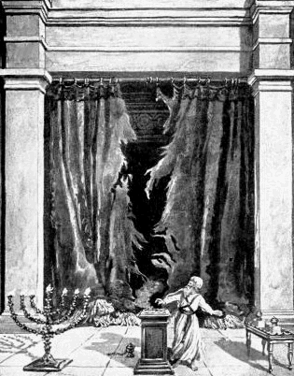
The Day of Atonement Yom Kippur
Bull for sin of the high priest
Sacrificial goat and scape goat.
Sins laid on sacrificial goat, killed outside the camp.
Prefigure of the salvation of Jesus. Heb 9:11-15

Slide 102
Deuteronomy:
Learning to Rely on God. Blessings and Curses
Ch 1-3 Moses recounts the wanderings in the wilderness.
Ch 4-11 Do not forget your God. God is great, not you.
Ch 12-27 The Law revisited (this is the meaning of the word Deuteronomy)
Ch 28-30 Blessings for obedience and curses for disobedience.
Ch 31-33 Farewell address of Moses.
Ch 34 The death of Moses on Mt. Nebo.

Slide 103
Deuteronomy: Learning to Rely on God
Deut 1:17 Do not be afraid of man.
Deut 4:2 Do not add or subtract to my words.
Deut 6:4-5 Love God
Deut 6:24-25 Be careful to obey
Deut 7:7-8 Chosen by God
Deut 8:1-5 Rely on God, not self
Deut 9:4-6 Do not rely on self

Slide 104
Deuteronomy 7:1-6 Make no treaty, show no mercy
Q: Why no treaties?
Q: Why no mercy?
Q: How does this apply to us?

Slide 105
Response to the Question of Violence in the OT
If you are not bothered by this on some level, I am worried about you!
The argument assumes that physical death is bad/evil. This is a false assumption. Sin is evil but death is not. Death is a transition, hopefully, to something better.
God has a perfect right to judge—not us.
There is the issue of the religion of the Amelekites. Sacrificing of children in fire, worshipping gods by having sex with a prostitute in the temple, etc.
The situation for the children in this situation was hopeless.

Slide 106
Violence in the OT (cont.)
In the case of Amelek and other Canaanites, both God’s love and his justice demanded that something be done.
Either God was going to create a nation or he was not. If God is going to have a “people,” then such people must have a physical land and must have an army.
  God’s plan is to choose a man, then a nation, through whom to send a savior. God’s plan to bless humanity through Jesus trumps all else.
  It is sinful to take the life of another in anger, out of greed or selfishness, but it is not necessarily sinful to take a life in war.
Everything God did to Israel as a nation was to limit their ability to wage war.
  No authority to establish an empire.
  No standing army.
  No cruelty, no abuse, no rape

Slide 107
Deuteronomy: Blessings and Curses
Deut 28:1f Blessings for obedience.
Deut 28:15f Curses for disobedience.
  Deut 28:36-37 A prophecy.
Deut 30:11-20 Summary. Choose life so that God can bless you in the land you are entering to possess.

Slide 108
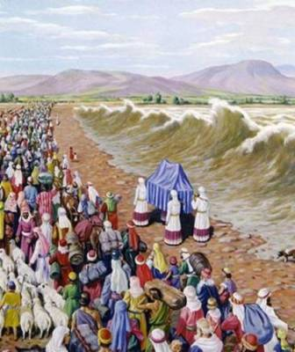
Joshua: Entering the Promised Land
Theme: Victory for God’s people.
Subtheme: Joshua: God’s leader.
Subtheme: Sin in the camp.

Slide 109
Outline of Joshua
Ch 1-5 God prepares Joshua, Israel crosses the Jordan River.
Ch 6 Defeat of Jericho.
Ch 7,8 Achan’s sin and the battle of Ai.
Ch 9 Gibeonite deception.
Ch 10-12 Victory in Canaan.
Ch 13-22 Division of the land.
Ch 23,24 Joshua’s farewell address.

Slide 110
Joshua: Prefigure of the Messiah
Saved Israel—brought them to Promised Land.
Joshua (aramaic) Jeshua (Greek) Jesus (English)
2nd Generation baptized into Joshua in the Jordan.
Josh 5:2-3 Circumcision: a prefigure of baptism.
  Coll 2:11-12
Josh 6 Defeats God’s enemies

Slide 111
Entering the Promised Land
Ch 1 God strengthens Joshua. Josh 1:6-9
Ch 2 Spies check out Jericho.
Ch 3 Crossing the Jordan. Josh 3:7-8, 14-17
Ch 4 12 stones and circumcision

Slide 112
Archaeological Facts about Jericho
1. The city was strongly fortified in the Late Bronze I period, the time of the Conquest according to the biblical chronology (Joshua 2:5,7,15).
2. The city was massively destroyed by fire (Joshua 6:24).
3. The fortification walls collapsed at the time the city was destroyed, possibly by earthquake activity (Joshua 6:20).
4. The destruction occurred at harvest time, in the spring, as indicated by the large quantities of grain stored in the city (Joshua 2:6, 3:15, 5:10).
5. The siege of Jericho was short, as the grain stored in the city was not consumed (Joshua 6:15,20).
6. Contrary to what was customary, the grain was not plundered, in accordance to the command given to Joshua (Joshua 6:17,18).

Slide 113
Sin in the camp: God’s people defeated
Joshua 7 Failed attack on Ai.
Joshua 7:10-12 Sin in the camp.

Slide 114
Joshua Ch 8-14 Victories (mostly)
Ch 10 Sun stands still.
Southern kings defeated.
Northern kings defeated.
Ch 14 Caleb: Give me that hill country

Slide 115
But….
Joshua 9 Gideonite deception.
Joshua 13 Unconquered territory.

Slide 116
Joshua 23-24 God’s Leader Gives His Final Words
Josh 24:14-15. Choose today whom you will serve. As for me and my house, we will serve the Lord!

Slide 117
Judges
Theme: God’s people with and without a godly leader
Theme passage (bad) Judges 21:25
Theme passage (good) Judges 5:2

Slide 118
Outline of Judges
Ch 1,2 Compromise with “the world”, disobedience and defeat.
Ch 3 Ehud
Ch 4,5 Deborah
Ch 6-8 Gideon
Ch 9 Abimelech The worst kind of leader.
Ch 10-12 Jephthah
Ch 13-16 Samson
Ch 17-21 Further misadventures in Israel without a godly ruler.

Slide 119
Judges: Prefigures of the Messiah
The pattern: Judges 2:6-16
A typical example: Judges 10:11-16
Lessons from Judges:
  Boldness of Ehud
  Deborah: When the men do not take the lead…
  Gideon: Relying on God, not your own power.
  Jephthah: Don’t speak too quickly
  Samson: Great potential wasted because of worldliness.

Slide 120
Ruth
Theme: The lineage of David. God is sending the Messiah
  God’s providence in preserving the line of the Messiah
  God uses the faith of a Gentile woman to work his plan.
  Genealogy of David Ruth 4:13-21

Slide 121
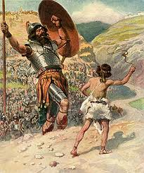
I and II Samuel, 1 Chronicles
Theme: God’s plan to bless his people. God gives them a King and a Savior: David.
Subtheme: An ungodly leader (Saul) and a godly leader (David)

Slide 122
Outline of I,II Samuel, I Chronicles
1 Sam 1-9 Samuel, Priest, Prophet and Judge
1 Sam 10-15 Rise and Fall of Saul, the first king of Israel.
1 Sam 16-29 David anointed as king and persecuted by Saul.
1 Sam 30-2 Sam 1 Death of Saul.
2 Sam 2-10 David, King of Israel.
2 Sam 11-21 David’s sins and the consequences.
2 Sam 22-24 David’s accomplishments.

Slide 123
Samuel: A Prefigure of the Messiah
Prophet, Priest and King (Judge)
The last Judge and the first Prophet.
Born of a barren woman (think about how many examples). Jesus of a virgin.
Dedicated to God from birth. A nazarite.

Slide 124
David: A Prefigure of the Messiah
Born in Bethlehem
A shepherd
Anointed as king 1 Sam 16:13 The Spirit descended on David.
Physical king of Jerusalem. Jesus spiritual king of Jerusalem.
Brought the ark (brought God) to Jerusalem. So did Jesus!!!
Saved Israel from slavery to Philistia. Killed Goliath
Saved Israel by offering a sacrifice on Mt. Moriah. 2 Sam 24
Persecuted by God’s people. Very similar to Jesus (Psalms 2:1,2 Psalms 22, etc.

Slide 125
Key Events in 1 Samuel
1 Sam 1-3 Miraculous birth and ministry of Samuel.
1 Sam 8 Israel demands a king.
1 Sam 9-10 Saul, first king of Israel.
1 Sam 13, 15 Saul disobeys, rejected as king
1 Sam 16 David anointed King of Israel.
1 Sam 17 David and Goliath.
1 Sam 18-30 Saul, David and Jonathan.
1 Sam 31 Death of Saul and Jonathan.

Slide 126
Key Events in 2 Samuel
2 Sam 2 David, King of Israel
2 Sam 2-10 David’s victories.
2 Sam 7 God makes a covenant with David.
2 Sam 10-11 Sin with Bathsheeba
2 Sam 12-21 Consequences for David’s sin.
2 Sam 23-24 David’s farewell address.

Slide 127
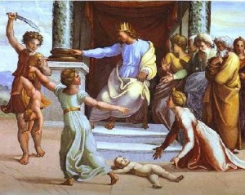
I, II Kings, 2 Chronicles
Theme: Israel sins and God judges his people.

Slide 128
Outline of I, II Kings
1 Kings 1-11 Solomon, son of Bathsheeba, King of Israel.
1 Kings 12 The kingdom of Israel divided under Rehoboam by revolt of Jeroboam.
1 Kings 13-2 Kings 16 The divided kingdom. Israel (Samaria, Ephraim) and Judah.
2 Kings 17 Northern Kingdom (Samaria) destroyed by Assyria.
2 Kings 18-24 Judah alone
2 Kings 25 The fall of Jerusalem and Judah to Babylon.

Slide 129
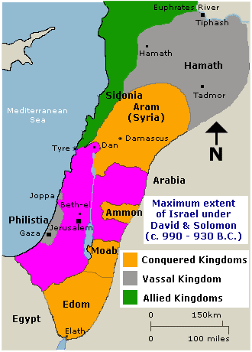
Solomon’s Kingdom about 940 BC

Slide 130
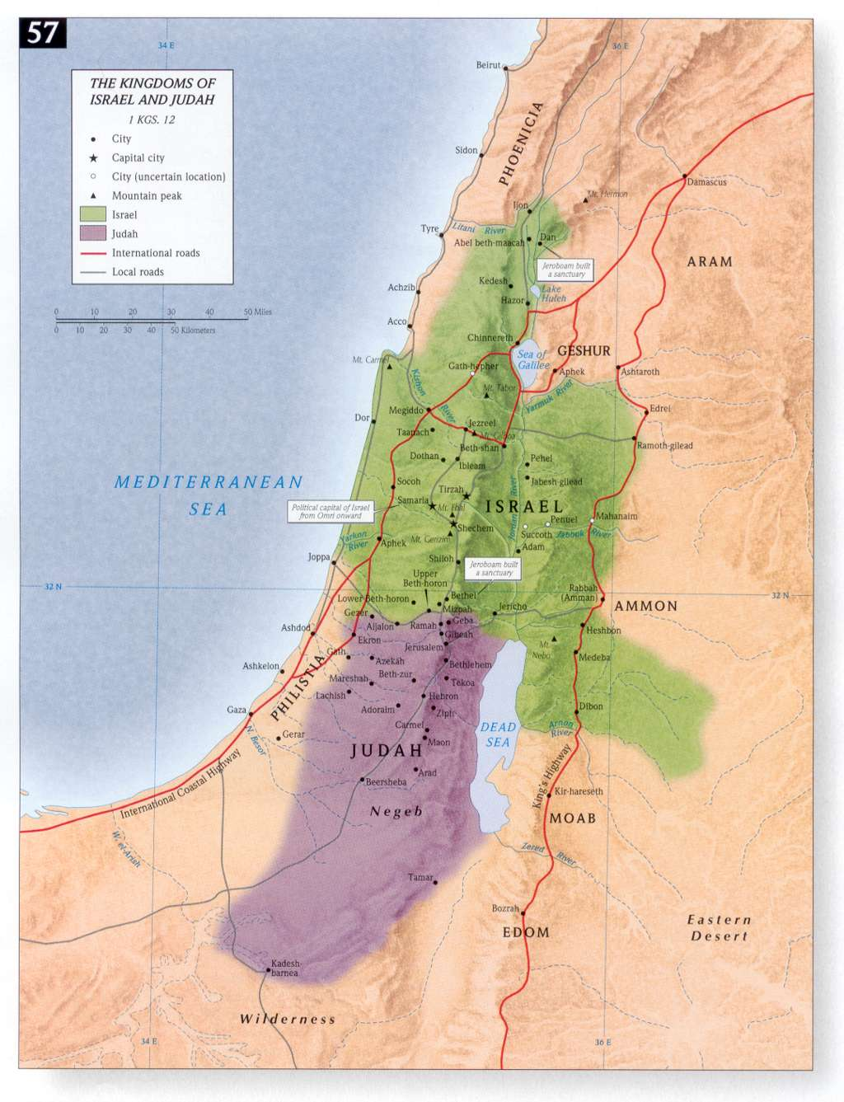
Divided Kingdom Under Rehoboam and Jeroboam
930 BC

Slide 131
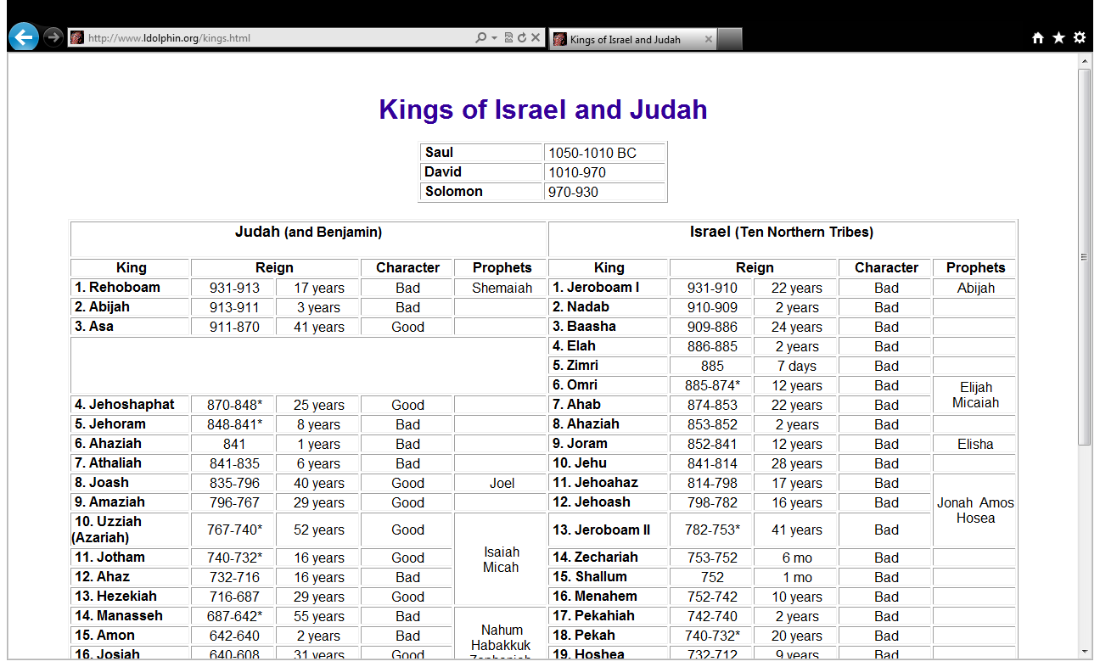

Slide 132
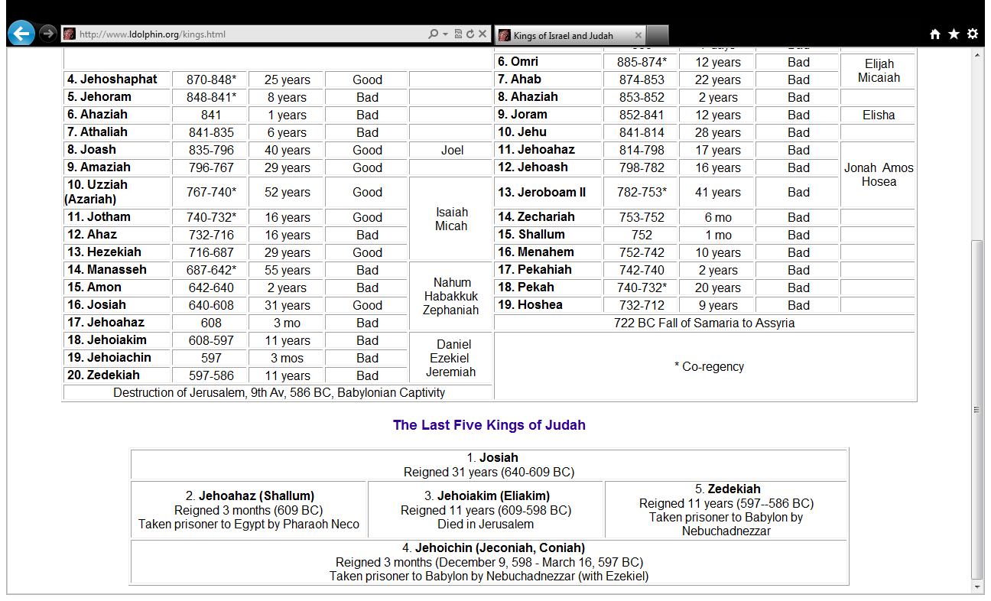

Slide 133
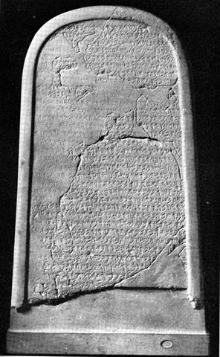
The Moabite Stone or Mesha Stele 870 BC
the Louvre
Ahab “of the house of Omri”
1 Kings 16:28

Slide 134
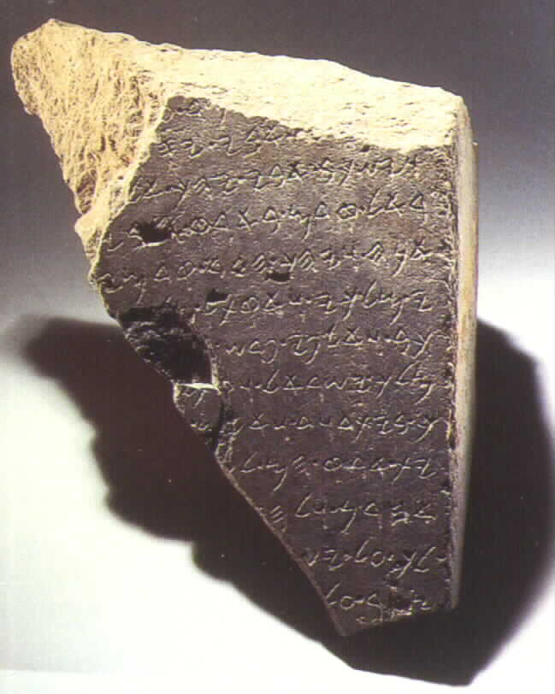
The Tel Dan Inscription
820 BC
2 Kings 8:28-29
‘I killed Jehoram, son of Ahab, king of Israel and I killed Ahaziah, son of Jehoram, king of the house of David”

Slide 135
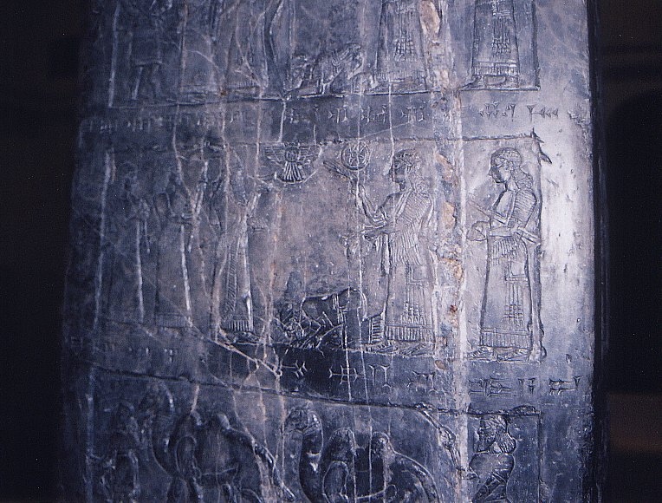
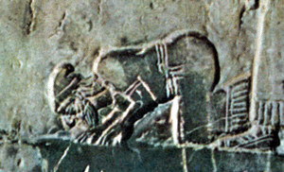
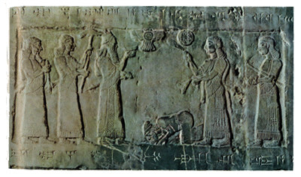
Black Obelisk of Shalmanezer III 840 BC
British Museum 2 Kings 17:3-6

Slide 136
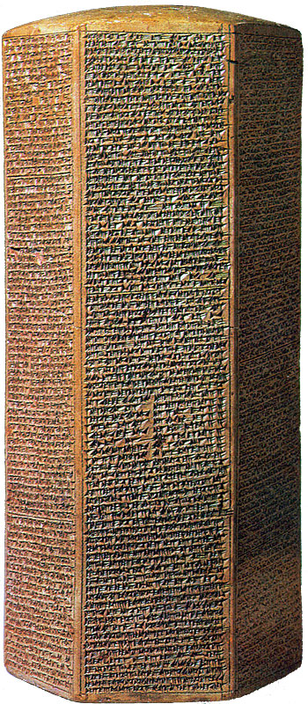
The Sennacherib Cylinder or Taylor Prism British Museum, London (2 Kings 18) 691 BC
As to Hezekiah the
Jew… I made him…
“like a bird in a
cage”

Slide 137
The Siloam Inscription.
2 Kings 20:20-21
"Now the rest of the acts of Hezekiah--all his might, and how he made a pool and a tunnel and brought water into the city--are they not written in the book of the chronicles of the kings of Judah? So Hezekiah rested with his fathers."

Slide 138
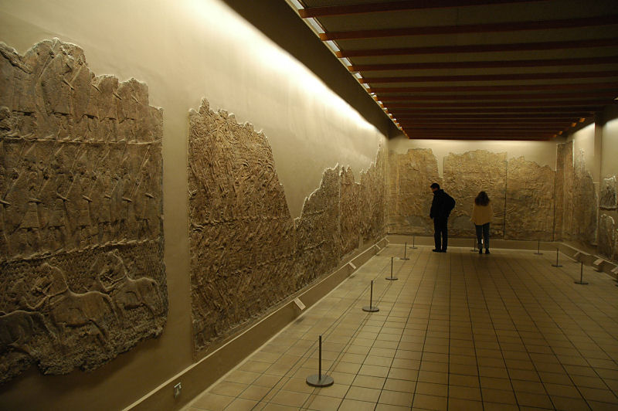
Lachish Room, British Museum

Slide 139
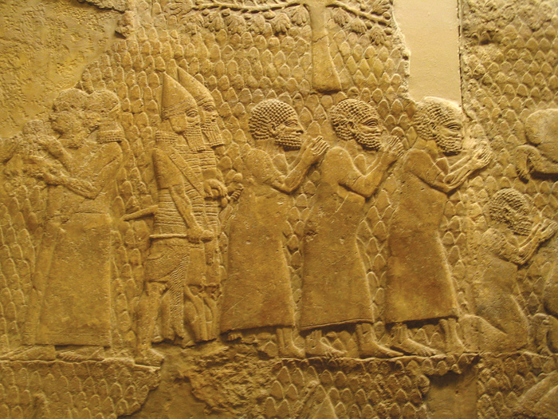
Israeli Captives Being Led from Lachish

Slide 140
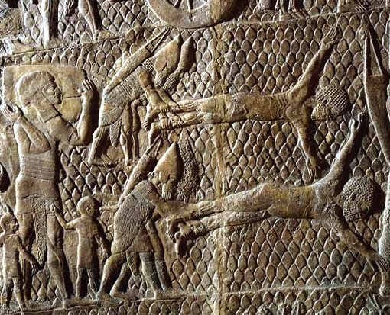
Jewish captives skinned alive in front of Lachish Walls

Slide 141
The Prophets

Slide 142
Prophets
Ex 4:16;7:1 Aron was Moses’ prophet
A prophet is a speaker of and for God
A prophet does more forth telling than fore telling
Jer.20:9

Slide 143
Prophets
nibba- one who has been called or appointed to proclaim as a herald the message of God
The man of God- The prophet must first and foremost belong to God.
Seer- the prophet received special visions to convey spiritual realities other men could not see.

Slide 144
Timeline
Israel’s Prophets before Captivity (Assyria)- Amos and Hosea
Judah pre-exile- Isaiah, Micah, Habakkuk, Zephaniah, & Jeremiah.
Judah during the exile-(Babylon) Daniel, Ezekiel
Judah post-exile-Haggiah, Zechariah, Joel and Malachi

Slide 145
The 7th And 8th
Century Prophets
The Demise of a Nation
The Petrification of the Law

Slide 146
The Demise of a Nation
Beginning with Jereboam and ending with Hoshea, Israel kept going farther and farther from God.
Warned by other prophets- Elijah and Elisha
Noted for changing what God set up, depending on their own strength, and becoming like the nations around them.
2Kings 17:1-23 note v.14-18

Slide 147
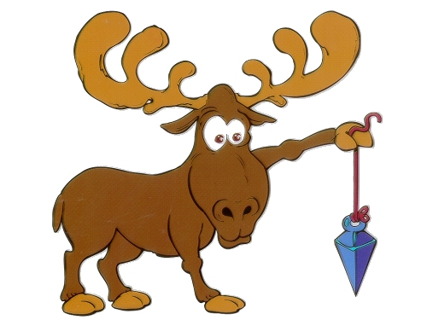
Amos (A Moose)

Slide 148
Israel’s Demise
Amos 2:6-16- For three transgressions and for four…(1:6,9,11,13;2:1)
Crime was against their own- sold the needy!
3:8 The Lion Roars
3:10 They do not know how to do right.
4- Nothing I did made any difference
4:1- Cows of Bashan- who oppress the poor

Slide 149
Amos
4:12- Prepare to meet your God
5:21-24 Religion without justice is offensive to God
7:7-9 The Plumb line
7:10-17 The prophets rebuke
9:11-15 There is a future remnant

Slide 150
Through out the book of Amos- I brought you out of Egypt- Remember where you came from.
When God’s people forget who saved them and become content with being like everyone else, destruction is on its way.

Slide 151
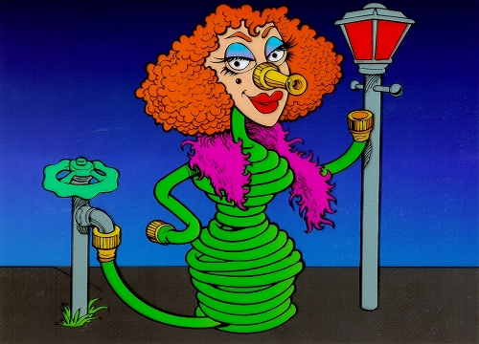
Hosea

Slide 152
Hosea
The Prophet of Redemptive Love

Slide 153
Hosea’s Marriage
Chs. 1 / 3: Hosea’s Marriage
–Doom –1:2-9; 3:1-4
–Hope –1:10-2:1; 3:5
Ch. 2: Yahweh’s Marriage
•Sermon to Israel
–Doom –2:2-13
–Hope –2:14-23

Slide 154
Hosea’s Children
Jezreel- God will scatter
Lo-ruhamah- No Mercy
Lo-Ammi- Not my people
Hosea 1:10-2:1
Ammi- my people
Ruhamah- Received Mercy
1Pet.2:10

Slide 155
God’s Marriage
2:5 I will go to my lovers (v.8).
2:16-17
God longed for Israel to call him Ishi (My Husband) instead of Baali (My Husband)
11:2-4 The more they were called the more they went away
11:8 How can I give you up!

Slide 156
The Covenant
Hosea 6:6-7
God desires mercy/ steadfast love and not sacrifice, the knowledge of God rather than burnt offerings
v.7 What Covenant did Adam break?
A covenant is not a contract- A covenant demands faithfulness out of love not obligation or reward.

Slide 157
Hosea
Hosea’s Marriage
Fidelity vs. infidelity
“Tough love”
Relation with Amos
Amos: sovereignty of God; social critique
Hosea: covenantal love; religious critique

Slide 158
Judah
Pre exile:
Isaiah, Micah, Habakkuk, Zephaniah, Jeremiah,

Slide 159

Isaiah (I Say Ah)

Slide 160
Isaiah’s Audience
four kings of Judah: Uzziah, Jotham, Ahaz, and Hezekiah

Slide 161
Isaiah
1:11-18 Worship is no longer accepted.
Key verse 1:19-20
Chapters 1-39- Judgment
Chapter 40-66- Redemption

Slide 162
Noteworthy
Isaiah contains 111 separate predictions. Of the 1,292 verses in the book, 754 (59%) deal with future events.
Forty-seven chapters of this book were directly quoted or alluded to by Christ or the Apostles. With more than four hundred allusions, Isaiah stands second only to Psalms as the most cited book in the New Testament.

Slide 163
Christ/ Church in Isaiah
1. The future temple which attracts Gentiles (2:2–4).
2. The glorious Branch (4:2–6).
3. The virgin birth of Immanuel (7:13–14).
4. The dawning of a new day in the birth of a child (9:1–7).
5. The Shoot of the stem of Jesse (11:1–10).
6. The conversion of Gentiles (19:18–25).
7. The new Jerusalem (54:9–13; 60:19–22).

Slide 164
Christ/ Church in Isaiah
8 The marriage supper of the Lamb (25:6–8; 26:19).
9. The ministry of the Messiah (42:1–4).
10. The Servant as a light to the Gentiles (49:1–13).
11. The willing obedience of the Servant (50:4–11).
12. The redemption achieved by the Servant (52:13–53:12).
13. The promises made to David to be fulfilled (55:1–5).
14. Converted heathen to become leaders in worship (66:19–23 )

Slide 165
Summary
Isaiah prophesied that because of continued idolatry God would send Judah into Babylonian captivity, yet he would graciously restore them (through the work of his Servant, who would bear away their sins by his death), so that his kingdom would be unending in the new heavens and the new earth.

Slide 166

Micah

Slide 167
Micah
“Who is like the Lord”
Audience: Jotham, Ahaz, and Hezekiah (mainly about 740–700 b.c.)
Ahaz listened to Micah and made reforms

Slide 168
Micah
Micah 4:1–3 is almost exactly like Isaiah 2:2–4
Compare Joel 3:10

Slide 169
Judgment and Blessing
First cycle
  Judgment (1:1–2:11) Trust in themselves
  Blessing (2:12–13) Gather a remnant
Second cycle
  Judgment (3:1–12) Unjust Rulers
  Blessing (4:1–5:15) Just Ruler is Coming
Third cycle
  Judgment (6:1–7:7) God requires
  Blessing (7:8–20) God Saves

Slide 170
Micah- Courtroom
Yahweh is coming in Judgment against Samaria and Jerusalem
Court is now in Session!
Social Justice: 2:1-5
Deluded Preachers 2:6-11
Preaching for Profit 3:5-8
Symbol of God’s presence destroyed 3:9-12

Slide 171
Micah
The Coming Kingdom 4:1-5
There will be justice
Kingdom of Survivors 4:6-8
Human failure and Divine help 4:9-10
Zion will triumph 4:11-13
The king and his Kingdom 5
v-7 The is a remnant

Slide 172
Covenant Lawsuit
Micah 6:1-8
There is no excuse for their infidelity to their offer of ritual performance comes the charge: do justice, love kindness, and walk wisely with your God.

Slide 173
Micah 6:6-8
6With what shall I come before the Lord, and bow myself before God on high?
Shall I come before him with burnt offerings,
with calves a year old? 7 Will the Lord be pleased with thousands of rams, with ten thousands of rivers of oil? Shall I give my firstborn for my transgression, the fruit of my body for the sin of my soul?” 8 He has told you, O man, what is good; and what does the Lord require of you but to do justice, and to love kindness, and to walk humbly with your God?

Slide 174
The Book of Micah–Religious Significance
Social Injustice
Against the powerful of the land (especially the capitalsof Samaria and Jerusalem)
Against oppressive social structures
Hope / Restoration:new Jerusalem, new Ruler (Messiah)
Micah:prophet for the poor of the land

Slide 175

Habakkuk

Slide 176
Habakkuk
When Habakkuk asked God questions about the nature of evil and its punishment, God answered by revealing his righteousness and sovereignty, and the prophet then responded with worship and faith.

Slide 177
Habakkuk 2:4
“Behold, his soul is puffed up; it is not upright within him,
but the righteous shall live by his faith.

Slide 178
Questions
Habakkuk’s first question: “Why is evil in Judah not being punished?” (1:1–4)
God’s first answer: “God will use Chaldea to punish evil in Judah” (1:5–11)

Slide 179
But
Habakkuk’s second question: “How can God righteously use the more wicked (Chaldea) to punish the less wicked (Judah)?” (1:12–2:1)
God’s second answer: “Chaldea will also be punished for its evil” (2:2–20)

Slide 180
Hab.3:17-19
17 Though the fig tree should not blossom, nor fruit be on the vines, the produce of the olive fail
and the fields yield no food, the flock be cut off from the fold and there be no herd in the stalls,
18 yet I will rejoice in the Lord; I will take joy in the God of my salvation.
19 God, the Lord, is my strength; he makes my feet like the deer’s; he makes me tread on my high places..

Slide 181

Zephaniah- (Z fan niah)

Slide 182
Day of the Lord
Although Zephaniah prophesied coming judgment against the nations, his main message was against Judah, whose sins were so serious that they would go into exile on “the day of the Lord,” but later they would be restored to righteousness

Slide 183
Zeph.3:17
The Lord your God is in your midst,
a mighty one who will save;
he will rejoice over you with gladness;
he will quiet you by his love;
he will exult over you with loud singing.

Slide 184
Jeremiah, Ezekiel, Daniel
An Overview
By Pedro Figueroa

Slide 185
Outline of Jeremiah
The Call of Jeremiah (Ch. 1)
God’s Charges and Judgement (Chs. 2-25)
Events in the Life of Jeremiah (Chs. 26-45)
Foreign Nations Judged (Chs. 46-51)
The Fall of Jerusalem (Ch. 52)

Slide 187
Themes in Jeremiah
False Religion
God’s Judgement
The Remnant

Slide 188
Jeremiah History
2Chron 34:1-2 Josiah (8 years old)became King 640 B.C. (2Kings22:1-2)
2Chron 34:3-7 Josiah began to seek God 632B.C. Josiah 16 years old.
Jer 1:1-10 During Josiah’s 13th year. Jeremiah began ministry in 627 B.C.
How did Jeremiah begin ministry? With appointment by God. This is contrasted to other “prophets, teachers and leaders” in Jeremiah.

Slide 189
False Religion
Jer 2:8-12 Leaders gone astray.
Jer 2:20-25 Israel gone astray.
Jer 5:1-3 Jerusalem in rebellion.
Jer 19:1-5 Israelites burning children as sacrifices.
What had happened to God’s people?
• 2 Chron 34:14-33 Lost Law
Jer 26:1-24 A few remembered God’s Word and others did not.
Jer 27:1-3, 12-15, Jer 28:1-5, 15-17
Jeremiah 36:1-2, 5-6, 8-10, 13-19, 20-24

Slide 190
God’s Judgements
Jer 6: 1-6 Against Jerusalem
Jer 28: 1-9, 17 Against false prophets
Jer 39: 1-7 Against ungodly leaders Against the ungodly nations
  Egypt 46:1-4, 13-15  Damascus 49:23-26
  Philistine 47:1-4  Edom 49:7-10
  ❖ Moab 48:1-3  Babylon 50:1-5,18-21

Slide 191
Remnant
Jer 6:9 God gleans the remnant
Jer 29:1-11 God has plans for the remnant (written within days of captivity)
Jer 31:7, Jer 33:14-18 God saves the remnant
Jer 39:9 God directs the remnant
Jer 40:11 God abundantly blesses the remnant
Jer 42:1-3, 15, 19 God releases the remnant
Jer 43:4-7, 44:14
Jer 50:20 God forgives the remnant

Slide 192

History
Jer:

Slide 193
Key Life Events: Jeremiah
Jer 16:1-4 Forbidden to marry or have children
Jer 37: 1-5, 11-21 Imprisoned
Jer 40: 1-6 Freed

Slide 194
Symbolism
Jer 1:11-16 The Almond Tree
Jer 13:1-11 The Linen Belt
Jer 13:12-14 The Wineskins
Jer 18:1-10 The Potter’s House
Jer 19:10-13 The Jar
Jer 24:1-10 The Figs baskets
Jer 27:1-8 The Yoke
Jer 32:1-41 The Field
Jer 43: 8-13 The Stones

Slide 195

One of the Lachish Letters, 586 BC
Jeremiah 34:6,7

Slide 196

Yaukin (Jehoiachin), king of the land of Judah

Slide 197
Archaeology
Lachish Letters.
The Lachish Letters 588 BC 6 letters on clay shards
Send an army of relief or the city will fall to Nebuchadnezzar
One: the light at the top of Azekah just went out, and we are next Jeremiah 34:6,7
Within two days, the author of this letter was killed. Two years later, Jerusalem fell.

Slide 198
Ezekiel Outline
Judah Denounced
Ch 1-24 (593-588 B.C.) Before fall of Jerusalem
II. Oracles Against Foreign Nations
Ch 25-32 (587-571 B.C.)
Future Restoration
Ch 33-48 (585-573 B.C.) After fall of Jerusalem

Slide 199

Ezekiel’s Place in History

Slide 200
Judah Denounced
Lord’s Watchman Ez 3:16-21
Jerusalem Replica Ez 4:1-5
Sharp Sword Ez 5:1-4, 9-12
Temple Glory Departs Ez 10:15-19
Judgement Ez 14:12-14
Unfaithful bride Ez 16:1-15

Slide 201
Oracles Against Foreign Nations
Ammon Ez 25:1-4 Rejoiced over Israel’s suffering
Edom Ez 25: 12-13 Took revenge on Judah
Tyre Ez 28:1-3 Took place of God
Philistia Ez 25:15 Sought to destroy Israel
Egypt Ez 29:17-20 Egypt boasted (v.9)

Slide 202
Future Restoration
New Life Ez 37:1-10
New Heart Ez 36:24-28,36
New Temple Ez 40-43

Slide 203
The Restoration of Judah
Prophesied Deut 30:1-5 Isaiah 45:13 (and many more).
Jer 29:10-14, Daniel 9:1-3
  605-536 BC First captives to first returnees
  586-516 BC Destruction to restoration of temple

Slide 204
Post-Resurrection Books
1. Daniel
  a. Ch 5 538 BC. Last day of the Babylonian Empire
  b. Ch 6. Daniel, chief official of Darius the Mede
2. Ezra.
  a. Ch 1-3 Decree of Cyrus to rebuild Jerusalem 538-535 BC.
  b. Ch 4-6 Opposition and Darius’ decree to complete the temple. The temple is built. 520-516 BC.
  c. Ch 7-10 Artaxerxes decree to restore and rebuild Jerusalem. Return under Ezra. 458 BC.
3. Haggai 520-516 BC The temple is rebuilt.
4. Zechariah 520-518 BC Parallel ministry to Haggai

Slide 205
Post-Restoration Books (cont.)
5. Esther Queen to Xerxes (485-465 BC) or
Ahasuerus/Artaxerxes (465-425 BC)
6. Nehemiah 445 BC
7. Malachi 444 BC or a bit later. Soon after Nehemiah.

Slide 206

Daniel, Prophet to the Nations

Slide 207
Theme of Daniel:
God Rules the Nations: Do Not Fear!
Message of Daniel:
Stay Righteous in an Unrighteous World
God is in Control!

Slide 208
Very Brief Outline of Daniel
Practical examples in the lives of Daniel, Shadrach, Meshach and Abednego: how to remain righteous in an unrighteous world. Ch 1, 3-6
Prophecies of the future: God Rules the Nations Ch 2, 7-12

Slide 209

Daniel Chapter Five
538 BC
Party animal meets man of God.
The writing is on the wall, literally!!!
Side note: v. 8 “I will make you third highest ruler in the kingdom.” Q: Why third?
Message: If you stand up against unrighteousness, God will cover your back and he will take revenge on the unrighteous.

Slide 210

Ziggurat in Ur: Nabonidus and Belshazzar

Slide 211

Daniel Chapter Six c. 536 BC
Thrown to the lions for being righteous.
Righteousness on the job.
v. 4-5 “We will never find any basis for charges against this man Daniel unless it has something to do with the law of his God.”
Would they say that about you?
Why did he pray with his windows open?

Slide 212
Daniel Chapter Twelve: The Time of the End
Those who are wise will shine like the brightness of the heavens, and those who lead many to righteousness, like the stars for ever and ever.
Daniel 12:3-4
How do I know that I will raise from the dead?

Slide 213
Ezra: Teacher of Righteousness
Ezra, Teacher Ezra 7:10
Ezra, Historian
Outline of Ezra
  Ch 1-3 Decree of Cyrus to rebuild Jerusalem 538-535 BC. 42,000 return to Jerusalem. Foundation and an altar laid.
  Ch 4-6 Opposition and Darius’ decree to complete the temple. The temple is built. 520-516 BC.
  Ch 7-8 Artaxerxes decree to restore and rebuild Jerusalem. Return under Ezra. 458 BC.
  Ch 9-10 Ezra, teacher/preacher of righteousness.

Slide 214

Cyrus Cylinder British Museum 535 BC
Ezra 1:2-4

Slide 215
Haggai: Build the Lord’s House
Cyrus had commanded the Jews to build the temple. (536 BC)
Darius had to challenge them to do it! (520 BC)
Message of Haggai: Build the Lord’s House, not your own.
  Submessage: Discouragement is not an excuse to neglect the work on God’s house

Slide 216
Haggai: No more excuses! Build the temple
Haggai 1:2 We’re too busy!
Haggai 1:3-4 You’re not too busy to put an addition on your home!
Haggai 1:5-6 Consider your ways. Is it working?
Haggai 1:7-11. The solution: Get working on my house!
  V. 9 You expected much, but it turned out to be little.
  Q: Can anyone relate?
  The irony of Haggai
Haggai 1:12-15 The people repented and the temple got built!

Slide 217
Zechariah: The Messiah is Coming!
Get Your House in Order.
• Dated prophecies: Nov. 520 BC – Dec 518 BC
• Mentioned in Ezra 5:1
• The book is apocalyptic (it contains vivid symbolism which represents spiritual truths).
• The book contains many predictive prophecies, especially of the Messiah, but also of the Kingdom.
• The book is eschatological in nature (it is about end times).

Slide 218
Outline of Zechariah
Zech 1:1-6 It is time to repent!
Zech 1:7-6:8 Eight visions
Zech 6:9-15 Coronation scene (a messianic prophecy)
Zech 7:1-14 Religion vs. true worship.
Zech 8:1-14:21 The Messiah is coming! Get ready!

Slide 219

Vision #1 A Messenger on a red horse
The Message Zech 1:16 I will rebuild my house!

Slide 220

Vision #2 Four Horns and Four Craftsmen
Message: God will judge your enemies.

Slide 221

Vision #3 A Man with a measuring line
Message: God will protect his city/kingdom/church/people.

Slide 222

Vision #4 Joshua Accused by Satan
Message: I am sending a savior to remove your sins!
Zech 3:8-10

Slide 223

Vision #5 The Golden Lampstand and the Two Olive Trees
Message: Not only am I sending the Messiah, I am also sending the Holy Spirit.
Olive Trees: an endless supply
Zech 4:6 Not by might or by power but by my Spirit, says the Lord.

Slide 224
Messianic Prophecies in Zechariah
Zechariah 3:8-9 My servant the branch (of Jesse Isaiah 11:1,10)
Zechariah 6:11-13 Crowning the Messiah/Branch Joshua = Jesus
Zech 9:9 Jesus triumphal entry into Jerusalem. (Matt 21:2-7)
Zech 11:7-13 30 pieces of silver Matt 26:14-15
Throw it to the potter Matt 27:3-10
Zechariah 12:10-14 The one they have pierced (John 19:31-37)
Zechariah 13:7 Strike the shepherd and the sheep will be
scattered. (Mark 14:27)

Slide 225
Kingdom Prophecies in Zechariah
Zechariah 6:15 Those who are far away will come and help build the temple of the Lord.
Zechariah 8:1-7 I will return to Zion and dwell in Jerusalem.
Zechariah 9:10 His rule will extend from sea to sea and from the River to the ends of the earth.
Zechariah 13:1-3 On that day a fountain will be opened to the house of David.…. Pentecost.
Zechariah 14:1-21 The Lord reigns in heaven.

Slide 226
Esther: God saves his people
Esther: Queen of Xerxes (485-465 BC) or Ahasuerus/Artaxerxes (465-425 BC)
Esther in the “writings” in Hebrew Bible.
Included by the Jews, in part, because of the festival Purim.
Esther is a prefigure of the Messiah.

Slide 227
Nehemiah: God’s leader does great things for God
1:2-3 Nehemiah sees a need.
1:4-11 Nehemiah seeks God for help.
2:1-5 Nehemiah steps out on faith.
2:6-9 God blesses Nehemiah’s faith.
2:11-16 Nehemiah comes up with a practical plan.
2:17-20 Nehemiah gives vision to the people and calls them to unity.
3:1-6:16 The work gets done (despite an incredible amount of opposition).
9:1-10:39, 13:1-30 Nehemiah calls the people to repentance.

Slide 228
Malachi: Be Faithful to God
Offer True Worship
Date: After 445 BC. Chronologically, last book in the Bible.
Malachi = My Messenger. May not be an actual name.
Situation: Both people and priests have faith in God but are not being faithful to God.
“Socratic Style” You have robbed God. How have we robbed you? In tithes and offerings.

Slide 229
Outline of Malachi
Introduction: God still loves Israel 1:1-5
I The Priests have been unfaithful 1:6-2:9
a. Unworthy offerings. 1:6-10 With such offerings…
b. What a burden. 1:13
II The People have been unfaithful 2:10-3:18
a. In marriage and divorce 2:10-16
b. In tithes and offerings 3:6-12
c. What did we gain? 3:13-15
III The Day of the Lord is coming 4:1-6

Slide 230
Malachi 4:1-6 The Day of the Lord
A bridge to the New Testament.
Malachi 4:5-6 See, I will send you the prophet Elijah before the great and dreadful day of the Lord comes. He will turn the hearts of the fathers to their children, and the hearts of the children to their fathers; or else I will come and strike the land with a curse.
Luke 1:17 John comes in the spirit and power of Elijah, Matt 11:14 He [John] is the Elijah who is to come.

Slide 231
WISDOM LITERATURE
Mark Wilkinson
SDCOC- 2-12

Slide 232

Wisdom Books
Scripture-3 Divisions
The Law- Torah
The Prophets- Nebhi-im
The Writings- Kethubhim

Slide 233
Wisdom Books
Written in Hebrew Poetry
Not historically oriented
Issues of universal concern
Writers speak for man to God

Slide 234
Wisdom
Dealing with life’s basic issues within society and moral structure
God rules theo world and a right relationship with him produces true wisdom.
Wisdom is not directly related to covenant relationship but God’s just and ordered rule of the world.

Slide 235
Poetic Parallelism
Synonymous- verbal parallel in initial line is in succeeding line.
Ps.19:1 The heavens declare the glory of God
The skies proclaim the work of his hands

Slide 236
Chiastic parallelism
- ideas presented in opposite order
Ps.51:1
Have mercy on me, O God,
according to your unfailing love;
according to your great compassion
blot out my transgressions

Slide 237
Antithetic Parallesim
The second line is the opposite of the first.
Ps.1:6
For the Lord watches over the way of the righteous,
but the way of the wicked leads to destruction

Slide 238
Synthetic or Constructive
Ps.2:6 the second line completes the first
Prov.15:17 There is a comparison
Ps.1:1 Builds to a climax

Slide 239
Lost in Translation
Alliteration- Use of similar sounds
Paranomasio- Play on sound or meaning of words
Acrostic structure – Ps.119; Prov.31:10-31
Terseness- three to four word phrases
Imagery- Ps.23:1

Slide 240
Literally Speaking
Ps.91:4- God has feathers
Gen.41:57 All countries including Americas
Job 41:81-21 Leviathan is a Dragon

Slide 241
Job
God’s Rule- Just or Unjust

Slide 242


Slide 243
Key Term: Suffering
“Speculative wisdom”- Question of human existance
Key Text: Job 1:21
Naked I came from my mother’s womb,
and naked I will depart.
The Lord gave and the Lord has taken away;
may the name of the Lord be praised.

Slide 244
Examples of Parallelism
Parallel in thought not rhyme
Synonymous- Job5:10
Antithetic- 10:3
Sythentic- 31:15

Slide 245
Outlines
The Narrative prologue (1-2)
Poetic dialogues and monologues (3-41)
Epilogue (42)
Job’s Distress- 1-3
Job’s Defense- 4-37
Job’s Deliverance- 38-42

Slide 246
One Sentence Summary
After the upright Job suddenly lost family, health, and possessions, he and his friends dialogued at length about the reasons for his sufferings, but God alone had the final word and ultimately restored Job’s losses.

Slide 247
Job
Name- “Where is the father?” or “hated one”
Date- Debatable
Patriarchal
Job performed his own sacrifices (1:5)
Wealth measured in herds (1:3)
Roving tribes (1:15-17)
Life span 140 years consistent with patriarchs

Slide 248
Fictitious or Real
Ezek.14:14,20 James 5:11
His Character Job1:1
Blameless and Upright
Feared God
Shunned Evil

Slide 249
Job Guilty or God Unjust
Three friends come to restore Job
Claim that all suffering in the result of sin and prosperity is the result of virtues
BE CAREFUL NOT TO BELIEVE THIS!

Slide 250
Three Friends
Eliphaz knew that God judged the wicked therefor Job must be guilty (4;15; 22)
Bildad (8; 18; 26) If you repent God will restore you. Plant without water (8).
Zophar (11; 20) Caustic and unsympathetic. Boasting over your innocence

Slide 251
Job’s Case
The heart of Job’s case was that God did not always bless the righteous and judge the wicked as his friends claimed. No, many wicked people were happy and prosperous (21:7–34; 24:1–17)
Job needed an explanation

Slide 252
God Questions Job
God’s second longest speech in the Bible
Asks Job Questons and expects Answers
Job 38:3; 40:1-7 Time to man up and face God
Read 38-42 and you will grow in amazement of the greatness of God
Job’s Response 42:1-6 note verse 5

Slide 253
Theological Significance of Job
1. God may allow people to be tested so that they can demonstrate their dedication to God and His will for their lives.
2. It is an error to conclude that all sickness and trouble come because of sin. Sometimes the innocent suffer, and the wicked are not immediately judged.
3. Since people on earth cannot see the whole picture and have a very limited understanding of God’s plans and wise purposes, they should not question God’s justice.
4. Comforting the sufferer is not achieved by naive accusations, but by identifying with their grief and praying for God’s mercy.

Slide 254
Danger of Religious Knowledge
Religion gives people the notion that they have God under control. Religion says that we can understand God absolutely and completely. We can predict what the Almighty will do tomorrow. The Christian religion teaches that the Bible answers virtually every question that’s brought to the sacred text. The problem with this line of thought is that the true God cannot fit into anyone’s box. God will always end up breaking out of our human expectations and understanding. Every attempt to capture God and cram and ram Him in a system will ultimately fail.
The true God is an untamed lion. He cannot be controlled. The true God is the controller.

Slide 255


Slide 256


Slide 257
Ecclesiastes
Opposite of Job
God is not involved in the affairs of men.

Slide 258


