Slide 2
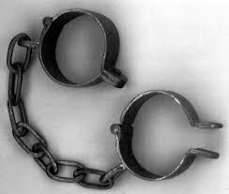
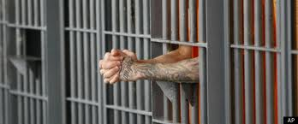
Here was Your Situation:
Lost
Enslaved
Captured
Imprisoned

Slide 3
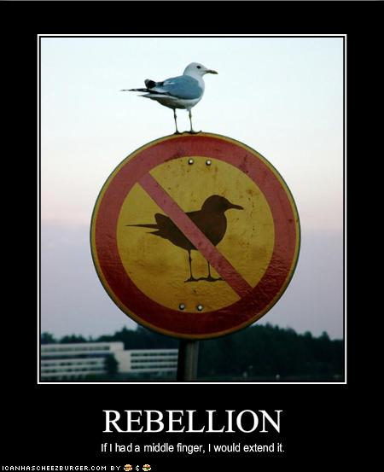
How Did you get there?
You Rebelled.
You went after other gods.
You said that what God
wants for you is not
enough.

Slide 4
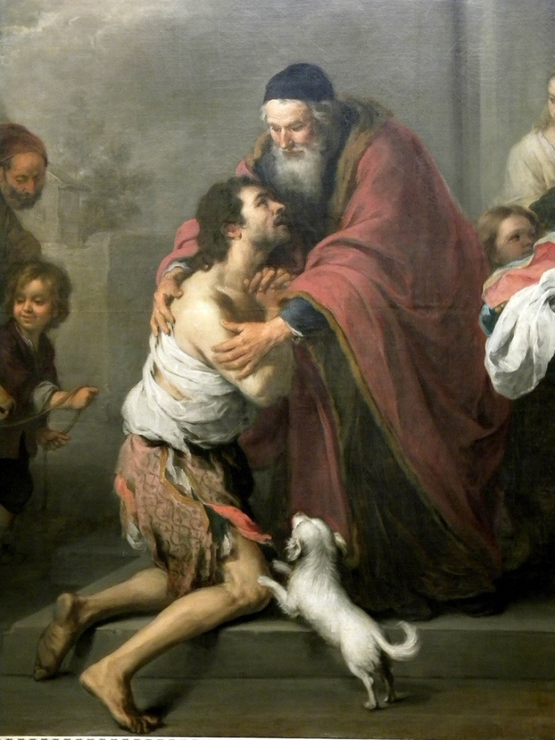
What is the solution?
Repent and Return
So that God can
Restore and Rebuild

Slide 5
Who are you?
You are people loved by God
You are Israel
You are any individual
You are the Church
You are a Church

Slide 6
Historical Background
722 BC Northern Kingdom destroyed by Sennacherib
605 BC First siege of Jerusalem by Nebuchadnezzar
597 2nd siege Ezekiel taken as captive to Babylon.
592 Ezekiel receives his commission.
586 Jerusalem Destroyed 70 years of captivity begins
538 Cyrus captures Babylon. Cyrus decrees the temple should be rebuilt. (Ezra 1:1-4)
537-536 First wave of remnant returns under Zerubbabel.
520 Zechariah begins to prophesy
518 Darius: Rebuild the temple! (Ezra 6:1-12) Haggai agrees.
516 Temple is completed (seventy years after Solomon’s temple destroyed)
458 Ezra returns to Jerusalem, second wave of exiles. Artaxerxes: Rebuild the city of Jerusalem. (Ezra 7:11-29)
445-444 Nehemiah returns and the city is built.

Slide 7
Prophets of the Exile

Slide 8
Post-exile books
Ezra, Zechariah, Haggai, Esther, Nehemiah and Malachi
Theme of these books: God’s wrath is complete. It is time for his remnant to Repent and Return so that God can Restore and Rebuild them.

Slide 9
schedule
Week 1 Introduction John Parts of Ezra James
Week 2 Haggai, begin Zechariah John
Week 3 Zechariah cont. John
Week 4 Esther, Rest of Ezra James
Week 5 Nehemiah James
Week 6 Malachi John

Slide 10
All this was prophesied
Deuteronomy 28:15-19 If you do not obey the Lord your God… you will be cursed.
Deuteronomy 28:36-37 You and your king will be taken to a foreign land.
Deut 28:49-57 The Lord will bring a nation against you. Terrible suffering. Cannibalism in Jerusalem.
Summary: Deut 29:22-29.

Slide 11
Deuteronomy 30:1-6 Repent, Return, Restore REbuild
When all these blessings and curses I have set before you come on you and you take them to heart (repent) wherever the LORD your God disperses you among the nations, and when you and your children return to the LORD your God and obey him with all your heart and with all your soul according to everything I command you today, then the LORD your God will restore your fortunes[a] and have compassion on you and gather you again from all the nations where he scattered you. Even if you have been banished to the most distant land under the heavens, from there the LORD your God will gather you and bring you back. He will bring you to the land that belonged to your ancestors, and you will take possession of it. He will make you more prosperous and numerous than your ancestors. (rebuild) The LORD your God will circumcise your hearts and the hearts of your descendants, so that you may love him with all your heart and with all your soul, and live.

Slide 12
If God says it will happen It will happen
Jeremiah 4:5-6 6:1-2Disaster from the North!
Jeremiah 7:30-34 The Valley of Slaughter.
But… Jeremiah 27:16-22
Ezekiel 4: God besieges Jerusalem.
Ezekiel 7:5-10 Disaster! Doom! 9:5-6 kill without pity 12:1-16 Pack your bags….
But…. Ezek 36:24-32

Slide 13
Summary
The story of Judah is our story. We, too, began as God’s people. We, too, went after other gods and told God that what he has to give us is not enough. We, too, rebelled. We, like them, were lost, enslaved, and imprisoned.
But… By his mercy and because of his love
We, too, repented and returned. Now, God is in the process of restoring and rebuilding us into a people who will give him glory.

Slide 14
2 Chronicles 36:6, 10, 19-21
Notes:
Nebuchadnezzar conquered Palestine. Happened in three waves (36:6 Jehoiakim, Daniel 605 BC; 36:10 Jehoiachin in 597 BC; and 36:20 Zedekiah in 587 BC). They stayed until Persia overtook Babylon (v. 22).

Slide 15
Jeremiah 29:10-14
Notes:
Context of “plans to prosper”: before captivity about return. Bear consequences of sin, but God still loves them! He will bring them back after 70 years. (Also Jeremiah 25:11-14 will punish Babylon after 70 years)

Slide 16
2 Views of 70 Year Return:
605-538 BC (Jehoiakim until Zerubbabel)
587-516 BC (destruction to temple rebuilt)
Notes:
If you’re good at math, only 49-50 years from destruction to return. Two possibilities. Take your pick (first as approximation). Either way, God fulfilled his promise.

Slide 17
Ezekiel 36:33-36
Towns resettled
Ruins rebuilt
I will do it!
Notes:
John: This was spoken right before the captivity. God knows what he is doing, bringing stress and bringing relief. They both show his power (not within our control) and his grace (using enemies, providing hope).

Slide 18
Ezekiel 37:11-14
Hope is gone
You will know I did it!
Notes:
Dry bones. Hopeless (going to be burned and taken captive), but God can bring you back (v. 12) and fill you with his spirit - breath! * Bro who (dad suicide) for 3 years couldn’t believe God would bless him; beginning to now.

Slide 19
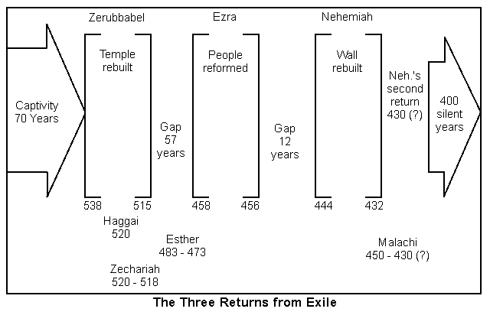
Notes:
Outline of period: Cyrus takes over Babylon in 539 BC, issued his decree next year. Jews left sometime afterward. Started building & stopped; began again after prophets. Then Esther in Susa. Then Ezra and Nehemiah.

Slide 20
Ezra 1:1-3
Notes:
Why? Goodwill, collection of tribute, god’s favor. Almost a century later: In 407 BC, letter to Persian governor requesting that a Jewish temple at Elephantine in Egypt be rebuilt after destroyed by Egyptians in 411 BC.

Slide 21
Notes:
“I returned the statues of the divine patrons of every land…to their own sanctuaries. When I found their sanctuaries in ruins, I rebuilt them. I also repatriated the people of these lands and rebuilt their houses. Finally, with Marduk’s permission, I allowed statues of the dive patrons of Sumer and Akkad to be returned to their own sanctuaries.”

Slide 22
Isaiah 44:26-45:7
Notes:
Inhabited, rebuilt, restored! Isaiah prophecies through Hezekiah (1:1) - 4 kings before Jehoiakim! Cyrus as shepherd, anointed. Why? So that all may know. No other Lord. Prosperity and disaster; I do all!

Slide 23
Ezra 1:1, 5, 6
Notes:
The Lord moved: the king (Prov. 21:1), his people (moved from where they had settled) and their neighbors (like in Ex. 12:35-36 favorably disposed, so plundered—previous exodus). Easy to lack faith when lack resources, but God!

Slide 24
Ezra 2 / Nehemiah 7
Same list
Notes:
Assume is a composite list of all the Jews who returned from exile over that period of time. Zerubbabel went under Cyrus, Ezra & Nehemiah went under Artaxerxes (80 and 90 years later, respectively). Urim (v. 63) used in Ex. 28:30; Lev. 8:8; Nu 27:21; Dt 33:8; 1 Sam 28:6.

Slide 25
Ezra 3:1-3, 11-13
One
Fear
Joy
Sadness
Notes:
Can be together and still afraid. Courage, not absence of fear, but facing it. Despite. * Sharing faith, asking about purity etc. We must overcome! Finished foundation: Praise, but wept. * Building church (remember before).

Slide 26
Ezra 4:4-7
Notes:
Not totally chronological: Cyrus, Darius, Xerxes, Artaxerxes (115 years). Point opposition! Been, always will (Mt 5:10-12 same as prophets; 1 Peter 4:12-19 don’t be surprised; 2 Tim 3:12 everyone godly). * What you doin?

Slide 27
Ezra 5:1; 6:1-2, 6-8, 14-15
Notes:
Back to Darius (4:24). Prophets (Hag / Zech - John later) because stopped 20 years. Ecbatana (capital Medes, Persian summer residence). Persepolis ceremonial capital. Don’t interfere. Able to finish (God with kings)
Susa (winter residence), Babylon (veared river, satrapy).

Slide 28
Ezra 7-10
Notes:
We’ll do the final chapters later, because they jump over to Artaxerxes’ time when Ezra arrives to put the ceremonial aspect of Judaism in order (not just temple).

Slide 29
Haggai
Message: Build up the house of the Lord, not your own house. (Matt 6:19-21)
Submessage: Discouragement is not sufficient excuse to neglecting the work of the Lord.

Slide 30
Historical Background
586 BC Jerusalem and the temple destroyed.
538 BC Cyrus defeats Belshazzar and Babylon.
537/536 BC First wave of Jews return to Jerusalem, altar built foundation of temple is laid. (Ezra 1:1-3:13). Opposition arises. Project abandoned.
521 BC Darius I takes the throne of Persia.
520 BC Haggai preaches. Build the temple!
Nov. 520 BC – Dec 518 BC Zechariah preaches to Jerusalem. (Ezra 5:1-6:22)
520 BC Work begins on the temple.
516 BC Temple completed.

Slide 31
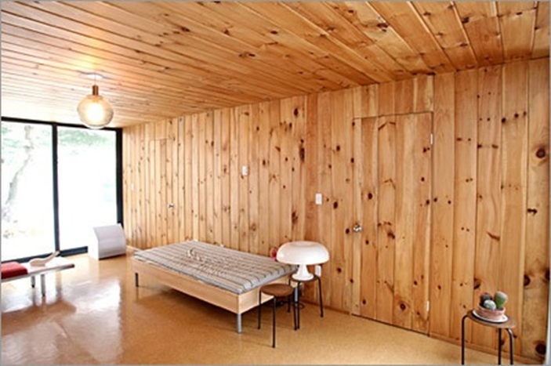
The People’s Excuse
Haggai 1:2 We’re too busy to build the temple.
Q: Can you relate?
Haggai 1:3-4 Hmmm…. You seem to have time to build your house.
Haggai 1:5-6 You have
planted much but
harvested little.
Q: Can you relate?

Slide 32
God’s Solution
“Indifference to the things of God produces calamity.”
1. Haggai 1:7 Give careful thought to your ways.
2. Haggai 1:8 Bring down timber to build God’s temple.
Haggai 1:12-15 The people obeyed, the leaders led, the people’s spirits were inspired and the work got started.

Slide 33
Rebuild
Haggai 1:12-15 The people repented and the temple got rebuilt.
Result: God: I am with you (Matthew 28:20)
Haggai 2:1-9 The work is hard and we humans can get discouraged, but God encourages us.
God really gets carried away with excitement when he sees his people repenting and returning so that he can restore and rebuild.

Slide 34
Two Great Memory Verses
Haggai 2:6
“In a little while I will once more shake the heavens and the earth, the sea and the dry land.”
Haggai 2:8
“'The silver is mine and the gold is mine,’ declares the Lord Almighty.”

Slide 35
Haggai 2:10-18 “parable of defiled flesh
Does coming into contact with clean meat make you clean? No!
Does coming into contact with defiled meat make you unclean? Yes!
Defilement is a thing. Holiness is a lack of a thing.
Sin is contagious. Holiness is not necessarily contagious. We need to deal with the plague of materialism.

Slide 36
Haggai 2:19-23
If we repent, God will bless us.
“I will shake the heavens and the earth. I will overturn royal thrones and shatter the power of the foreign kingdoms. I will overthrow chariots and their drivers; horses and their riders will fall, each by the sword of his brother.”

Slide 37
Zechariah
Theme: The Messiah is coming: Get your house in order.
Message: It is time to build the temple: Repent, Return, Restore, Rebuild.

Slide 38
Things to bear in mind When reading zechariah
• Dated prophecies: Nov. 520 BC – Dec 518 BC
• Contemporary of Haggai
• Mentioned in Ezra 5:1-2 6:1-10, 13-15
• The book is apocalyptic
• The book has many Messianic prophecies
• The book has many prophecies of the Kingdom of God
• The book is eschatological (it is about end-times)

Slide 39
The messiah is coming
Q: Is your (spiritual) house ready for guests right now?
(Or would you be scrambling around, trying to straighten up all the mess)

Slide 40
Outline of Zechariah
1:1-6 Prologue: Repent, Return, Restore and Rebuild
1:7-6:8 Eight visions. Highly apocalyptic, not so prophetic
6:9-15 Coronation of Joshua/Jesus
7:1-14:21 Two Oracles concerning Jerusalem. More prophetic, less apocalyptic. More Messianic.

Slide 41
Zech 1:1-6 Introduction
God: Repent and Return so I can Restore and Rebuild
v. 2 Why was God so angry with their forefathers?
v. 3 The solution: Repent and Return
v. 4-6 Those faithless Jews are no longer around, but my Words are still in place.
v. 6 Good news. They repented and the temple got rebuilt.
We are seeing the end of the story right at the beginning.

Slide 42
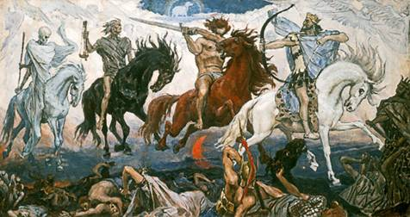
Vision #1 Zech 1:7-17 A man on a red horse
v. 11 All is quiet and at peace, is that good? No! Because God’s people are still in captivity.
Isn’t God the prince of peace? Matthew 10:34-36
Does God want people to feel secure? Amos 6:1-7
That depends….

Slide 43
Vision #1 cont.
Zech 1:16-17
This, in essence, is the theme of Zechariah: The Messiah is coming: Get your house in order!
God’s reply: I will return to Jerusalem and rebuild my house! Do not look at outward appearances.
Application: If your situation or church seems stagnant, do not look at the outward appearance. God can and will work in your life.

Slide 44
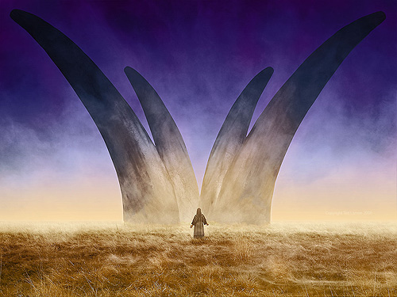
Vision #2 The vision of four horns
The four horns are four nations which scattered God’s people as a judgment for their sins.
Assyria, Egypt, Babylon, Persia?
Zech 1:21 God will throw down those horns. How do you feel about the fact that God will judge your enemies?

Slide 45
Vision #3 a man with a measuring line
God: I will make my kingdom into a city without walls.
Zech 2:1-2 Measuring = Protecting Rev 11:1-6, Ezekiel 38:7-16
2 Sam 24 Do not rely on “statistics”
Message: Do not rely on protection the world provides. Rely on God for your safety.

Slide 46
Vision #3 (cont.)
Zech 2:6 Repent and Return from the North—from captivity.
2:8 You are the apple of my eye.
2:10-13 A kingdom prophecy. (parallel: Ezek 36:24-38 and Ezek 37:11-14)

Slide 47
Kingdom prophecies in Zechariah
Zechariah 2:10-13
Zechariah 6:15 Those who are far away will come and help build the temple of the Lord.
Zechariah 8:1-7
Zechariah 9:10
Zechariah 13:1-3 On that day…. Pentecost.
Zechariah 14: the whole thing!!!
And many more….

Slide 48
Vision #4 Zech 3:1-10 Joshua accused and exonerated
Zech 3:1-2 Who is Joshua symbolic of here?
Satan is an accuser (Zech 3:2, Rev 12:10)
Satan is a deceiver (John 8:44)
What would Satan say to/about you?
Zech 3:3-10 can be a bit confusing
Is it about the high priest Joshua? yes
Is it the Messiah? yes
Is it about you and me? yes

Slide 49
Vision #4 cont.
Zech 3:6-7 If you repent and return, I will restore and rebuild.
Zech 3:8-9 In case you were wondering, Joshua is Jesus. The Branch. Hebrew nazer. The nazarene. The Messiah is coming, get your house in order.
Zech 3:10 Let’s invite our neighbor to sit under the vine and the fig tree with us.

Slide 50
Vision #5 The Golden Lampstand and the Two Olive Trees
Zechariah 4:1-3
A vision of the menorah in the Temple.
The oil in the menorah is the Holy Spirit.

Slide 51
Vision #5 (cont.)
Another great memory scripture: Zech 4:6 “Not by might, nor by power, but by my Spirit says the Lord Almighty.”
The two olive trees represent the permanent, unending, limitless supply of the Holy Spirit in our lives. John 7:37-39 Streams of living water….
4:10 seven channels = seven spirits (Rev 2:1)
4:12-14 The two trees represent the two anointed to serve: Joshua and Zerubbabel and Joshua. Jesus is priest and king.

Slide 52
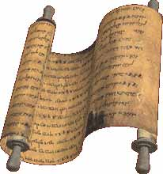
Vision #6 The flying scroll
Judgment on sinners and on all the enemies of God’s people.

Slide 53
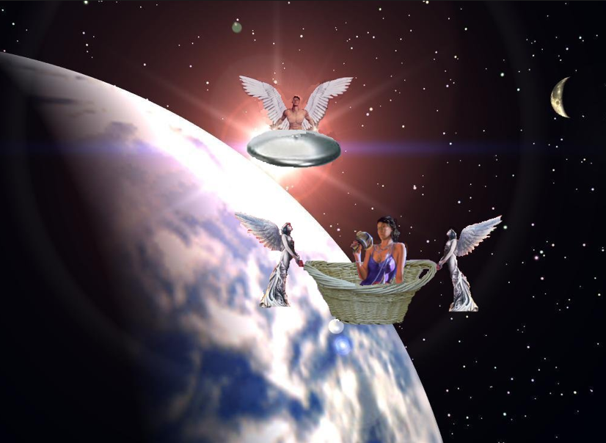
Vision #7 A woman in a basket
Message:
Judgment on sinners
Measuring basket:
Judgment
v. 7 Woman = sin = Babylon
v. 10-11 Those who sin will be sent to Babylon

Slide 54
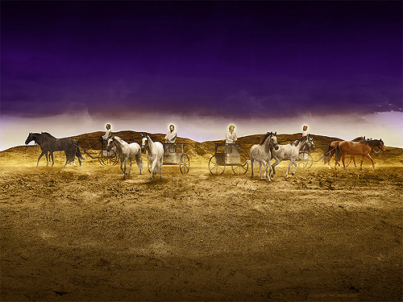
Vision #8 Four Chariots
Message: Judgment is coming!
Parallel passage: Revelation 6:2-7

Slide 55
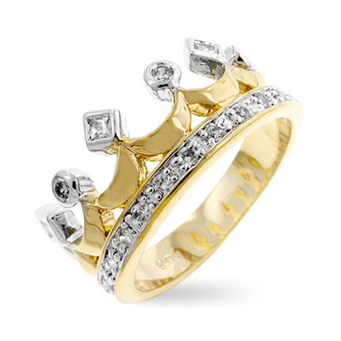
Zechariah 6:9-15 The coronation scene
The Messiah is coming!
v. 11 Does a priest wear a crown?
v. 12 Branch = nazer = Nazarene (Matthew 2:23)
v. 13 Harmony between the two = between the priest and the king.

Slide 56
IV. Zech 7 & 8 Two Sermons
Zech 7:1-14 True worship versus religion.
v. 3 Should I mourn and fast in the 5th month?
5th month: for the destruction of the temple 586
7th month: for the assassination of Gedaliah
10th month: for the capture of Jerusalem in 597
Do I have to serve God? Do I have to help the poor?

Slide 57
Should I mourn and fast?
Zech 7:4-7 Why were you fasting? Was it about me or was it about you?
Zech 7:9-10 How can we be sure that our motivation is pure? Practice social justice. Memory verse:
“Administer true justice; show mercy and compassion to one another. Do not oppress the widow or the fatherless, the alien or the poor. In your hearts do not think evil of one another.”
In other words: act like God! Isaiah 58:6

Slide 58
Should I mourn and Fast?
Zech 8:18-19. No! The Messiah is coming! You should party. It is time for joy and gladness.
Zech 7:11-14 You need to repent!
Zech 8:1-11 Then you will return, be restored and rebuilt!
v. 3 God will return and rebuild Jerusalem
v. 6 A miracle
v. 7 Restoration
v. 9 Get building!

Slide 59
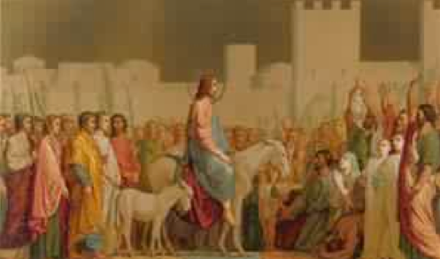
Zech 9-11 The First oracle
Zech 9:9-17 The Messiah is coming to Jerusalem
Zech 9:9 What do you see about Jesus here?

Slide 60
Messianic Prophecies in Zechariah
Zechariah 3:8-9 My servant the branch
Zechariah 6:11-13 Crowning of the Messiah/Branch
Zech 9:9 Triumphal entry (Matt 21:2-7, Mark 11:4)
Zech 11:7-13 30 pieces of silver Matt 26:14-15 The potter Matt 27:3-10
Zechariah 12:10-14 The one pierced (John 19:31-37)
Zech 13:7 Strike the shepherd (Mark 14:27)

Slide 61
Zech 9:10-17 A kingdom prophecy
Zech 9:10-11 Q: What do you see about the kingdom here?
Q: What kind of waterless pit did God pull you out of?
v. 13 God will “bend Judah”
Does Zech 9:14-15 contradict Zech 9:10 (he will proclaim peace)? Matthew 10:34-36.
v. 16-17 We will sparkle. We will be beautiful!

Slide 62
Zechariah 10
Return
Restore
Rebuild

Slide 63
Zechariah 11:4-14
God will revoke the first covenant and establish a new covenant.
11:4-9 God has had enough: Rome will judge the Jews who rejected Jesus. (fulfilled in AD 70)
v.9 Cannibalism! As predicted in Leviticus 26:29 and as confirmed by Josephus
v. 10-11 The Covenant (my staff called favor) with Moses will be revoked.

Slide 64
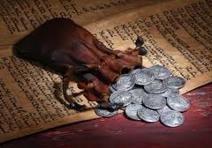
Zech 11:11-12 A messianic prophecy
Thirty pieces of silver… Matthew 26:14
Throw it to the potter… Matthew 27:1-10
The price at which they priced Me

Slide 65
Oracle #2 Zechariah 12-14
Zech 12:1-9 A kingdom prophecy: God will bless his
people
Is this about restored Judah?
Is this about the church?
Is this about us, individually?
Is this about heaven?
Zech 12:10-14 A messianic prophecy
…the one they have pierced Jn 19:31-37
Hadad Rimmon: Josiah, the last righteous king

Slide 66
Zechariah 13 The kingdom of god (cont.)
13:1 on that day a fountain will be opened Pentecost
13:2-6 Prophecy will cease.
13:7 The sheep will be scattered Mark 14:49
13:8-9 The church will be persecuted but also refined.

Slide 67
Zechariah 14 The end of time
Parallels with Ezekiel 47:1-12, Revelation 21:1-22:5, Daniel 12 and Matthew 24:4-35
Zech 14:2-7 more affinity with AD 70 and the destruction of Jerusalem.
v. 5 earthquake in the time of Uzziah Amos 1:1
Zech 14:8-21 more affinity with end-times

Slide 68
Zech 14:8-21 The time of the end
v. 8-9 Living water from Jerusalem
Heaven Ezek 47:3-12, Rev. 22:1-5
v. 10-11 Jerusalem will be secure
v. 12-15 But God’s enemies will be judged
v. 16 Perpetual Feast of Tabernacles: Celebrating being in a relationship with God.
v. 17-19 But some choose not to go. God accepts their decision.
v. 20-21 Holy, Holy is the Lord.
No Canaanite = no merchant = all will be supplied by God

