Slide 1
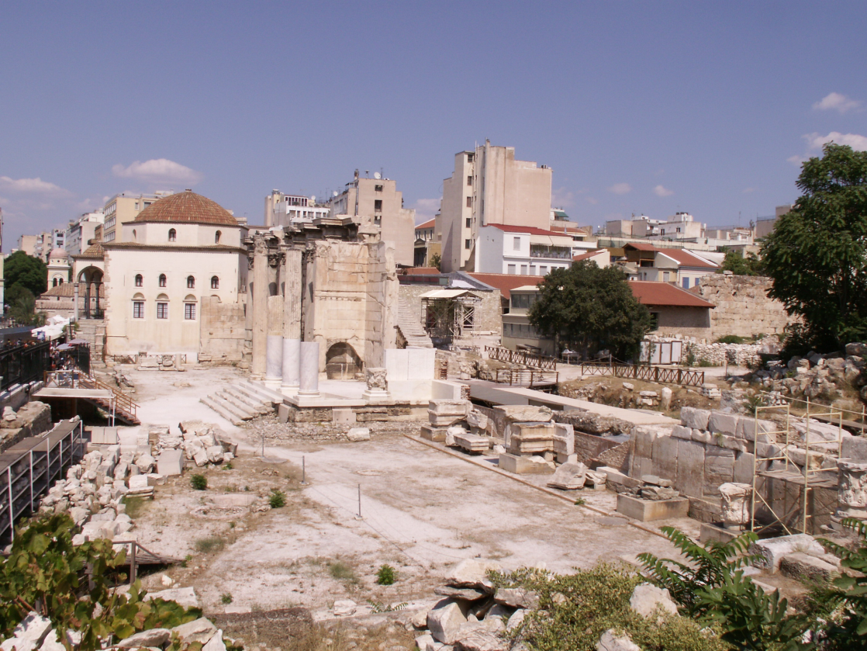
Thoughts on Acts and Church History
思考使徒行傳及教會歷史
The Agora in Athens 雅典廣場
John Oakes, PhD
January 4, 2012

Slide 2
Also…
Apologetics Research Society Presents
Certificate Program in Christian Apologetics
Classes on DVD
For information: joakes01@san.rr.com
www.evidenceforchristianity.org
護教學研究社呈獻
基督教護教學證書課程

Slide 3
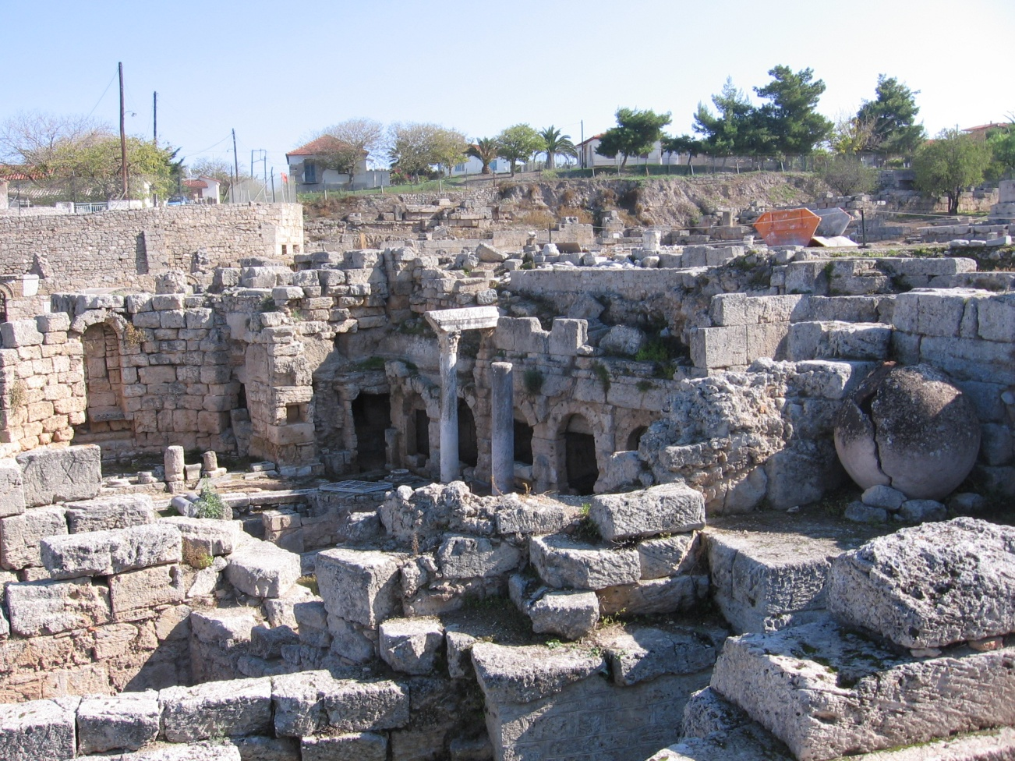
Acts 1:8 “You will be my witnesses to the ends of the earth”
使徒行傳1:8 “但聖靈降臨在你們身上，你們就必得著能力，並要在耶路撒冷、猶太全地，和撒瑪利亞，直到地極，作我的見證。”
The Marketplace in Corinth哥林多的市集
How did they do it?
為何他們能做得到呢？
How can we do it?
我們又如何做得到呢？

Slide 4
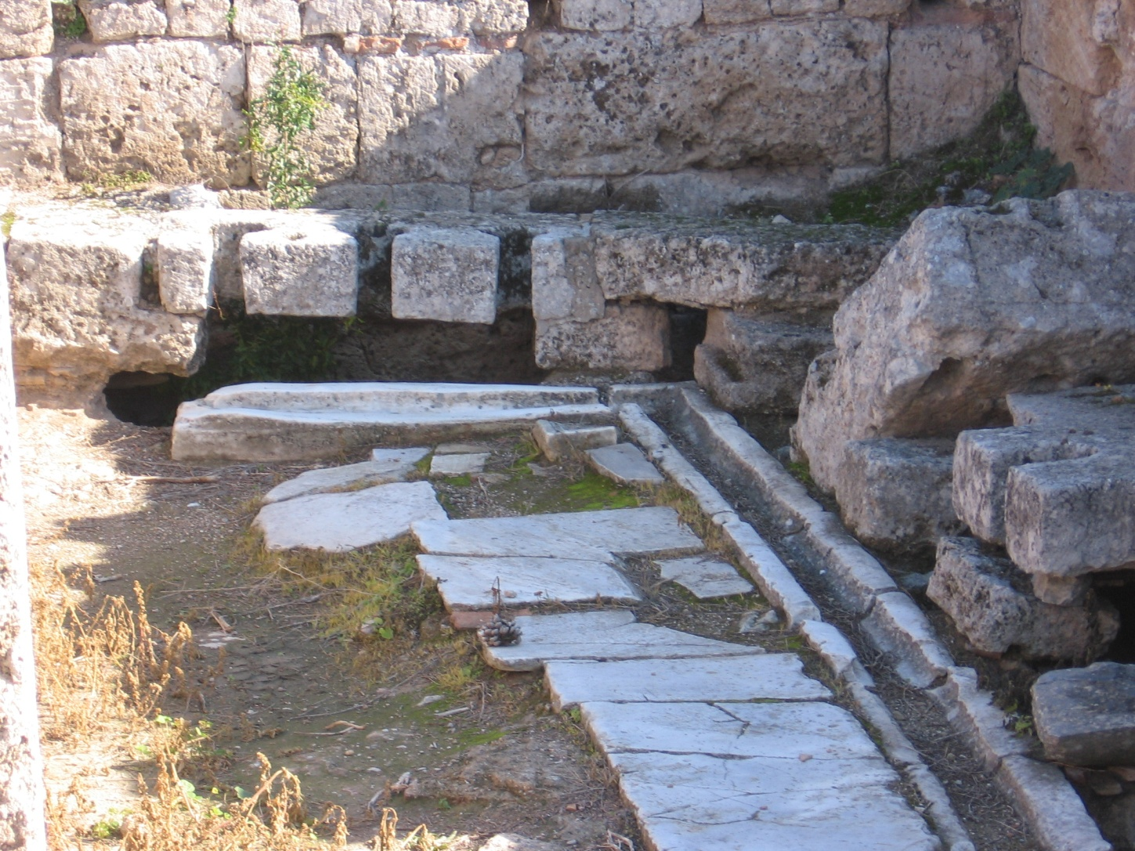
What Were the Odds?
成功的可能性在哪裡？
A public bathroom in Corinth
在哥林多的公共廁所

Slide 5
Why Did They Change the World/
How Can We Change the World?
Acts 5:39
為何他們能改變世界/我們又如何能改變世界呢？
使徒行傳5:39
I. They knew Jesus. The personal effect of the man Jesus of Nazareth. 他們認識耶穌，拿撒勒人耶穌的個人影響力
Powerful truth-claims. 強而有力的真理宣稱
Those two alone were not enough to sustain a movement
但這兩點並不足夠維持一個運動

Slide 6
Changing the World in Our Time
改變我們這時代的世界
III. Moral/Ethical superiority of the Christians. 基督徒所倡導的道德/倫理優越
IV. They could successfully answer the hard questions. Intellectual superiority. 基督徒能成功解答疑難，智慧優越
V. Christianity gave dignity to all people
The church had compassion like no one else 基督教給予世人尊嚴，教會給予世界無與倫比的憐憫
VI. Because God was with them (Acts 5:39) 因為神與他們同在 (使徒行傳5:39)

Slide 7
I. The Life of Jesus: Knowing Jesus I. 耶穌的生命：認識耶穌
Acts 4:1-21 Fear to Fearlessness. 使徒行傳 4:1-21 從恐懼到無畏
Acts 4:13 They took note that they had been with Jesus. 使徒行傳 4:13 人們能注意他們曾經與耶穌一起
Why was Paul transformed? Acts 9:1-16 為何保羅會改變？使徒行傳9:1-16
We need to meet Jesus on our road to Damascus (or HK, or Kowloon or….) 我們都需要在大馬士革的路上相遇耶穌 （或香港，或九龍...）

Slide 8
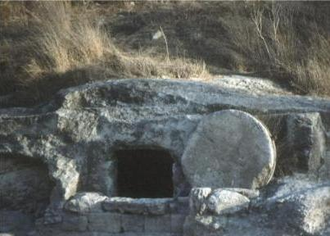
II. Powerful Truth Claims
II. 強而有力的真理宣稱
Acts 2:22-24 徒 2:22-24
  Jesus fulfilled the OT prophecies 耶穌應驗舊約的預言
  Jesus worked signs, wonders and miracles 耶穌曾做奇事神蹟
  Jesus was raised from the dead耶穌從死裡復活
Acts 3:11-16, 4:33, 5:29-32, 13:26-35 徒3:11-16, 4:33, 5:29-32, 13:26-35
Acts 26:24-32 True and Reasonable 徒 26:24-32 真實明白話

Slide 9
According to the Old Testament, the Messiah must: 根據舊約，救世主一定要：
Be born in Bethlehem 在伯利恆出生
Be raised in Galilee near Nazareth 在加利利附近的拿撒勒長大
Be despised and rejected by men 被人鄙視及拒絕
Be meek and silent before his accusers 在控告者面前溫順及平靜
Be “pierced” 被刺破
Be crucified 被釘十字架
Have his garments divided and gambled over被拈鬮分他的衣服
Be betrayed for 30 pieces of silver 因三十塊錢而被出賣
Come to Jerusalem to make atonement for sin in about AD 33 於公元33年來到耶路撒冷為人贖罪
And many more…. 還有其他….
Notes:
9

Slide 10

III. Ethically and Morally They Were Very Different. We need to be as well!!
他們擁有與別不同的倫理及道德標準，我們都需要模仿!!
Marketplace, Corinth 哥林多市集
Acts 17:5-9 徒17:5-9
Acts 19:17-20 Confronting the world and its ways. 徒19:17-20 對抗世界的價值觀
Acts 19:23-41 They confronted idolatry 徒19:23-41 對抗偶像崇拜
HK today? 今天的香港？

Slide 11
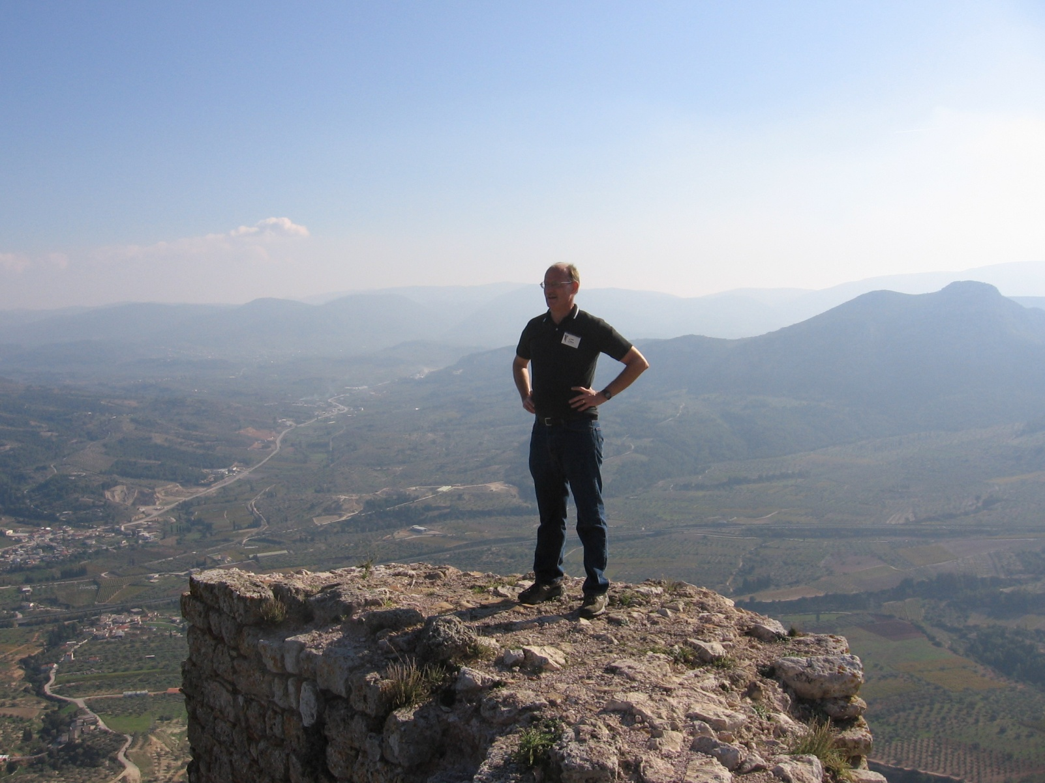
The Acropolis in Corinth 哥林多的衛城

Slide 12
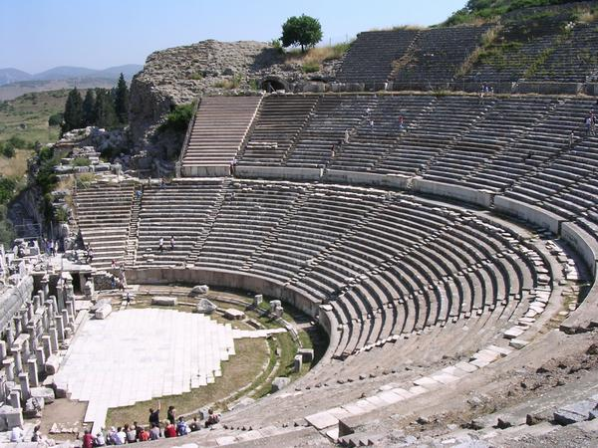
Being Different Just Might Get Us Into Trouble
與別不同會令我們構成麻煩
A Little Riot in Ephesus以弗所的小暴亂

Slide 13
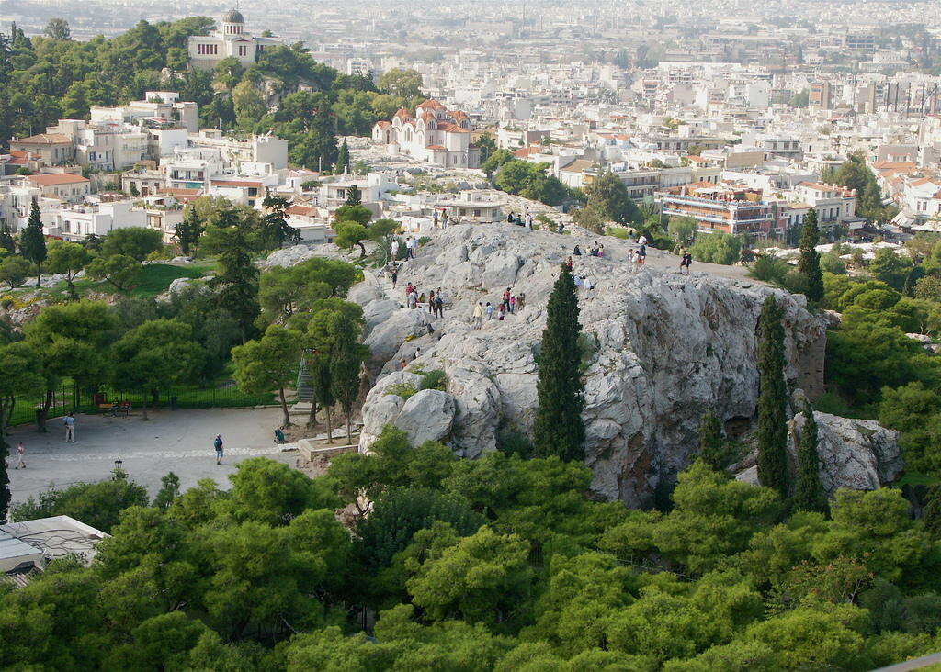
IV. Engage the World Intellectually With the Christian World View 將基督教的世界觀有智慧地融入這世界
Acts 17:16-34徒 17:16-34
Paul in Athens 保羅在亞略巴古
We need to confront the enemy in the Areopagus and in the Lecture Hall of Tyrannus 我們需要在亞略巴古及推喇奴的學房對抗敵人
The Areopagus in Athens雅典的亞略巴古

Slide 14
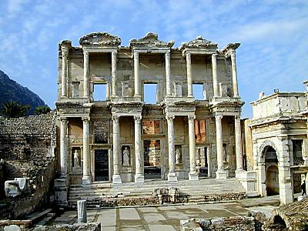
The Lecture Hall of Tyrannus 推喇奴的學房(辯論演講廳)

Slide 15
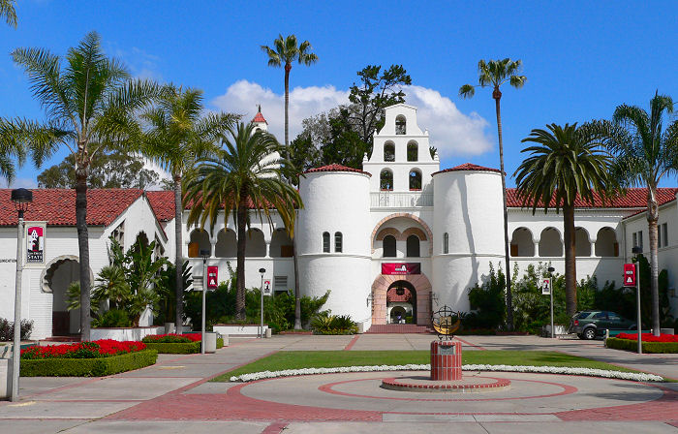
The Lecture Hall of SDSU
聖地牙哥州立大學的辯論演講廳

Slide 16
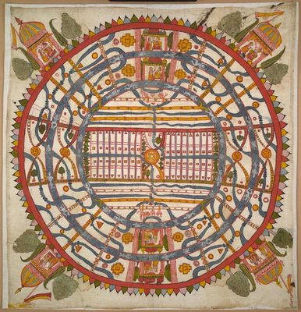
World View 世界觀
One‘s world view is the perspective one uses to process and interpret information received about the world. 一個人所用的觀點去分析及理解這世界的資訊就會是他的世界觀
James W. Sire put it this way, “A world view is a set of presuppositions (ie. assumptions) which we hold about the basic makeup of our world.” 一套解釋這世界組成的假設就是一個人的世界觀
James W. Sire, The Universe Next Door (InterVarsity Press, 1997)
A Jain World View
耆那教的世界觀

Slide 17
A “Good” World View Defined
一個 “好” 的世界觀定義
A. It is true. 使真實的
  It is consistent with reality. It works. 與真實接軌，行得通的
B. It answers satisfactorily the questions people really want answered. 對生命的難題能提供令人滿意的答案
  What is prime reality/the ultimate cause/the nature of God?) 甚麼是最原始的真實？最基本的起因 / 神的本質？
  What is my value as a human being? 甚麼是我作為人類的價值？
  What happens to a person at death? 人死後會發生什麼呢？
  How do we know what is right and wrong? 我們如何能知道什麼是對，甚麼是錯呢？
  What is my purpose? 我的人生意義是甚麼？
  What is the nature of my relationship, with the “prime reality?” 我與那個最原始的真實的關係是甚麼呢？
C. It causes those who hold to it to be better people than they would otherwise have been if they held to competing alternative world views. 那套世界觀能使一個人認為自己活得比用其他世界觀做人更好

Slide 18
The Hard Questions 很難的問題
Evil: What is Evil and Why is There Evil 邪惡：甚麼是邪惡及為何有邪惡
Why is There Suffering? 為何有受苦？
The Problem of Justice 公義的問題
The Problem of Sin 罪的問題
The Problem of Death 死亡的問題

Slide 19
Acts 17:16-34 Paul confronts Greek World Views
徒17:16-34 保羅對抗希臘的世界觀
God is Creator. He exists outside creation. 神是創造者，他是創造以外的，自有永有的
  Disproves pantheism/Stoicism. 推翻泛神論 /斯多亞哲學
God is close to us. 神是離我們很近的
  Disproves deism/Epicureanism. 推翻自然神論 /伊壁鳩魯學說
God is personal and has given us an individual purpose. 神是個人化的及賜予每一個人有目的
God will bring all of us to judgment. Evil will be defeated 神會對每一個人有審判，邪惡會被打敗
  Disproves dualism/Gnosticism. 推翻二元論 / 諾斯底主義

Slide 20
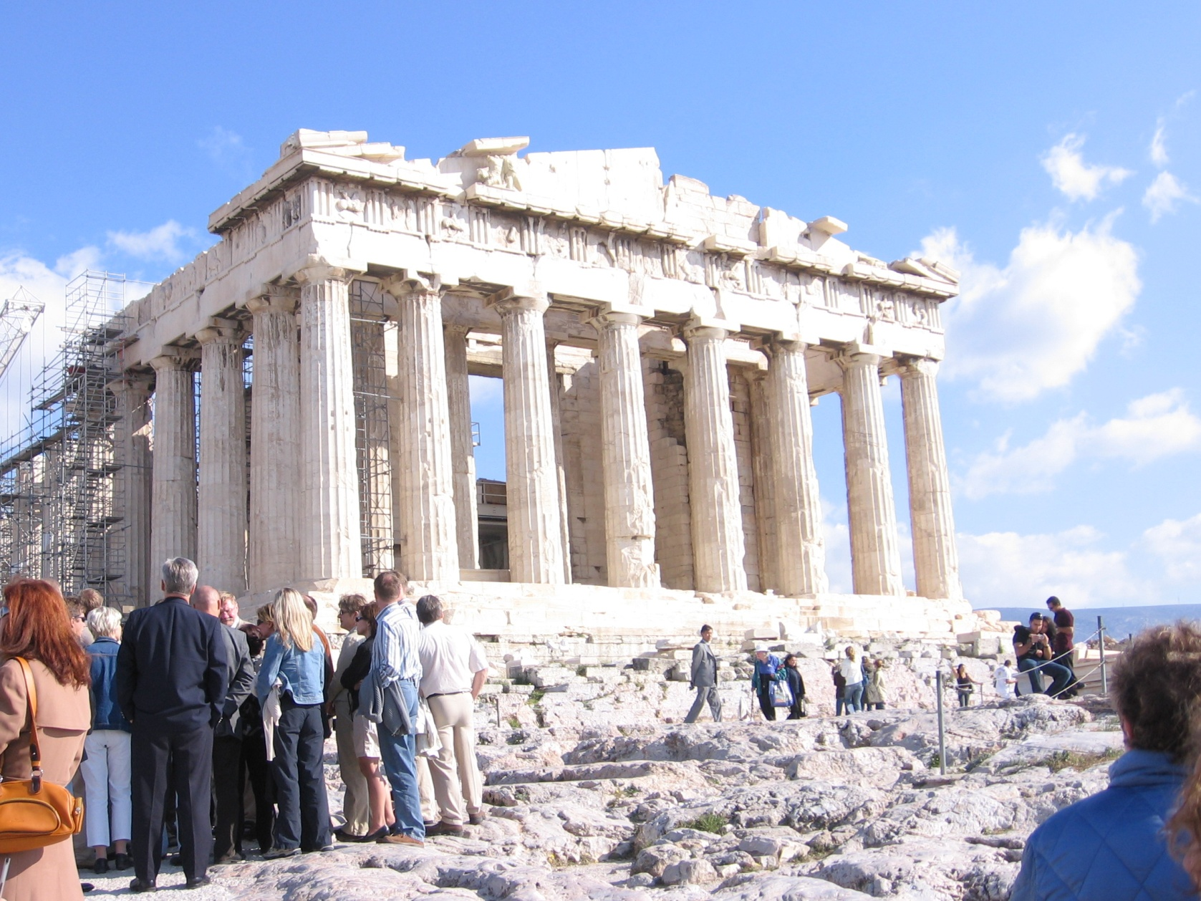
Paul Confronts Greek World Views
保羅對抗希臘的世界觀

Slide 21
The Bible and Other World Views (cont.)
聖經與其他的世界觀
Acts 17:16-34 Paul shares the gospel by arguing for the Christian World View. 徒17:16-34 保羅透過分享福音去傳揚基督教的世界觀
  v. 22-23 Paul finds common ground. 保羅找到大家的共同點
  v. 24-28 Paul argues for the superiority and the truth of the Christian world view as opposed to Epicureanism/pantheism and Stoicism/deism 保羅辯證基督教的世界觀比起伊壁鳩魯學說 / 泛神論 / 斯多亞哲學 /自然神論更為優越
  v. 28 Paul quotes from Aretas a Stoic philosopher. “ For we are his offspring.” 保羅引用斯多亞哲學家的名言 “我們也是他所生的”
  v. 29-31 Having laid the groundwork, Paul points them to Jesus. 打好辯論根基後，保羅引導他們去明白耶穌
  v. 32-34 Some, but not all were converted. 有些人，並不是所有人被保羅改變信仰

Slide 22
Competing World Views for Us
與我們對抗的世界觀
Naturalism/Materialism 自然主義 / 物質主義
Postmodernism 後現代主義
Pantheism/Eastern Religions 泛神論 / 東方宗教
Islamic Worldview 伊斯蘭教的世界觀

Slide 23
Other World Views: The Leading Philosophies of Our Day 其他的世界觀：現今帶領潮流的哲學
Naturalism/Scientism/Materialism 自然主義 /科學至上主義 / 物質主義
Postmodernism: The Loss of Truth 後現代主義：失去真理
Delos B. McKown:
“Christianity is scientifically unsupported and probably insupportable, philosophically suspect at best and disreputable at worst, and historically fraudulent.”
“基督教是沒有科學的根據，在哲學上是被受質疑的，名譽是不好的與及有歷史欺詐的成份。”

Slide 24
Naturalism/Scientism/Materialism
自然主義 /科學至上主義 / 物質主義
The belief that the only reliable or valid instrument to deciding the truth or even the value of any proposition is the scientific method. 相信只有科學方法才能得出可靠的真理及其推論的價值
No basis for ethics or morality, no supernatural, no God, no truth (except that found by science), no consciousness, no “I.” Justice is a figment of our imagination. 沒有倫理及道德的準則，沒有超自然，沒有神，沒有真理 （除了科學能證明的），沒有良知，沒有 “自己”， 公義是人想像出來虛構的事

Slide 25
Materialism
物質主義
“We exist as material beings in a material world, all of whose phenomena are the consequences of material relations among material entities.” In a word, the public needs to accept materialism, which means that they must put God in the trash can of history where such myths belong.” 我們是在物質世界中存在的物質個體，所有的現象都是不同物質實體互動之後的結果。簡單而論，大眾需要接受物質主義，亦代表人需要將神放到那些遠古神話的垃圾筒中。
Richard Lewontin
Retrospective essay on Carl Sagan in the January 9, 1997 New York Review of Books,

Slide 26
Questions Science Can Answer
科學能解答的問題
When? 何時？
What? 甚麼？
Where? 在那裡？
How many? 有多少？
By what means? 透過甚麼方法？

Slide 27
Questions Science Cannot Answer:
(That Christianity Does Answer)
科學不能解答的問題： （但基督教可以解答）
  Why am I here? 我為何在這裡？
  Is that the right thing to do? 做這事是對的嗎？
  How valuable am I? 我的價值有多少？
  Does God exist? Does God act (theism)? 神存在嗎？神或否作工(有神論)？
  Will that God respond if I pray? 神會回應我的禱告嗎？
  Do supernatural events (miracles) happen? 超自然事件（神蹟）會發生嗎？
  Why is there evil and suffering in the world? 為何世界有邪惡及受苦？

Slide 28
Materialism is Patently False
物質主義是公然的錯
If Materialism/Naturalism is right then; 如果物質主義 / 自然主義是對的；
“I” do not exist. Consciousness is just random moving around of chemicals. “我”並不存在，良知只不過是一些隨機流動的化學物質
No soul, no spirit, no non-physical reality. 沒有魂，沒有靈，沒有非肉體的真實
Life has no value. Human beings have no value. What is value? 生命是沒有價值的。人類是沒有價值的，甚麼是價值呢？
Love is chemicals moving around (vs. God is love) 愛只是一些化學物質在流動 (相對神是愛)

Slide 29
Does Naturalism tend to make its believers better people? 自然主義能協助它的信徒成為更好的人嗎？
If the naturalist is right then: 如果自然主義是對的：
Good and evil are meaningless ideas. 善與惡是沒有意義的概念
Our purpose, if it exists at all, is to pass on our DNA. 我們的人生意義，如果真的存在，只是傳授我們的基因到下一代
Any kind of sexual behavior is as right as any other. Stealing is probably good. 任何形色的性行為都能接受，偷竊或許是好的
There is nothing inherently evil about genocide, racism, slavery, etc. 種族滅絕，種族歧視, 奴隸制度並沒有甚麼既定的邪惡

Slide 30
Postmodernism: The Loss of Truth
後現代主義：失去真理
Truth, if such a thing exists, is the property of culture. There is no absolute truth. All truth is relative. It is created by societies. There is no ultimate moral authority or moral absolute. 真理，如果真的存在，是文化的產物。沒有絕對的真理，所有的真理是相對的，是社會製造出來的。世上是沒有最終的，絕對的道德權威

Slide 31
Problems With Postmodernism
後現代主義的問題
Self-refuting. 自相矛盾
  If nothing is true, then postmodernism is not true. 如果甚麼也沒有是真的，那麼後現代主義也不是真的
  Its authors insist on authorial privilege. 後現代主義的作者堅持作家的特權
I do not care what they say, some things are just true. 我並不會理會他們所說的話，有些事情是對的
Either God is real or he is not. Even if I cannot prove it one way or another. 神可能是真或是假的, 即使我不能證實或反證祂

Slide 32
Hindu World View 印度教的世界觀
Maya. The physical world is an illusion. 這肉體世界是幻象
Brahman. Universal soul. 婆羅門，全體的魂
The goal: Nirvana; oneness with the universal soul which is within yourself. 目標：極樂世界；在你心中與全體的魂達成一體
The Hindu world view has man looking inward, not outward. 印度教的世界觀需要一個人向內反省，不是向外的

Slide 33
The Four Noble Truths of Siddhartha
释迦牟尼的四個崇高真理
Suffering is not getting what one wants. 受苦並不能得到你想要的東西
The cause of suffering is desire which leads to rebirth. 受苦的原因是因為慾望，慾望引領去重生
The way to end suffering is to end desire. 要終止受苦就要終止慾望
The way to the end of desire and of suffering is the eight-fold path. 終止慾望及受苦的方法是八正道
Buddhism encourages dispassion, not compassion. 佛教鼓吹不動感情，非同情

Slide 34
Islamic Worldview: 伊斯蘭教的世界觀：
God is very distant from mankind 神是遠離世人的
In Islam, Allah determines everything, even who will choose to follow him. 在伊斯蘭教，阿拉決定所有，甚至決定誰能跟從祂
2:142, 6:39 6:125
Inshallah God willing. It is God’s will that people suffer. 聽天由命，這是神的旨意要人受苦
.

Slide 35
Islamic Theology 伊斯蘭教神學
“Surely good deeds take away evil deeds” (11:114). 好行為確實能除去惡行為
Salvation by own effort 能透過自我努力而得救
(40:9, 39:61, 7:43)
Charity atones for sins 做善事能贖罪
(2:271,277)
Earn grace. 賺取恩典
Earn favor of Allah. 賺取阿拉的喜愛
Earn salvation. 賺取救恩
Earn paradise. 賺取天堂

Slide 36
Islam: Salvation is earned through the efforts of those who were pre-selected by Allah to inhabit a very sensual paradise.
伊斯蘭教： 救恩是那些被阿拉揀選而透過個人努力而最終賺取一個官能享受的天堂
Christianity: Salvation is granted by the grace of a loving God to those who, through faith and repentance and baptism accept that love.
基督教：救恩是神恩典的賞賜，透過對神的信心，接受悔改與受洗

Slide 37
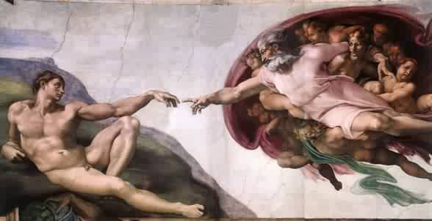
A Question: Who reaches out to whom? 問題：是誰先伸手找誰呢？

Slide 38


Initiative 主動
Human approach 人的方法 Truth 真理
God 神 God 神
Mankind 人 Mankind 人

Slide 39
Works Salvation: Man reaches out to God. 行為稱義的救恩：人伸手找神
Islam 伊斯蘭教
Hinduism 印度教
Jaina 耆那教
Sikkhism 錫克教
  Gnosticism 諾斯底主義
New Age 新紀元運動
Buddhism? 佛教
Salvation by Grace: God reaches out to man. 因為恩典而稱義的救恩：神伸手找人
Judaism 猶太教
Christianity 基督教

Slide 40
Summary 總結
The theologies of world religions are fundamentally and diametrically opposed to one another. Many paths to the same God is a ludicrous philosophy. 世界不同宗教的神學觀基本上及正相反上是互相反對的，所有道路通往同一個神是荒唐可笑的哲學
The truth of the Bible is confirmed by 聖經的真理的真確性
  Clear evidence of inspiration (fulfilled prophecy, types and foreshadows, historical accuracy, scientific evidence, etc…) 清晰的啓示的確據 （預言應驗，預示與真像，歷史的準確性，科學的準確性…）
  Public miracles worked by Moses, Elijah and others, and especially by Jesus Christ (Hebrews 2:3,4). 摩西，以利亞，特別是耶穌曾做過公開的神蹟

Slide 41
The Christian World View 基督教的世界觀
1. The physical world is: a. real b. created out of nothing (ex nihilo) and c. essentially good. 這肉體世界是： a/真實 b/從無創造出來的 c/實質上是好的
2. There exists an unseen spiritual reality which is not limited to or defined by the physical reality. Human beings have a spiritual aspect to their nature. 是有一個看不見的屬靈真實,亦不會被肉體世界所規範，人是有屬靈的一面
3. The creator of both the physical and spiritual realm is the God who reveals himself in the Bible. 創造肉體與屬靈世界的神在聖經中顯露自己
4. Human beings have both a physical and a spiritual nature, The spiritual nature is more essential as it is eternal. 人是有肉體及屬靈的本質，屬靈本質更為重要因為它是永恆的
5. God is not easily defined but he can be characterized by certain qualities. God is a person. God is love, God is just, God is holy, God is omniscient, omnipotent and omnipresent. 神並不能很容易去描述，但能用一些確實的特質去形容。神是一個個體，神是愛，神是公義，神是聖潔，神是全知，神是全能，神是無處不在的。

Slide 42
The Christian World View (cont.)
基督教的世界觀
6. Although all God’s creation, is good, evil does exist. Such evil is the result of freedom of will given to created beings and their subsequent decision to use that freedom to rebel--to “sin” 縱使所有神的創造都是“好”的，邪惡仍然存在。這邪惡是神賜予祂的創造物自由意志去選擇而他們仍然決定反叛而產生的罪
7. Because of God’s justice and his holiness, those who choose to rebel against him will ultimately be judged and separated from God for eternity. 因為神的公義及聖潔，那些選擇反叛神的最終被審判及永遠與神隔絕
8. The solution to evil, to sin and its eternal consequences is provided by God through the atoning substitutionary sacrifice of Jesus Christ. 解決罪惡問題的終極方法就是透過耶穌基督的犧牲來替人贖罪

Slide 43
Christianity Offers Solutions to the Big Problems of Human Beings
基督教提供人類大難題的答案
The Problem of Evil 邪惡的難題
The Problem of Suffering 受苦的難題
The Problem of Death 死亡的難題

Slide 44
The Christian World View Has Given Us: 基督教的世界觀給與我們：
Science 科學
Abolition of Slavery (Wilberforce) 廢除奴隸制度 （威伯福斯）
Civil Rights 民權
Women’s Rights 女權
Christian groups do a majority of all benevolent work in the world (James 1:27, Micah 6:8) 基督教團體在這世界做了很多慈善的工作 (雅各書1:27, 彌迦書6:8)
Notes:
44

Slide 45
Two Good Questions 兩個好問題
Does evil exist? 邪惡存在嗎？
If God is all-loving and all-powerful and all-good, then why is there evil? 如果神是全愛及全能，為何有邪惡呢？

Slide 46
The answer: God’s love.
答案：神是愛
Free Will: God Gives Us a Choice
自由意志：神給我們選擇
Why? Because he loves us.
為甚麼？因為祂愛我們
The result: We rebelled and brought evil into the world. Is this God’s fault? What is the alternative?
結果：我們反叛及將邪惡帶到這世界，這是神的錯嗎？有其他的選擇嗎？
Deuteronomy 30:15-20 申明記 30:15-20

Slide 47
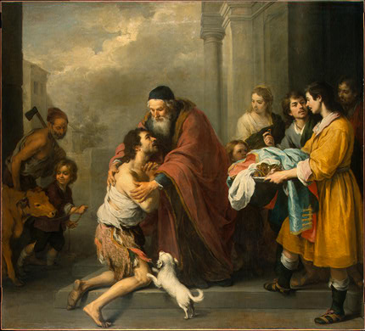
Free Will, An Illustration: The Prodigal Son自由意志，例子：浪子回頭

Slide 48
Apologetics and Evil: What are the alternatives? 護教學與邪惡：有其他選擇嗎？
Dualism: Good and Evil in an unending more or less equal balance 二元論：善與惡是永遠相互平衡的
Pantheism: The physical world is evil. Evil is being tied down to the physical—it is missing the god-likeness in you. 泛神論：肉體世界是邪惡的，邪惡約束這肉體，在人心中是缺乏神的特質的
Naturalism: There is no evil. 自然主義：沒有邪惡
Postmodernism: Evil??? 後現代主義：邪惡???
Determinism/Fate God is the cause of evil. 決定論 / 命運 神是邪惡的起因

Slide 49
Christianity and the Problem of Evil
基督教與邪惡的難題
Evil is very much real. Quite indirectly, it is the product of God’s love. God loved us so much that he loved us and that he gave us a choice. We chose evil, and thus evil came into the world. 邪惡是真的，間接地說，這是神的愛的副產品。神對人的愛的程度願意給予人選擇，這就是邪惡進入這世界的開始
Remember your alternatives: 記得你的其他選擇：
  Predestination/Determinism God is the cause of evil. 預定論 / 決定論 神是邪惡的起因
  Deny evil exists 否定邪惡存在
  Physical creation is evil, but you are God 肉體創造是邪惡，但你是神
  An unending battle/balance between good and evil. 善與惡是永遠相互平衡的

Slide 50

The Problem of Sin 罪的問題
God’s love met God’s justice at the cross. As far as we are concerned, love won神的愛與神的公義相遇在十字架上，就我們而論，愛贏了。
Romans 3:21-26 羅馬書3:21-26
Other world views….其他世界觀….

Slide 51
How, then, should we interact with members of other religions? 那我們如何與其他信仰的人相處呢？
Find common ground. 找共通點
Give respect where respect is due. 給予適當的尊重
Acknowledge the good and do not make personal attacks—especially toward revered people. 承認好的地方及不要作個人攻擊 － 特別是對一些虔敬的人
Highlight distinctions in world view/theology and introduce them to Jesus Christ. 指出不同世界觀 / 神學觀的分別，然後將耶穌教導給他們
This is EXACTLY what Paul did in Acts 17:22-34 這正是保羅在使徒行傳17:22-34所做的

Slide 52
V. The Church Met Needs/We Need to Meet Needs 教會滿足需要 / 我們都需要去滿足需要
Acts 2:44-45 All the believers were together and had everything in common. Selling… 徒2:44-45 信 的 人 都 在 一 處 、 凡 物 公 用 ．並 且 賣 了 田 產 家 業 、 照 各 人 所 需 用 的 分 給 各 人 。
Acts 3:6-10 Silver and gold we do not have, but what we have we will give. In the name of Jesus, get up and walk. What a testimony. We do not have much but what we have we will freely give. 徒3:6-10金 銀 我 都 沒 有 、 只 把 我 所 有 的 給 你 、 我 奉 拿 撒 勒 人 耶 穌 基 督 的 名 、 叫 你 起 來 行 走 。 這時多美妙的見證，我們並沒有很多，但我們有的都能拿出來
Acts 4:32-35 All needs were met. 徒4:32-35 所有的需要都被滿足
Acts 5:12-16 Meeting needs, healing.

Slide 53
Christianity and The Problem of Suffering
基督教與是受苦的難題
Suffering is not evil. Sin is evil, but much suffering is caused by our choice to sin. 受苦並不是邪惡，罪是邪惡，大部份的苦難是來自我們選擇犯罪
Not all suffering is due to sin. (Job, John 9) 並不是所有的苦難都是來自罪 (約伯記，約翰福音 9)
Christianity’s answer to suffering: 基督教對苦難的答案： Compassion. Jeremiah 22:15-16, James 1:27 憐憫的心 耶 22:15-16 雅1:27
Jesus Wept 耶穌哭了
Matt 9:35-38 太 9:35-38

Slide 54
Julian “the apostate.” (332-363) 朱利安
“Atheism (i.e. Christian faith) has been specially advanced through the loving service rendered to strangers, and through their care for the burial of the dead. It is a scandal that there is not a single Jew who is a beggar, and that the godless Galileans care not only for their own poor but for ours as well; while those who belong to us look in vain for the help that we should render them.” 無神論 （指基督教） 透過他們愛的服侍及埋葬死人的關懷有特別的成長。對於沒有一個猶太人是乞丐這是一件醜聞。那些無神的加利利人不但關心他們的窮人，也關懷我們的窮人。 然而那些屬於我們的人不要指望我們會給予他們甚麼應有的幫助。

Slide 55
VI. If God is With Us…. 如果神與我們同在….
Acts 5:38-39 徒 5:38-39
With God’s help, they did it. They conquered the world. With God’s help, so can we. 透過神的幫助，他們成功了，他們戰勝這世界； 同樣地，我們透過神的幫助，我們也能戰勝這世界。

